Slide 1

Object-Oriented Programming Discussion, Lecture, & Lab Eric Pogue
Monday, November 18th from 2 to 2:50pm CST:
Sprint 5 Retrospective
Wednesday Demo Schedule
Demo Volunteers
Remaining Schedule
Sprint Planning Overview
Assignment for Next Class
Lab
Discussion & Questions welcome at any time… please be present with no phones or email during our time together

Slide 2
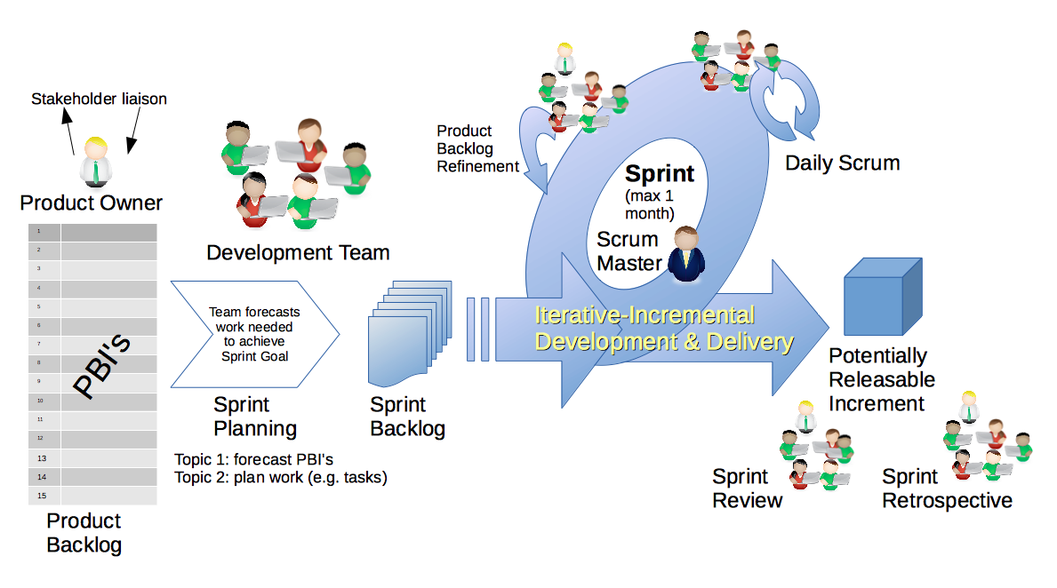
Scrum Process & Roles – Sprint Retrospective
By Dr ian mitchell - Own work, CC BY-SA 4.0, Link

Slide 3
SwissArmyKnife v2 Demos - Wednesday

Slide 4
Demo Volunteers

Slide 5
Remaining Schedule

Slide 6
Scrum Process & Roles – Sprint Planning
By Dr ian mitchell - Own work, CC BY-SA 4.0, Link

Slide 7
Assignment
Complete activities list items [link] 1 and 2 before Wednesday class
Wednesday Demos
Friday Discussion Board
PA7 Thunderbird due Sunday, November 24th by 11:59pm CT
All other assignments due Sunday, December 1st by 11:59pm CT… grace period until noon Monday

Slide 8
Lab
As A Scrum Team:
Do we need a new Scrum Master?
Review Sprint 7 activities and assignments in detail
Assignment Q&A
ThunderbirdLite and Thunderbird starter code
Report out at 2:46
Team Report Out Guidelines
Scrum Master will stand up, give your name, your team name, and briefly answer the following questions:
What did you accomplish since the last meeting? And what will you be working on until the next meeting?
Is the team committed to completing assignments? All/Most/Some
What is getting in your way or keeping you from completing the assignments?

Slide 9
End of Session

Slide 10
SwissArmyKnife v2 Demos - Wednesday

