Slide 1

Object-Oriented Programming Discussion, Lecture, & Lab Eric Pogue
Agenda for Monday, September 16^{h} from 2 to 2:50pm CST:
Review Assignment from Last Class
Friendly Conversation Topic – Javadoc
Q&A: Sprint 2 Activity List and Assignments
Discussion: Shapes Step 1 & 2… Demo?
Foreshadowing FaceDraw
Assignment
Lab
Discussion & Questions welcome at any time… please be present with no phones or email during our time together

Slide 2
Assignment
Complete Activities List items through item 8 and be prepared to discuss them at the start of our next class.

Slide 3
Javadoc [link]
History:
Javadoc was an early Java language documentation generator.^{[5]} Prior to the use of documentation generators it was customary to use technical writers who would typically write only standalone documentation for the software,^{[6]} but it was much harder to keep this documentation in sync with the software itself.

Slide 4
Q&A: Sprint 2 Activity List and Assignments

Slide 5
Discussion: Shapes Step 1 & 2

Slide 6
Shapes Step 1 or 2 Demo – Volunteers?

Slide 7
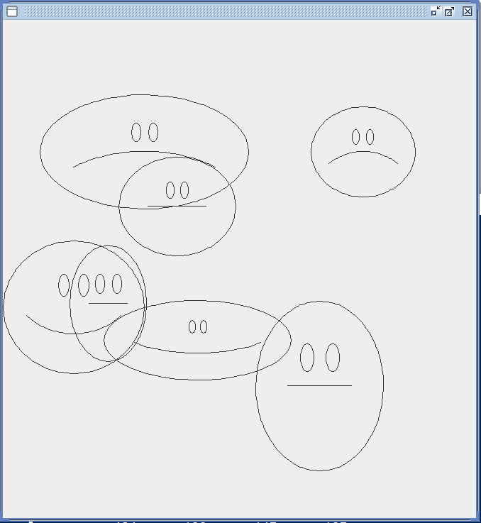
Foreshadowing FaceDraw
In the sprint 3 FaceDraw assignment, you will need to:
Create an graphical Java application
Draw 3 to 10 random faces on a window
Make each face a random width and height
Give each face a random emotion
Make it all visually appealing
And more
It will be challenging!

Slide 8
Assignment
Complete all items on the Activities List with the possible exceptions of the Programming Assignment and Quiz. You should have a solid start on both items, but it is okay if you need to spend time over the weekend to complete them.

Slide 9
Lab
As A Scrum Team:
Fix OvalDraw Together
Select two team members that will each share one OOP Principle or Design Characteristic
Programming Together – By Request
Programming Assignment 2 and Shapes Tutorials
Team report out by Scrum Master at 2:46
Team Report Out Guidelines
Scrum Master will stand up, give your name, your team name, and briefly answer the following questions:
What did you accomplish since the last meeting? And what will you be working on until the next meeting?
Is the team committed to completing assignments? All/Most/Some
What is getting in your way or keeping you from completing the assignments?

Slide 10
Preview
Principles – Software design principles represent a set of guidelines that allow us to create high quality object-oriented designs
Design characteristics to avoid include Rigidity, Fragility, and Immobility
The prevalence of Agile development has made design Principles even more important
Key design Principles include:
Single-Responsibility Principle
Open-Closed Principle
Liskov's Substitution Principle
Dependency-Inversion Principle
Interface-Segregation Principle

Slide 11
End of Session

