Slide 1

Object-Oriented Programming Discussion, Lecture, & Lab Eric Pogue
Agenda for Monday, August 26th from 2 to 2:50pm CST:
Welcome!
Friendly Conversation Topic… let’s make sure that everyone can hear and speak
Introductions*
Review Course Syllabus
Assignments for Next Class
Review Week 1 / Sprint 1 Activities & Assignments
Lab… starting no later than 2:35
Wrap-up and Final Questions/Comments?
Discussion & Questions welcome at any time… please be present with no phones or email during our time together

Slide 2
Welcome!
This is:
Object-Oriented Programming
MWF 2-2:50pm CST
AS 104A
And I am:
Eric Pogue
Review Welcome Announcement

Slide 3
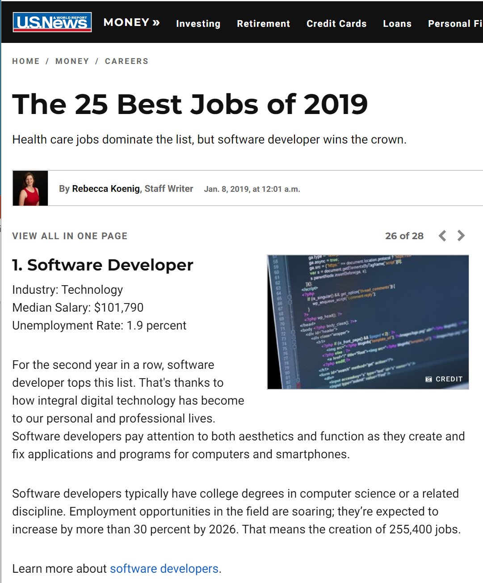
Today’s “Friendly Conversation” topic

Slide 4
Introductions – Discussion Board (DB) 1
Please use this discussion forum to introduce yourself and to learn about your classmates.
Please post a message which includes the following information:
Your Full Name / Preferred Name
A little about your Family, Home, and College background
Likely programming environment that you will be utilizing... do you have access to a Windows 10 environment?
A Hobby or Special Interest
Top two or three things you would like to get out of this class
A couple of times during the week would be most convenient for you to participate in a Live Lecture & Discussion session and/or to meet (virtually) with a small group of classmates
A Fun Fact about yourself
Please post your initial submission by the end of the day Sunday (11:59pm) and respond to one or more of your classmates' posts by the end of the day the following Sunday.
Notes:
Hand out name tags and introduction forms before Syllabus Overview

Slide 5
Introductions – Name Card plus Interesting Fact
Please fill out a name card...
Include:
Preferred Name followed by Last Name
A score of 0 to 5 in the upper right-hand corner to describe your programming experience with:
0 being “I’ve never seen a line of code”
1 being “This is my first college level programming class”
3 being “I’ve had a couple of programming classes”
5 being “I’m ready to graduate and get and entry level programming job”
Also place a “A” by the number if you are part of the aeronautical program
Leave a little space at the bottom so that you can add your Scrum team name Thursday
Be ready to introduce yourself and to share an interesting fact about yourself
Anything else you would like to add
Notes:
Hand out name tags and introduction forms before Syllabus Overview

Slide 6
Introductions
Full and Preferred Name:
Eric Pogue
Eric, Mr. Pogue, or Professor
Family, Home, College background:
Married with five children, recently relocated from Davenport, IA to Chicago area
Undergraduate in CS and Masters in Business… teaching online/evening for many years
Programming experience:
Decades in the industry as a developer, architect, project manager, division manager, and vice president of various software development organizations.
Part of many teams that have delivered products to ten’s of millions of customers globally
Parsons Technology, Intuit, The Learning Company, Jasc Software, and John Deere
… and most recently working on a startup product “Stadia” with my oldest son

Slide 7


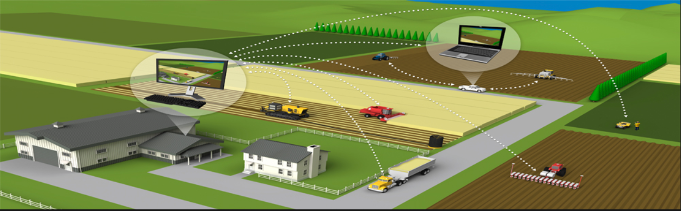



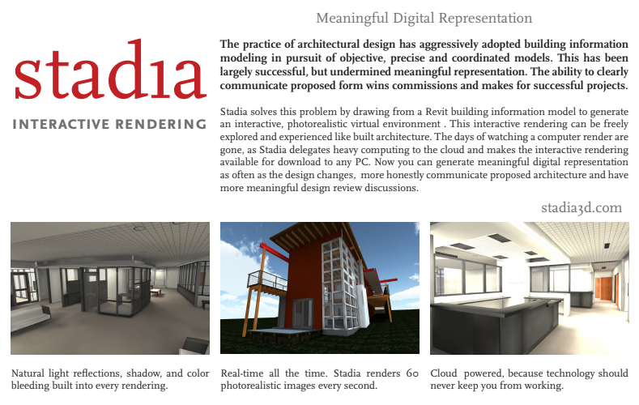

Slide 8
Welcome & Introductions
Likely programming environment
Personal Laptop, Windows 10 (moving to MacOS), Chrome browser, and Visual Studio Code text editor
Hobbies:
Wilderness Canoeing & Camping (Quetico) and Triathlons
Top two or three things that you would like to get out of this class
help each of you be successful in this class
explore software development processes and techniques together and motivate you to look deeper
and for us to find a little enjoyment and fun along the way*
… oh yes, and it would be wonderful if I could help you build something that made you proud during the semester
Fun Fact:
At one point I had the very dubious “honor” or being the most traveled John Deere employee to India with 40+ trips over a 5-6 year period while setting up the 400+ person John Deere Technology Center – India application development organization.

Slide 9
Syllabus Overview

Slide 10
Assignment for Next Class
Complete Activity List items 1 through 8 before our next class and be prepared to discuss them
Be ready to form Scrum teams that each have a mix of skill sets during our next lab/lecture session
Take your name tags with you and bring them back to class through the end of Sprint 2

Slide 11
Weeks 1&2 / Sprint 1 Activities List & Assignments

Slide 12
Object-Oriented Programming Discussion, Lecture, & Lab Eric Pogue
Agenda for Monday, August 26th from 2 to 2:50pm CST:
Welcome!
Friendly Conversation Topic… let’s make sure that everyone can hear and speak
Introductions*
Review Course Syllabus
Assignments for Next Class
Review Week 1 / Sprint 1 Activities & Assignments
Lab… starting no later than 2:35
Wrap-up and Final Questions/Comments?
Discussion & Questions welcome at any time… please be present with no phones or email during our time together

Slide 13
Lab
Lab Activates:
Complete Name cards and start DB1: Introductions
Introduce yourself
Get the computer that you will be using for this class out
Register for Safari Books

Slide 14
Introductions – Name Cards plus Interesting Fact
Please fill out a name card…
Include:
Preferred Name followed by Last Name
A score of 0 to 5 in the upper right hand corner to describe your programming experience with:
0 being “I’ve never seen a line of code”
1 being “This is my first college level programming class”
3 being “I’ve had a couple of programming classes”
5 being “I’m ready to graduate and get and entry level programming job”
Also place a “A” by the number if you are part of the aeronautical program
Leave a little space at the bottom so that you can add your Scrum team name next class
Be ready to introduce yourself and to share an interesting fact about yourself
Anything else you would like to add
Notes:
Hand out name tags and introduction forms before Syllabus Overview

Slide 15
Wrap-up and Final Questions/Comments
Notes:
Optimism, good natured humor, and effectively working together is immensely important to delivering good software… and likely equally important to delivering just about any quality product
Even if you don’t intend to be a professional software developer, many of the things that we learn will be valuable in related areas.
Soooo… We have 16 weeks to learn something valuable and interesting. Let’s enjoy our time together and make the most out of it.

Slide 16
End of Session

Slide 17
Today’s “Friendly Conversation” topic
Agile Manifesto
“We are uncovering better ways of developing software by doing it and helping others do it. Through this work we have come to value:
Individuals and interactions over processes and tools
Working software over comprehensive documentation
Customer collaboration over contract negotiation
Responding to change over following a plan
That is, while there is value in the items on the right, we value the items on the left more.”
Notes:
This was kind of “hippy-ish” and egalitarian in its day… quite controversial in its day
“Everyone is a team member and is responsible for the work getting done”… we don’t need no titles or positions… self-organizing… we will make our own commitments… transparency (let’s share the information)… flexible/organic teams, organic architecture (minimal documentation/standards)… no contracts (let’s talk it over)
The flip side:
We will actively and voluntarily play important roles on our team
The rules (rituals) that we do have… we WILL follow
We will create, demo, and release working software/products
We will utilize practical processes, tools, documentation, and planning
When we make commitments, we will live up to those commitments… as a team (“No winners on a losing team, and no losers on a winning team”)
We will be responsive and continuously improve (Retrospectives)
We will be transparent with how WE work and share our information

