Slide 1

Object-Oriented Programming Discussion, Lecture, & Lab Eric Pogue
Agenda for Monday, September 23rd from 2 to 2:50pm CST:
Assignment from Last Class
Demos & Demo Schedule
Sprint Retrospective
Remaining Schedule
Sprint 3 Planning Overview
Assignment for Next Class
Lab
Discussion & Questions welcome at any time… please be present with no phones or email during our time together

Slide 2
Recall Class Demos

Slide 3
Demo Guidelines – Presenter
Everyone will give at least one demo of their work during the semester.
Your demo can include any or all of the following:
A 2 to 5 minute activity
Where you show your application running
Comment on your implementation
Show the source code
Explain how you organized the code
Talk about any challenges
You should not prepare slides or a presentation
You will also need to provide a link to a public Git repository of demo source code in our class forum.

Slide 4
Demo Guidelines – Listener
Everyone will be listening to many demos during the semester.
Your responsibilities during the demo is:
Actively listen and watch what is being demoed
Come up with an meaning yet easy to answer question
During or after the demo ask your question if the presenter does not get “sufficient” questions from other listeners
Do not ask hard question or attempt to review the presenters code
Clap for the presenter at the end of the demo and thank them for presenting
If you have a hard question or want to make a recommendation, do it later and in private

Slide 6
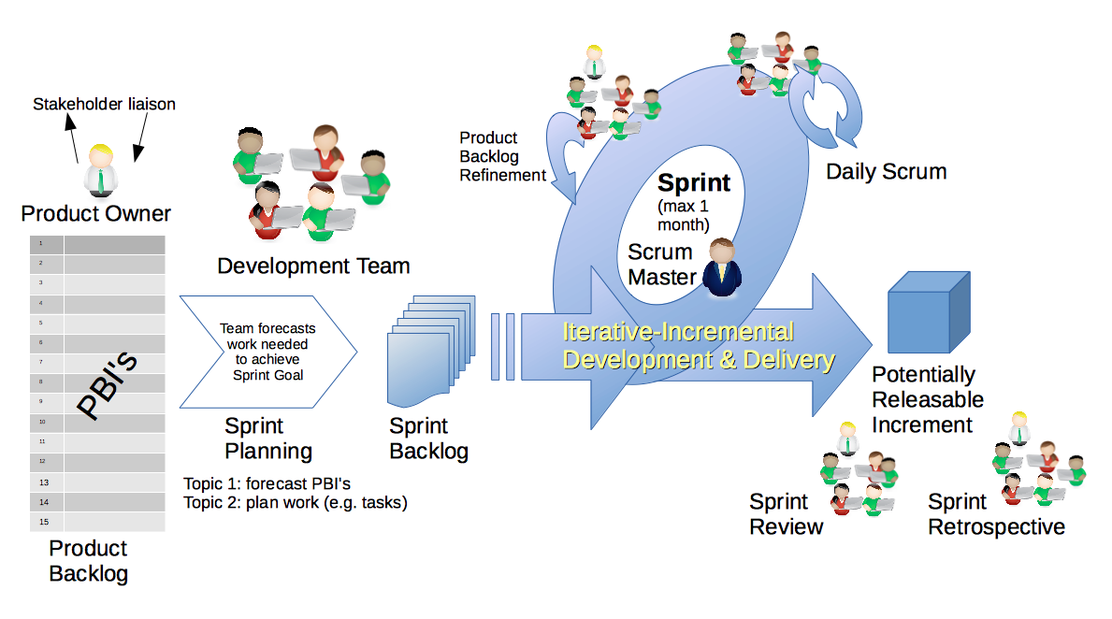
Scrum Process & Roles – Sprint Retrospective
By Dr ian mitchell - Own work, CC BY-SA 4.0, Link

Slide 7
Recall: Start, Stop, Continue Feedback

Slide 8
Remaining Schedule

Slide 9
Scrum Process & Roles – Sprint Planning
By Dr ian mitchell - Own work, CC BY-SA 4.0, Link

Slide 10
Sprint 3 Planning: It all starts with the Activities List

Slide 11
Assignment
Complete Activities List items 1 through 3 and be prepared to discuss them at the start of our next class.

Slide 12
Lab
As A Scrum Team:
Very briefly document a sprint 2 retrospective using Start, Stop, Continue feedback model
Complete sprint 3 planning by reviewing our Activities List and Assignments including our Demo assignment
Team report out by new Scrum Master at 3:44
Team Report Out Guidelines
Scrum Master will stand up, give your name, your team name, and briefly answer the following questions:
What did you accomplish since the last meeting? And what will you be working on until the next meeting?
Is the team committed to completing assignments? All/Most/Some
What is getting in your way or keeping you from completing the assignments?

Slide 13
End of Session

