Slide 1
Graphical User Interfaces (GUI) - Java
Eric Pogue

Slide 2
Topics
Summarize Java Graphical User Interface Development
Position Java GUI development
Explain Heavyweight components
Explain Lightweight components
Examine the paint and paintComponent methods
Explain Layout Managers
Review Class extension
Introduce Interface implementation
Introduce Event Handling
Examine an implementation of ActionListener
Recap

Slide 3
Java Graphical User Interface Development
Tragic: Java platform graphics have been the Achilles heel of the Java platform since the mid-1990s:
Originally there was AWT that introduced Heavyweight components to the Java platform
Programmers joked that it stood “Awful Window Toolkit”… it actually stood for “Abstract Window Toolkit”
Later Swing and Lightweight components were introduced
Later IBM introduced the Standard Widget Toolkit (SWT) which was adopted by the Eclipse Development Environment (IDE) [link]
Finally, Google utilizes the “Java” API in Android… much to the dismay of Oracle
Notes:
A heavyweight component is associated with its own native screen resource. AWT Components from the java.awt package, such as Button and Label, are heavyweight components.
Lightweight components such as Swing components depend less on the target platform and use less native GUI resource. They also look less native.
These notes are from the Oracle site. There is also a nice article about on the Oracle site about mixing heavyweight and lightweight components at:
http://www.oracle.com/technetwork/articles/java/mixing-components-433992.html
IBM’s Standard Widget Toolkit (SWT) toolkit is an alternative to AWT and Swing that has taken root in the Eclipse Integrated Development Environment (IDE) world.
https://en.wikipedia.org/wiki/Standard_Widget_Toolkit
.
Java Applets are Java applications that run in a browser. They never really did work… The “write once and run everywhere” philosophy never did play out very well in the industry when it comes to leading edge client applications. Browser based applications seem to have filled that gap while native applications have filled the “rich client” areas. I suspect that trend will continue.

Slide 4
Java GUI Development and Other Platforms
Despite very limited commercial success, AWT and Swing are excellent learning tools as the concepts that they introduced have been largely implemented in other environments and languages including:
Most native applications (Windows, Macintosh, IOS, etc.) have employed similar concepts using platform native tools and languages (C#, Swift, C++, etc.)
Web applications have moved largely to JavaScript oriented toolsets and left Java applets for dead long ago
Note: Java and Java Script have nothing to do with each other. It was solely a marketing ploy to give JavaScript the Java name
Notes:
Java Applets are Java applications that run in a browser. They never really did work… The “write once and run everywhere” philosophy never did play out very well in the industry when it comes to leading edge client applications. Browser based applications seem to have filled that gap while native applications have filled the “rich client” areas. I suspect that trend will continue.

Slide 5
Heavyweight Components
Paint themselves using their “paint(Graphic g)” method.
Provide methods associate with “Graphic g” such as: drawOval(), fillOval(), drawRect(), fillRect(), and drawstring()
Own a Content Pane, which is a type of Container
Implement “getContentPane()” method to access their Content Pane
Can implement a Layout Manager via their Container
Notes:
The Graphics class is defined in package java.awt.
A window in Java is called a JFrame. JFrames are heavyweight components: graphical components that communicate directly with the operating system and show up directly on the desktop. Heavyweight components contain what are called lightweight components. Lightweight components include panels and buttons. In Java, panels are implemented as JPanels, and buttons are implemented as JButtons.

Slide 6
Lightweight Components
Paint themselves using their “paintComponent(Graphics g)” method
Provide methods associate with “Graphic g” such as: drawOval(), fillOval(), drawRect(), fillRect(), and drawstring()
Are a Container… so no need to call a method to get a Container
Can implement a Layout Manager via their Container
Notes:
Specifically, a JFrame, a heavyweight component …
Can setDefaultCloseOperation(JFrame.EXIT_ON_CLOSE) to make the program vanish from memory (i.e. free resources) when closed.
Can set size and location using setBounds(x,y,width,height)
Can show itself using setVisible(true) and hide itself using setVisible(false)
Can give you a reference to its Container through its getContentPane() function. Once you have access to its Container object, you can set the layout of that container so that you can arrange lightweight components in it.
Popular Lightweight Swing UI components include:
Jbutton
JTextArea
JPanel

Slide 7
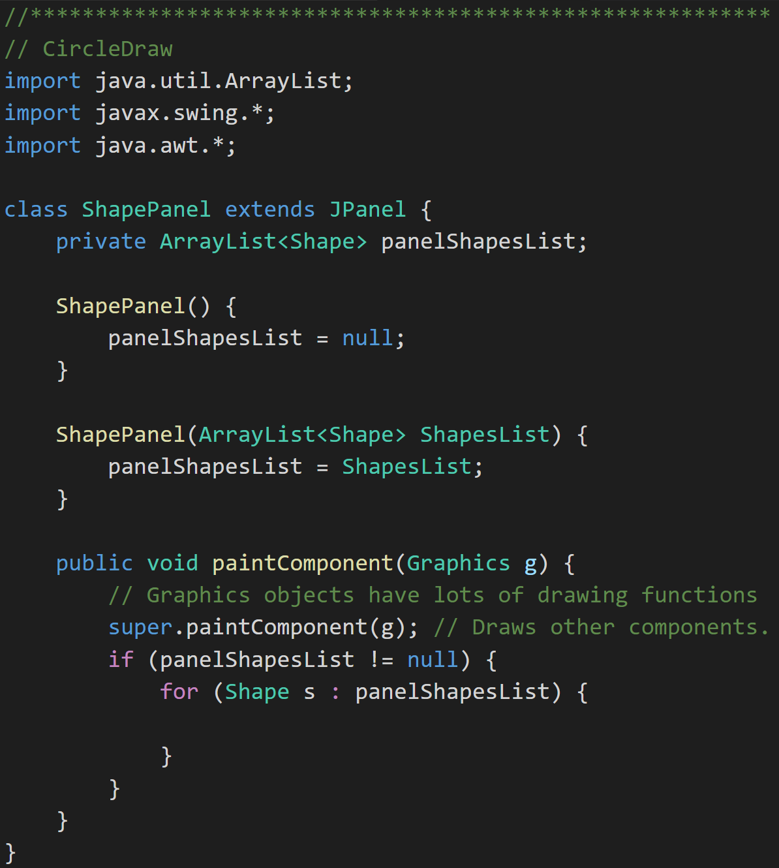
Graphics Objects
Graphics Objects [link]: We will generally see the Graphics object as part of overriding paintComponent(Graphics g). The “g” object has many useful methods including:
drawOval(x,y,width,height)
fillOval(x,y,width,height)
setColor(Color.BLUE)
drawRect()
drawArc() [link]… You will want to use this draw your smiling faces in the assignment this week.
drawString()
setFont()
Notes:
JavaDoc:
https://docs.oracle.com/javase/7/docs/api/java/awt/Graphics.html
Java Graphics Tutorial:
https://docs.oracle.com/javase/tutorial/2d/basic2d/
drawArc:
http://www.java2s.com/Code/JavaAPI/java.awt/GraphicsdrawArcintxintyintwidthintheightintstartAngleintarcAngle.htm
drawArc Example:
http://www.java-examples.com/draw-arc-applet-window-example
Repaint Sequence:
OS -> Frame -> Frame’s paint function -> each LW component paintComponent function

Slide 8
Layout Managers
Layout Managers arrange controls on the screen so they are visually appealing. The allow developers to be able to focus less on layout details. Both AWT and Swing provide general purpose Layout Managers including:
BorderLayout
BoxLayout
CardLayout
FlowLayout
GridBagLayout
GridLayout
GroupLayout
SpringLayout
Notes:
This is different from environments where developers (or designers) layout screens pixel by pixel (like Visual Basic for example). With modern UIs that need to fit in all types of sizes and orientations, layout managers are a necessity.

Slide 9
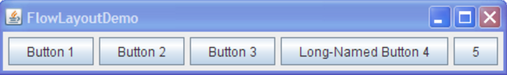
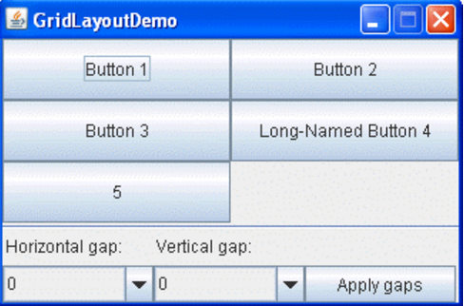
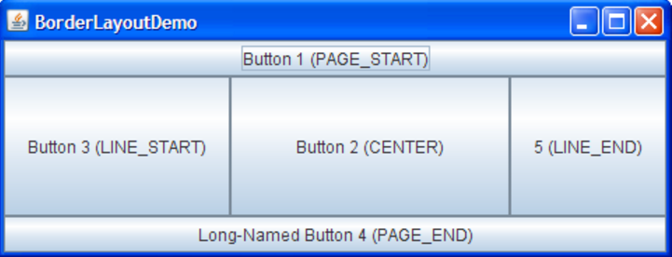
Layout Managers (continued)
Layout Managers arrange controls on the screen so they are visually appealing. We will be focusing on three very common Layout Managers:
FlowLayout: Arranges components left to right, top to bottom. When a FlowLayout runs out of room horizontally on a row, it places the next component as far left as it can go on the row below.
BorderLayout: Arranges components in NORTH, SOUTH, EAST, WEST, and CENTER sections.
GridLayout: Arranges components in an Excel-like table of rows and columns.
Notes:
This is different from environments where developers (or designers) layout screens pixel by pixel (like Visual Basic for example). With modern UIs that need to fit in all types of sizes and orientations, layout managers are a necessity.
Several AWT and Swing classes provide layout managers for general use:
BorderLayout
BoxLayout
CardLayout
FlowLayout
GridBagLayout
GridLayout
GroupLayout
SpringLayout

Slide 10
Interface Implementation vs. Class Extension
Differences include:
Interfaces are implicitly abstract and cannot have implementations
An interface specifies one or more abstract methods that a class that implements the interface must implement
Abstract classes can have both abstract methods and concrete methods
A class can descend (extends) only one Class but can implement many interfaces
Note: Interfaces are Java’s way of avoiding the significant complexities of multiple inheritance while providing most of the benefits.
Notes:
A little history:
Some languages including C++ implemented multiple inheritance in order to allow Classes to inherit from multiple parent classes. That solution has pros and cons beyond the scope of this course.
Other languages including Java only support single inheritance, but also implemented Interfaces in order to allow class to act like multiple things. An example that we will be discussing this week is our OvalFrame that we would like to be a JFrame but may also want it to act like an ActionHandler to respond to buttons being pushed.

Slide 11
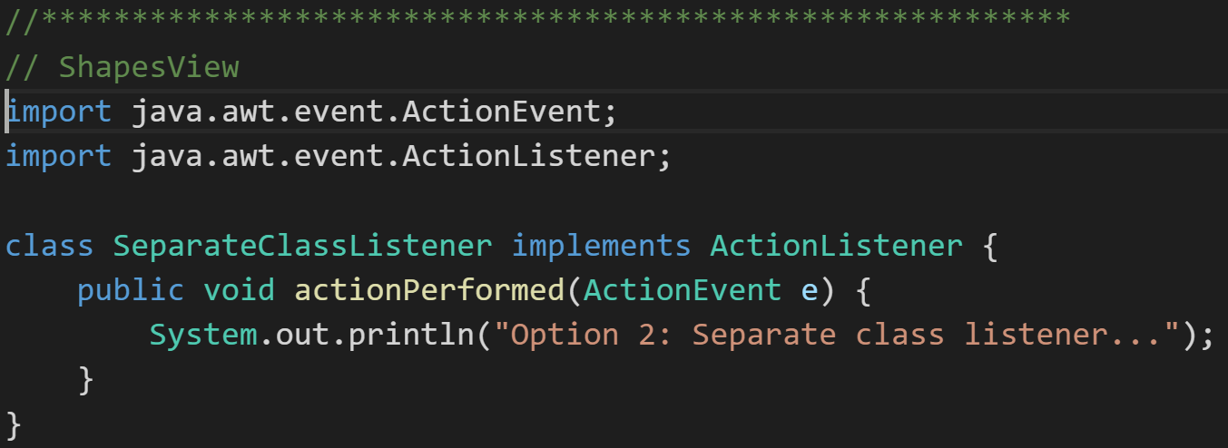
Interface Implementation
Interface implementation is basically agreeing to a contract to implement a given set of methods.
The ActionalListener Interface is a good example of an interface that a class must implement in order to receive notification that a button has been pushed by the user.

Slide 12
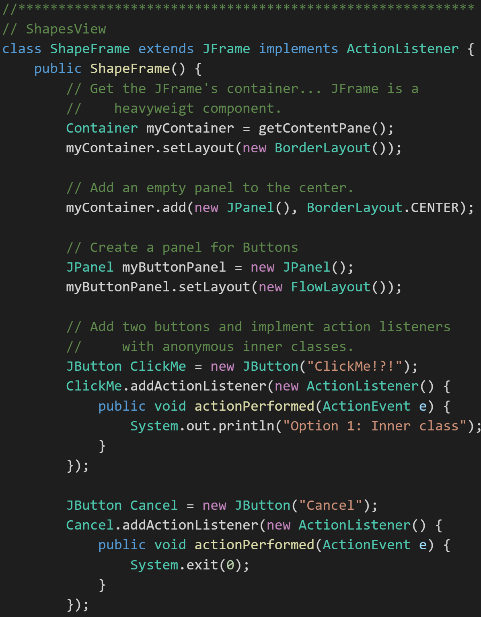
Class Extension
Class Extension is Inheritance. Enough said?
In Java a class can extend from only one parent class, but can implement multiple interfaces.
The code to the right demonstrates ShapeFrame:
Extending from JFrame so that it can “be a” JFrame and hold lightweight UI components
Implementing ActionionListener so that it can “act like” a ActionListener and receive notification that a button has been pressed.

Slide 13
Event Handling
Clicking Event Handling is the way that all graphic user interface environment allow an application to respond to user (or system) events. Possible events include:
Keyboard strokes
Clicking buttons
Dragging a mouse
Low power warning or automatic system hibernation
Attaching to an overhead projector
And many, many others

Slide 14
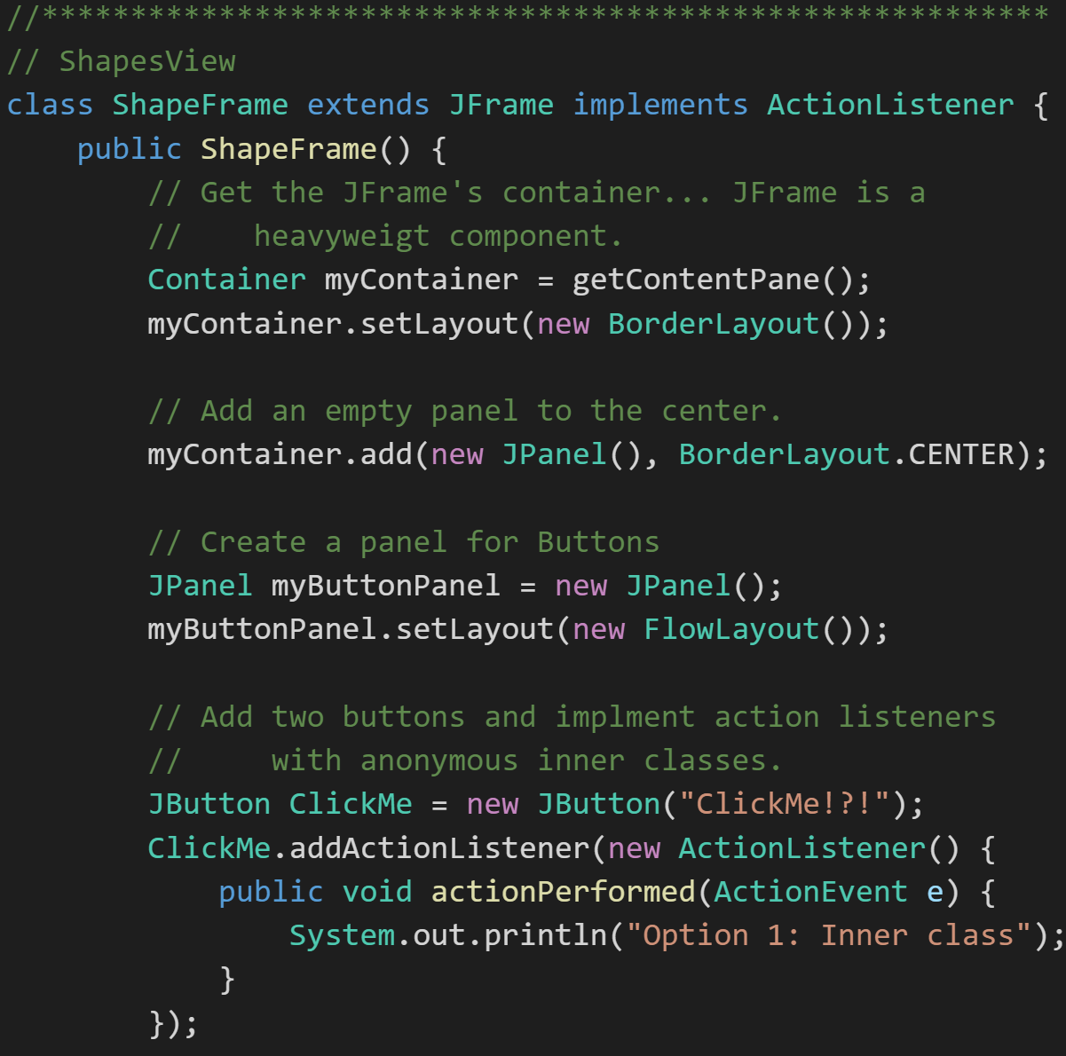
Implementing ActionListener
Consider needing to implement Java ActionListeners to respond to button clicks:
Understand that ActionListener, like other listeners, are an Interface… not a class
Implement the Java ActionListeners Interface
Utilize our ActionListener to receive notifications of an event and respond appropriately
Understand the three ways we could implement an ActionListener to respond to a user pressing a button contained in a our JFrame:
Implement an ActionListener interface in our JFrame
Utilize an external class that implements ActionListener
Implement an ActionListener utilizing an Anonymous Inner Class

Slide 15
Recap
Summarize Java Graphical User Interface development
Position Java GUI development
Explain Heavyweight components
Explain Lightweight components
Examine the paint and paintComponent methods
Explain Layout Managers
Review Class extension
Introduce Interface implementation
Introduce Event Handling
Examine an implementation of ActionListener
Recap

Slide 16
Graphical User Interfaces (GUI) - Java
Eric Pogue

