Slide 1

Object-Oriented Programming Discussion, Lecture, & Lab Eric Pogue
Agenda for Friday, September 6th from 2 to 2:50pm CST:
Review Assignment from Last Class
Friendly Conversation Topic – One Space or Two Spaces After a Period?
Q&A: Object-Oriented Programming Concepts and Practices
Discussion: OOP Patterns
Assignment for Next Class
Lab
Discussion & Questions welcome at any time… please be present with no phones or email during our time together

Slide 2
Assignment from Last Class
Complete all items on the sprint 1 Activities List with the possible exceptions of Programming Assignment 1 and Quiz 1. You should have a solid start on both items, but It is okay if you need to spend some time over the weekend to complete them.
Be ready to Discuss OOP Patterns and to present your team’s Pattern
Take your name tags with you and bring them back to class through the end of Sprint 2

Slide 3
One Space or Two Spaces After a Period?

Slide 4
Only One Space After a Period
Rule: Utilize one space after a period or similar punctuation [link]
Proportional based fonts like Helvetica and Times were designed to have the most visually appealing amount of space after the period.
Notes:
A possible exception would be non-proportional based fonts

Slide 5
Friendly Conversation Topic – Source Code Snippets in VS Code

Slide 6
Q&A: Concepts & Practices
Notes:
Encapsulation
Inheritance
Polymorphism

Slide 7
Discussion: OOP Patterns (Who are the Gang of Four?)

Slide 8


Model-View-Controller (MVC)
Diagram of interactions within the MVC pattern.
Model–view–controller is an architectural pattern commonly used for developing user interfaces that divides an application into three interconnected parts. This is done to separate internal representations of information from the ways information is presented to and accepted from the user.[1][2] The MVC design pattern decouples these major components allowing for efficient code reuse and parallel development.
Traditionally used for desktop graphical user interfaces (GUIs), this architecture has become popular for designing web applications and even mobile, desktop and other clients.[3] Popular programming languages like Java, C#, Ruby, PHP have MVC frameworks that are used in web application development straight out of the box

Slide 9
Assignment for Next Class
ALL Sprint 1 Assignments & Activity List Items are due this Sunday.

Slide 10
Lab
As A Scrum Team:
Select a Scrum Master for Sprint 2
Programming Assignment 1 and Quiz 1
Team report out by new Scrum Master at 2:48
Team Report Out Guidelines
Scrum Master will stand up, give your name, your team name, and briefly answer the following questions:
What did you accomplish since the last meeting? And what will you be working on until the next meeting?
Is the team committed to completing assignments? All/Most/Some
What is getting in your way or keeping you from completing the assignments?

Slide 11
End of Session

Slide 12
Demo Guidelines – Presenter
Everyone will give at least one demo of their work during the semester.
Your demo can include any or all of the following:
A 2 to 5 minute activity
Where you show your application running
Comment on your implementation
Show the source code
Explain how you organized the code
Talk about any challenges
You should not prepare slides or a presentation

Slide 13
Demo Guidelines – Listener
Everyone will be listening to many demos during the semester.
Your responsibilities during the demo is:
Actively listen and watch what is being demoed
Come up with an meaning yet easy to answer question
During or after the demo ask your question if the presenter does not get “sufficient” questions from other listeners
Do not ask hard question or attempt to review the presenters code
Clap for the presenter at the end of the demo and thank them for presenting
If you have a hard question or want to make a recommendation, do it later and in private

Slide 14
Javadoc [link]
History:
Javadoc was an early Java language documentation generator.^{[5]} Prior to the use of documentation generators it was customary to use technical writers who would typically write only standalone documentation for the software,^{[6]} but it was much harder to keep this documentation in sync with the software itself.

Slide 15
Start, Stop, Continue Retrospective Feedback Model
Continue: What is working in the class? Something that we should make sure that we continue to do.
Start: What is something that would be nice to do in the class that we are not doing now? Maybe something that you have seen work well in other classes.
Stop: What is not working in the class? Something that we should stop doing.

Slide 16
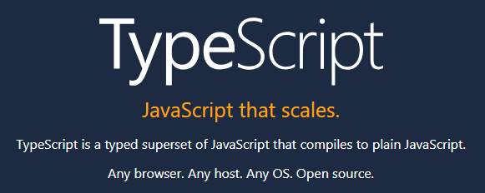

Slide 17
