Slide 1

Object-Oriented Programming Discussion, Lecture, & Lab Eric Pogue
Agenda for Thursday, February 13th
Prework & Announcements
Demos
Friendly Conversation Topic
Q&A for Sprint 3
Assignment for Next Class
Lab
Discussion & Questions welcome at any time… please be present with no phones or email during our time together

Slide 2
Prework & Announcements
Complete Activities List items through item 6
Be ready for Sprint 2 demos (prework includes Class Forum postings)
Be ready to complete DB3 as a team
Notes:
Grace period until Monday morning a 6am CT

Slide 3
Demo Guidelines – Presenter
Everyone will give at least one demo of their work during the semester.
Your demo can include any or all of the following:
A 2 to 5-minute activity
Where you show your application running
Comment on your implementation
Show the source code
Explain how you organized the code
Talk about any challenges
You should not prepare slides or a presentation
You will also need to provide a link to a public Git repository of demo source code in our class forum.

Slide 4
Demo Guidelines – Listener
Everyone will be listening to many demos during the semester.
Your responsibilities during the demo is:
Actively listen and watch what is being demoed
Come up with an meaning yet easy to answer question
During or after the demo ask your question if the presenter does not get “sufficient” questions from other listeners
Do not ask hard question or attempt to review the presenters code
Clap for the presenter at the end of the demo and thank them for presenting
If you have a hard question or want to make a recommendation, do it later and in private

Slide 5
Demos for Thursday, February 13th
Demos will be the first Thursday of each sprint.

Slide 6
Friendly Conversation Topic

Slide 7
Network Architecture & Protocols – Part 1

Slide 8
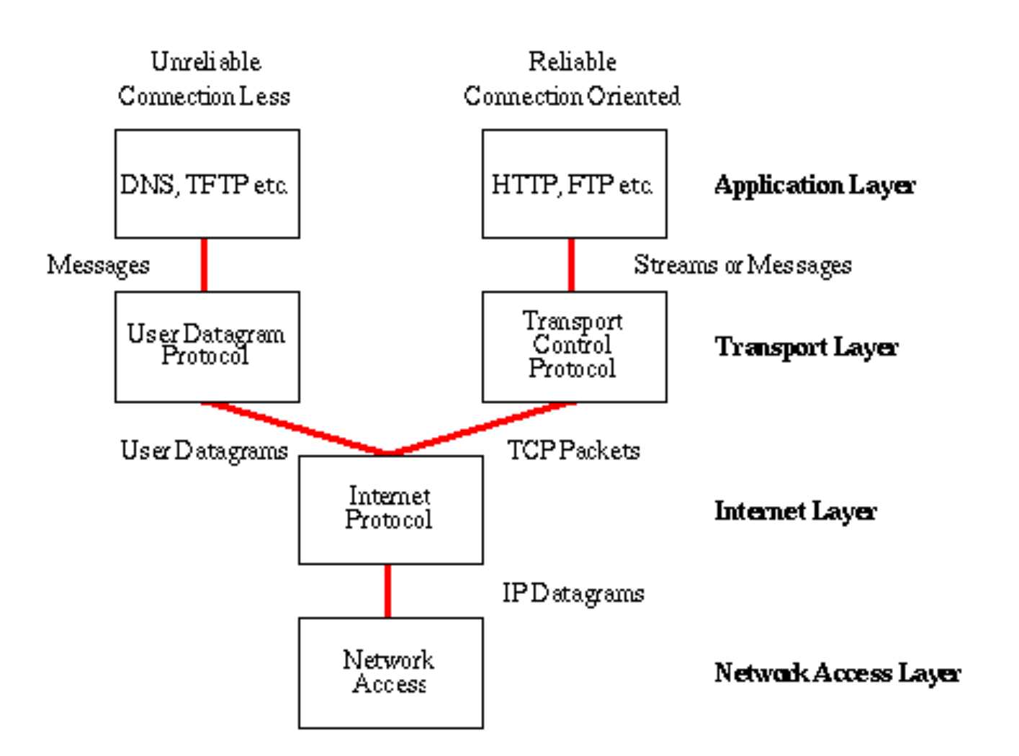
Network Architecture – The Internet
The Internet [link]
IP (Internet Protocol) [link]
TCP (Transmission Control Protocol) [link]
TCP/IP
UDP (User Datagram Protocol) [link]
UDP/IP
TCP/IP or UDP/IP Socket [link]
TCP and UDP Protocols & Port Numbers [link]

Slide 9
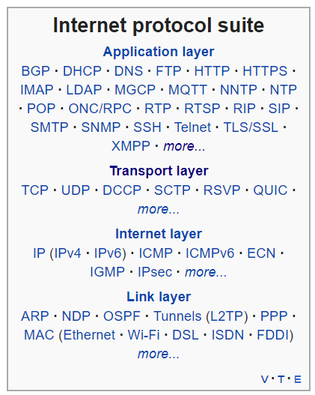
Network Architecture – The Web
The Web [link]
HTTP (Hypertext Transfer Protocol) [link]
DNS (Domain Name System) [link]
HTML (Hypertext Markup Language) [link]
CSS (Cascading Style Sheets) [link]
JavaScript [link]
Internet Protocol Suite [link]

Slide 10
Network Architecture – Distributed Computing
RPC (Remote procedure call) [link]
… SOA (service-oriented architecture) version 1
Java RMI (Java remote method invocation) [link]
DCOM (Distributed Component Object Model) [link]
CORBA (Common Object Request Broker Architecture) [link]
… [The Web takes over the world]
XML (Extensible Markup Language) [link]
XML-RPC (XML & HTTP) [link]
Internet Protocol Suite [link]

Slide 11
Network Architecture – Web Services
Web Services [link]
…SOA (service-oriented architecture) version 2
XML (Extensible Markup Language) [link]
XML-RPC (XML & HTTP) [link]
SOAP (Simple Object Access Protocol) [link]
JSON (JavaScript Object Notation) [link]
REST (Representational State Transfer) [link]
Internet Protocol Suite [link]

Slide 12
Network Architecture – Back to the Future
Web Services [link]
…SOA (service-oriented architecture) version 2 [link]
JSON (JavaScript Object Notation) [link]
REST (Representational State Transfer) [link]
gRPC [link] Or https://grpc.io/faq/
REST vs gRPC
REST vs. gRPC: Battle of the APIs [link]
Evaluating Performance of REST vs. gRPC [link]
Internet Protocol Suite [link]

Slide 13
Q&A for Sprint 3

Slide 14
Assignment
Complete Activities List items through item 8
FaceDraw v1 complete by the start of class on Tuesday, February 18th
Notes:
Grace period until Monday morning a 6am CT

Slide 15
Lab
As A Group:
Complete Discussion Board 3 as a team (14 minutes):
Assign a note taker and presenter
Discuss DB3 as a team
Identify participants and key discussion topics topics in notes
Share notes with team and have each team member copy/paste notes into their individual DB2 post
Present overview
FaceDraw, FaceDraw, and more FaceDraw
Report Out Guidelines
Scrum Master stand up, give your name, your team name, and briefly answer the following questions:
What did you accomplish since the last meeting? And what will you be working on until the next meeting?
Is the team committed to completing assignments? All/Most/Some
What is getting in your way or keeping you from completing the assignments?

Slide 16
End of Session

