Slide 1

Object-Oriented Programming Sprint Planning Eric Pogue
Agenda for Monday, April 27th:
Sprint 8 Planning
Assignment
Please be present with no phones or email during our time together. Discussion & Questions welcome at any time.

Slide 2
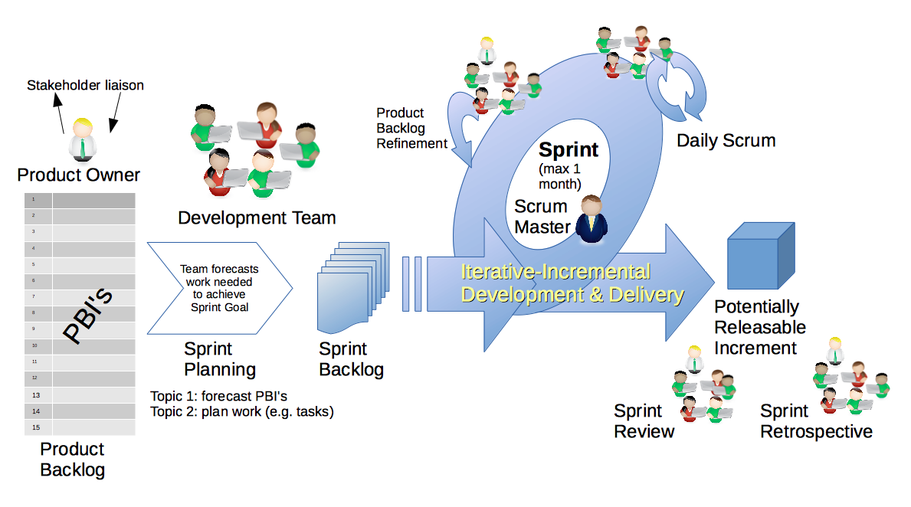
Scrum Process & Roles – Sprint Planning
By Dr ian mitchell - Own work, CC BY-SA 4.0, Link
Notes:
Calendar, Activities List, and Assignments

Slide 3
Sprint 8 Planning

Slide 4
Assignment
All sprint 8 assignments & activity list items are due 2 hours prior to your final project review session
Upon request, you may resubmit sprint 8 assignments up until the end of the day Thursday, May 7th
Notes:
Grace period until Monday morning a 6am CT

Slide 5
End of Session

