Slide 1
Discussion & Lecture Session Sound & Recording Check
Participants:
Log into Join.me
Announce yourself in the chat session or via audio
Provide your full name in your profile so that we can tell who is talking
For viewing my screen and/or sharing your screen your Chrome or FireFox browser
For Audio either:
Utilize your computer computer microphone and speakers
OR dial in with your phone utilizing Dial-in Number: (857) 444-6500 & Access Code: 332-234-179#
Host:
Test recording
Check recording sound when video is released by Join.me
Notes:
Be ***Sure*** to start recording!

Slide 2

Object-Oriented Programming Discussion & Lecture Eric Pogue
Agenda for Tuesday, April 28th
Friendly Conversation Topic
Prework & Announcements
Sprint 7 Demos Preview
Sprint 7 Retrospective
Sprint 8 Planning Update and Final Project Q&A
Final Project Review Schedule
Assignment
Lab
Discussion & Questions welcome at any time… please be present with no phones or email during our time together
Notes:
Be ***Sure*** to start recording!

Slide 3
Friendly Conversation Topic
Notes:
Java Servlets
Java Servlets with Spring

Slide 4
Prework & Announcements
All Sprint 7 Assignments due this Sunday which is April 26, 2020
Metrics Challenge – Percent Submitted On Time:
Goal for Sprint 7 is 84% Goal for Sprint 8 is 95% (18 out of 19)
Notes:
Grace period until Monday morning a 6am CT

Slide 5
Sprint 7 Demos for Thursday, April 30th
Plus a bonus appearance by:
Chris Gamboa and Husni Abuobeid
With ThroughThePipes version 1.0
Notes:
Does anyone else want/need to present version 1 of their final project?

Slide 6
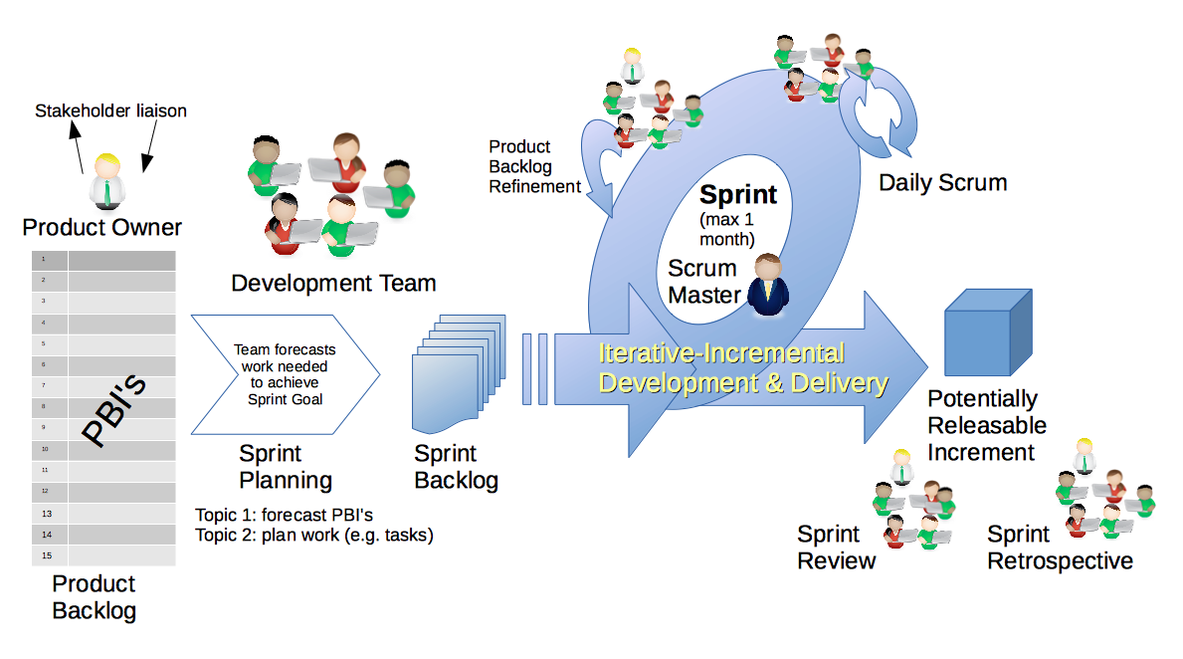
Scrum Process – Sprint Retrospective
By Dr ian mitchell - Own work, CC BY-SA 4.0, Link
Notes:
Calendar, Activities List, and Assignments

Slide 7
Historical Metrics & Metric Goals:
Sprint 5 Percent Submission: 84% Sprint 6 Percent Submission: 68% Goal for Sprint 7 is 84% Goal for Sprint 8 is 95% (18 out of 19)
Notes:
Grace period until Monday morning a 6am CT

Slide 8
Historical Metrics & Metric Goals:
Sprint 5 Percent Submission: 84% Sprint 6 Percent Submission: 68% Sprint 7 Percent Submission: 81% (vs Goal of 84%)
Goal for Sprint 8 is 94% (revised from 95%)
Notes:
21 Enrolled
18 Participating
3
16 out of 19 Submitted All Sprint 5 Assignments by Monday morning at 6am CT
Sprint 7
21 Enrolled
5 Have not logged in since April 13 or not submitted anything in this or the previous sprint
16 Participating (21-5)
13 out of 16 submitted all assignments on-time

Slide 9
Sprint 8 Planning Update

Slide 10
Final Project Q&A

Slide 11
Final Project Review Schedule

Slide 12
Assignment
Be prepared for sprint 7 Demos on Thursday
Complete Final Project v2 MVP by class on Thursday
Notes:
Grace period until Monday morning a 6am CT

Slide 13
Lab
Optional sprint 7 demos
Final Project v2

Slide 14
End of Session

