Slide 1
Discussion & Lecture Session Sound & Recording Check
Participants:
Log into Join.me
Announce yourself in the chat session or via audio
Provide your full name in your profile so that we can tell who is talking
For viewing my screen and/or sharing your screen your Chrome or FireFox browser
For Audio either:
Utilize your computer computer microphone and speakers
OR dial in with your phone utilizing Dial-in Number: (857) 444-6500 & Access Code: 332-234-179#
Host:
Test recording
Check recording sound when video is released by Join.me
Notes:
Be ***Sure*** to start recording!

Slide 2

Object-Oriented Programming Discussion & Lecture Eric Pogue
Agenda for Thursday, April 30th
Friendly Conversation Topic
Prework & Announcements
Sprint 7 Demos
Sprint 8 Q&A
Final Project Review Schedule
Final Project Q&A
Assignment
Lab
Discussion & Questions welcome at any time… please be present with no phones or email during our time together
Notes:
Be ***Sure*** to start recording!

Slide 3
Friendly Conversation Topic Globally Unique Identifiers (GUIDs) [link]
Notes:
Java Servlets
Java Servlets with Spring

Slide 4
Prework & Announcements
Be prepared for sprint 7 Demos on Thursday
Complete Final Project v2 MVP by class on Thursday
Notes:
Grace period until Monday morning a 6am CT

Slide 5
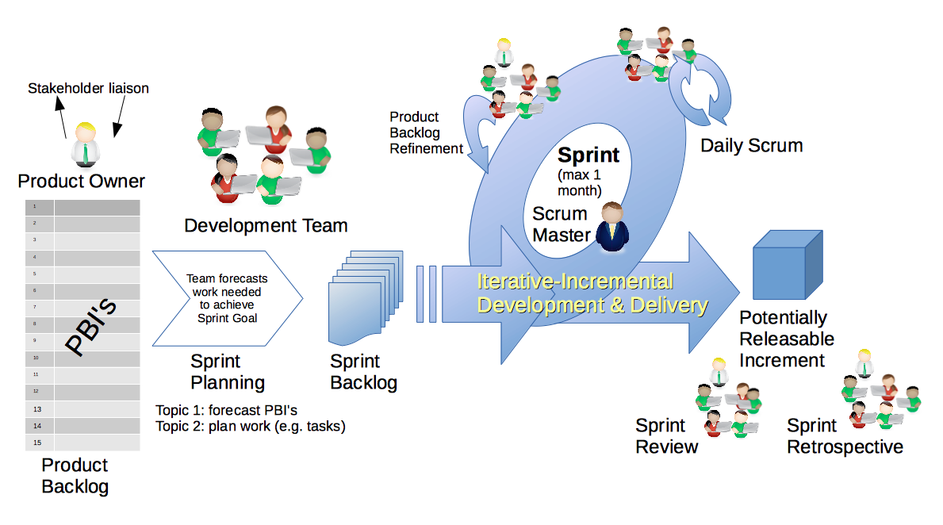
Scrum Process – Sprint Demo And Potentially Shippable Products (PSI)
By Dr ian mitchell - Own work, CC BY-SA 4.0, Link
Notes:
Calendar, Activities List, and Assignments

Slide 6
Sprint 7 Demos for Thursday, April 30th
Plus a bonus appearance by:
Chris Gamboa and Husni Abuobeid
With ThroughThePipes version 1.0
Notes:
Does anyone else want/need to present version 1 of their final project?

Slide 7
Sprint 8 Q&A

Slide 8
Final Project Review Schedule

Slide 9
Final Project Q&A

Slide 10
Assignment
Submit Final Project v2 (PA8) and Quiz 8 at least 2 hours prior to the start of your scheduled final project review time
Notes:
Grace period until Monday morning a 6am CT

Slide 11
Lab
Final Project v2 (PA8)

Slide 12
End of Session

