Slide 1

Object-Oriented Programming Discussion, Lecture, & Lab Eric Pogue
Agenda for Tuesday, February 18th
Prework & Announcements
Optional Open Mic Demos
Friendly Conversation Topic
Q&A for Sprint 3
Assignment for Next Class
Lab
Discussion & Questions welcome at any time… please be present with no phones or email during our time together

Slide 2
Prework & Announcements
Complete Activities List items through item 8
FaceDraw v1 complete by the start of class on Tuesday, February 18th
Notes:
Grace period until Monday morning a 6am CT

Slide 3
Friendly Conversation Topic

Slide 4
Network Architecture & Protocols – Part 2

Slide 5
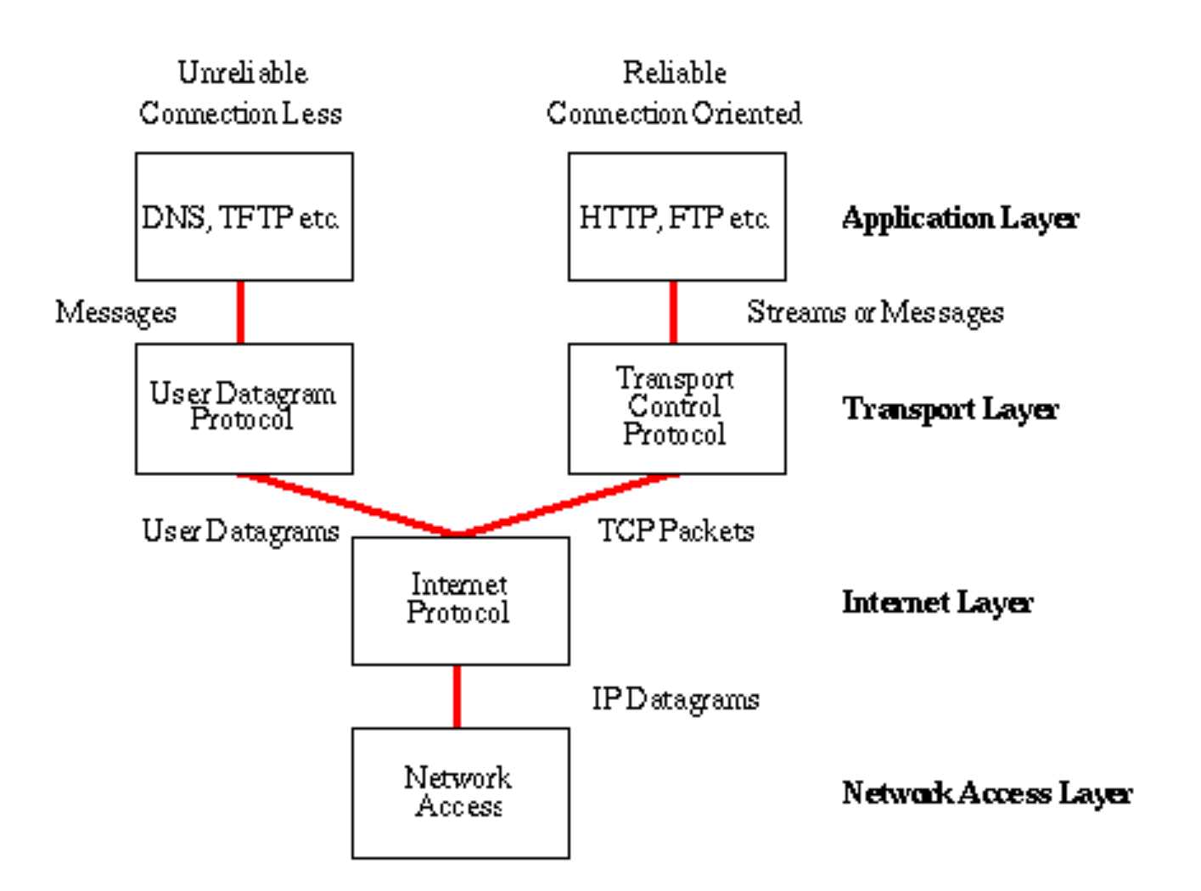
Network Architecture – The Internet
The Internet [link]
IP (Internet Protocol) [link]
TCP (Transmission Control Protocol) [link]
TCP/IP
UDP (User Datagram Protocol) [link]
UDP/IP
TCP/IP or UDP/IP Socket [link]
TCP and UDP Protocols & Port Numbers [link]

Slide 6
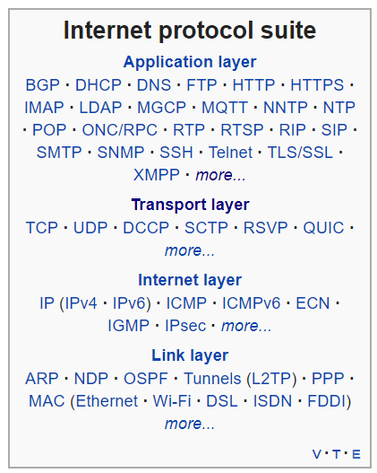
Network Architecture – The Web
The Web [link]
HTTP (Hypertext Transfer Protocol) [link]
DNS (Domain Name System) [link]
HTML (Hypertext Markup Language) [link]
CSS (Cascading Style Sheets) [link]
JavaScript [link]
Internet Protocol Suite [link]

Slide 7
Network Architecture – Distributed Computing
RPC (Remote procedure call) [link]
… SOA (service-oriented architecture) version 1
Java RMI (Java remote method invocation) [link]
DCOM (Distributed Component Object Model) [link]
CORBA (Common Object Request Broker Architecture) [link]
… [The Web takes over the world]
XML (Extensible Markup Language) [link]
XML-RPC (XML & HTTP) [link]
Internet Protocol Suite [link]

Slide 8
Network Architecture – Web Services
Web Services [link]
…SOA (service-oriented architecture) version 2
XML (Extensible Markup Language) [link]
XML-RPC (XML & HTTP) [link]
SOAP (Simple Object Access Protocol) [link]
JSON (JavaScript Object Notation) [link]
REST (Representational State Transfer) [link]
Internet Protocol Suite [link]

Slide 9
Network Architecture – Back to the Future
Web Services [link]
…SOA (service-oriented architecture) version 2 [link]
JSON (JavaScript Object Notation) [link]
REST (Representational State Transfer) [link]
gRPC [link] Or https://grpc.io/faq/
REST vs gRPC
REST vs. gRPC: Battle of the APIs [link]
Evaluating Performance of REST vs. gRPC [link]
Internet Protocol Suite [link]

Slide 10
Optionål Open Mic Demos join.me/ericjpogue

Slide 11
Upcoming Demos
Demos will be the first Thursday of each sprint.

Slide 12
Q&A for Sprint 3

Slide 13
Assignment
ALL Sprint 2 Assignments & Activity List Items are due Sunday.
FaceDraw v2 complete by the start of class on Thursday, February 20th
Notes:
Grace period until Monday morning a 6am CT

Slide 14
Lab
As A Group:
Optional coding together with HelloGoodbye:
HelloGoodbye class
Random
Override toString
ArrayList
Submitting zip file
FaceDraw, FaceDraw, and more FaceDraw
Report Out Guidelines
Scrum Master stand up, give your name, your team name, and briefly answer the following questions:
What did you accomplish since the last meeting? And what will you be working on until the next meeting?
Is the team committed to completing assignments? All/Most/Some
What is getting in your way or keeping you from completing the assignments?

Slide 15
End of Session

