Slide 1

Object-Oriented Programming Discussion, Lecture, & Lab Eric Pogue
Agenda for Tuesday, February 11th
Friendly Conversation Topic
Announcements and Prework
Sprint 2 Retrospective
Upcoming Demos
Sprint 3 Planning
Assignment for Next Class
Lab
Discussion & Questions welcome at any time… please be present with no phones or email during our time together

Slide 2
Friendly Conversation Topic Feedback Models

Slide 3
Recall Start, Stop, Continue Feedback Model
Continue: What is working? Something that we should make sure that we continue to do.
Start: What is something that would be nice to do that we are not doing now? Maybe something that you have seen work well in other classes or with other teams.
Stop: What is not working? Something that we should stop doing.

Slide 4
Lab Today? Start, stop, continue? Or more coding together on BMI Calculator?

Slide 5
Announcements & Prework
ALL Sprint 2 Assignments & Activity List Items are due Sunday.

Slide 6
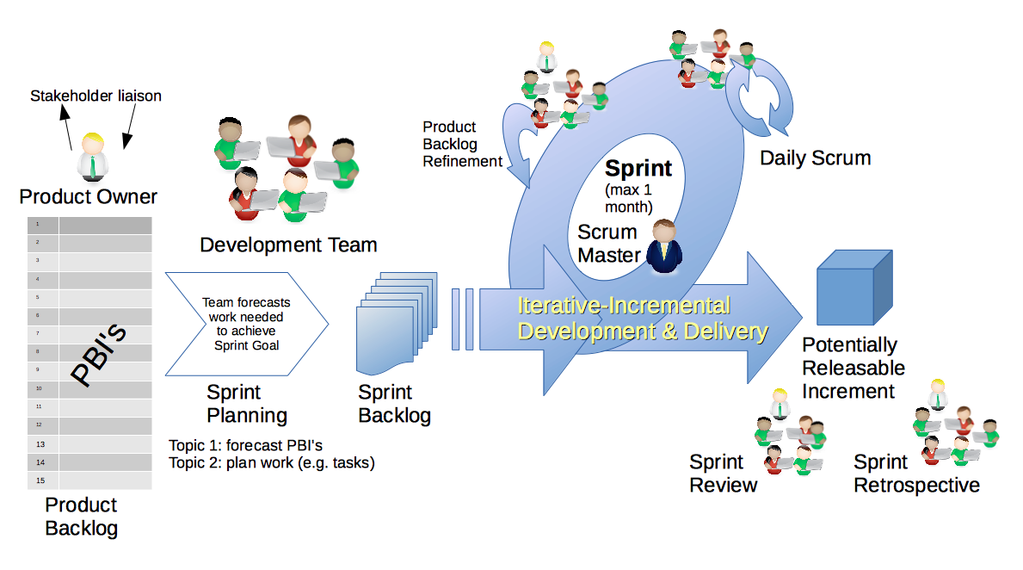
Scrum Process – Sprint Retrospective
By Dr ian mitchell - Own work, CC BY-SA 4.0, Link
Notes:
Calendar, Activities List, and Assignments

Slide 7
Start – Asking for help and clarification early

Slide 8
Feedback?
Notes:
Discussion Board Thursdays?
Programming in class?

Slide 9
Demos for Thursday, February 13th
Demos will be the first Thursday of each sprint.

Slide 10
Scrum Process & Roles – Sprint Planning
By Dr ian mitchell - Own work, CC BY-SA 4.0, Link

Slide 11
Assignment
Complete Activities List items through item 6
Be ready for Sprint 2 demos (prework includes Class Forum postings)
Be ready to complete DB3 as a team
Notes:
Grace period until Monday morning a 6am CT

Slide 12
Lab
As A Group:
Complete Sprint 3 Planning
Coding together with Graphical BMI Calc Plus utilizing Coding Standards
F1: Graphical Hello World (JFrame & JPanel)
F2: Add Calc BMI code
F3: Separate Calc BMI into separate files for each class
F4: Add “Calculate” button
F5: Add output field
F6: Add input fields for height and weight
F7: Add English and Metric options
F8: Test
F9: Cleanup and verify coding standards
F10: Zip & submit
Report Out Guidelines
Scrum Master stand up, give your name, your team name, and briefly answer the following questions:
What did you accomplish since the last meeting? And what will you be working on until the next meeting?
Is the team committed to completing assignments? All/Most/Some
What is getting in your way or keeping you from completing the assignments?

Slide 13
Coding Standards
Our coding standards include:
All code must compile and execute without errors or warnings
Only submit the source code files required to compile and execute the application along with a README.md file and license file
README.md file must include clear and concise build and execute instructions
CamelCase naming conventions with Classes starting with a capital letter and methods and variables starting with lower case letters
Descriptive class, method, and variable naming
Use tabs (no spaces) for indention at the beginning of lines, only line feeds (LF, /n) at the end of the lines, and UTF-8 text compatible text files
Include valuable but conservative comments and a Javadoc compatible author statement
Utilize Git and GitHub to manage code
When submitting a zip file, the zip file should include all files in the root folder
Each Java Class should be in its own Java file
Notes:
Code Must Compile and Ex

Slide 14
Git & GitHub… Configuration Management
Source code control is Part of Configuration Management. Professional organizations often feel new software developers do not get enough experience with Configuration Management in college.
Git & GitHub can play a central role in:
Allowing a team to collectively share and manage code
Managing the master copy of your source code
Providing a “safety net” while you are programming… allowing you to be bold in your programming
Submitting project code for class
Deploying code to test or production environments

Slide 15
Git and GitHub Commands
Git is a rich and powerful tool. Today we are going to be focused on utilizing some of the basic Git commands as well as branching commands. These commands include:
git clone & git pull
git add
git commit [-a -m “Update file.”]
git branch
git checkout
git merge
git push
Pattern:
git branch f-0x
git checkout f-0x
git commit -a -m “Implement f-0x”
git checkout master
git merge f-0x
git push

Slide 16
End of Session

