Slide 1
TypeScript

Slide 2
TypeScript
Topics:
What is TypeScript
Why TypeScript
How to Get Started

Slide 3
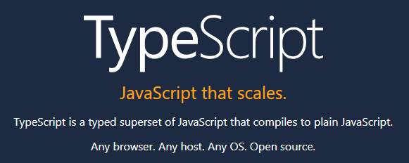
What is TypeScript

Slide 4
What is TypeScript (continued)
TypeScript consists of three components:
Language
Compiler
Language Service

Slide 5
Why TypeScript
TypeScript:
Implements class-based object-oriented programming
Introduces type checking
Formalizes modules
Fully embraces JavaScript
Notes:
JavaScript provides a prototype-based style of object-oriented programming sometimes called object-based programming.
All valid JavaScript is valid TypeScript… consider the similar relationship between C and C++

Slide 6
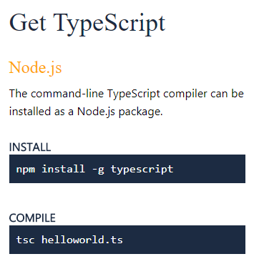
How to Get Started
Getting started with TypeScript begins with:
Visiting the TypeScript site at www.typescript.com
Following the installation instructions
Notes:
Anders Hejlsberg
Turbo Pascal, Delphi, J++, C#, and TypeScript
https://channel9.msdn.com/Events/Build/2017/B8088/

Slide 7
“let” vs “var”… in both JavaScript and TypeScript
let allows you to declare variables that are limited in scope to the block, statement, or expression on which it is used. This is unlike the var keyword, which defines a variable globally, or locally to an entire function regardless of block scope.
Conclusion: Always use let.
Notes:
Why might we not want to us “let” in our JavaScript… because it was introduced in ES2015 and might not be implemented in all browsers.

Slide 8
TypeScript Language
The TypeScript language characteristics:
Valid JavaScript IS valid TypeScript
Variables
Types… optionally static typed
Functions
Classes and Instances
Encapsulation, Inheritance, and Polymorphism… object-oriented programming
Modules and Namespaces
Interfaces… not the same as Java or C# interfaces
Packaging with Node Package Manager (NPM)
Notes:
Modules are preferred over Namespaces

Slide 9
How are Visual Studio Code (and Atom) Developed?

Slide 10
End of Session

