Slide 1
Discussion & Lecture Session Sound & Recording Check
Participants:
Log into Join.me
Announce yourself in the chat session or via audio
Provide your full name in your profile so that we can tell who is talking
For viewing my screen and/or sharing your screen your Chrome or FireFox browser
For Audio either:
Utilize your computer computer microphone and speakers
OR dial in with your phone utilizing Dial-in Number: (857) 444-6500 & Access Code: 332-234-179#
Host:
Test recording
Check recording sound when video is released by Join.me
Notes:
Be ***Sure*** to start recording!

Slide 2

Object-Oriented Programming Lecture & Sprint Planning Eric Pogue
Agenda for Tuesday, March 31st
Friendly Conversation Topic
Prework & Announcements
Potential Shippable Product & Demos
Sprint 5 Retrospective & Metrics
Sprint 6 Planning Q&A
Assignment
Sprint 5 Demos
Lab
Discussion & Questions welcome at any time… please be present with no phones or email during our time together
Notes:
Be ***Sure*** to start recording!

Slide 3
Friendly Conversation Topic Final Project Idea: Azure Functions in Java with VS Code [link]
Notes:
Java Servlets
Java Servlets with Spring

Slide 4
Prework & Announcements
All Sprint 5 Assignments & Activity List Items are due Sunday, March 29th
Notes:
Grace period until Monday morning a 6am CT

Slide 5
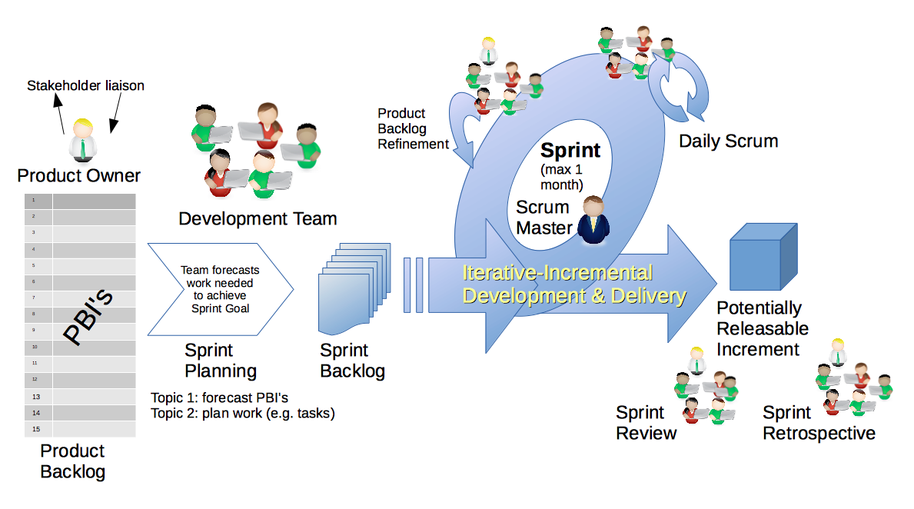
Scrum Demo - Potentially Shippable Product
By Dr ian mitchell - Own work, CC BY-SA 4.0, Link
Notes:
Calendar, Activities List, and Assignments

Slide 6
Sprint 5 Demos for Thursday
Notes:
Everyone except Henry (Palmer), Mauricio (Ortiz) and Mathew (Seifert) should have their demo assignment submitted before class on Thursday

Slide 7
Review Demo Assignment

Slide 8
Scrum Process – Sprint Retrospective
By Dr ian mitchell - Own work, CC BY-SA 4.0, Link
Notes:
Calendar, Activities List, and Assignments

Slide 9
Feedback

Slide 10
Metrics Percent Submission: 84%
Notes:
22 Enrolled
19 Participating
16 out of 19 Submitted All Sprint 5 Assignments by Monday morning at 6am CT

Slide 11
Scrum Process & Roles – Sprint Planning
By Dr ian mitchell - Own work, CC BY-SA 4.0, Link
Notes:
Calendar, Activities List, and Assignments

Slide 12
Sprint 6 Planning Q&A

Slide 13
Azure Web Service Q&A

Slide 14
SwissArmyKnife (v2) Q&A

Slide 15
Assignment
Verify that you have submitte your Demo assignment (unless you are one of the three people scheduled to demo sprint 6 or sprint 7)
SwissArmyKnife v2 minimum viable product (MVP) [link]
Notes:
Grace period until Monday morning a 6am CT

Slide 16
Lab
As A Group:
Complete Discussion Board 6 and your Azure Web Service with JSON files
SwissArmyKnife v2, SwissArmyKnife v2, and more SwissArmyKnife v2
Scrum Master to hold a scrum meeting via Discord (or alternative)
Team Report-out by Scrum Master for topics including a team status for sprint 6 assignments
Report Out Guidelines
Scrum Master stand up, give your name, your team name, and briefly answer the following questions:
What did you accomplish since the last meeting? And what will you be working on until the next meeting?
Is the team committed to completing assignments? All/Most/Some
What is getting in your way or keeping you from completing the assignments?

Slide 17
End of Session

Slide 18
Friendly Conversation Topic Final Project Idea: Azure Functions in Java with VS Code [link] Open Java Development Kit [link]

Slide 19
Demos – Thursday, March 26th
Demos will be the first Thursday of each sprint.

