Slide 1

Object-Oriented Programming Discussion, Lecture, & Lab Eric Pogue
Agenda for Monday, September 9th from 2 to 2:50pm CST:
Review Assignment from Last Class
Friendly Conversation Topic – Start, Stop, Continue Feedback Model
Sprint 1 Retrospective
Remaining Schedule
Sprint 2 Planning
Assignment
Lab
Discussion & Questions welcome at any time… please be present with no phones or email during our time together

Slide 2
Assignment
ALL Sprint 1 Assignments & Activity List Items are due Sunday.

Slide 3
Start, Stop, Continue Retrospective Feedback Model
Continue: What is working? Something that we should make sure that we continue to do.
Start: What is something that would be nice to do that we are not doing now? Maybe something that you have seen work well in other classes or with other teams.
Stop: What is not working? Something that we should stop doing.

Slide 4
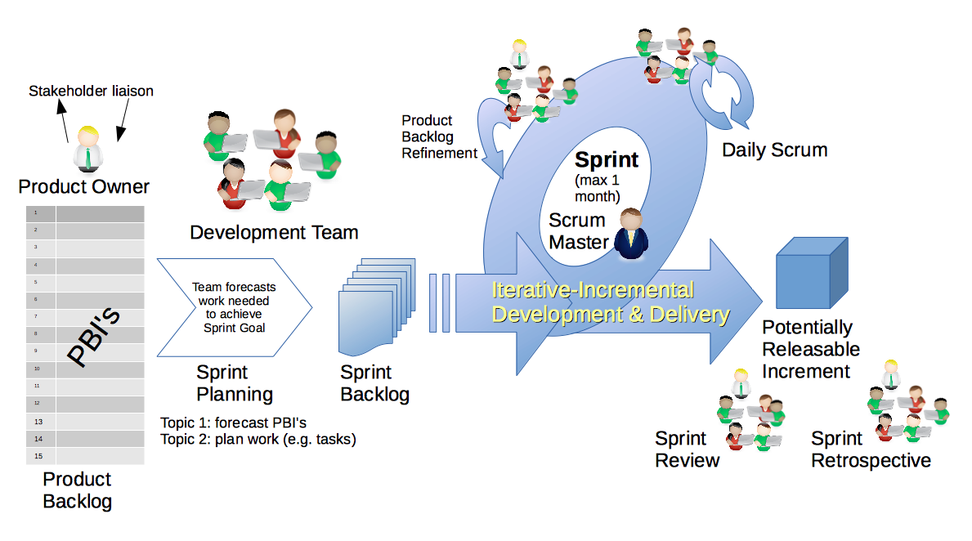
Scrum Process & Roles – Sprint Retrospective
By Dr ian mitchell - Own work, CC BY-SA 4.0, Link

Slide 5
Sprint 1 Retrospective: Start, Stop, Continue Feedback

Slide 6
Continue: Turning in Assignments on Time! Well Done!!!

Slide 7
Feedback?

Slide 8
Remaining Schedule

Slide 9
Scrum Process & Roles – Sprint Planning
By Dr ian mitchell - Own work, CC BY-SA 4.0, Link

Slide 10
Assignment
Complete Activities List items 1 through 5 and be prepared to discuss them at the start of our next class.

Slide 11
Lab
As A Scrum Team:
Sprint 1 Retrospective (for team & class) using Start, Stop, Continue feedback model
Sprint 2 Planning by reviewing our Sprint 2 Activities List and Assignments
Team report out by new Scrum Master at 2:44
Team Report Out Guidelines
Scrum Master will stand up, give your name, your team name, and briefly answer the following questions:
What did you accomplish since the last meeting? And what will you be working on until the next meeting?
Is the team committed to completing assignments? All/Most/Some
What is getting in your way or keeping you from completing the assignments?

Slide 12
End of Session

Slide 13
Demo Guidelines – Presenter
Everyone will give at least one demo of their work during the semester.
Your demo can include any or all of the following:
A 2 to 5 minute activity
Where you show your application running
Comment on your implementation
Show the source code
Explain how you organized the code
Talk about any challenges
You should not prepare slides or a presentation

Slide 14
Demo Guidelines – Listener
Everyone will be listening to many demos during the semester.
Your responsibilities during the demo is:
Actively listen and watch what is being demoed
Come up with an meaning yet easy to answer question
During or after the demo ask your question if the presenter does not get “sufficient” questions from other listeners
Do not ask hard question or attempt to review the presenters code
Clap for the presenter at the end of the demo and thank them for presenting
If you have a hard question or want to make a recommendation, do it later and in private

Slide 15
Javadoc [link]
History:
Javadoc was an early Java language documentation generator.^{[5]} Prior to the use of documentation generators it was customary to use technical writers who would typically write only standalone documentation for the software,^{[6]} but it was much harder to keep this documentation in sync with the software itself.

Slide 16
Start, Stop, Continue Retrospective Feedback Model
Continue: What is working in the class? Something that we should make sure that we continue to do.
Start: What is something that would be nice to do in the class that we are not doing now? Maybe something that you have seen work well in other classes.
Stop: What is not working in the class? Something that we should stop doing.

Slide 17
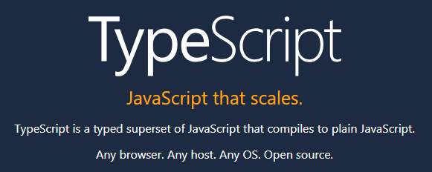

Slide 18
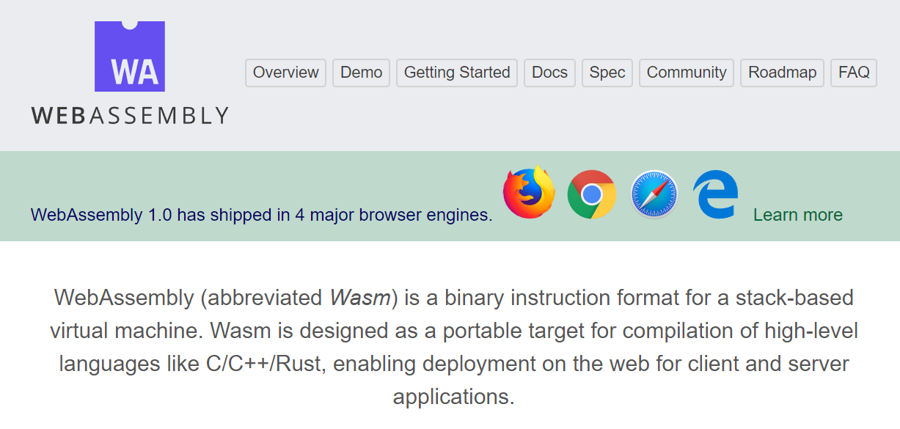

Slide 19

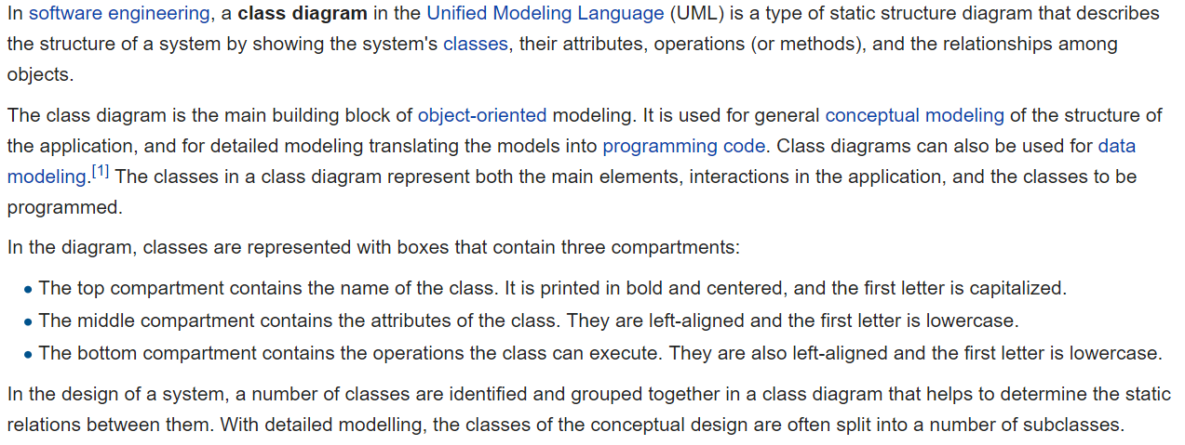
UML Class Diagram [link]

Slide 20
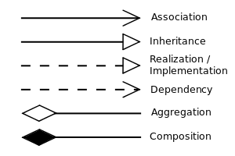


UML Class Diagram (continued) [link]

Slide 21
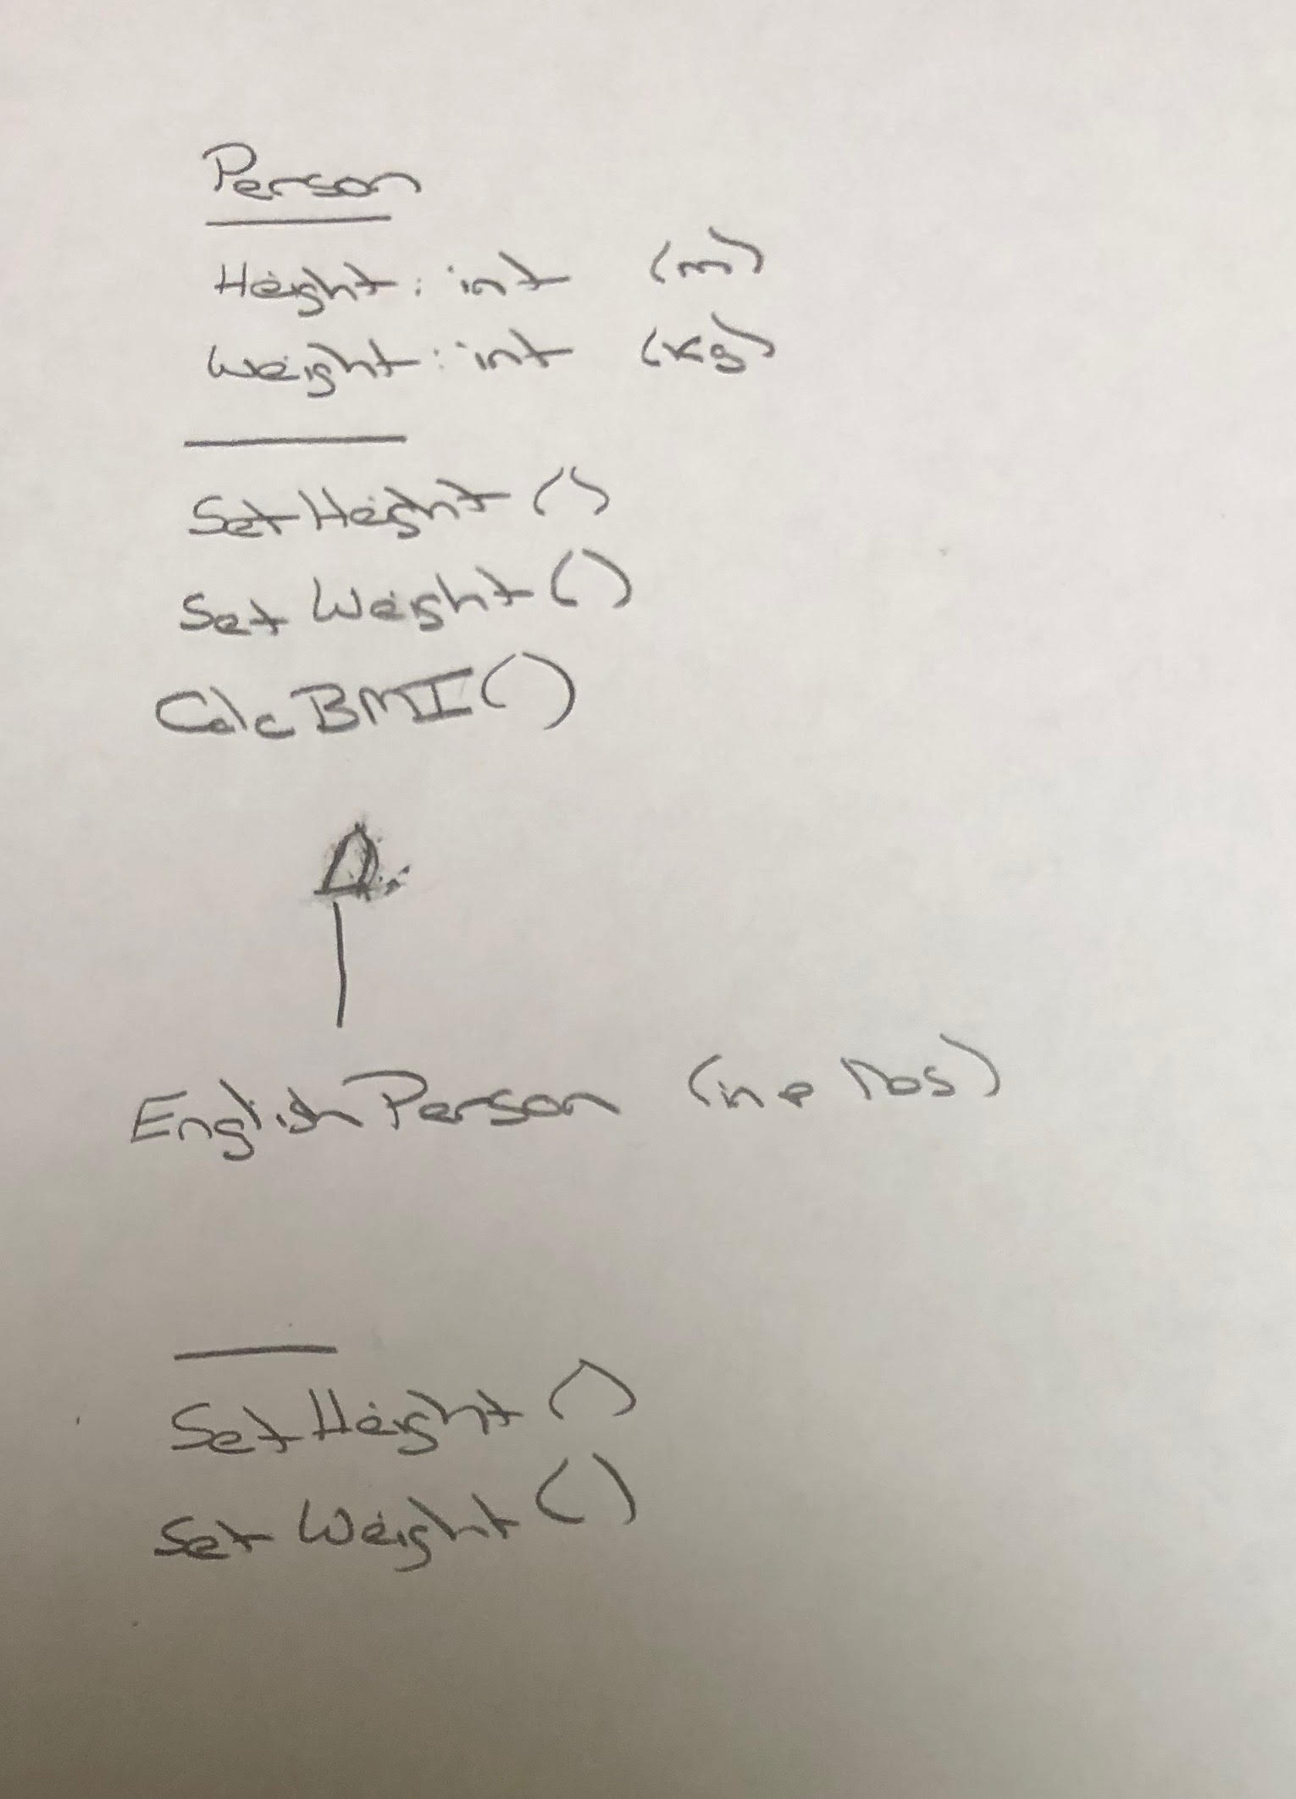
UML – BMI Calculator Plus

