Slide 1

Object-Oriented Programming Discussion, Lecture, & Lab Eric Pogue
Wednesday, November 6th from 2 to 2:50pm CST:
Friendly Conversation Topic – Containers & Docker
Assignment from Last Class
SwissArmyKnife Demos
Assignment Q&A
Assignment for Next Class
Lab
Discussion & Questions welcome at any time… please be present with no phones or email during our time together

Slide 2
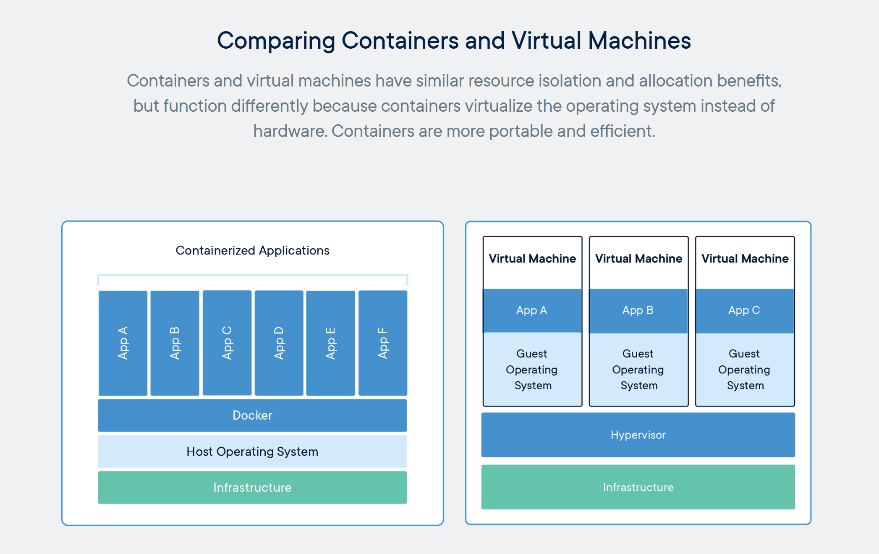
Containers & Docker [link]

Slide 3
Assignment
Complete 6 activities list items [link] through item 4
Wednesday Demos
Friday Discussion Board (as needed)

Slide 4
SwissArmyKnife Demos

Slide 5
Assignment
Complete 6 activities list items [link] through item 4
Final Project Proposal
Friday Discussion Board (as needed)

Slide 6
Lab
As A Scrum Team:
Seat Numbers
Final Project Proposals
… and then SwissArmyKnife v2 as time allows
Final Project Proposal idea report out at 2:40
Team Report Out Guidelines
Scrum Master will stand up, give your name, your team name, and briefly answer the following questions:
What did you accomplish since the last meeting? And what will you be working on until the next meeting?
Is the team committed to completing assignments? All/Most/Some
What is getting in your way or keeping you from completing the assignments?

Slide 7
End of Session

