Slide 1

Object-Oriented Programming Discussion, Lecture, & Lab Eric Pogue
Agenda for Wednesday, September 18^{h} from 2 to 2:50pm CST:
Review Assignment from Last Class
Friendly Conversation Topic – Files & JSON
Q&A: Sprint 2 Activity List and Assignments
Discussion: OOP Principles (Lab)
Assignment
Lab
Discussion & Questions welcome at any time… please be present with no phones or email during our time together

Slide 2
Assignment
Complete all items on the Activities List with the possible exceptions of the Programming Assignment and Quiz. You should have a solid start on both items, but it is okay if you need to spend time over the weekend to complete them.

Slide 3
Files & JSON

Slide 4
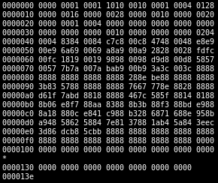
Binary Files
A binary file is a computer file that is not a text file. The term "binary file" is often used as a term meaning "non-text file". The can be open or closed formats that are generally:
Fast, small, and efficient*
Often not very portable across applications and platforms
Difficult to maintain backward compatibility
Notes:
Some people would say that binary files include all files, and that text files are just binary files that are being interpreted in a specific way.

Slide 5
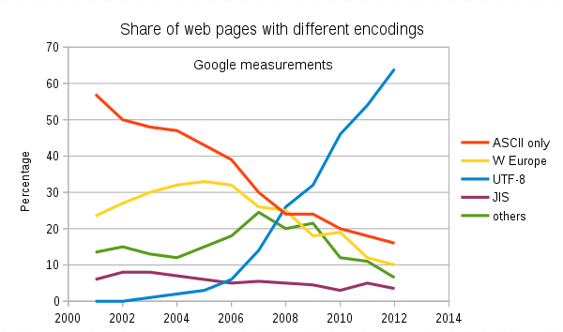
Recall: Text File Encoding Standards
ASCII
Unicode
UTF-8
Others

Slide 6
Recall: Text File End-Of-Line (EOL) and Encoding
Industry adoption of end-of-line encoding includes:
Windows: Both Carriage Return (CR, \r, 0x0d) and Line Feed (LF, \n, 0x0a) together.
Unix/Linux/OSX: Just Line Feed (LF, \n, 0x0a)
Mac (pre-OSX): Just Carriage Return (CR, \r, 0x0d)
Article on Windows Notepad supporting non-Windows EOF conventions [link]

Slide 7
Special Types of Text Files
Most programming is made up of different types of Text Files including:
HTML
CSS
JavaScript… and other coding languages
XML
JSON

Slide 8
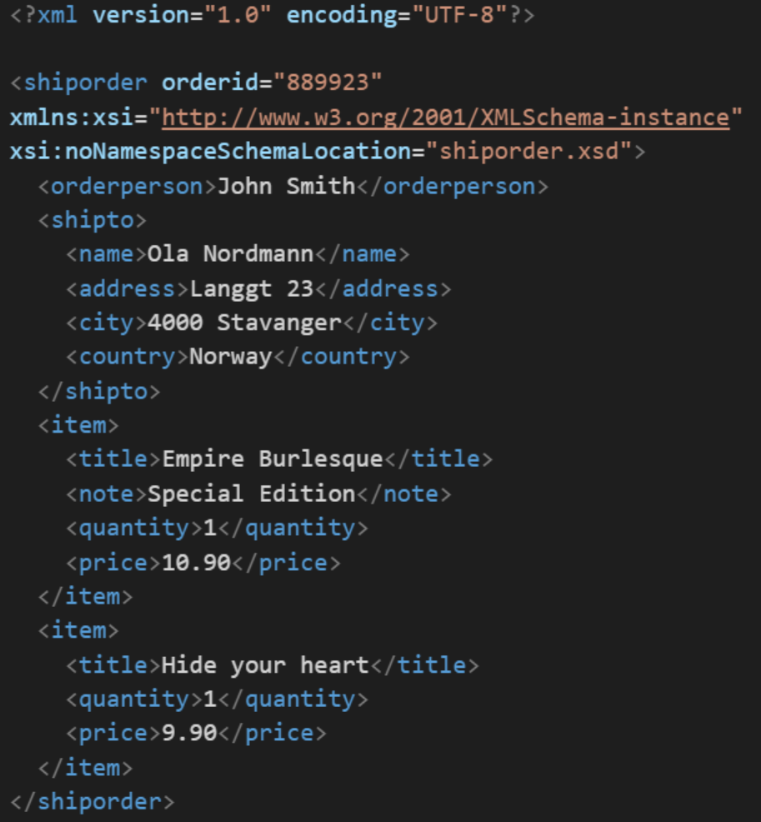
XML Example
In computing, XML (Extensible Markup Language) is a markup language that defines a set of rules for encoding documents in a format that is both human-readable and machine-readable. It is an open standard that:
Supports nearly all development languages and platforms
Allows us to cross between many applications
Can result in large files
Supports schema to validate data directly

Slide 9
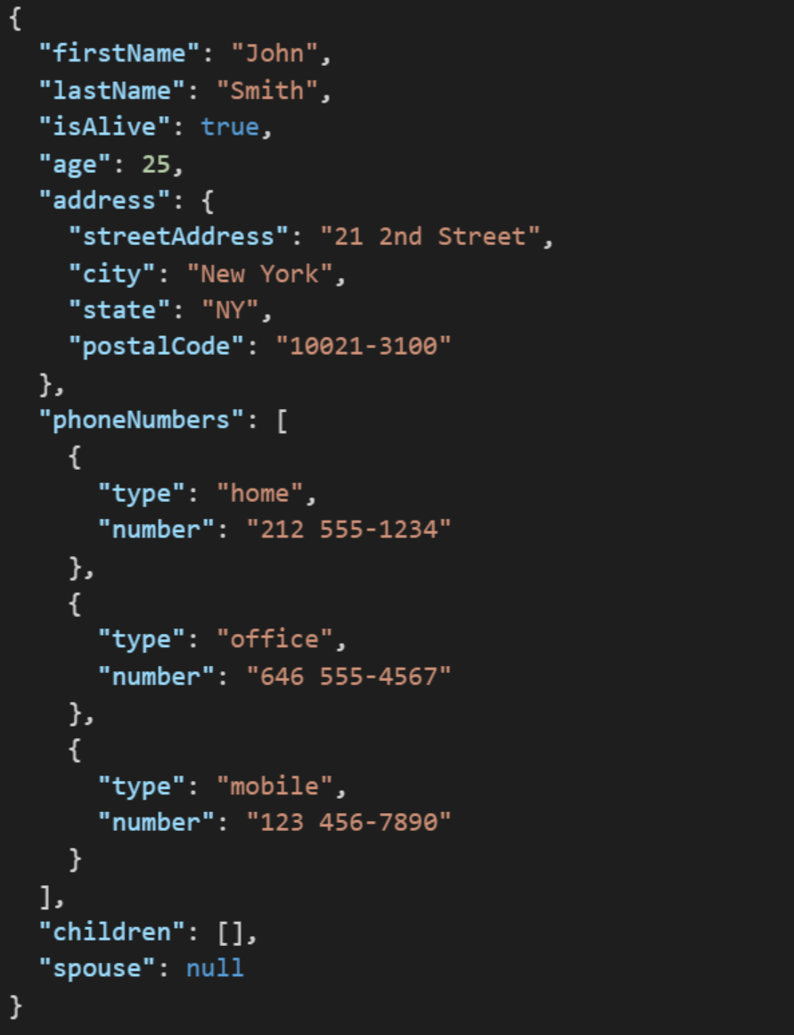
JSON Example
JSON (JavaScript Object Notation) is a lightweight data-interchange format. It is easy for humans to read and write. It is easy for machines to parse and generate. It is an open standard that:
Supports nearly all development languages and platforms
Allows us to cross between many applications
Can result in large files
Notes:
JSON is an open-standard format that uses human-readable text to transmit data objects consisting of attribute–value pairs. It is a very common data format used for asynchronous browser/server communication, including as a replacement for XML in some web service style systems.

Slide 10
Question: What is the difference between a UTF-8 XML file that contains only ACSII characters and an ACSII XML file?

Slide 11
Q&A: Sprint 2 Activity List and Assignments

Slide 12
Assignment
Complete all items on the Activities List with the possible exceptions of the Programming Assignment and Quiz. You should have a solid start on both items, but it is okay if you need to spend time over the weekend to complete them.

Slide 13
Lab
As A Scrum Team:
Review SOLID Design Principles
Prepare and share your OOP Principle or Design Characteristic including acronym
Review HelloWorld Plus upon request
Sprint 2 Assignments
Team report out by Scrum Master at 2:46
Team Report Out Guidelines
Scrum Master will stand up, give your name, your team name, and briefly answer the following questions:
What did you accomplish since the last meeting? And what will you be working on until the next meeting?
Is the team committed to completing assignments? All/Most/Some
What is getting in your way or keeping you from completing the assignments?

Slide 14

Agile Design Principles
Software design principles represent a set of guidelines that allow us to create high quality object-oriented designs. The design principles are attributed to Robert Martin who gathered them in the book "Agile Software Development: Principles, Patterns, and Practices".
According to Robert Martin there are 3 important characteristics of a bad design that should be avoided:
Rigidity – The system is hard to change, even to implement what seems like simple changes.
Fragility – The system tends to break in many places when a single change is made. And fixing the problems tend to lead to more creates more issues.
Immobility – The system is hard to reuse in another application because it cannot be disentangled from the current application.
Plus Viscosity, Needless Complexity, Needless Repetition, and Opacity.
Notes:
Our procedural (C) implementation of BMI would be a great example of Immobility… maybe a good example of all three of these.

Slide 15
Recap
Principles – Software design principles represent a set of guidelines that allow us to create high quality object-oriented designs
Design characteristics to avoid include Rigidity, Fragility, and Immobility
The prevalence of Agile development has made design Principles even more important
Key design Principles include:
Single-Responsibility Principle (SRP)
Open-Closed Principle
Liskov's Substitution Principle
Dependency-Inversion Principle
Interface-Segregation Principle

Slide 16
End of Session

