Slide 1

Object-Oriented Programming Discussion, Lecture, & Lab Eric Pogue
Agenda for Tuesday, January 28th
Friendly Conversation Topic
Announcements & Prework
Sprint 1 Retrospective
Upcoming Demos
Foreshadowing FaceDraw
Sprint 2 Planning
Assignment for Next Class
Lab
Discussion & Questions welcome at any time… please be present with no phones or email during our time together

Slide 2
Friendly Conversation Topic Feedback Models

Slide 3
Start, Stop, Continue Retrospective Feedback Model
Continue: What is working? Something that we should make sure that we continue to do.
Start: What is something that would be nice to do that we are not doing now? Maybe something that you have seen work well in other classes or with other teams.
Stop: What is not working? Something that we should stop doing.

Slide 4
Announcements & Prework
ALL Sprint 1 Assignments & Activity List Items are due Sunday.

Slide 5
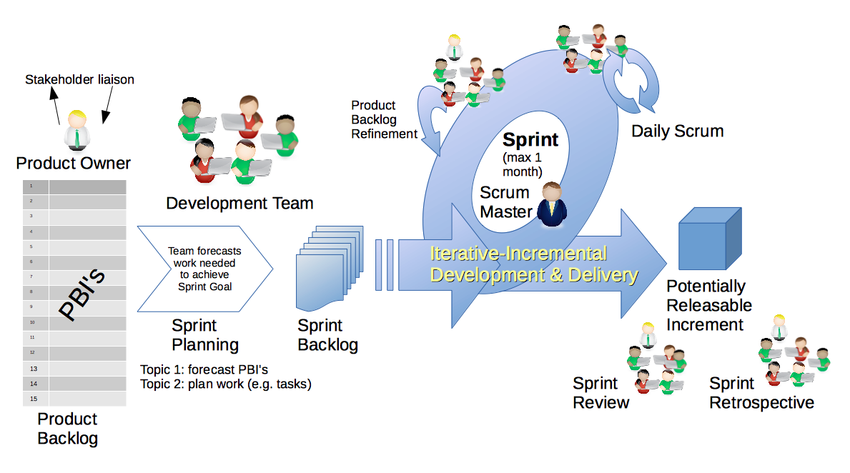
Scrum Process – Sprint Retrospective
By Dr ian mitchell - Own work, CC BY-SA 4.0, Link
Notes:
Calendar, Activities List, and Assignments

Slide 6
Continue: Submitting Assignments On Time

Slide 7
Feedback?

Slide 8
Upcoming Demos for Thursday
Demos will be the first Thursday of each sprint.

Slide 9
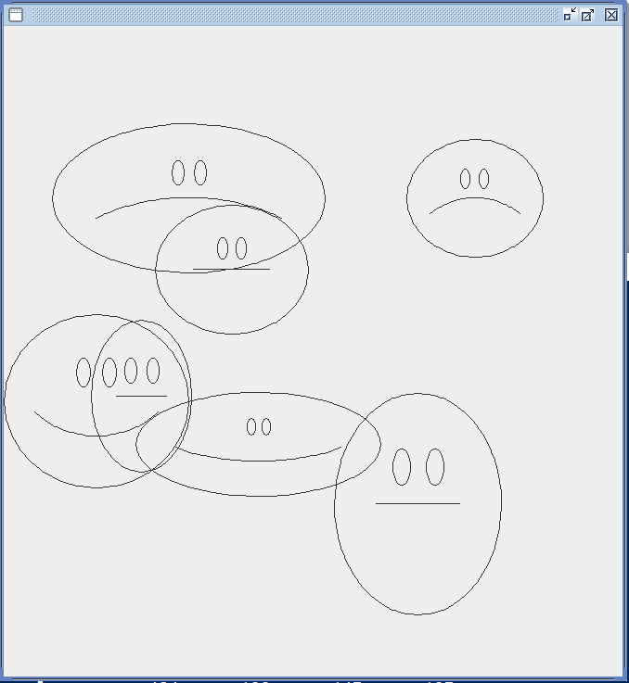
Foreshadowing FaceDraw
In the sprint 3 FaceDraw assignment, you will need to:
Create a graphical Java application
Draw 3 to 10 random faces on a window
Make each face a random width and height
Give each face a random emotion
Make it all visually appealing
And more
It will be challenging!

Slide 10
Scrum Process & Roles – Sprint Planning
By Dr ian mitchell - Own work, CC BY-SA 4.0, Link

Slide 11
Assignment
Complete Activities List items through item 6
Be ready for Sprint 1 demos (prework includes Class Forum postings)
Be ready to complete DB2 as a team
Notes:
Grace period until Monday morning a 6am CT

Slide 12
Lab
As A Team:
Complete a thorough review of the Sprint 2 Activities List and Assignments
Draw a UML class diagram that represents and apple watch
Optional coding together with BMI Calc Plus, Coding Standards, and Git/GitHub
Or start working on Programming Assignment 2
Team report out by Scrum Master
Report Out Guidelines
Scrum Master stand up, give your name, your team name, and briefly answer the following questions:
What did you accomplish since the last meeting? And what will you be working on until the next meeting?
Is the team committed to completing assignments? All/Most/Some
What is getting in your way or keeping you from completing the assignments?

Slide 13

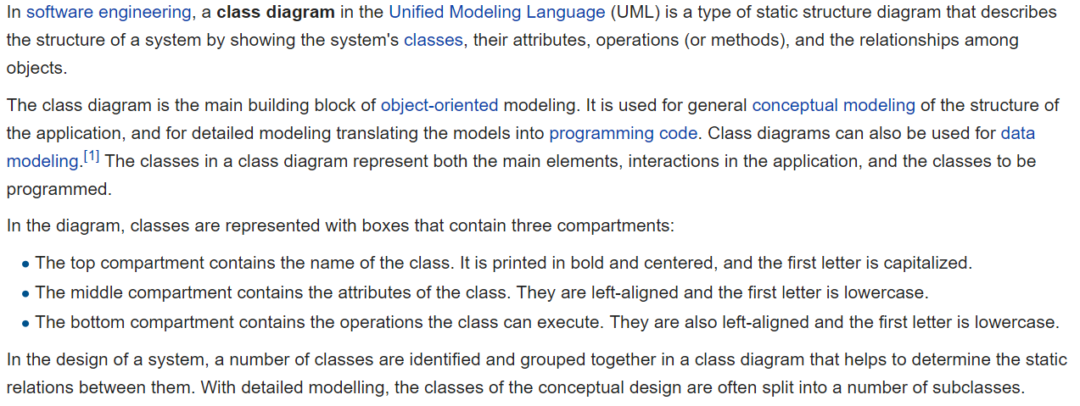
UML Class Diagram [link]

Slide 14
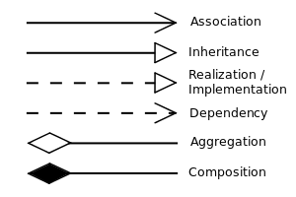


UML Class Diagram (continued) [link]

Slide 15
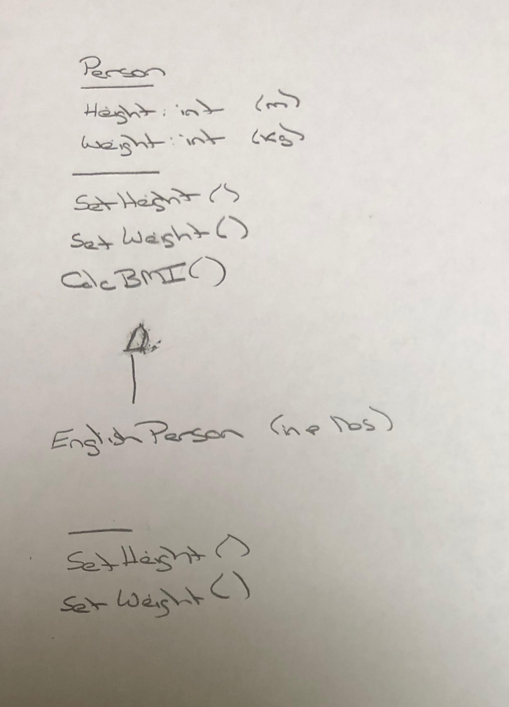
UML – BMI Calculator Plus

Slide 16
Git & GitHub… Configuration Management
Source code control is Part of Configuration Management. Professional organizations often feel new software developers do not get enough experience with Configuration Management in college.
Git & GitHub can play a central role in:
Allowing a team to collectively share and manage code
Managing the master copy of your source code
Providing a “safety net” while you are programming… allowing you to be bold in your programming
Submitting project code for class
Deploying code to test or production environments

Slide 17
Coding Standards
Our Java coding standards will include:
Only submit (or version control) README.md file, license file, plus the source code files required to compile and execute the application (i.e. no class files)
When submitting a zip file, the zip file should include all files in the “root” folder (no subfolders)
Each Java Class should be in its own Java file
CamelCase naming conventions with Classes starting with a capital letter and methods/variables starting with lower case letters
Descriptive class, method, and variable naming with appropriate comments and no commented-out code in the submitted assignments
UTF-8 text files, only tabs (no spaces) at the beginning of lines, and only line feeds (LF, /n) at the end of the line
README.md file includes clear and concise build/execute instructions
Valuable but conservative use of comments and a Javadoc compatible author statement

Slide 18
Git and GitHub Commands
Git is a rich and powerful tool. Today we are going to be focused on utilizing some of the basic Git commands as well as branching commands. These commands include:
git clone & git pull
git add
git commit [-a -m “Update file.”]
git branch
git checkout
git merge
git push
Pattern:
git branch f-0x
git checkout f-0x
git commit -a -m “Implement f-0x”
git checkout master
git merge f-0x
git push

Slide 19
End of Session

