Slide 1

Object-Oriented Programming Discussion, Lecture, & Lab Eric Pogue
Agenda for Thursday, February 20th
Friendly Conversation Topic
Prework & Announcements
Q&A for Sprint 3
Assignment for Next Class
Lab
Discussion & Questions welcome at any time… please be present with no phones or email during our time together

Slide 2
Friendly Conversation Topic

Slide 3
Network Architecture & Protocols – Part 3

Slide 4
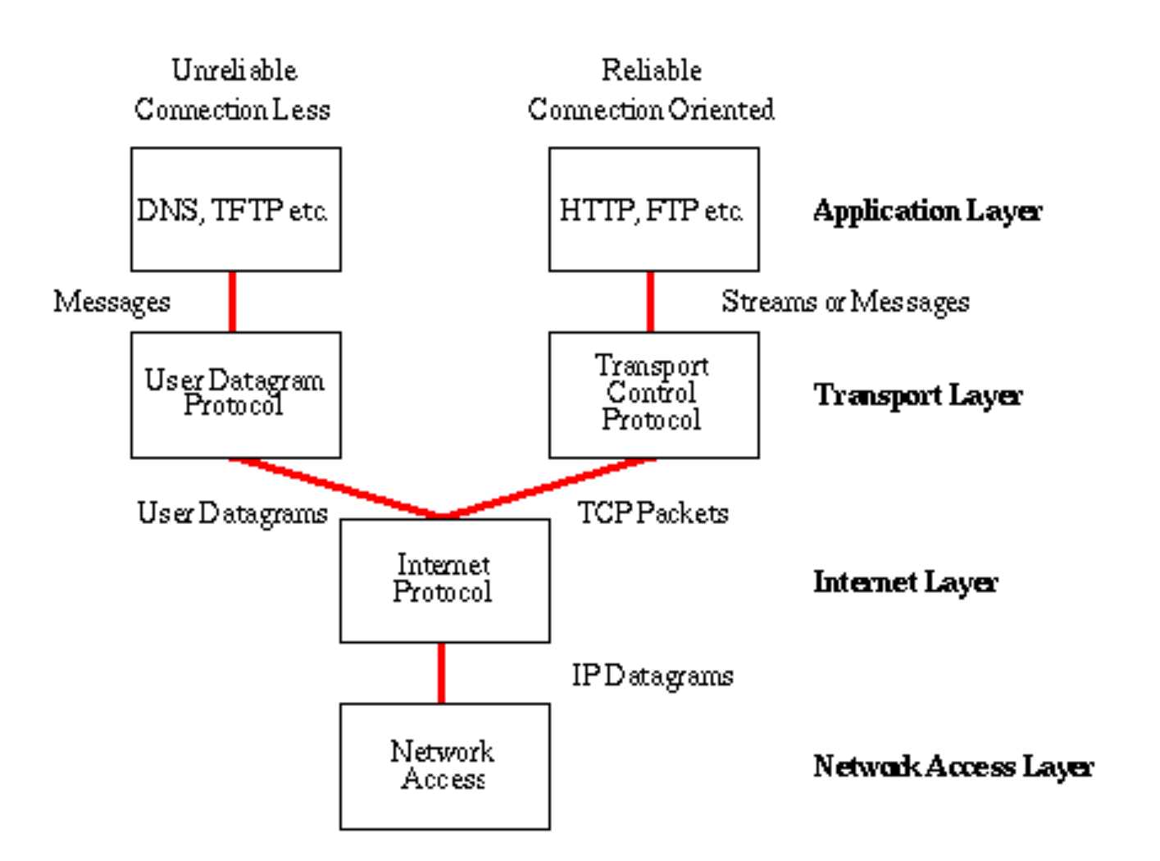
Network Architecture – The Internet
The Internet [link]
IP (Internet Protocol) [link]
TCP (Transmission Control Protocol) [link]
TCP/IP
UDP (User Datagram Protocol) [link]
UDP/IP
TCP/IP or UDP/IP Socket [link]
TCP and UDP Protocols & Port Numbers [link]

Slide 5
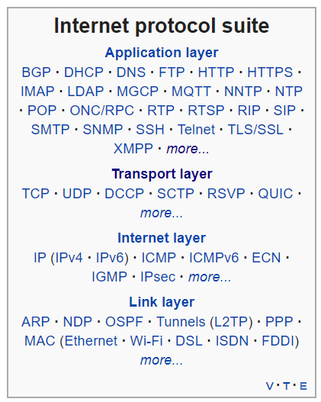
Network Architecture – The Web
The Web [link]
HTTP (Hypertext Transfer Protocol) [link]
DNS (Domain Name System) [link]
HTML (Hypertext Markup Language) [link]
CSS (Cascading Style Sheets) [link]
JavaScript [link]
Internet Protocol Suite [link]

Slide 6
Network Architecture – Distributed Computing
RPC (Remote procedure call) [link]
… SOA (service-oriented architecture) version 1
Java RMI (Java remote method invocation) [link]
DCOM (Distributed Component Object Model) [link]
CORBA (Common Object Request Broker Architecture) [link]
… [The Web takes over the world]
XML (Extensible Markup Language) [link]
XML-RPC (XML & HTTP) [link]
Internet Protocol Suite [link]

Slide 7
Network Architecture – Web Services
Web Services [link]
…SOA (service-oriented architecture) version 2
XML (Extensible Markup Language) [link]
XML-RPC (XML & HTTP) [link]
SOAP (Simple Object Access Protocol) [link]
JSON (JavaScript Object Notation) [link]
REST (Representational State Transfer) [link]
Internet Protocol Suite [link]

Slide 8
Network Architecture – Back to the Future
Web Services [link]
…SOA (service-oriented architecture) version 2 [link]
JSON (JavaScript Object Notation) [link]
REST (Representational State Transfer) [link]
gRPC [link] Or https://grpc.io/faq/
REST vs gRPC
REST vs. gRPC: Battle of the APIs [link]
Evaluating Performance of REST vs. gRPC [link]
Internet Protocol Suite [link]

Slide 9
Prework & Announcements
ALL Sprint 3 Assignments & Activity List Items are due Sunday.
FaceDraw v2 complete by the start of class on Thursday, February 20th
Notes:
Grace period until Monday morning a 6am CT

Slide 10
Q&A for Sprint 3

Slide 11
Assignment
ALL Sprint 3 Assignments & Activity List Items are due Sunday.
FaceDraw v2 complete by the start of class on Thursday, February 20th
Notes:
Grace period until Monday morning a 6am CT

Slide 12
Lab
As A Group:
FaceDraw, FaceDraw, and more FaceDraw
Report Out Guidelines
Scrum Master stand up, give your name, your team name, and briefly answer the following questions:
What did you accomplish since the last meeting? And what will you be working on until the next meeting?
Is the team committed to completing assignments? All/Most/Some
What is getting in your way or keeping you from completing the assignments?

Slide 13
End of Session

