Slide 1

Object-Oriented Programming Week 1 Session 2 Eric Pogue
Agenda:
Assignment Review through Scrum of Scrums Stand-up
Friendly Conversation & Good Natured Banter… Gytis?
Your Introductions
Introduction to Object-Oriented Programming
Assignment
Lab
Wrap-up
Discussion & Questions welcome at any time… please be present with no phones or email during our discussion time
Notes:
*Your opportunity to give introductions will come after the syllabus overview.
Lab Time needs to start no later than 2:40 today… please help me keep us on track

Slide 2
Assignment Review through Scrum of Scrums Standup
Prior to class on Thursday:
View and reflect on “Introduction to Scrum in 7 Minutes” video [link]
Install/implement MS PowerShell [link]
Install Git Client [link]
Utilize (local) Git Client to create, update, branch, and merge a local project utilizing a beginners level tutorial… one option would be “An Intro to Git and GitHub for Beginners” [link]
Estimate: 3 hours… “Fist of Five” Agile polling

Slide 3
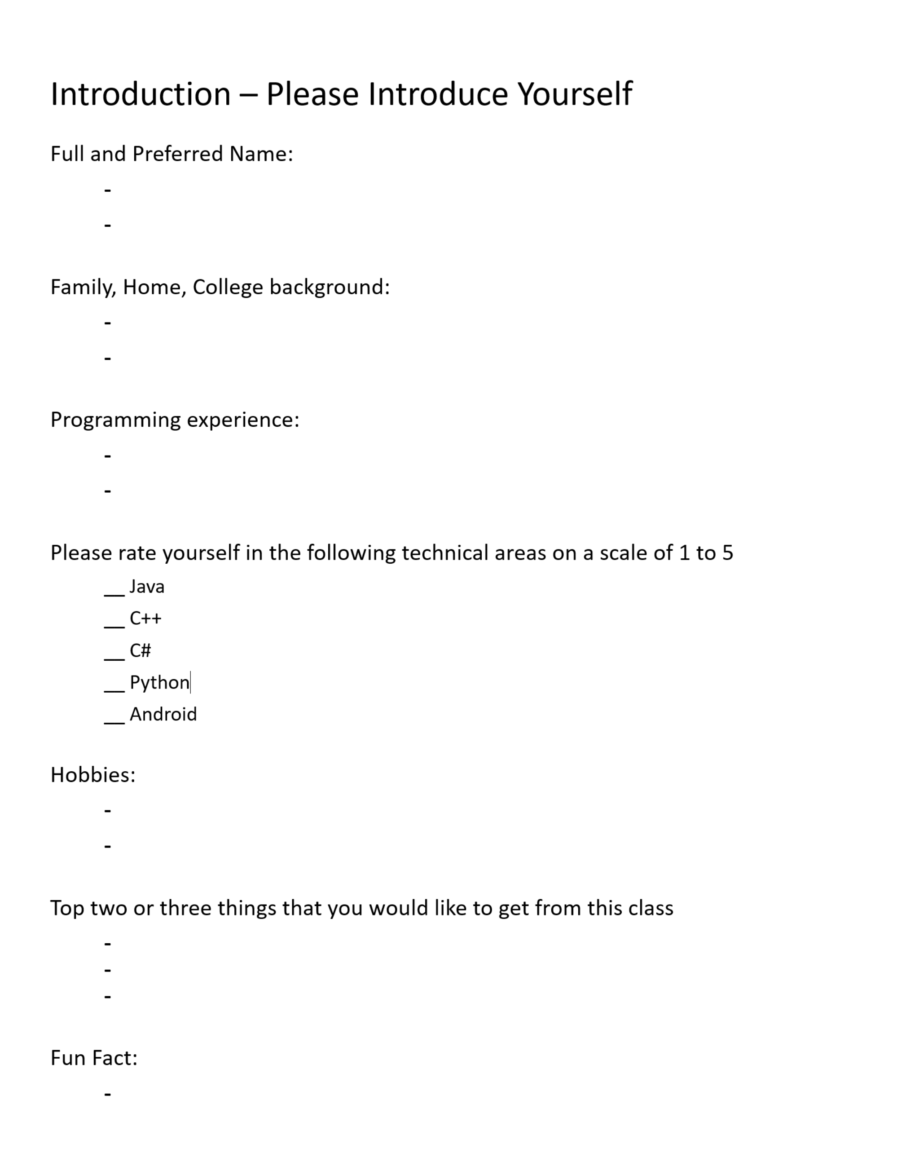
Your Time for Introductions… and Name Cards

Slide 4
Introduction to Object-Oriented Programming
Notes:
Optimism, good natured humor, and effectively working together is immensely important to delivering good software… and likely equally important to delivering just about any quality product
Even if you don’t intend to be a professional software developer, many of the things that we learn will be valuable in related areas.
Soooo… We have 16 weeks to learn something valuable and interesting. Let’s enjoy our time together and make the most out of it.

Slide 5
Assignment
Prior to class on Tuesday:
Complete Discussion Board “Introduction” before you leave class today
Be prepared to discuss our Introduction to Object-Oriented Programming Introduction slides for Sessions 1 & 2
Install MS PowerPoint & MS Word Viewers (if you do not have access to the full products)
Setup a GitHub account with a Student Developer Pack/Plan [link]
Utilize Git & GitHub to create, update, branch, and merge both local and remote projects utilizing several tutorials including:
“An Intro to Git and GitHub for Beginners” [link]
The GitHub “Hello World” [link]
Be prepared to install Java command line tools and to create “Hello World” for Java
Estimate: 3 hours… “Fist of Five” Agile polling
Notes:
Discussion Board postings and Responses are an ongoing backlog item that is expected to be completed outside of class

Slide 6
Lab (report-out at 3:12)
Lab Agenda:
Rebalance Scrum teams so that they have at least 3 team members and an adequate mix of skills and skill levels ~5mim
Elect or reconfirm Scrum Master for at least the next four weeks ~1min
Revisit team name and adjust or enhance as you see fit ~1min
Review and work on Assignment
Perform a team “Fist of Five” polling on the Assignment
Be ready for report-out
Optionally, continue to assist each other with today’s assignment outside of class

Slide 7
Wrap-up
Notes:
Who will volunteer to bring us a “Friendly Conversation” topic Thursday?

Slide 8
End of Session

Slide 9
How to Be a Successful Programmer
Top-ten list on how to be a successful programmer, and successfully complete course project:
Start early on project assignments
Establish a physical work environment that allows you to focus for extended periods of time
Become comfortable with your development environment/tools
Read or re-read the project assignment and related materials
Suggest changes to the assignment if you feel there is a better (or more entertaining) way
Save and deploy working versions of your project regularly… this allows you to experiment without risking what you have already accomplished
Ask for help if you are stuck… often simply articulating the problem/question will lead you to finding your own answer
Look for similar examples… but write your own code that you understand
Come to class and participate in class exercises… ask questions during or after class
Review the textbook and review the lecture slides
Notes:
In my opinion programming and software development is a creative and analytical group activity.

