Slide 1

Object-Oriented Programming Week 3 Session 1 Eric Pogue
Agenda:
Review assignment commitment and provide status update through Scrum of Scrums stand-up
JSON Demo… Thank you, Tyler!
More Object-Oriented Programming (OOP)
Assignment
Lab
Lab Report-out & Wrap-up
Discussion & Questions welcome at any time… please be present with no phones or email during our discussion time
Notes:
*Your opportunity to give introductions will come after the syllabus overview.
Lab Time needs to start no later than 2:40 today… please help me keep us on track

Slide 2
Assignment
Review Sprint 1 timeline, cut line, and status:
Submit your Discussion Board (DB) responses before you leave class today
Install Java command line tools and create “Hello World” for Java [link]
Read and be prepared to discuss our Introduction to Object-Oriented Programming Introduction slides
Read: “What is JSON? JavaScript Object Notation explained” [link]
Read: “JSON Introduction” from W3C [link]
As a Team agree on a standard and extensible “My Information” JSON format and associated data requirements that include FirstName, LastName, PreferredName, TeamName, SeatLocation, and Roles* at a minimum
Complete Sprint 1 Quiz
Download class materials by performing: “git clone https://github.com/EricJPogue/sp18-cpsc-24500-001.git”
Individually setup a Microsoft Imagine Azure account [link]
Individually complete the Azure static website tutorial... leave the site in place [link]
Individually complete a “permanent” personal static website where you will initially host your “My Information” JSON file for this class utilizing the previous tutorial to create the new website

Slide 3
JSON Demo Thank you, Tyler!
Notes:
Starting with Slide 29

Slide 4
Introduction to Object-Oriented Programming
Notes:
Starting with Slide 29

Slide 5
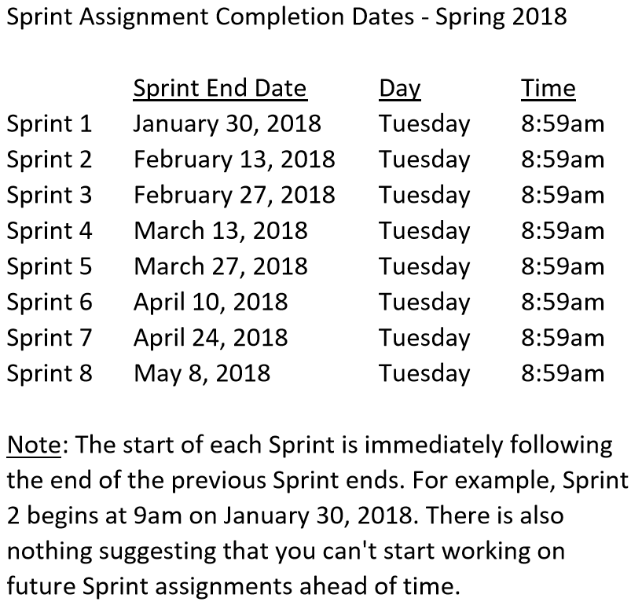

Slide 6
Assignment
Sprint 2 Week 1 Items:
Carry-over items from Sprint 1
As a Class agree on a standard and extensible “My Information” JSON format and associated data requirements that include FirstName, LastName, PreferredName, TeamName, SeatLocation, and Roles* at a minimum
Individually setup a Microsoft Imagine Azure account [link]
Individually complete the Azure static website tutorial... leave the site in place [link]
Individually complete a “permanent” personal static website where you will initially host your “My Information” JSON file for this class utilizing the previous tutorial to create the new website
Pull (or “re-clone”) class content site, review “source” folder projects, and compile/run each sample: “git clone https://github.com/EricJPogue/sp18-cpsc-24500-001.git”

Slide 7
Lab (report-out at 3:08)
Lab Agenda:
Briefly review Scrum team assignments
Display Team name card
Discuss current status and commitment for the rest of Sprint 1 (Tuesday 9am)
Determine Team Sprint 1 cut-line
Work on assignments
Be ready for report-out

Slide 8
Lab Report-out & Wrap-up
Notes:
Who will volunteer to bring us a “Friendly Conversation” topic Thursday?

Slide 9
End of Session

Slide 10
Previous Assignments

Slide 11
Assignment Review through Scrum of Scrums Standup
Prior to class on Tuesday:
Complete Discussion Board “Introduction” before you leave class today
Be prepared to discuss our Introduction to Object-Oriented Programming Introduction slides for Sessions 1 & 2
Install MS PowerPoint & MS Word Viewers (if you do not have access to the full products)
Setup a GitHub account with a Student Developer Pack/Plan [link]
Utilize Git & GitHub to create, update, branch, and merge both local and remote projects utilizing several tutorials including:
“An Intro to Git and GitHub for Beginners” [link]
The GitHub “Hello World” [link]
Be prepared to install Java command line tools and to create “Hello World” for Java
Estimate: 3 hours… “Fist of Five” Agile polling
Notes:
Discussion Board postings and Responses are an ongoing backlog item that is expected to be completed outside of class

Slide 12
Assignment
Review timeline, cut line, and status:
Submit your Discussion Board (DB) responses before you leave class today
Install Java command line tools and create “Hello World” for Java [link]
Read and be prepared to discuss our Introduction to Object-Oriented Programming Introduction slides
Read: “What is JSON? JavaScript Object Notation explained” [link]
Read: “JSON Introduction” from W3C [link]
As a Team agree on a standard and extensible “My Information” JSON format and associated data requirements that include FirstName, LastName, PreferredName, TeamName, SeatLocation, and Roles* at a minimum
Individually setup a Microsoft Imagine Azure account [link]
Individually complete the Azure static website tutorial... leave the site in place [link]
Individually complete a “permanent” personal static website where you will host your “My Information” JSON file for this class utilizing the previous tutorial to create the new website

