Slide 1

Object-Oriented Programming Week 3 Session 2 Eric Pogue
Agenda:
Scrum Standup and Scrum-of-Scrums Report-out
A/V Soundcheck Assistant… https://www.join.me/ericjpogue
Demo: JSON… Thank you, Tyler!
Demo: UML Phone Diagram?
Assignment/Quiz Comments
Discussion Board Questions/Comments
Quick Review of More Object-Oriented Programming (OOP)
Interactive OOP Coding
Lab
Lab Report-out & Wrap-up
Discussion & Questions welcome at any time… please be present with no phones or email during our discussion time
Notes:
*Your opportunity to give introductions will come after the syllabus overview.
Lab Time needs to start no later than 2:40 today… please help me keep us on track

Slide 2
“Completed” Assignment
Review Sprint 1 status:
Submit your Discussion Board (DB) responses before you leave class today
Install Java command line tools and create “Hello World” for Java [link]
Read and be prepared to discuss our Introduction to Object-Oriented Programming Introduction slides
Read: “What is JSON? JavaScript Object Notation explained” [link]
Read: “JSON Introduction” from W3C [link]
As a Team agree on a standard and extensible “My Information” JSON format and associated data requirements that include FirstName, LastName, PreferredName, TeamName, SeatLocation, and Roles* at a minimum
Complete Sprint 1 Quiz
Download class materials by performing: “git clone https://github.com/EricJPogue/sp18-cpsc-24500-001.git”
Individually setup a Microsoft Imagine Azure account [link]
Individually complete the Azure static website tutorial... leave the site in place [link]
Individually complete a “permanent” personal static website where you will initially host your “My Information” JSON file for this class utilizing the previous tutorial to create the new website

Slide 3
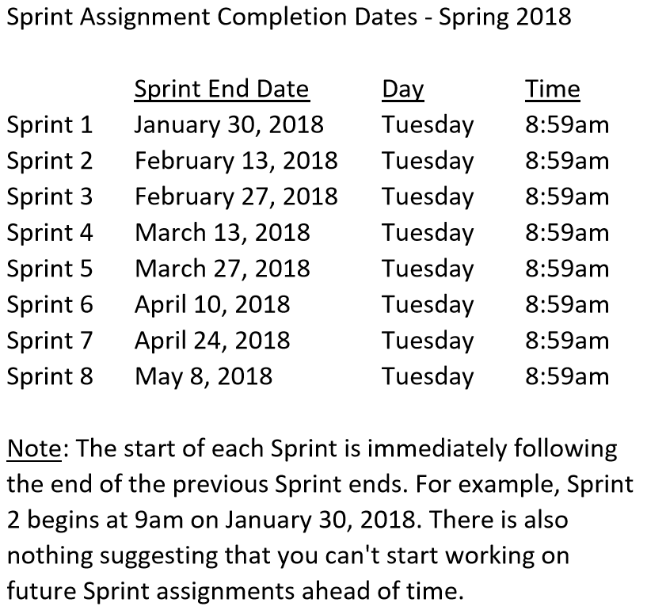

Slide 4
Assignment
Sprint 2 Week 1 Items:
Carry-over items from Sprint 1 if any
As a Class agree on a standard and extensible “My Information” JSON format and associated data requirements that include FirstName, LastName, PreferredName, TeamName, SeatLocation, and Roles* at a minimum
Individually setup a Microsoft Imagine Azure account [link]
Individually complete the Azure static website tutorial... leave the site in place [link]
Individually complete a “permanent” personal static website where you will initially host your “My Information” JSON file for this class utilizing the previous tutorial to create the new website
Pull (or “re-clone”) class content site, review “source” folder projects, and compile/run each sample: “git clone https://github.com/EricJPogue/sp18-cpsc-24500-001.git”

Slide 5
Scrum Team Standup
The “daily” scrum meeting is not used as a problem-solving or issue resolution meeting. Issues that are raised are taken offline and usually dealt with by the relevant subgroup immediately after the meeting. During the daily scrum, each team member answers the following three questions:
What did you do since our last standup?
What will you do before our next standup?
Are Items 1-8 from Sprint 1 Done?... Please be transparent.
Are there any impediments in your way?

Slide 6
Scrum-of-Scrums Report-out
Repeat: The “daily” scrum meeting is not used as a problem-solving or issue resolution meeting. Issues that are raised are taken offline and usually dealt with by the relevant subgroup immediately after the meeting. During the daily scrum, each team member answers the following three questions:
What did you do since our last standup?
What will you do before our next standup?
Are Items 1-8 from Sprint 1 Done?
Are there any impediments in your way that you need help from outside the Team to resolve?

Slide 7
JSON Demo Thank you, Tyler!
Notes:
Starting with Slide 29

Slide 8
UML Phone Demo?
Notes:
Starting with Slide 29

Slide 9
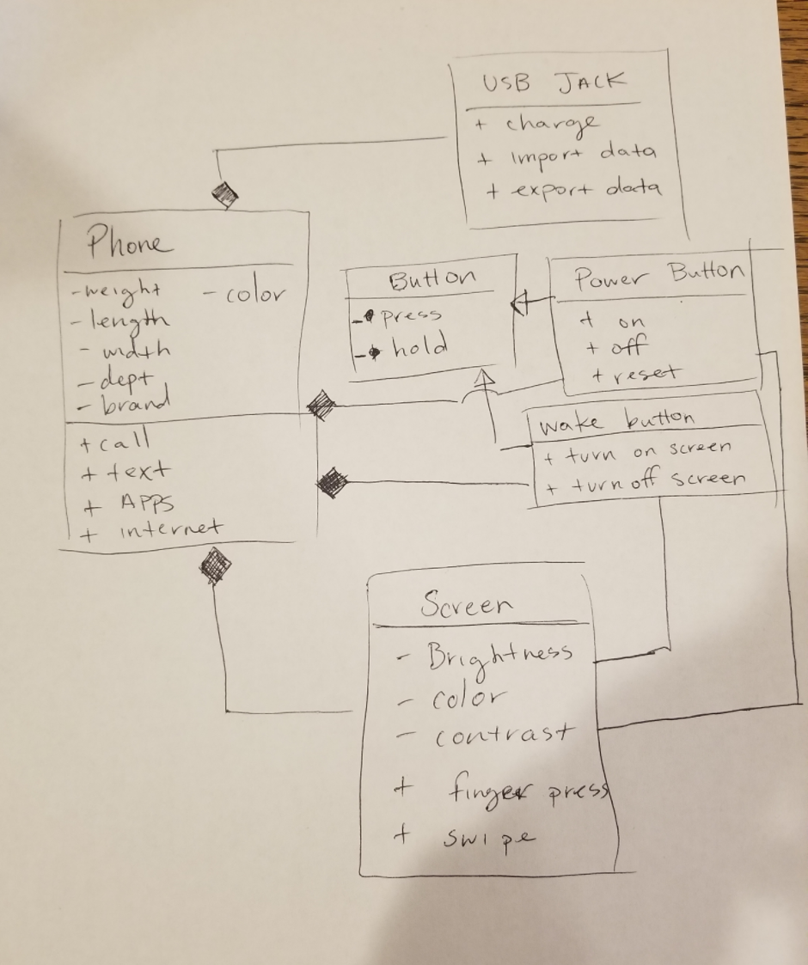

Slide 10
Quick Review of More Object-Oriented Programming (OOP)
Notes:
Starting with Slide 29

Slide 11
Assignment (repeated)
Sprint 2 Week 1 Items:
Carry-over items from Sprint 1
As a Class agree on a standard and extensible “My Information” JSON format and associated data requirements that include FirstName, LastName, PreferredName, TeamName, SeatLocation, and Roles* at a minimum
Individually setup a Microsoft Imagine Azure account [link]
Individually complete the Azure static website tutorial... leave the site in place [link]
Individually complete a “permanent” personal static website where you will initially host your “My Information” JSON file for this class utilizing the previous tutorial to create the new website
Pull (or “re-clone”) class content site, review “source” folder projects, and compile/run each sample: “git clone https://github.com/EricJPogue/sp18-cpsc-24500-001.git”

Slide 12
Lab (report-out at 3:10)
Lab Agenda:
Work on Sprint 2 assignments

Slide 13
Lab Report-out & Wrap-up

Slide 14
End of Session

Slide 15
Previous Assignments

Slide 17
Assignment Review through Scrum of Scrums Standup
Prior to class on Tuesday:
Complete Discussion Board “Introduction” before you leave class today
Be prepared to discuss our Introduction to Object-Oriented Programming Introduction slides for Sessions 1 & 2
Install MS PowerPoint & MS Word Viewers (if you do not have access to the full products)
Setup a GitHub account with a Student Developer Pack/Plan [link]
Utilize Git & GitHub to create, update, branch, and merge both local and remote projects utilizing several tutorials including:
“An Intro to Git and GitHub for Beginners” [link]
The GitHub “Hello World” [link]
Be prepared to install Java command line tools and to create “Hello World” for Java
Estimate: 3 hours… “Fist of Five” Agile polling
Notes:
Discussion Board postings and Responses are an ongoing backlog item that is expected to be completed outside of class

Slide 18
Assignment
Review timeline, cut line, and status:
Submit your Discussion Board (DB) responses before you leave class today
Install Java command line tools and create “Hello World” for Java [link]
Read and be prepared to discuss our Introduction to Object-Oriented Programming Introduction slides
Read: “What is JSON? JavaScript Object Notation explained” [link]
Read: “JSON Introduction” from W3C [link]
As a Team agree on a standard and extensible “My Information” JSON format and associated data requirements that include FirstName, LastName, PreferredName, TeamName, SeatLocation, and Roles* at a minimum
Individually setup a Microsoft Imagine Azure account [link]
Individually complete the Azure static website tutorial... leave the site in place [link]
Individually complete a “permanent” personal static website where you will host your “My Information” JSON file for this class utilizing the previous tutorial to create the new website

Slide 19
Assignment
Review Sprint 1 status:
Submit your Discussion Board (DB) responses before you leave class today
Install Java command line tools and create “Hello World” for Java [link]
Read and be prepared to discuss our Introduction to Object-Oriented Programming Introduction slides
Read: “What is JSON? JavaScript Object Notation explained” [link]
Read: “JSON Introduction” from W3C [link]
As a Team agree on a standard and extensible “My Information” JSON format and associated data requirements that include FirstName, LastName, PreferredName, TeamName, SeatLocation, and Roles* at a minimum
Complete Sprint 1 Quiz
Download class materials by performing: “git clone https://github.com/EricJPogue/sp18-cpsc-24500-001.git”
Individually setup a Microsoft Imagine Azure account [link]
Individually complete the Azure static website tutorial... leave the site in place [link]
Individually complete a “permanent” personal static website where you will initially host your “My Information” JSON file for this class utilizing the previous tutorial to create the new website

