Slide 1

Object-Oriented Programming Week 7 Session 2 Eric Pogue
Agenda:
Assignment Review, Scrum Standup, and Scrum-of-Scrums Report-out
FaceDraw Discussion & Feedback
Review Sprint 4 Assignment/Quiz
Coming soon: Mosaic Assignment
Demos?
Lecture: Interactive User Interfaces
Lab
Wrap-up
Discussion & Questions welcome at any time… please be present with no phones or email during our discussion time

Slide 2
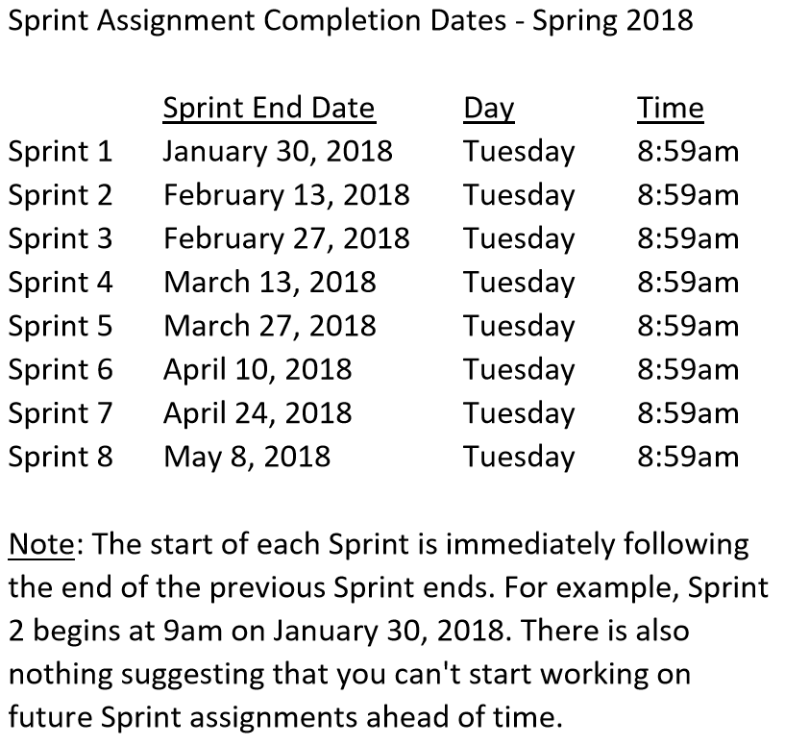

Slide 3
Assignment
Due Thursday, March 13 at 9am:
Complete Sprint 3 Assignment/Quiz… is there anything missing from the Assignment/Quiz
Start working on Mosaic

Slide 4
Scrum Team Standup & Report-out
The “daily” scrum meeting is not used as a problem-solving or issue resolution meeting. Issues that are raised are taken offline and usually dealt with by the relevant subgroup immediately after the meeting. During the daily scrum, each team member answers the following three questions:
What did you do since our last standup?
What will you do before our next standup?
Are there any impediments in your way?

Slide 5
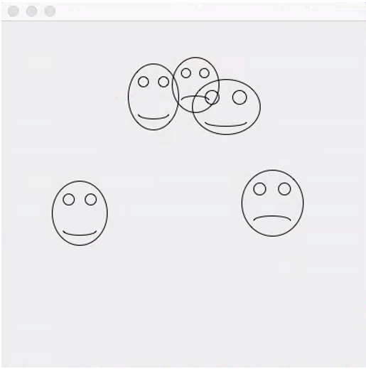
FaceDraw Discussion & Feedback
FaceDraw and Learning Objectives: FaceDraw will be a challenging assignment this week. Our Learning Objects, Discussion, Lecture, and Examples will all be focused on helping you complete the assignment and learn the key concepts through delivering a concrete example.
In FaceDraw we will:
Create an application in Java that draws random faces on a window
Generate a random number between 3 & 10 and draw that many faces
Randomly generate reasonable and visually appealing face
Position itself to a reasonable size and location
Draw all faces so they are entirely within the window.
Draw each face with two eyes and a mouth.
The mouth should be randomly smiling, frowning, or in-between
Notes:
I’m looking for your feedback!

Slide 6
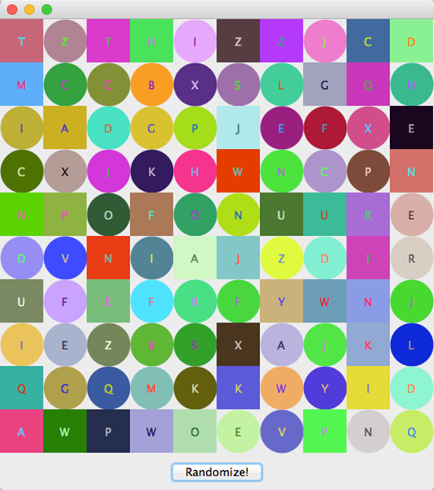
Review Mosaic Assignment
Mosaic and Learning Objectives: Mosaic will likely not be as challenging for you as FaceDraw was last week. Most of the elements that we will need for Mosaic we already learned last week. Therefore, this week’s objectives will be more forward looking.
In Mosaic we will:
Draw a set of random tiles
Draw random shapes, letters, and colors
Respond to a “Randomize” button
Display a new set of random tiles when the button is pushed
Implement a interesting and unique feature of our own choosing
Note: More details are available our W4Assignment document.
Notes:
Less theory and more practical development…

Slide 7
Learning Objectives
Explain the difference between lightweight and heavyweight components
Identify lightweight and heavyweight components
Describe how lightweight and heavyweight components render themselves
Identify layout managers for heavyweight and lightweight components
Explain what a layout manager does and identify and describe three of them
Explain how to achieve true Model-View-Controller architecture by removing any reference from the view to the model and from the model to the view
Distinguish between extending a class and implementing an interface
Explain multiple ways to implement an event handler for a particular object and event (anonymous inner classes vs. named classes vs. having the frame itself serve as the handler)
Create an event handler that implements the ActionListener interface to respond to the user clicking on a button
Use paint and paintComponent's Graphics object to draw a variety of shapes

Slide 8
Lab

Slide 9
Lab (report-out at 3:08)
Lab Activities:
I need two or three volunteers to demo their FaceDraw application… you can record it and submit the recording if you prefer
Complete initial Sprint 4 Discussion Board (DB) post… during class
Submit ALL completed Demos… during class
Review and/or Implement ButtonClick application

Slide 10
Wrap-up

Slide 11
End of Session

Slide 12
Previous Assignments and Backup Slides

Slide 14
Assignment Review through Scrum of Scrums Standup
Prior to class on Tuesday:
Complete Discussion Board “Introduction” before you leave class today
Be prepared to discuss our Introduction to Object-Oriented Programming Introduction slides for Sessions 1 & 2
Install MS PowerPoint & MS Word Viewers (if you do not have access to the full products)
Setup a GitHub account with a Student Developer Pack/Plan [link]
Utilize Git & GitHub to create, update, branch, and merge both local and remote projects utilizing several tutorials including:
“An Intro to Git and GitHub for Beginners” [link]
The GitHub “Hello World” [link]
Be prepared to install Java command line tools and to create “Hello World” for Java
Estimate: 3 hours… “Fist of Five” Agile polling
Notes:
Discussion Board postings and Responses are an ongoing backlog item that is expected to be completed outside of class

Slide 15
Assignment
Review timeline, cut line, and status:
Submit your Discussion Board (DB) responses before you leave class today
Install Java command line tools and create “Hello World” for Java [link]
Read and be prepared to discuss our Introduction to Object-Oriented Programming Introduction slides
Read: “What is JSON? JavaScript Object Notation explained” [link]
Read: “JSON Introduction” from W3C [link]
As a Team agree on a standard and extensible “My Information” JSON format and associated data requirements that include FirstName, LastName, PreferredName, TeamName, SeatLocation, and Roles* at a minimum
Individually setup a Microsoft Imagine Azure account [link]
Individually complete the Azure static website tutorial... leave the site in place [link]
Individually complete a “permanent” personal static website where you will host your “My Information” JSON file for this class utilizing the previous tutorial to create the new website

Slide 16
Assignment
Review Sprint 1 status:
Submit your Discussion Board (DB) responses before you leave class today
Install Java command line tools and create “Hello World” for Java [link]
Read and be prepared to discuss our Introduction to Object-Oriented Programming Introduction slides
Read: “What is JSON? JavaScript Object Notation explained” [link]
Read: “JSON Introduction” from W3C [link]
As a Team agree on a standard and extensible “My Information” JSON format and associated data requirements that include FirstName, LastName, PreferredName, TeamName, SeatLocation, and Roles* at a minimum
Complete Sprint 1 Quiz
Download class materials by performing: “git clone https://github.com/EricJPogue/sp18-cpsc-24500-001.git”
Individually setup a Microsoft Imagine Azure account [link]
Individually complete the Azure static website tutorial... leave the site in place [link]
Individually complete a “permanent” personal static website where you will initially host your “My Information” JSON file for this class utilizing the previous tutorial to create the new website

Slide 17
Assignment
Review Sprint 1 status:
Install Java command line tools and create “Hello World” for Java [link]
Read and be prepared to discuss our Introduction to Object-Oriented Programming Introduction slides
Read: “What is JSON? JavaScript Object Notation explained” [link]
Read: “JSON Introduction” from W3C [link]
As a Team agree on a standard and extensible “My Information” JSON format and associated data requirements that include FirstName, LastName, PreferredName, TeamName, SeatLocation, and Roles* at a minimum
Complete Sprint 1 Quiz
Download class materials by performing: “git clone https://github.com/EricJPogue/sp18-cpsc-24500-001.git”

Slide 18
Assignment
Sprint 2 Items:
Carry-over items from Sprint 1 if any
As a Class agree on a standard and extensible “My Information” JSON format and associated data requirements that include FirstName, LastName, PreferredName, TeamName, SeatLocation, and Roles* at a minimum
Individually setup a Microsoft Imagine Azure account [link]
Individually complete the Azure static website tutorial... leave the site in place [link]*
Individually complete a “permanent” personal static website where you will initially host your “My Information” JSON file for this class utilizing the previous tutorial to create the new website
Pull (or “re-clone”) class content site, review “source” folder projects, and compile/run each sample: “git clone https://github.com/EricJPogue/sp18-cpsc-24500-001.git”
Discussion Board
Assignment / Quiz #2
*Note that to complete Item #4 the Azure static website tutorial you will likely need to setup a Pay-As-You-Go account in order to obtain storage for the Web Bash Shell.

