Slide 1

Object-Oriented Programming Spring 5 Session 2 Eric Pogue
Agenda:
Assignment Review, Scrum Standup, and Scrum-of-Scrums Report-out
FaceDraw Demos
Mosaic Assignment
Mosaic Lite
Lab
Wrap-up
Discussion & Questions welcome at any time… please be present with no phones or email during our discussion time

Slide 2
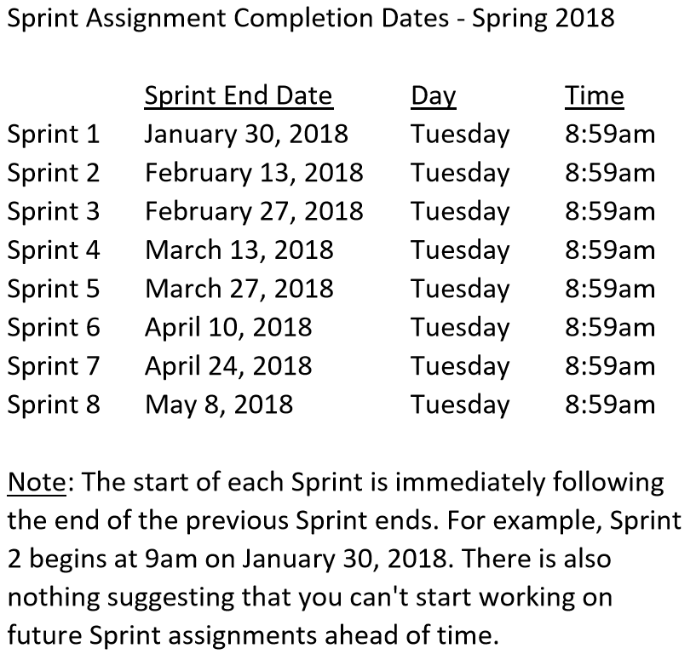

Slide 3
Scrum Team Standup & Report-out
The “daily” scrum meeting is not used as a problem-solving or issue resolution meeting. Issues that are raised are taken offline and usually dealt with by the relevant subgroup immediately after the meeting. During the daily scrum, each team member answers the following three questions:
What did you do since our last standup?
What will you do before our next standup?
Are there any impediments in your way?

Slide 4
FaceDraw Demos

Slide 5
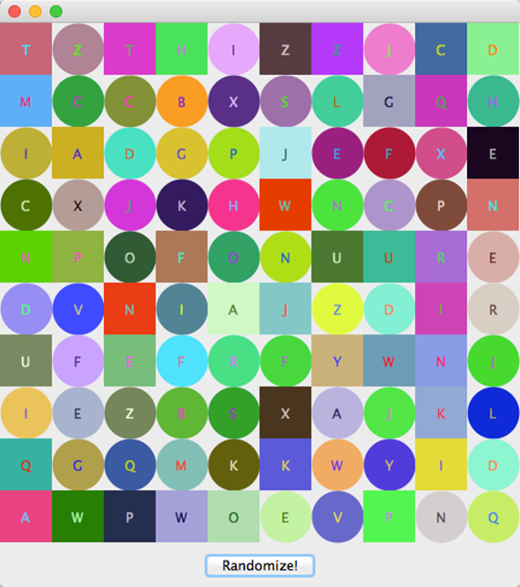
Review Mosaic Assignment Overview
Mosaic and Learning Objectives: Mosaic will likely not be as challenging for you as FaceDraw was last week. Most of the elements that we will need for Mosaic we already learned last week. Therefore, this week’s objectives will be more forward looking.
In Mosaic we will:
Draw a set of random tiles
Draw random shapes, letters, and colors
Respond to a “Randomize” button
Display a new set of random tiles when the button is pushed
Implement a interesting and unique feature of our own choosing
Note: More details are available our Assignment document.
Notes:
Less theory and more practical development…

Slide 6
Review Mosaic Assignment
Load external MS Word file for full assignment
Note that the official assignment will be part of the Sprint 5 Assignment / Quiz
Notes:
Less theory and more practical development…

Slide 7
Lab: Mosaic Lite

Slide 8
Wrap-up

Slide 9
End of Session

