Slide 1

Object-Oriented Programming Spring 6 Session 3 Eric Pogue
Agenda:
Assignment Review, Scrum Standup, and Scrum-of-Scrums Report-out
Assignment 6 and Thunderbird Discussion
Review Seat Location
Lab: ThunderbirdLite Video plus Individual Assistance
Wrap-up
Discussion & Questions welcome at any time… please be present with no phones or email during our discussion time

Slide 2
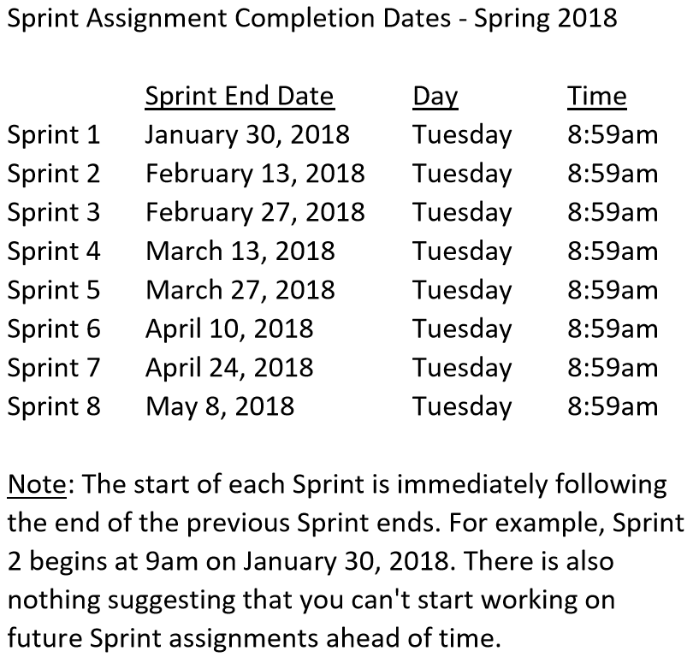

Slide 3
Scrum Team Standup & Report-out
The “daily” scrum meeting is not used as a problem-solving or issue resolution meeting. Issues that are raised are taken offline and usually dealt with by the relevant subgroup immediately after the meeting. During the daily scrum, each team member answers the following three questions:
What did you do since our last standup?
What will you do before our next standup?
Are there any impediments in your way?

Slide 4
Assignment 6 & Thunderbird Discussion

Slide 6
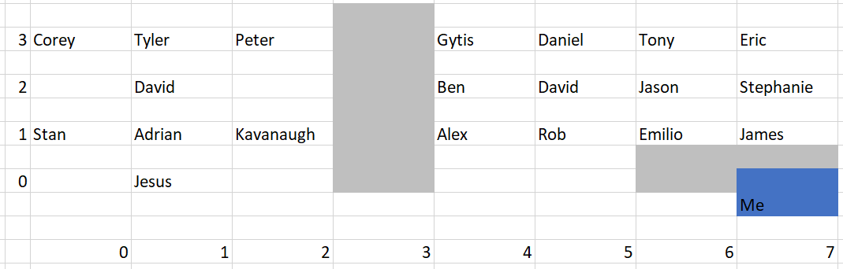
Finding Seat Location

Slide 7
Lab: ThunderbirdLite Video plus Individual Assistance

Slide 8
Wrap-up

Slide 9
End of Session

