Slide 1

Object-Oriented Programming Spring 6 Session 3 Eric Pogue
Agenda:
Assignment Review, Scrum Standup, and Scrum-of-Scrums Report-out
Review Object Oriented Languages: Java, C#/.Net, and Python
Assignment 6 and Thunderbird Discussion
Where are we heading?
Priorities
Lab: Threads and RandomNumbers
Wrap-up
Discussion & Questions welcome at any time… please be present with no phones or email during our discussion time

Slide 2
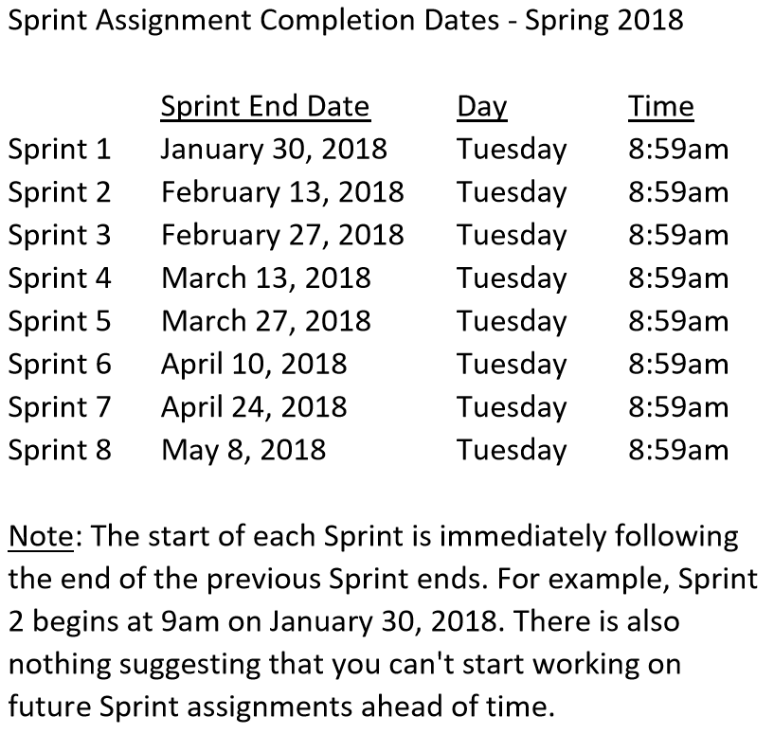

Slide 3
Scrum Team Standup & Report-out
The “daily” scrum meeting is not used as a problem-solving or issue resolution meeting. Issues that are raised are taken offline and usually dealt with by the relevant subgroup immediately after the meeting. During the daily scrum, each team member answers the following three questions:
What did you do since our last standup?
What will you do before our next standup?
Are there any impediments in your way?

Slide 4
Assignment 6 & Thunderbird Discussion

Slide 5
Object Oriented Languages: Java, C#/.Net, and Python

Slide 6
Where are we heading?

Slide 8
Where are we heading?
We have two Sprints left. Sprint 7 will be focused on enhancing Thunderbird with threads and UI improvements.
Sprint 8 will be a final project of your choice. The requirements include:
It must of equal or greater complexity to Thunderbird
It can be in Java or another Object-Oriented language of your choice… if you pick another language/platform, the application complexity can be substantially lower
Fully define your final project and “demo” the proposal to the class during Sprint 7
Optionally work in teams of up to 2 people… each person will submit the full proposal and final project independently (identify you full team however)
Demo/present the project before (or at) the time of our final… all presentations must be scheduled by the end of Sprint 7

Slide 9
Priorities
Get Thunderbird turned in today (Thursday) by 11:59pm… make sure that it compiles/runs, meets a most of the requirements
Define you your Final Project proposal and be ready to “demo” your proposal Tuesday (or Thursday) next week
Assignment 7 will be a reduced assignment but will still be due at the end of Sprint 7

Slide 10
Lab: Threads and RandomNumbers

Slide 11
Suggested Multithreaded Exercise
ThreadedRandomNumbers: Calculate 1,000,000,000 random numbers between 1 and 2,000,000. Print “We found number 1024!” to the console each time 1024 is generated. We would expect it to come up approximately 500 times.
Write a single threaded application
Divide the application into multiple threads and repeat
Consider the diminishing returns of adding additional threads
Implement by extending Thread
… and by extending Thread (vs. implementing Runnable)

Slide 12
Wrap-up

Slide 13
End of Session

