Slide 1

Object-Oriented Programming Sprint 8 Session 1 Eric Pogue
Agenda:
Assignment Review, Scrum Standup, and Scrum-of-Scrums Report-out
Assignment 7 and SwissArmyKnife Discussion
Final Project Demo Schedule plus Q&A
Object-Oriented Programming, Databases, and 3-tier /n-tier Architectures
Lab: Final Project
Discussion & Questions welcome at any time… please be present with no phones or email during our discussion time

Slide 2
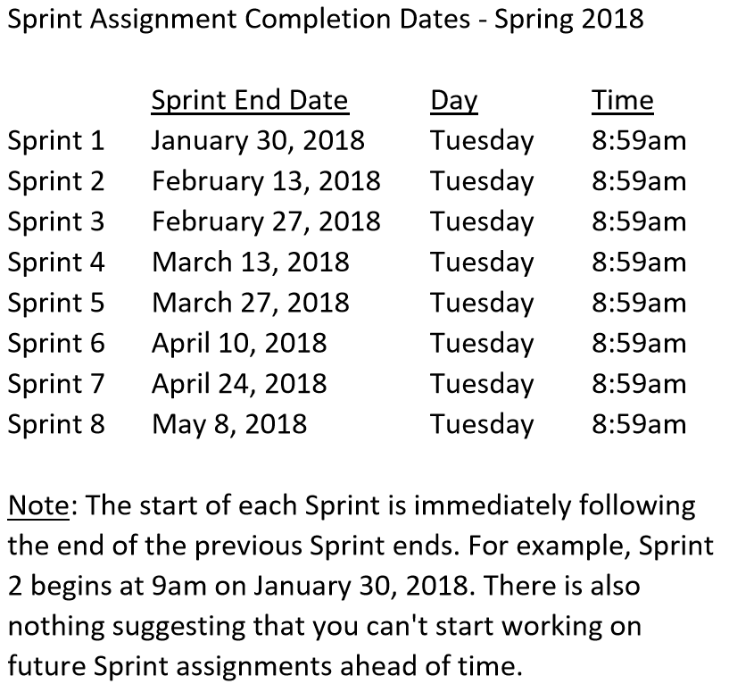

Slide 3
Scrum Team Standup & Report-out
The “daily” scrum meeting is not used as a problem-solving or issue resolution meeting. Issues that are raised are taken offline and usually dealt with by the relevant subgroup immediately after the meeting. During the daily scrum, each team member answers the following three questions:
What did you do since our last standup?
What will you do before our next standup?
Are there any impediments in your way?

Slide 4
Assignment 7 and SwissArmyKnife Discussion

Slide 5
Final Project Demo Schedule plus Q&A
Thursday, May 3:
Tyler
Peter
Dan & Gytis
James & Emilio
Stephanie & Jason
Thursday, May 8th at 2pm CST:
Robert
Jesus
Corey

Slide 6
Final Project Demo Schedule plus Q&A

Slide 7
Object-Oriented Programming, Databases, and 3-tier /n-tier Architectures

Slide 8
Lab: Final Project

Slide 9
End of Session

