Slide 1

Object-Oriented Programming Sprint 8 Session 2 Eric Pogue
Agenda:
Scrum Standup, and Scrum-of-Scrums Report-out
Assignment 8 and Discussion Board (DB) 8
Final Project Demo Schedule
Lab: Complete DB8 and Final Project
Discussion & Questions welcome at any time… please be present with no phones or email during our discussion time

Slide 2
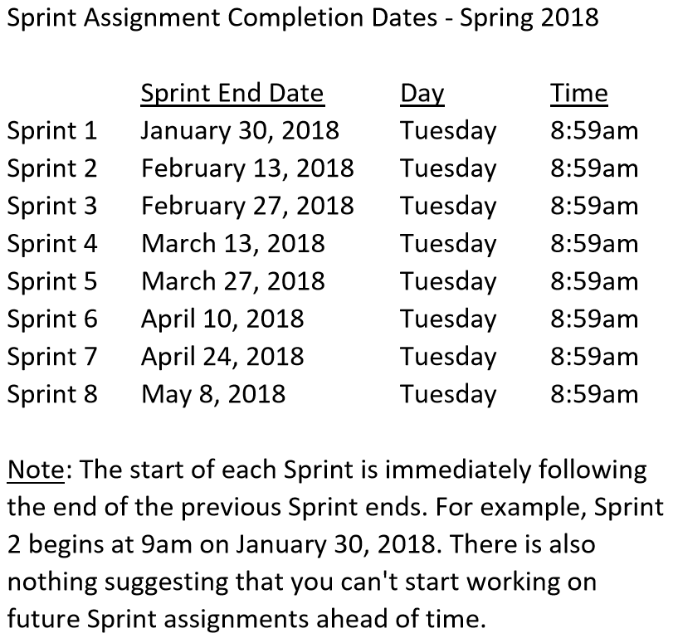

Slide 3
Scrum Team Standup & Report-out
The “daily” scrum meeting is not used as a problem-solving or issue resolution meeting. Issues that are raised are taken offline and usually dealt with by the relevant subgroup immediately after the meeting. During the daily scrum, each team member answers the following three questions:
What did you do since our last standup?
What will you do before our next standup?
Are there any impediments in your way?

Slide 4
Assignment 8 and Discussion Board 8

Slide 5
Final Project Demo Schedule
Thursday, May 3:
Tyler
Peter
Dan & Gytis
James & Emilio
Stephanie & Jason
Thursday, May 8th at 2pm CST:
Robert
Jesus
Corey
First Name | Last Name
Daniel | Budziak | Thursday, May 3rd
Adrian | De Guzman
Kavanaugh | Dempsey | Tuesday, April 24th
Benjamin | Gorgan
Gytis | Jankauskas | Thursday, May 3rd
James | Kaht | Thursday, May 3rd
David | Mendez | Tuesday, April 24th
Stanimir | Petrov
Stephanie | Quick | Thursday, May 3rd
Fidel | Ramirez
Corey | Rose | Tuesday, May 8th at 2pm
Emilio | Salinas | Thursday, May 3rd
Jason | Schumacker | Thursday, May 3rd
Tyler | Starkus | Thursday, May 3rd
Robert | Twohill | Tuesday, May 8th at 2pm
Jesus | Vazquez | Tuesday, May 8th at 2pm
Peter | Veliz | Thursday, May 3rd
Complete Assignment 8 BEFORE your Final Project Demo

Slide 6
Lab: Lab: Complete DB8 and Final Project

Slide 7
End of Session

