Slide 1

Object-Oriented Programming Sprint 8 Session 3 Eric Pogue
Agenda:
Scrum Standup, and Scrum-of-Scrums Report-out
Assignment 8 and Discussion Board (DB) 8
Final Project Demo Schedule
Course Topics Review
Lab: Complete DB8 and Final Project
Discussion & Questions welcome at any time… please be present with no phones or email during our discussion time

Slide 2
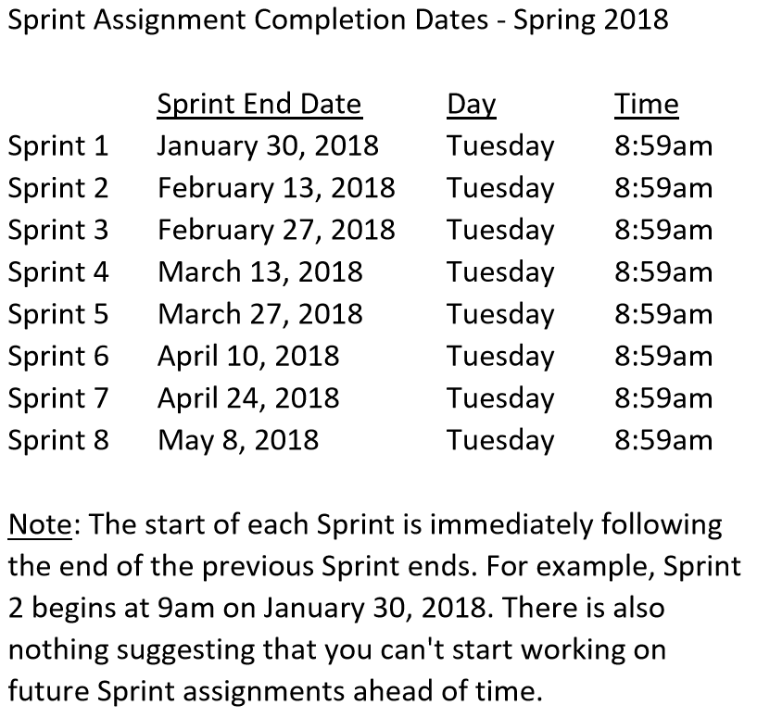

Slide 3
Scrum Team Standup & Report-out
The “daily” scrum meeting is not used as a problem-solving or issue resolution meeting. Issues that are raised are taken offline and usually dealt with by the relevant subgroup immediately after the meeting. During the daily scrum, each team member answers the following three questions:
What did you do since our last standup?
What will you do before our next standup?
Are there any impediments in your way?

Slide 4
Assignment 8 and Discussion Board 8

Slide 5
Final Project Demo Schedule
Thursday, May 3:
Tyler
Peter
Dan & Gytis
James & Emilio
Stephanie & Jason
Alex*
Fidel*
Thursday, May 8th at 2pm CST:
Robert
Jesus
Corey
First Name | Last Name
Daniel | Budziak | Thursday, May 3rd
Adrian | De Guzman | Thursday, May 3rd**
Kavanaugh | Dempsey | Tuesday, April 24th
Benjamin | Gorgan
Gytis | Jankauskas | Thursday, May 3rd
James | Kaht | Thursday, May 3rd
David | Mendez | Tuesday, April 24th
Stanimir | Petrov
Stephanie | Quick | Thursday, May 3rd
Fidel | Ramirez | Thursday, May 3rd**
Corey | Rose | Tuesday, May 8th at 2pm
Emilio | Salinas | Thursday, May 3rd
Jason | Schumacker | Thursday, May 3rd
Tyler | Starkus | Thursday, May 3rd
Robert | Twohill | Tuesday, May 8th at 2pm
Jesus | Vazquez | Tuesday, May 8th at 2pm
Peter | Veliz | Thursday, May 3rd
Complete Assignment 8 BEFORE your Final Project Demo

Slide 6
Course Topics Review

Slide 7
Agile Manifesto
“We are uncovering better ways of developing software by doing it and helping others do it. Through this work we have come to value:
Individuals and interactions over processes and tools
Working software over comprehensive documentation
Customer collaboration over contract negotiation
Responding to change over following a plan
That is, while there is value in the items on the right, we value the items on the left more.”
Notes:
This was kind of “hippy-ish” and egalitarian in its day… quite controversial in its day
“Everyone is a team member and is responsible for the work getting done”… we don’t need no titles or positions… self-organizing… we will make our own commitments… transparency (let’s share the information)… flexible/organic teams, organic architecture (minimal documentation/standards)… no contracts (let’s talk it over)
The flip side:
We will actively and voluntarily play important roles on our team
The rules (rituals) that we do have… we WILL follow
We will create, demo, and release working software/products
We will utilize practical processes, tools, documentation, and planning
When we make commitments, we will live up to those commitments… as a team (“No winners on a losing team, and no losers on a winning team”)
We will be responsive and continuously improve (Retrospectives)
We will be transparent with how WE work and share our information

Slide 8
Assignment:
Prior to class on:
View and reflect on “Introduction to Scrum in 7 Minutes” video [link]
Install/implement MS PowerShell [link]
Install Git Client [link]
Utilize (local) Git Client to create, update, branch, and merge a local project utilizing a beginners level tutorial… one option would be “An Intro to Git and GitHub for Beginners” [link]

Slide 9
Assignment
Prior to class:
Complete Discussion Board “Introduction” before you leave class today
Be prepared to discuss our Introduction to Object-Oriented Programming Introduction
Install MS PowerPoint & MS Word Viewers (if you do not have access to the full products)
Setup a GitHub account with a Student Developer Pack/Plan [link]
Utilize Git & GitHub to create, update, branch, and merge both local and remote projects utilizing several tutorials including:
“An Intro to Git and GitHub for Beginners” [link]
The GitHub “Hello World” [link]
Be prepared to install Java command line tools and to create “Hello World” for Java

Slide 10
Introduction to Object-Oriented Programming
Notes:
Starting with Slide 11

Slide 11
Assignment
Sprint 1:
Submit your Discussion Board (DB) responses before you leave class today
Install Java command line tools and create “Hello World” for Java [link]
Read and be prepared to discuss our Introduction to Object-Oriented Programming Introduction slides
Read: “What is JSON? JavaScript Object Notation explained” [link]
Read: “JSON Introduction” from W3C [link]
As a Team agree on a standard and extensible “My Information” JSON format and associated data requirements that include FirstName, LastName, PreferredName, TeamName, SeatLocation, and Roles* at a minimum
Complete Sprint 1 Quiz
Download class materials by performing: “git clone https://github.com/EricJPogue/sp18-cpsc-24500-001.git”

Slide 12
Assignment
Sprint 2:
Carry-over items from Sprint 1 if any
As a Class agree on a standard and extensible “My Information” JSON format and associated data requirements that include FirstName, LastName, PreferredName, TeamName, SeatLocation, and Roles* at a minimum
Individually setup a Microsoft Imagine Azure account [link]
Individually complete the Azure static website tutorial... leave the site in place [link]*
Individually complete a “permanent” personal static website where you will initially host your “My Information” JSON file for this class utilizing the previous tutorial to create the new website
Pull (or “re-clone”) class content site, review “source” folder projects, and compile/run each sample: “git clone https://github.com/EricJPogue/sp18-cpsc-24500-001.git”
Discussion Board
Assignment / Quiz #2
*Note that to complete Item #4 the Azure static website tutorial you will likely need to setup a Pay-As-You-Go account in order to obtain storage for the Web Bash Shell.

Slide 14
More Object-Oriented Programming

Slide 16
Programming Graphical User Interfaces (GUI)

Slide 17
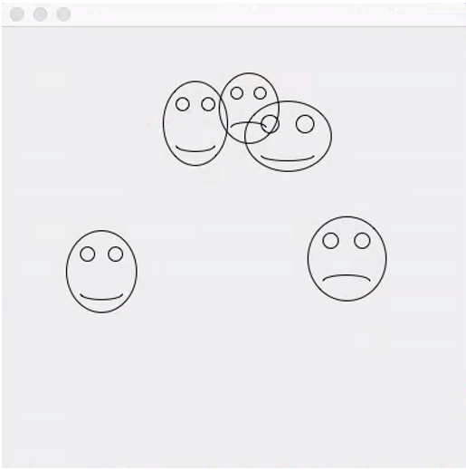
FaceDraw
FaceDraw will be a challenging assignment this week. Our Learning Objects, Discussion, Lecture, and Examples will all be focused on helping you complete the assignment and learn the key concepts through delivering a concrete example.
In FaceDraw we will:
Create an application in Java that draws random faces on a window
Generate a random number between 3 & 10 and draw that many faces
Randomly generate reasonable and visually appealing face
Position itself to a reasonable size and location
Draw all faces so they are entirely within the window.
Draw each face with two eyes and a mouth.
The mouth should be randomly smiling, frowning, or in-between
Notes:
G
I intentionally listed and reviewed our assignment first and our learning objectives second. This week our intent is to support our assignment through our learning objectives, discussion, lecture, and examples… and not the other way around.
It is important to understand the concepts, practices, and principles; however, it is essential that we can utilize them to deliver solutions.
The details of FaceDraw are provided in this week’s assignment.

Slide 19
Interactive Graphical User Interfaces

Slide 20
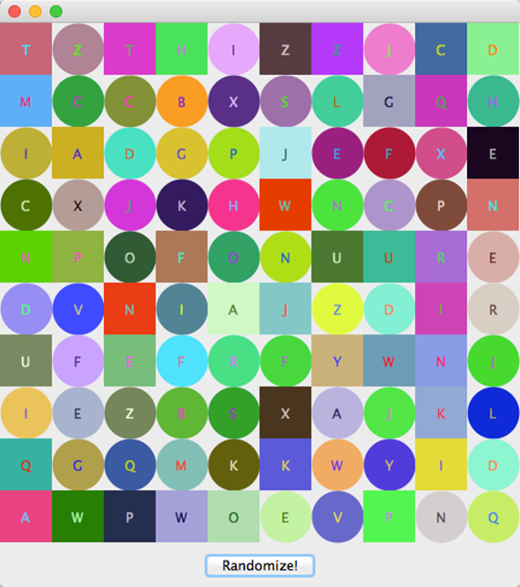
Review Mosaic Assignment
Mosaic and Learning Objectives: Mosaic will likely not be as challenging for you as FaceDraw was last week. Most of the elements that we will need for Mosaic we already learned last week. Therefore, this week’s objectives will be more forward looking.
In Mosaic we will:
Draw a set of random tiles
Draw random shapes, letters, and colors
Respond to a “Randomize” button
Display a new set of random tiles when the button is pushed
Implement a interesting and unique feature of our own choosing
Note: More details are available our W4Assignment document.
Notes:
Less theory and more practical development…

Slide 22
Files

Slide 23
Thunderbird

Slide 25
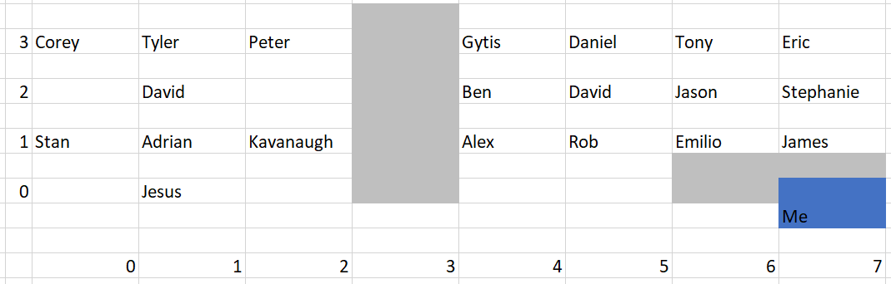
Finding Seat Location

Slide 26
Testing

Slide 28
Object Oriented Languages: Java, C#/.Net, and Python

Slide 29
SwissArmyKnife

Slide 31
Object-Oriented Programming, Databases, and 3-tier /n-tier Architectures

Slide 32
Final Project

Slide 33
Course Topics Review

Slide 34
Lab: Lab: Complete DB8 and Final Project

Slide 35
End of Session

