Slide 1

Object-Oriented Programming Sprint 8 Session 4 Eric Pogue
Agenda:
Scrum Standup, and Scrum-of-Scrums Report-out
Final Project Demos
Lab: Complete DB8 and Final Project
Discussion & Questions welcome at any time… please be present with no phones or email during our discussion time

Slide 2
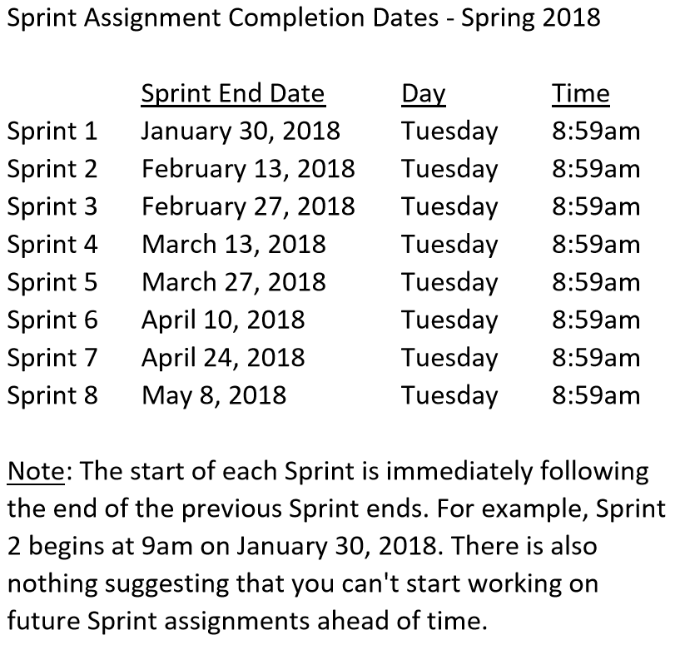

Slide 3
Scrum Team Standup & Report-out
The “daily” scrum meeting is not used as a problem-solving or issue resolution meeting. Issues that are raised are taken offline and usually dealt with by the relevant subgroup immediately after the meeting. During the daily scrum, each team member answers the following three questions:
What did you do since our last standup?
What will you do before our next standup?
Are there any impediments in your way?

Slide 4
Final Project Demo Schedule
Thursday, May 3:
Tyler
Dan & Gytis
James & Emilio
Stephanie & Jason
Alex*
Fidel*
Thursday, May 8th at 1:30 pm:
Robert
Jesus
Corey
Peter
First Name | Last Name
Daniel | Budziak | Thursday, May 3rd
Adrian | De Guzman | Thursday, May 3rd**
Kavanaugh | Dempsey | Tuesday, April 24th
Benjamin | Gorgan
Gytis | Jankauskas | Thursday, May 3rd
James | Kaht | Thursday, May 3rd
David | Mendez | Tuesday, April 24th
Stanimir | Petrov
Stephanie | Quick | Thursday, May 3rd
Fidel | Ramirez | Thursday, May 3rd**
Corey | Rose | Tuesday, May 8th at 2pm
Emilio | Salinas | Thursday, May 3rd
Jason | Schumacker | Thursday, May 3rd
Tyler | Starkus | Thursday, May 3rd
Robert | Twohill | Tuesday, May 8th at 2pm
Jesus | Vazquez | Tuesday, May 8th at 2pm
Peter | Veliz | Thursday, May 3rd
Complete Assignment 8 BEFORE your Final Project Demo

Slide 5
Lab
Do not leave class today until you have submitted:
Discussion Board (DB) 8
Assignment 8… Unless yo
All assignments that you intend to submit for the class (besides the final exam)
Notes:
… the test questions will be similar to the questions from the Quizzes. The test will be limited to 50 minutes and you will not have access to notes or other resources.
As a Class commit each Team to research, discuss, and present at least one of the following topics:
Databases on Azure including “Azure tables vs Azure MongoDB vs Azure other DBs”**
Cloud/Azure based Authentication/Authorization services and who they could be integrated into a NodeJS based application*
JavaScript and NodeJS with a focus on Azure and including the best Internet based tutorials and/or books on the topic
SaaS Frameworks including “MEAN vs LAMP vs Ruby on Rails”
Service Oriented Architectures including “Web Services and SOAP/WSAD vs REST vs Sockets”
SaaS Client Frameworks including “HTML/JavaScript vs AngularJS vs Angular2 vs React vs others”
File Formats including “HTML vs XML vs JSON vs Key/Value Pair Text Files”

Slide 6
Final Exam Tuesday, 8 May 2018 1:30 to 3:30pm CST in our normal location (AS104A)

Slide 7
End of Session

