Slide 1
Files
Types of Files:
Text… includes JSON and XML
Binary
Understand how Java uses files for input and output (IO)
Design and implement a controller class to serialize (reads & writes) data to a text file
Suggested Serialization Exercise
Notes:
Any of these items would be a good candidate for your “interesting and unique” feature to add to your Mosaic assignment.

Slide 2
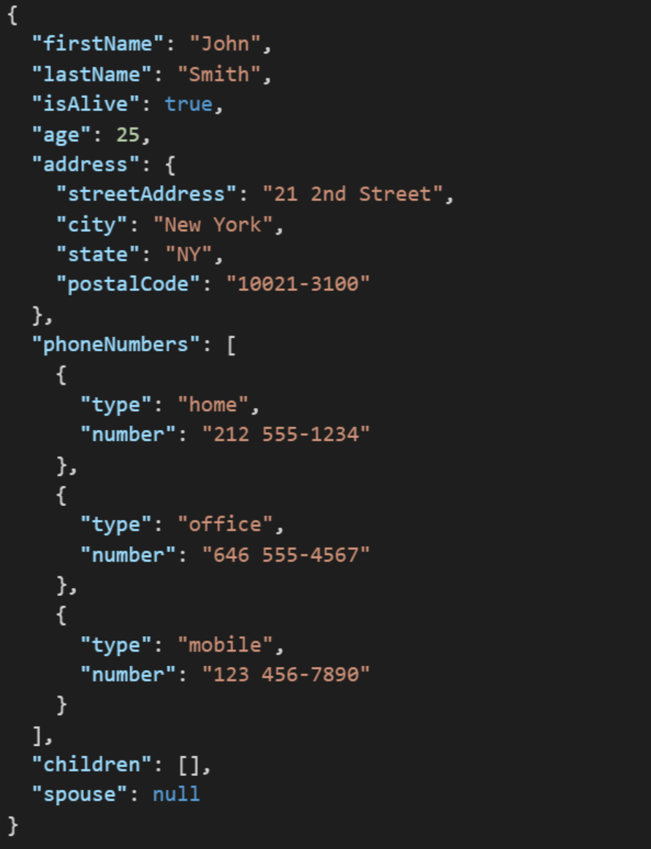
JSON Example
JSON (JavaScript Object Notation) is a lightweight data-interchange format. It is easy for humans to read and write. It is easy for machines to parse and generate. It is an open standard that:
Supports nearly all development languages and platforms
Allows us to cross between many applications
Can result in large files
Notes:
JSON is an open-standard format that uses human-readable text to transmit data objects consisting of attribute–value pairs. It is a very common data format used for asynchronous browser/server communication, including as a replacement for XML in some web service style systems.

Slide 3
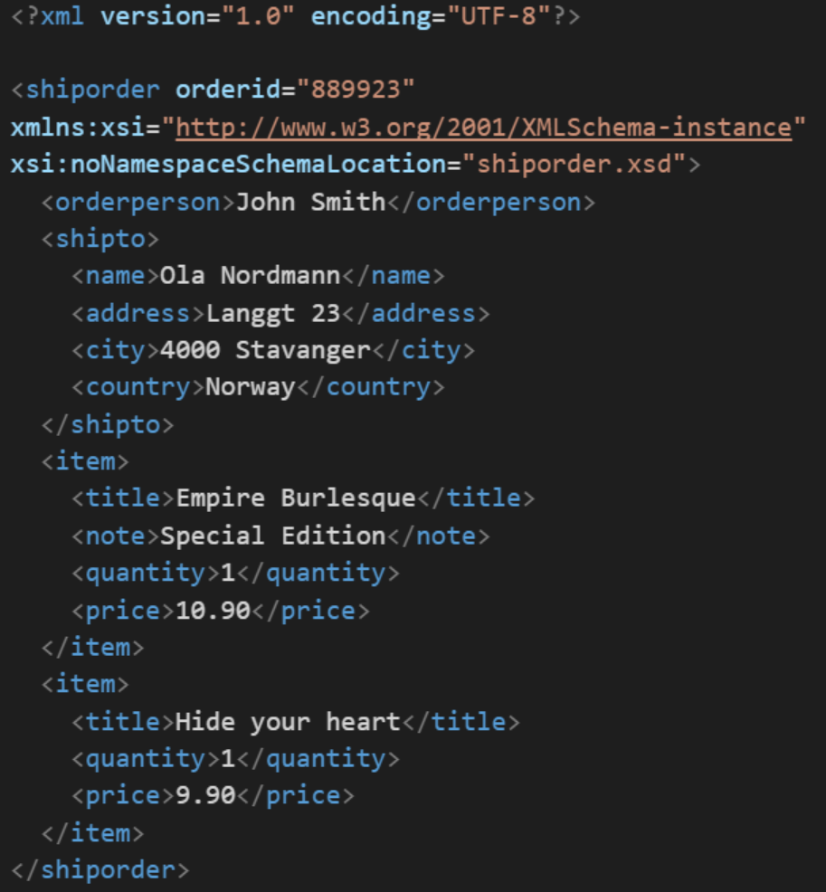
XML Example
In computing, XML (Extensible Markup Language) is a markup language that defines a set of rules for encoding documents in a format that is both human-readable and machine-readable. It is an open standard that:
Supports nearly all development languages and platforms
Allows us to cross between many applications
Can result in large files
Supports schema to validate data

Slide 4
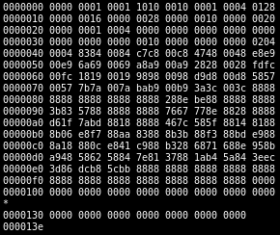
Binary Files
A binary file is a computer file that is not a text file. The term "binary file" is often used as a term meaning "non-text file". The can be open or closed formats that are generally:
Fast, small, and efficient*
Often not very portable across applications and platforms
Difficult to maintain backward compatibility
Notes:
Some people would say that binary files include all files, and that text files are just binary files that are being interpreted in a specific way.

Slide 5
Serialization and Writing/Reading Text Files (IO)
Serialization is an object-oriented programming term that means converting an object to a byte steam usually to be written to or read from a text or binary file.
To write to a text file:
Create a File object, feeding the file’s path to the File class constructor
Create a FileWriter to access the File
Create a BufferedWriter to write data to the FileWriter efficiently
Use BufferedWriter’s write and newLine functions to commit the data to the file.
To read from a text file:
Create a File object, feeding the file’s path to the File class constructor
Attach a Scanner object to it
Use Scanner’s readLine and hasNextLine functions to read the file
Notes:
A buffered writer or buffered stream efficiently organization reads and writes for optimal disk performance. The danger is that if there is a power failure (or someone accidentally kicks your power strip) you could lose data. It is good to “flush the buffer” at critical times when using a buffered writer on mission critical projects. There is little or no danger in using a buffered reader.
Binary files versus text files.
XML – Text file format for structured data… HTML for data.
JSON – “Simplified” text file format for structured data.
Binary

Slide 6
Suggested Serialization Exercise
We could demonstrate Writing and Reading OvalDraw data to a proprietary text file by:
Starting with the OvalDraw application
Hooking up the “Open” and “Save” menu events
Teaching our OvalDraw class to Write and Read itself
Saving our session
Loading our session
Notes:
A buffered writer or buffered stream efficiently organization reads and writes for optimal disk performance. The danger is that if there is a power failure (or someone accidentally kicks your power strip) you could lose data. It is good to “flush the buffer” at critical times when using a buffered writer on mission critical projects. There is little or no danger in using a buffered reader.
Binary files versus text files.
XML – Text file format for structured data… HTML for data.
JSON – “Simplified” text file format for structured data.
Binary

