Slide 1

Introduction to Object-Oriented Programming
Eric Pogue

Slide 2
Learning Objectives for Weeks 1 & 2
Define object-oriented programming
Review object-oriented language and tool selection
Demonstrate object-oriented programming concepts with examples
Distinguish between a class and an object
Identify and define “six” object-oriented concepts
Identify the superclass and the subclass in an inheritance relationship
Demonstrate inheritance, ownership, and abstraction in snippets of Java code
Distinguish between aggregation and composition
Position object-oriented programming within Software Development Lifecycle (SDLC)
Depict classes and their relationships using UML class diagrams
Define and discuss common object-oriented design patterns
Define and discuss common object-oriented design principles and characteristics of bad software
Recap: How is object-oriented programming different
Recap: Why did we choose to learn an object-oriented approach in developing software
Notes:
We have a lot of solid topics for our first week. You will quickly notice that three words are underlined. You will see references to object-oriented concepts, patterns, and principles throughout the week and throughout the class.
Concepts: Practices, standards, and tools the effectively support object-oriented design and programming… I need to do enhance the BMI class to provide better Encapsulation and hide the height and weight properties (hours).
Patterns: Well established templates for forging relationships between classes… I would like to generate the random Animal generator using a Factory pattern so it is more supportable (days)
Principles: Proven industry guidelines… Using a Factory Pattern is a good start; however, I think we should focus more on making sure that we follow the Open Close Principle throughout our product (weeks+)
If you take a look through the topics you will hopefully see a few that are familiar; however, I suspect that many will be new. Don’t be concern, by the end of the week you will have some familiarity with all of them. You should also have resources that will let you go back and refresh you memory when you need to do that.
I am going to divide the topics up into three or four sections so that we can focus and keep our energy.

Slide 3
Learning Objectives – Session 1
Define object-oriented programming
Review object-oriented language and tool selection
Demonstrate object-oriented programming concepts with examples
Distinguish between a class and an object
Notes:
Section 1 will be focused on where object-oriented design and programming (OOP) fits into the Software Development Lifecycle, what platforms and tools we will be using as we explore OOP, and then get us started with classes and objects.

Slide 4
Object-Oriented Programming [link]
Object-oriented programming (OOP) is a programming model based on the concept of "objects", which contain both Attributes (variables/data) and Methods (function) that operate on that those attributes.
Most popular OOP languages are class-based, meaning that objects are instances of classes.
Animal
Dog
Cat
Bigcat
Notes:
I will often start with definitions from Wikipedia and other sources. If you are struggling with a topic and/or would like more information, it can often be valuable to review the references. You should be able to click on the [link] tag (possibly while holding the shift key down) in order open the reference in a browser. Please let me know if this is not working for you.
Walking through the slide, you will see that words and terminology will be important as we discuss and learn new concepts. During the course I am sure you will notice that at times I will struggle with the attribute/property vs. data and method vs. procedure distinction when I am talking. I would like for us to try to make that distinction in our work as we go through the term.
For the purposes of this class, “attributes” and “properties” will be used interchangeably to describe variable belonging to a class or object. Also “procedures” and “functions” will be used interchangeably.

Slide 5
Object-Oriented Programming [link]
It includes concepts, patterns, and principles for designing and implementing modern software products.
Concepts – powerful features that prove indispensable to modern software development, brought to us automatically by object-oriented programming.
Patterns – tried-and-true templates for forging relationships between classes
Principles – guidelines that help you determine what classes are needed and how they should divide up the work
Notes:
I will often start with definitions from Wikipedia and other sources. If you are struggling with a topic and/or would like more information, it can often be valuable to review the references. You should be able to click on the [link] tag (possibly while holding the shift key down) in order open the reference in a browser. Please let me know if this is not working for you.
Walking through the slide, you will see that words and terminology will be important as we discuss and learn new concepts. During the course I am sure you will notice that at times I will struggle with the attribute/property vs. data and method vs. procedure distinction when I am talking. I would like for us to try to make that distinction in our work as we go through the term.
For the purposes of this class, “attributes” and “properties” will be used interchangeably to describe variable belonging to a class or object. Also “procedures” and “functions” will be used interchangeably.
Concepts/Patterns/Principles… Hours/Days/Months

Slide 6
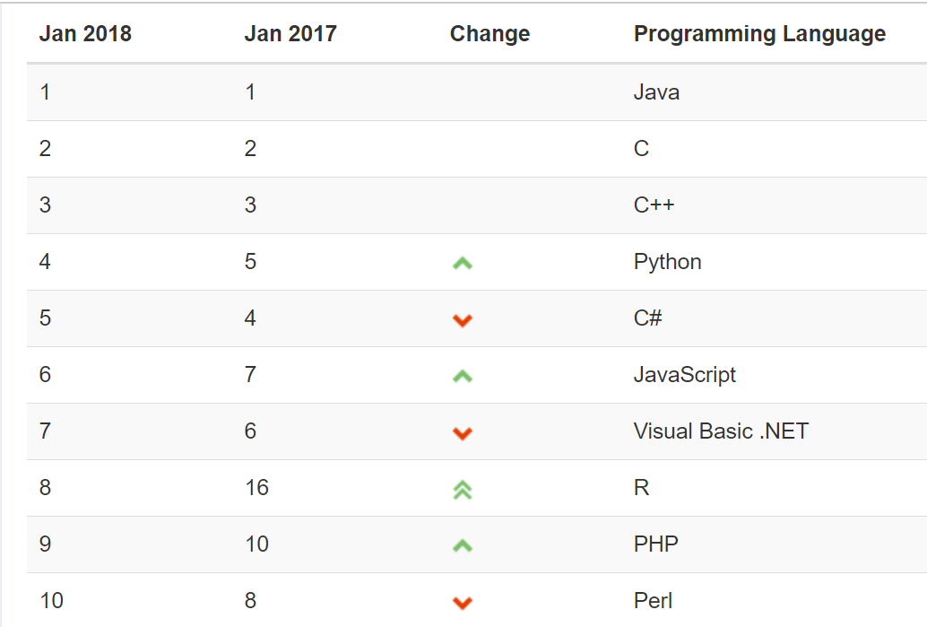
Object-Oriented Languages and Tools
The TIOBE index identifies which programming languages are most prevalent.
TIOBE Index for January 2018:
Non-OOP Examples
Notes:
We will utilize mostly Java and C# for our object-oriented programming examples. We may (or may not) do any Python work. Since it is often ‘unnatural’ to show procedural programming examples in Java, C#, or Python, we will implement programs in C to demonstrate procedure programming examples. Let me know if you have a desire to do some Python work… or work in another OOP language. If so, we can likely work something out.
Note that our reluctance to utilize C++ as a OOP learning tool is does not diminish the value of the C++ toolset. However, C++ is generally considered a very powerful set of tools with a steep learning curve. It’s a very sharp knife… use it carefully.

Slide 7
Object-Oriented Concepts Example
Implementing the body mass index (BMI) calculation in Java and C should allow us to effectively demonstrate some object-oriented design and programming concepts (Java). We will also compare that to how we would have implemented the same calculation using procedural programming techniques.
Background: BMI is a statistic developed by Adolphe Quetelet in the 1900’s for evaluating body mass. It is not related to gender and age. It uses the same formula for men as for women and children.
The body mass index is calculated based on the following formula:
BMI = weight [kg] / (height [m] * height [m])
Procedural BMI (body mass index):
Data:
Height
Weight
Procedures (or functions):
CalcBMI
Object-Oriented BMI:
Class BMI
Attributes
Height
Weight
Methods
CalcBMI
Notes:
Well let’s get started on a real-world example that will allow us to see how OOP is used, and to learn some of the basic concepts like classes and objects. I’ve picked a body mass index (BMI) calculator as our first example. If retrospect, I wish I would have used something with shapes or animals. However, I assure you that there will be no shortage of shape and animal examples in the coming weeks.
Can you see how data and procedures/functions map directly to call attributes and methods? Even though it is a directly mapping, it is still good to get our terminology correct.

Slide 8
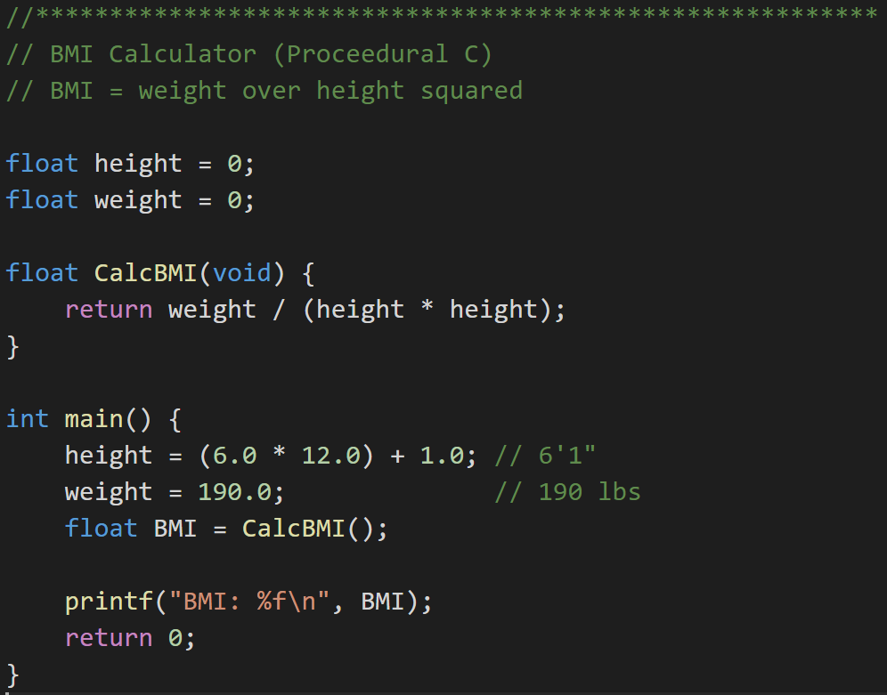
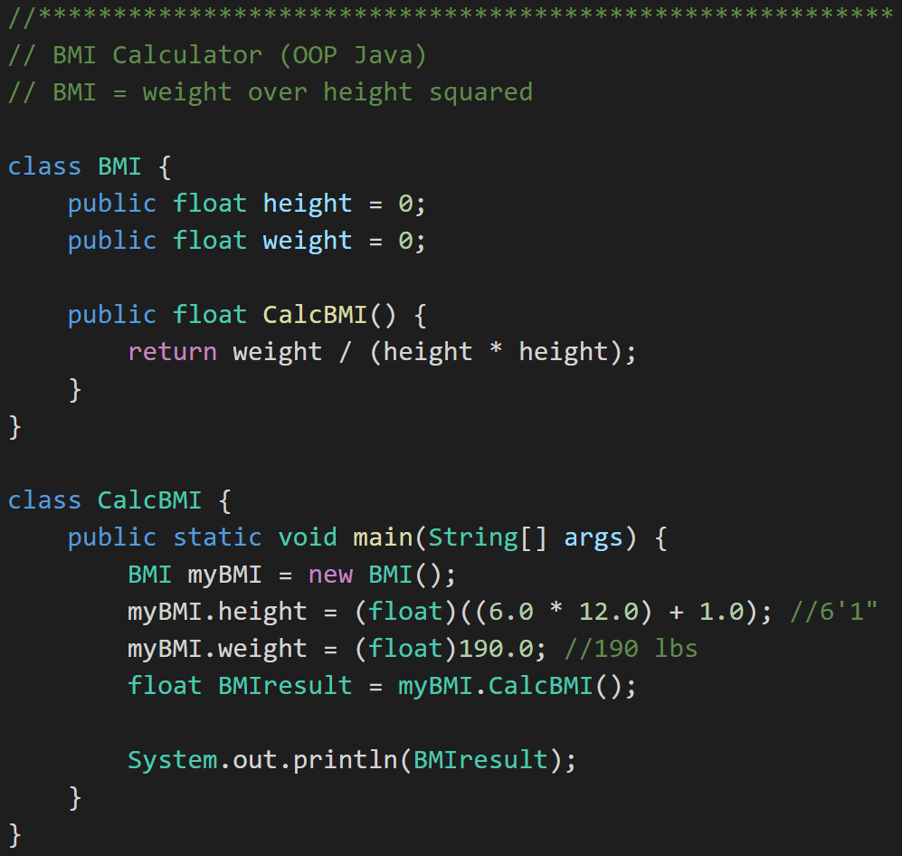
Example: Procedural vs. Object Oriented Programming
Procedural BMI (C):
“Object-Oriented” BMI (Java):
Notes:
Now let’s look at some real code examples. You will quickly notice that I like to use real code examples over philosophical discussion topics. I will try to make the more important coding examples available to you on my GitHub account. Let me know if you see something and would like a copy.
We have quite a lot of code to look at here. Let’s start with the procedural C code. We have data (height & weight) and procedures (CalcBMI)…
We have a pretty simple formula…
When I coded this the first time I used ‘int’ instead of ‘float’ for all my variables. That didn’t work very well.
If you look carefully you will see that we still have a logic problem in both of our implantations. Don’t worry we are going to get back to fix that using some of our OOP concepts.
For now let’s focus on looking through our first OOP Java implantation. We have our first class. Very nice, we will see many more of those.
Let’s go to the next slide to take a closer look at our class.

Slide 9
Distinguish Between a Class and an Object
Procedural BMI (C):
“Object Oriented” BMI (Java):
Notes:
There we have it, a class. It has attributes (height & weight) and a method (CalcBMI). Still has the same logic problem… but let’s wait on that.
Now we need to be able to use our class to do something. For that we need to create an instance of our class.

Slide 10
Distinguish Between a Class and an Object
Procedural BMI (C):
Object Oriented BMI (Java):
Notes:
Ahhhh… and we have an object “myBMI’ which is an instance off the class “BMI”.
We use or myBMI object to set some properties and then we have it calculate BMI by calling “my.BMI.CalcBMI()”
… and of course when we compile and run it, we get… the wrong answer. But it compiled and ran successfully. That’s something, right?
I know you can’t wait to see how this BMI story ends, so that will be our starting point for Section 2. How to fix BMI using object-oriented concepts/techniques.

Slide 11
Learning Objectives for Weeks 1 & 2
Define object-oriented programming
Review object-oriented language and tool selection
Demonstrate object-oriented programming concepts with examples
Distinguish between a class and an object
Identify and define “six” object-oriented concepts
Identify the superclass and the subclass in an inheritance relationship
Demonstrate inheritance, ownership, and abstraction in snippets of Java code
Distinguish between aggregation and composition
Position object-oriented programming within Software Development Lifecycle (SDLC)
Depict classes and their relationships using UML class diagrams
Define and discuss common object-oriented design patterns
Define and discuss common object-oriented design principles and characteristics of bad software
Recap: How is object-oriented programming different
Recap: Why did we choose to learn an object-oriented approach in developing software
Notes:
We have a lot of solid topics for our first week. You will quickly notice that three words are underlined. You will see references to object-oriented concepts, patterns, and principles throughout the week and throughout the class.
Concepts: Practices, standards, and tools the effectively support object-oriented design and programming… I need to do enhance the BMI class to provide better Encapsulation and hide the height and weight properties (hours).
Patterns: Well established templates for forging relationships between classes… I would like to generate the random Animal generator using a Factory pattern so it is more supportable (days)
Principles: Proven industry guidelines… Using a Factory Pattern is a good start; however, I think we should focus more on making sure that we follow the Open Close Principle throughout our product (weeks+)
If you take a look through the topics you will hopefully see a few that are familiar; however, I suspect that many will be new. Don’t be concern, by the end of the week you will have some familiarity with all of them. You should also have resources that will let you go back and refresh you memory when you need to do that.
I am going to divide the topics up into three or four sections so that we can focus and keep our energy.

Slide 12
Learning Objectives – Session 2
Identify and define “six” object-oriented concepts
Identify the superclass and the subclass in an inheritance relationship
Demonstrate inheritance, ownership, and abstraction in snippets of Java code
Distinguish between aggregation and composition
Position object-oriented programming within Software Development Lifecycle (SDLC)
Depict classes and their relationships using UML class diagrams
Notes:
For Section 2 we are going to cover some OOP concepts, use those concepts to extend our BMI example, and then talk a little about UML.

Slide 13
The “six” (Three plus) Object-Oriented Concepts
Object-oriented concepts:
Encapsulation… and Information Hiding
Inheritance… and Abstraction
Polymorphism
Plus… Composition & Aggregation
Notes:
Helpful Interview Hint: Whenever you are asked a conceptual question about object-programming in an software development interview (and you will be), answer confidently “Encapsulation”, “Inheritance”, and “Polymorphism”.
When asked what is Encapsulation (or how would you implement it), say, “I would limit or minimize variable scope and keep data attributes private as often as possible.”
Now as we are going through our object-oriented examples, be thinking about how you would answer the “What is Inheritance?” and “What is Polymorphism?” interview questions. Note that answering them both with very brief examples can be very effective… and it is always best to use animals in you OOP interview examples.
Now we just need to make sure that we are able to effectively utilize these concepts after we get the job. Let’s start by walking through an example.

Slide 14
Encapsulation & Information Hiding
Encapsulation: Wrapping properties and methods into a class and minimizing the scope of those properties and methods.
Information Hiding: Minimize visibility/scope of data, attributes, functions, and methods.

Slide 15
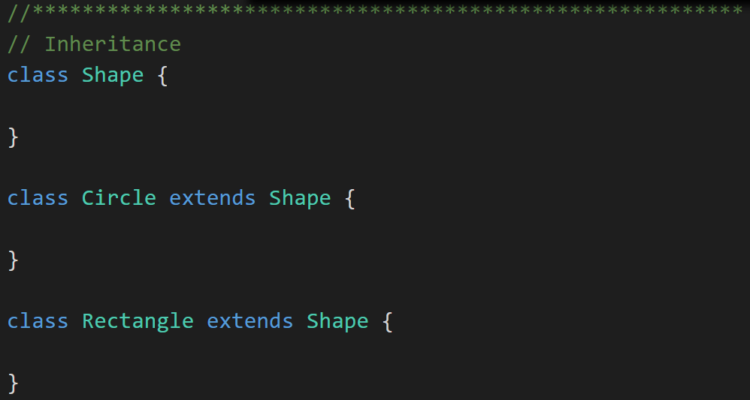
Inheritance & Abstraction
Inheritance: When one class acquires the properties and methods of another class it is called Inheritance.
Abstraction: Something is abstract when it is a concept but is not concrete or defined enough to actually be built. Generally, in OO design, we start with abstract things, and then we build on them through Inheritance.
Notes:
The first of many “Shape” examples. We will get to a Abstraction example in a few minutes.

Slide 16
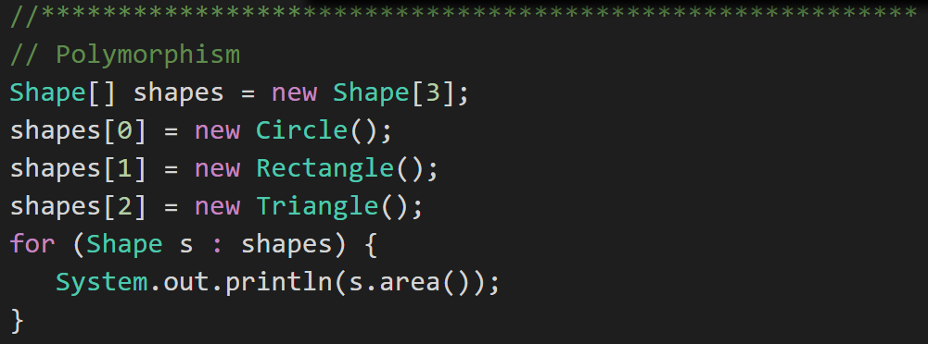
Polymorphism
Polymorphism: Polymorphism enables you to process collections of related things generically. This is particularly useful when you want to use a loop to march through a collection of items.
Notes:
Example of polymorphism: a for loop that moves through the entries of a list. The list might be of a collection of related kinds of object. We can refer to each of the objects in the list through a generic variable (whose data type matches the one that all are ultimately related to). But, when we invoke a particular function that all members of the family share, each will respond by performing that function in their own specific way. For example, we could have a collection of Shape objects. We could refer to each entry in the Shape list through a generic Shape variable, even though the actual entries in the list are specific kinds of shapes – Circle, Rectangle, etc. All Shape objects might have the ability to calculate their own area. When we refer to an object in the list through a generic Shape variable and tell it to calculate its area, thanks to polymorphism, the circle version of the area() function will be called when we’re dealing with a circle, and the Rectangle version of area() will be called when we’re dealing with a rectangle, etc.
The first time through the for loop, we’ll call the Circle.area() function – actually, we won’t; it will happen automatically. The next time through, we’ll call the Rectangle version, and then we’ll call the Triangle version.
Polymorphism is implemented behind the scenes using a Virtual Method Table (VMT). The VMT keeps track of where various related classes’ same-named functions are located in memory. Using the VMT, the operating system is able to figure out which code to implement when we tell each shape to fire its area() function.

Slide 17
The Problem?
BMI formula assumes M (height) and KG (weight)
Procedural BMI (C):
Object-Oriented BMI (Java):
Notes:
Let’s go back to where we left off in our BMI example. We had both Procedural (C) code and Object-Oriented Java code. Both compiled. Both ran. Neither produce the expected result because…
The function / method only worked if we used metric units where we were using English units. Specifically, our BMI formula assumes metric inputs of kg & m while our interactions with the BMI procedures and methods are using English units if inches & lbs. So our implementations do work; however, they only work for metric.
Let fix our BMI (C) implementation in our normal procedural way.
After that we will enhance our Java implementation using Encapsulation and Inheritance concepts.
Polymorphism will need a different example… definitely one with animals.

Slide 18
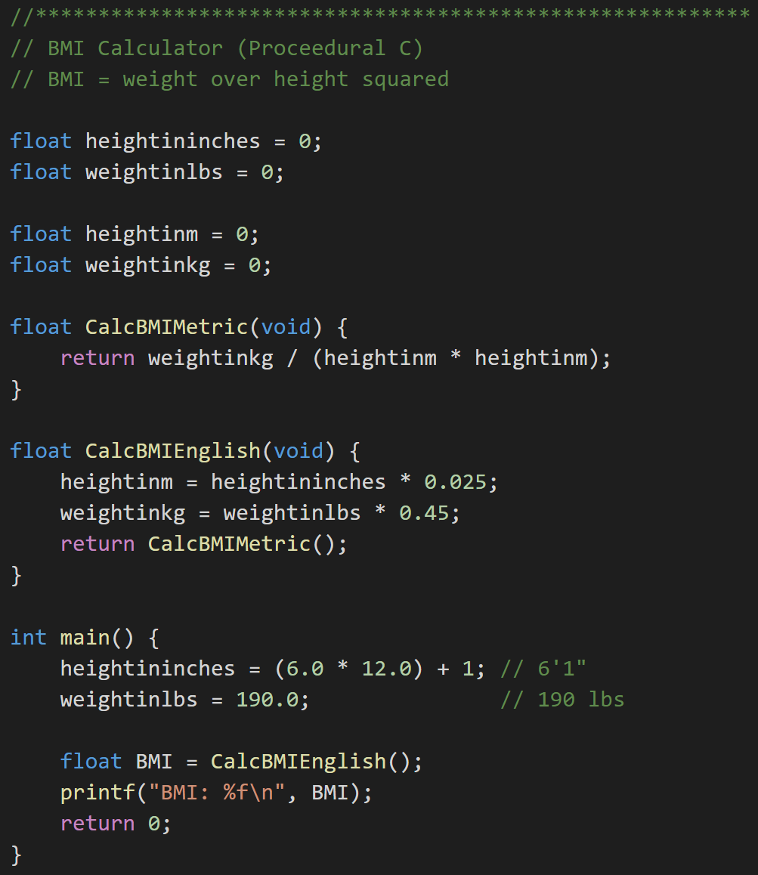
Revising Procedural (C) BMI Implementation
Procedural BMI (C):
Procedural BMI (C) - revised:
Notes:
First let’s spend a couple minutes revising our procedural C implementation the “old fashioned” way.
Since our current implementation actually works for metric units, lets not lose that. We will rename are variables to reflect that they are metric only units (hightinm and weightinkg). Note that since our variables were global, this change alone will break anyone else who was reusing our code (ouch!)
We will also rename our C function to reflect its Metric requirement.

Slide 19
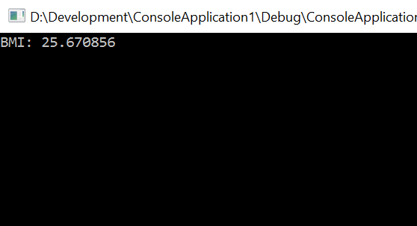
Revising Procedural (C) BMI Implementation
Procedural BMI (C):
Procedural BMI (C) - revised:
Notes:
Now we will add in English variables and functions. Finally, we will call the new English function… and voilà! It works as expected. Hmmmm, 25.6? I thought it would be lower than that.
Not bad. However, when we do these examples, always imagine thousands or tens-of-thousands of lines of code. And recognize that as the size of the code grows and the number of developers grows that the complexity grows exponentially.
Now think about the opportunity to reuse this type of code. If this was a complex ten thousand line implementation, would you want your livelihood dependent on this code and it’s owner? I would not want to be on call the Sunday night that he or she decided to make a last minute change and update the global variable name… and, of course, it would be my code that actually broke because my implementation would be dependent on the variable name remaining the same. This is one reason that the (very bad) practice of “copy-paste” code sharing has become so prevalent.
This is one of the many reasons that OOP has remained so prevalent over the years. It is not necessarily easier to write OOP code the fist time (vs. procedural development); however, the opportunity for well written OOP code to be reused, extended, maintained, and efficiently tested has made it indispensable in modern software development.

Slide 20

Revising BMI Implementations
Procedural BMI (C) - revised:
Object-Oriented BMI (revised):
Notes:
Repeat from last slide: This is one of the many reasons that OOP has remained so prevalent over the years. It is not necessarily easier to write OOP code the fist time (vs. procedural development); however, the opportunity for well written OOP code to be reused, extended, maintained, and efficiently tested has made it indispensable in modern software development.
Now let’s revise our Java OOP BPI implementation.

Slide 21
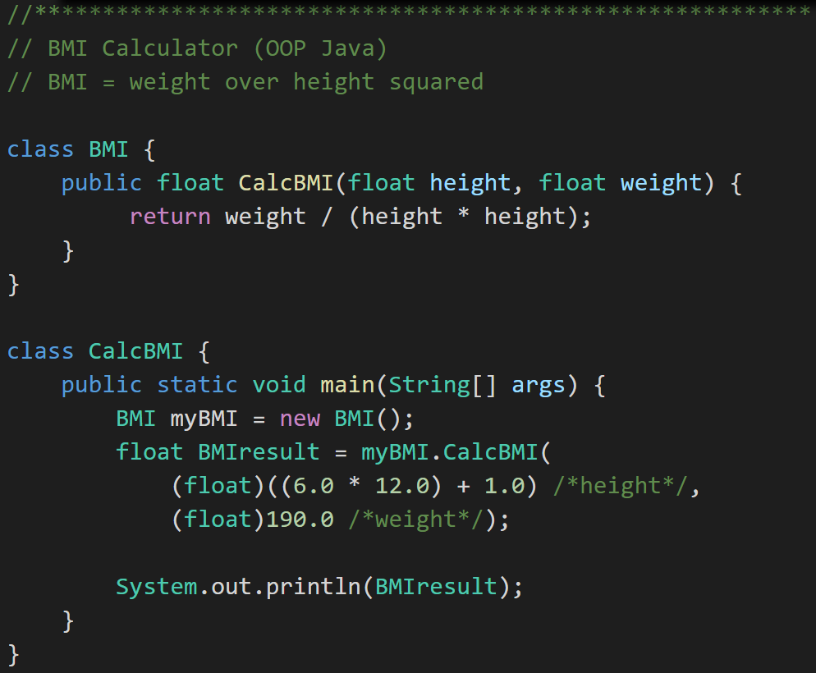
Encapsulation
Object -Oriented BMI:
Encapsulated Object-Oriented BMI:
Notes:
First, let’s Encapsulate our code.
#1 Rule for Encapsulation: Minimize class property and method scope and visibility: (1)none, (2)local, (3)method parameters, (4)private attribute, (5)protected attribute, and (6)public
In this case we can’t eliminate our height and width properties, and we can’t make them local to our method. However, we can make them parameters to our CalcBMI method. That’s a nice simplification. It also makes it very unlikely that future changes will impact users of our BMI class.
Consider: How would you add protective code around setting height to 0 in the initial code (height > 2ft & <9ft)? … How about in our second encapsulated example? Once again consider reuse, testing, and additional modification if this were thousands of lines off code.
This type of Encapsulation & Information Hiding is a feature of nearly all modern development languages… not just object-oriented languages.

Slide 22
Inheritance… Options to Implement English Units
Option #1:
Option #2:
BMI (metric)
BMI
BMI English
BMI Metric
BMI English
Notes:
Now let’s use Inheritance to implement English unit support in BMI. There are really two Inheritance class hierarchy options in this case. Option #1 is very practical and safe… and very unlikely to break anyone’s code who is currently using our class. Option #2 is more pure and elegant.
In the real world where not breaking existing code (causing a retest or potentially a defect) is a VERY high priority, we would have chosen Option #1. It is simpler, less risky, more practical, and can be done with less code. Profession developer rule #1: Don’t break what is working.
For our Learning exercise we will implement Option #2. It is a more pure and elegant implementation where BMI Metric and BMI English are at the same level in the class hierarchy… which satisfies my artistic needs. It also will allow us to demonstrate Abstraction, Superclass, and Subclass at the same time we are demonstrating Inheritance.

Slide 23
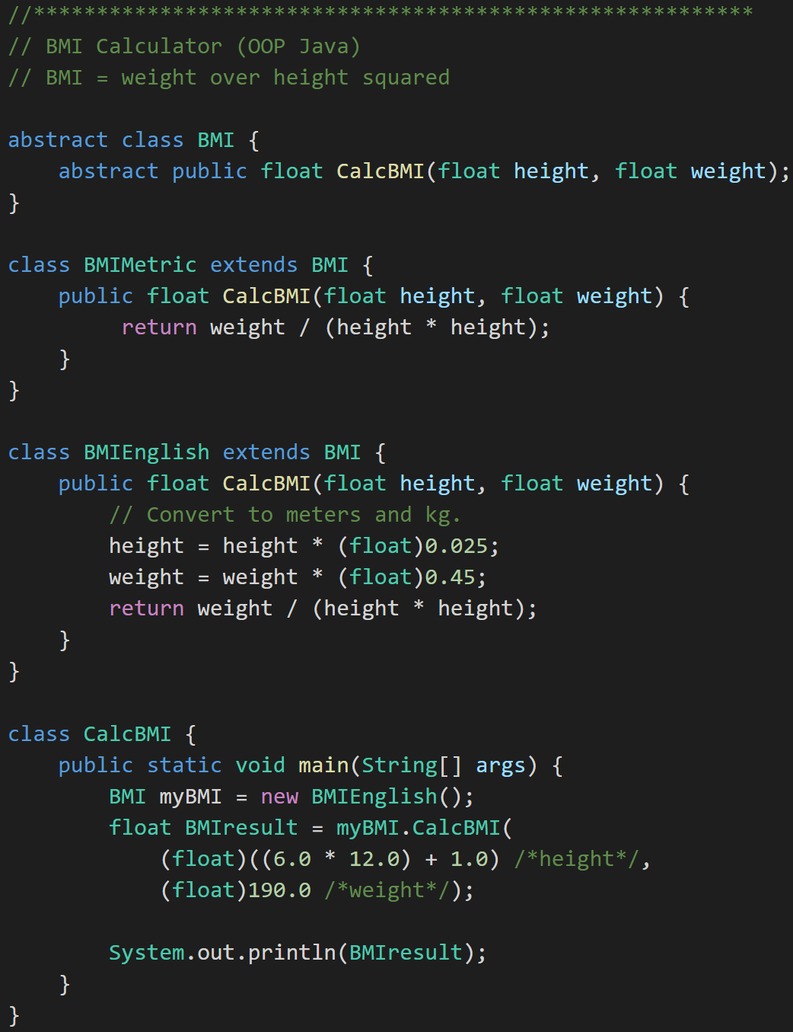
Inheritance to implement English units… And Abstraction
BMI
BMI Metric
BMI English
Notes:
Let’s look at how we enhanced our class hierarchy. We created a new Abstract base class call BMI. Yes, the fact that we did this likely broke others that were using our class. We will need to call them and apologize. Note that implementing Option #1 on the proceeding slide should have avoided this. Notice the Abstract CalcBMI method in BMI. We have not learned the difference between Abstract and Virtual yet. Virtual means a Method can be overridden where Abstract means it must be overridden.
We also implemented two classes that extend BMI. Our original class was renamed to “BMIMetric” and we added a new class “BMIEnglish”… seem elegant and simple.
Now we create a new BMI that is actually a BMIEnglish. If that doesn’t mess with you mind just a little, think about it some more. Note that we could have made the line:
“BMI myBMI = new BMIEnglish();” read
“BMIEnglish myBMIEnglish = new BMIEnglish();”
And have gotten the same results. I actually think the second line is cleaner and simpler. It avoids Polymorphism… which really isn’t need here.
If you understand why these two line produce the same results in this example? If so you are well on your way to understanding Abstraction and Polymorphism. Or you might want to come back to this after our Polymorphism example and see if it makes more sense.

Slide 24
Superclass and Subclass
BMI
BMI Metric
BMI English
Superclass
Notes:
Let’s backtrack and cover a couple required (and valuable) items.
We now have an example of a Superclass in BMI

Slide 25
Superclass and Subclass
BMI
BMI Metric
BMI English
Subclass
Notes:
And we have two examples of Subclasses. That was easy.

Slide 26
Abstraction
BMI
BMI Metric
BMI English
Abstraction
Notes:
And we have and example of Abstraction.
Abstraction
Abstraction is another key concept. Something is abstract when it is a concept but is not concrete or defined enough to actually be built. Generally, in OO design, we start with abstract things, and then we build on them through inheritance.
An abstract class is one that has one or more abstract methods.
An abstract method is a method / function that has no body – just a name, return type, and parameters.
An interface is the strictest interpretation of an abstract class – it is a data structure that consists entirely of abstract methods. In other words, none of its methods/functions have a body.
Abstraction is related to inheritance. Often, when we construct families of related objects, we start the family with an abstract class that represents the least common denominator for everyone in that family. In other words, what do all classes that are part of that family have in common? We often (not always, but often) put that in an abstract class.

Slide 27
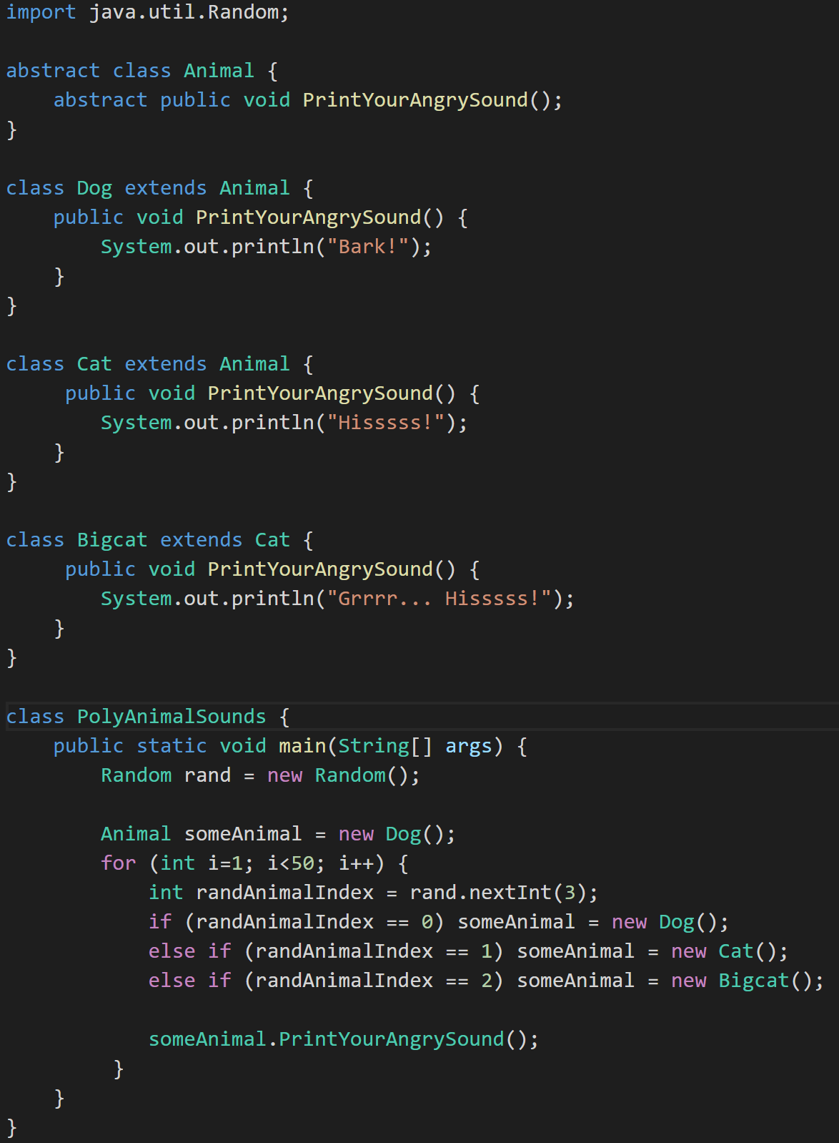
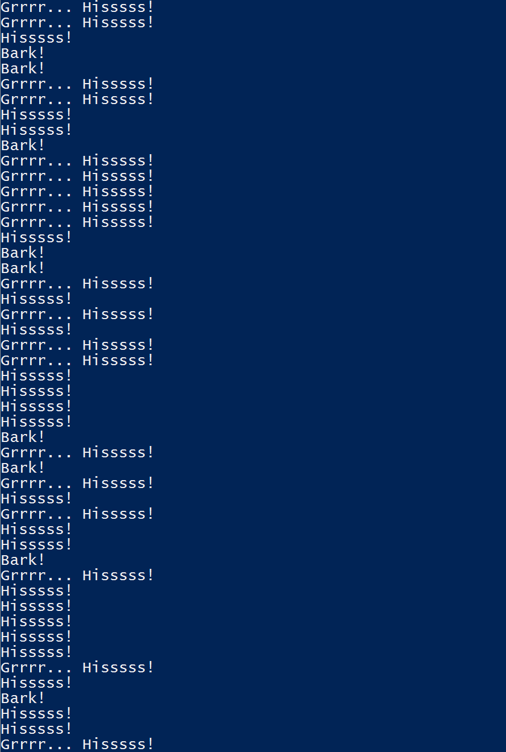
Polymorphism
Animal
Dog
Cat
Bigcat
Polymorphic
Notes:
Polymorphism? Let’s do something new. Let’s do something with Animals, Abstraction, Superclasses, and Subclasses. Take a look at the class hierarchy on the left. Can you track it to the code on the right?
We have and Abstract class Animal that provides the template for an Abstract method “PrintYourAngrySound()”. We have Subclasses Dog and Cat who both Override “PrintYour AngreeSound()” as required. Then we have a Bigcat class that Extends Cat. We have seen all of these things before.
Now we have added the idea of Random numbers. Let’s ignore that for now. It’s enough to know that the Random class that came from “java.util.Random” generates random numbers. Who would have guessed…
Now for the finalize… Notice how “someAnimal” can behave like “Dog”, “Cat”, or “Bigcat” depending the random number generated. This is Polymorphism.
Now can you come up with that brief animal based interview response for Polymorphism. Be sure to throw in “oh yes, Polymorphism is usually implemented with virtual methods and a virtual method table” to get full credit at the interview.
It may also be good to know what that actually means just in case one of the interviewers really know what a virtual method table is and has a follow up question.

Slide 28
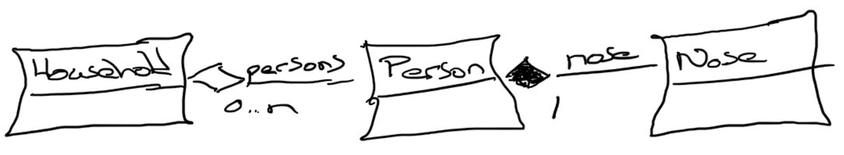
Composition & Aggregation
Composition: A relationship where an object will not exist without the parent object. For example, it is unlikely that the “Nose” object will exist after the “Person” object is gone.
Aggregation: A relationship where multiple objects will likely continue to exist independent of each other. For example, we might have a “Household” object and a “Person” object. It would be very reasonable to expect our “Person” object to continue to exist even if our “Household” object was deleted.
Our First UML:
Notes:
Composition: An example of composition: the relationship between Face and Nose, Mouth, and Eye
class Face {
Nose n;
Mouth m;
Eye le;
Eye re;
}
We probably wouldn’t let the Nose, Mouth, or Eye objects live beyond the Face. They are owned exclusively by the Face. That’s what composition is: exclusive ownership.
One clear sign that we are dealing with composition is if the owner (Face, for example) is responsible for actually creating the objects it owns. Then, clearly, the things that are owned – the Nose, Mouth, etc. – could not have existed on their own and are therefore exclusively owned by the owner object.
Aggregation: Aggregation is also a form of ownership, but it’s non-exclusive ownership. The owned objects can live on and perhaps existed prior to the owned object.
An example of aggregation: A library patron borrows a book. That’s not exclusive ownership, since several people can borrow a book over its lifetime.
The easy way to tell if something is composition or aggregation is to ask if the owner is responsible for creating and destroying the thing that is owned. If so, it’s a composition relationship.

Slide 29
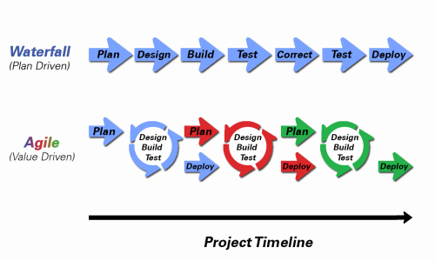
Object-Oriented Programming within Various Development Methodologies
Notes:
Development Methodology and Software Development Lifecycle (SDLC) are often used interchangeably.
The Iterative development methodology is not depicted here as even the mainstays and inventors of the Iterative development methodology seem to be moving toward agile. Plus as Waterfall “holdouts” move, they seem to be moving directly toward Agile. Can you start to see my biases?
Development Methodologies (SDLCs) are a future Bonus Topic. There are several optional slides t the end of this deck. Let me know if you would like to have a more formal overview of the topic as part of this class. I have a passion in this area.
Object oriented-programming concepts/practices evolve and reprioritize depending on the development methodology.
For example, in Waterfall (as well as in Iterative) object-oriented design often play a critical role in the (big upfront) design activities. UML diagrams and project artifacts are often important to the overall project success. (opinion) Practical reality has been that these design artifacts often do not reflect the actual implementation and are rarely maintained or updated.
The Agile practitioners do not reject these design artifacts. However, the focus on shorter time horizons, evolving architecture, and working code changes the value proposition for object-oriented practices to more focus on the build, test, enhance activities.

Slide 30
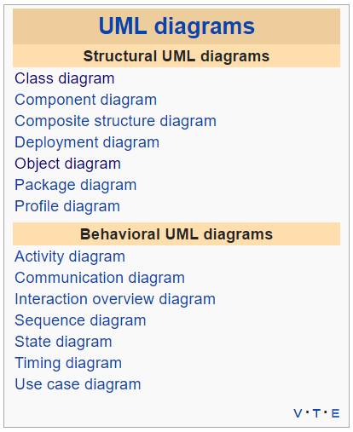
Unified Modeling Language [link]
The Unified Modeling Language (UML) is a general-purpose, developmental, modeling language in the field of software engineering, that is intended to provide a standard way to visualize the design of a system.
For our purposes we will limit our UML usage to diagrams where:
Classes as boxes with three sections, the top of which specifies the name of the class, the middle of which specifies the data, and the bottom of which specifies the functions.
Lines between the classes.
A line with an arrow / triangle pointing to the parent – inheritance
A line with a filled diamond next to the owner – composition
A line with an open diamond next to the owner – aggregation
A line with no decorations – just an association (a using kind of relationship)
Notes:
UML can describe many different things and become quite complex. There is some debate, particularly in the Agile development methodology circles, as to the benefits of this documentation outweigh the cost. Most developers agree that at least a basic understanding of UML diagrams aids greatly in the impromptu “chalkboard” design discussions that occur constantly during the design, implementation, and testing of a project.
UML helps us see the design without having to wade through lots of text to understand it.
UML reached its peak with Iterative Development methodologies like the Rational Unified Process (RUP) and OpenUp. It still is viewed as a critical part of Design for many Waterfall and Iterative organizations.

Slide 31
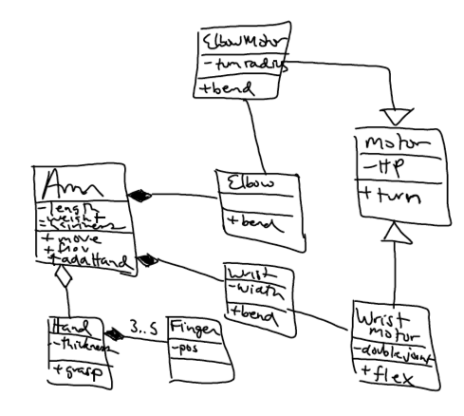
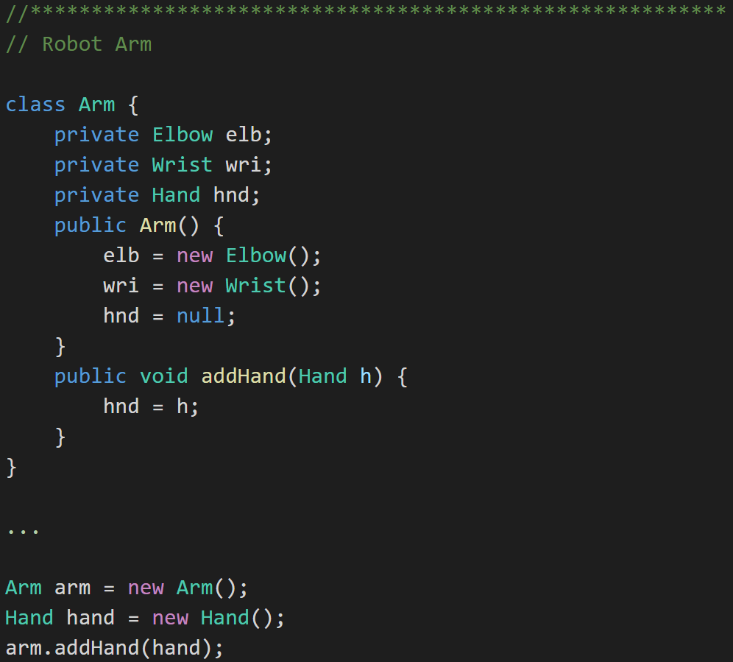
UML Example: Robot Arm
UML:
Java:
Notes:
UML can describe many different things and become quite complex. There is some debate, particularly in the Agile development methodology circles, as to the benefits of this documentation outweigh the cost. Most developers agree that at least a basic understanding of UML diagrams aids greatly in the impromptu “chalkboard” design discussions that occur constantly during the design, implementation, and testing of a project.
UML helps us see the design without having to wade through lots of text to understand it.
UML
UML, or Unified Modeling Language, is a way to show a system’s architecture in graphical form. UML represents
classes as boxes with three sections, the top of which specifies the name of the class, the middle of which specifies the data, and the bottom of which specifies the functions.
Lines between the classes.
A line with an arrow / triangle pointing to the parent – inheritance
A line with a filled diamond next to the owner – composition
A line with an open diamond next to the owner – aggregation
A line with no decorations – just an association (a using kind of relationship)
UML helps us see the design without having to wade through lots of text to understand it.

Slide 32
Learning Objectives
Define object-oriented programming
Position object-oriented programming within Software Development Lifecycle (SDLC)
Review object-oriented language and tool selection
Demonstrate object-oriented programming concepts with examples
Distinguish between a class and an object
Identify and define “six” object-oriented concepts
Identify the superclass and the subclass in an inheritance relationship
Demonstrate inheritance, ownership, and abstraction in snippets of Java code
Distinguish between aggregation and composition
Depict classes and their relationships using UML class diagrams
Define and discuss common object-oriented design patterns
Define and discuss common object-oriented design principles and characteristics of bad software
Recap: How is object-oriented programming different
Recap: Why did we choose to learn an object-oriented approach in developing software
Notes:
There ends Section 2. We have covered a lot including object-oriented concepts, encapsulation, inheritance, polymorphism, superclass, subclass, inheritance, abstraction, aggregation, composition, UML, and likely a few other topics as well.
It’s a lot. Be sure to take a break and come back to finish out this week’s topics with patterns, principles, and a recap of the week.
Be forewarned, even thought patterns and principles are “one-liners”, there’s a lot there. It will likely take as much time on thought to get through Section 3 as it did for us to get through Sections 1 and 3.

Slide 33
Learning Objectives - Session 3
Define and discuss common object-oriented design patterns
Define and discuss common object-oriented design principles and characteristics of bad software
Recap: How is object-oriented programming is different
Recap: Why did we choose to learn an object-oriented approach in developing software
Notes:
We made it to patterns, principles, and a recap of the week. These are big topics and will likely take us about as long to get through as sections 1 and 2.

Slide 34
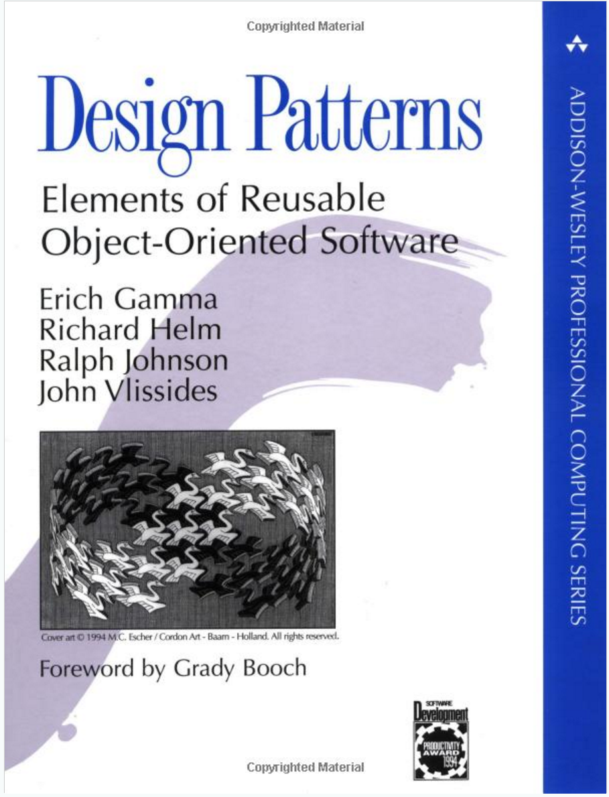
Object-Oriented Design Patterns
Definition: A software design pattern is a commonly repeated approach to constructing software. These approaches are commonly repeated because they consistently produce quality results.
Common Patterns Include:
Singleton
Factory
Delegation
Model-View-Controller
Others
Notes:
“Design Patterns: Elements of Reusable Object-Oriented Software” has been influential in defining software engineering patterns and is regarded as an important source for object-oriented design theory and practice. The authors are often referred to the “Gang of Four (GoF)”
Interview tip: The answer to any question that references design patterns should include “Gang of Four”, “Reusable Object-Oriented Software”, and “Model-View-Controller”. Now let’s learn what those are.
Why Use Patterns?
Using patterns helps us write good software more regularly, because they are tried-and-true approaches to writing it.

Slide 35
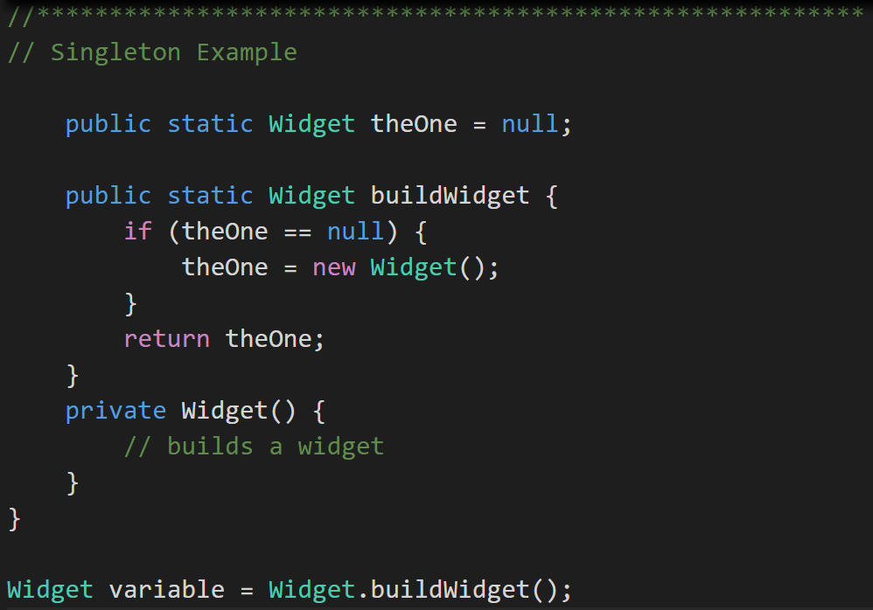
Singleton Design Pattern
Singleton Pattern: Utilized to make sure that only one instance of a class is in existence.
An example would include an application log files that needs to be synchronized across threads. [link]
Notes:
Singleton are pretty easy to understand and come in very handy. A application Logfile class or Configuration file manager are common examples of singletons.
Singleton (making sure there is just one instance of something to avoid conflicts - http://www.oodesign.com/singleton-pattern.html) These are great for coordinating activity across multiple threads of execution or making sure there is a single point of control for a limited resource like a file or printer.
A singleton can be written in Java by making the constructor for the class private and equipping the class with a static function that ensures that the constructor is called only if no other objects of that class already exist.

Slide 36
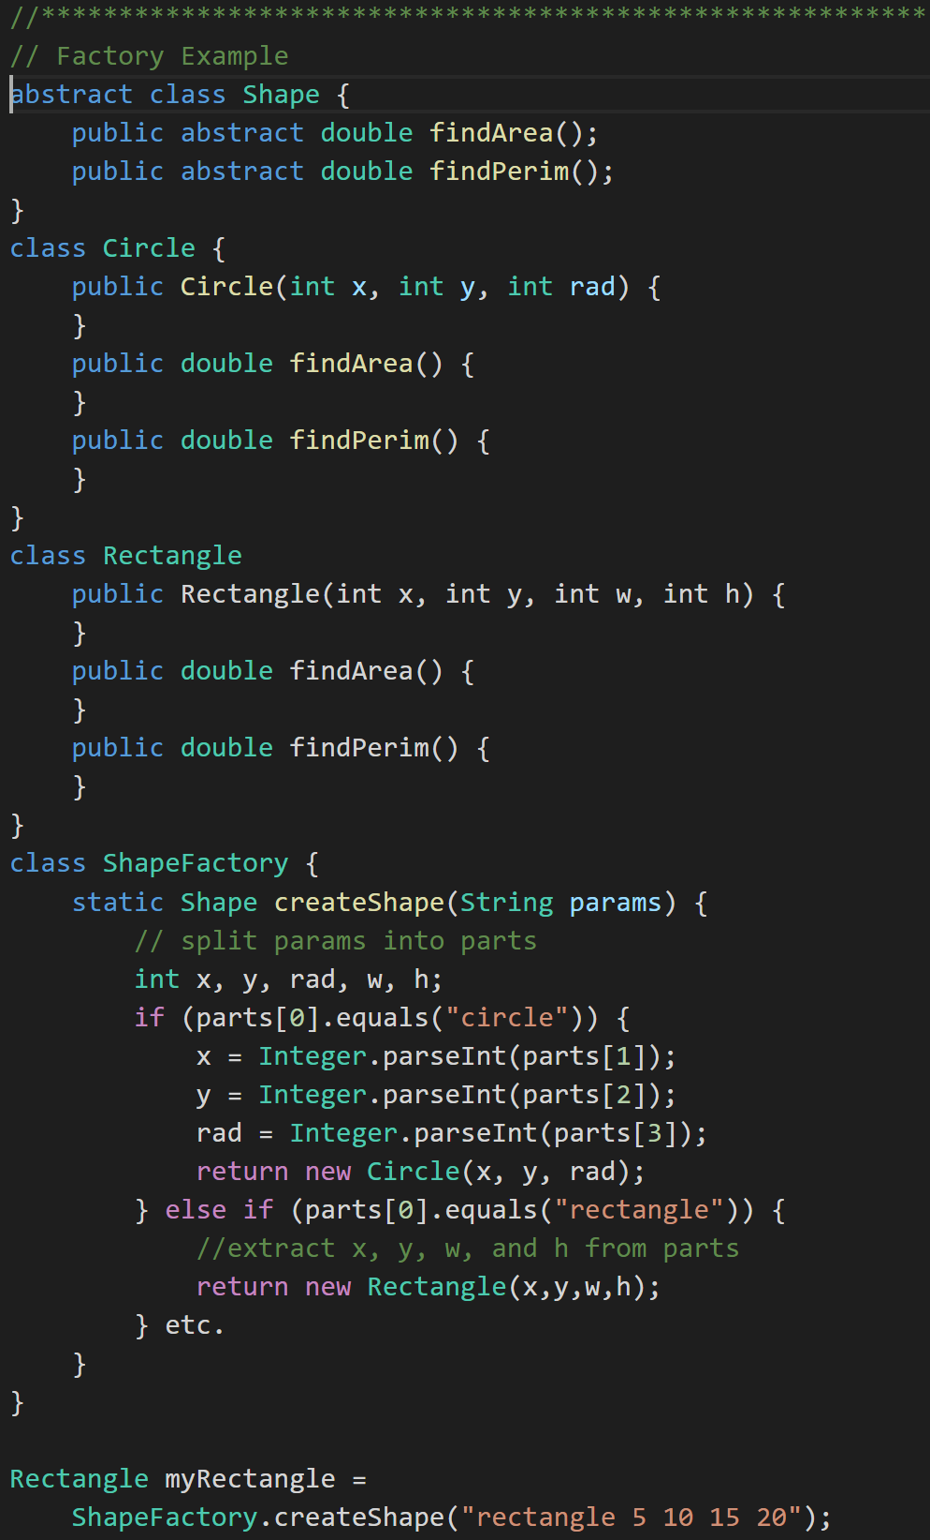
Factory Design Pattern
Factory Pattern: Utilized to create an object without exposing how it is created. [link]
Notes:
An example would have been in our Polymorphic Animal. We could have made an Animal Factory that his the fact that we were just creating random Dogs, Cats, and Bigcats. Then if we wanted to change the ratios or add Animals, we could do it without forcing code changes outside of the Animal Factory.
Another example would be a Shape Factory that return shapes based on input, but does not expose how the shapes are created. See coding example.

Slide 37
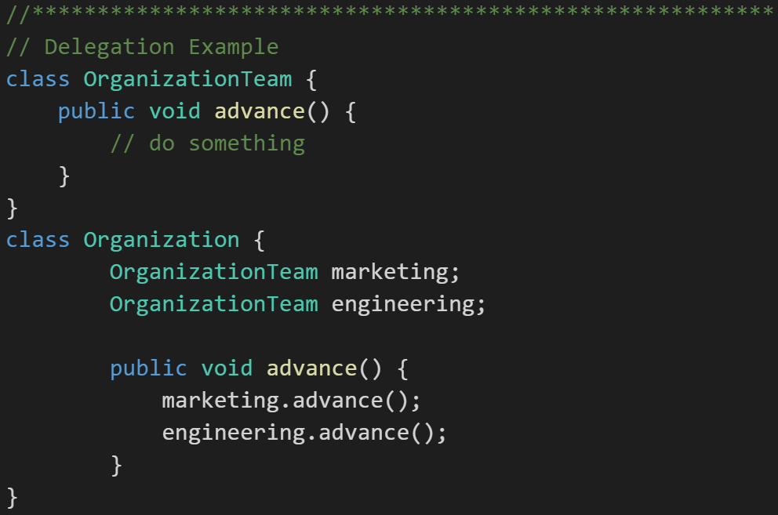
Delegation Design Pattern
Delegation Pattern: In delegation, an object handles a request by delegating to a second object (the delegate). [link]
“Delegation is a way to make composition as powerful for reuse as inheritance” - Grady Booch
Notes:
An example would be an financial application that displays streaming stock prices at the bottom of its windows. We may decide to license an “object” (likely associated with an external service) that we then Delegate the responsibility for displaying on that portion of the screen. Since it may not be technically possible to directly Inherit the functionality from the purchased product, the Delegation pattern allows us to achieve much of the same reuse through an object composition relationship.
Delegation (chain of command; ask an object to do something, which tells something else to do that thing)
Example of the Delegation pattern
In this example, we have software for managing inventory for a manufacturer who makes classroom furniture. We have a variety of writing surfaces that consist of parts. We want to print out our inventory of parts.
class Part {
}
class WritingSurface {
private Part[] parts;
public Part[] listParts() {
}
}
[[Left up to interested reader to complete… or ask for the code.]]

Slide 38
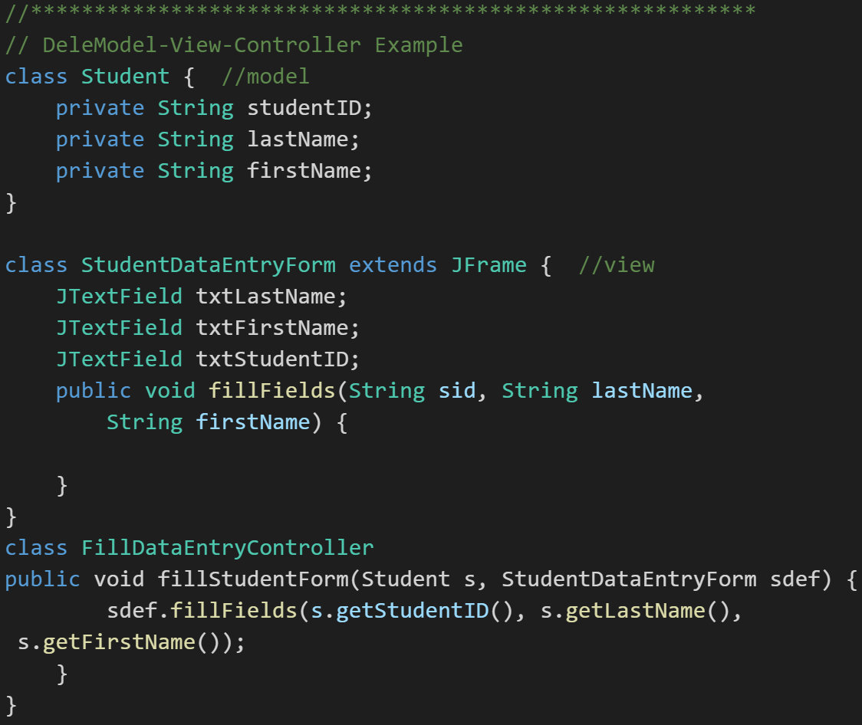
Model-View-Controller
Model-View-Controller (MVC): MVC is an important pattern, will be a primary focus of this course, and will be an important pattern for you to master in your career.
Segregation of our Model (data) from our View (user interface) is necessary to effectively develop, enhance, and maintain modern software.
Notes:
An example would be a system that manages student data. We would want to segregate the Model (data) from the View (UI) for several reasons including that there will likely be many different Views that access the same dataincluding:
student view
faculty view
administrator view,
Web student view,
mobile student view, etc.
Evolution of UI and Data segregation
Document-View (View was responsible for View-Controller functionality)
Model-View-Controller
Model–View–Viewmodel
Learn this Pattern!

Slide 39
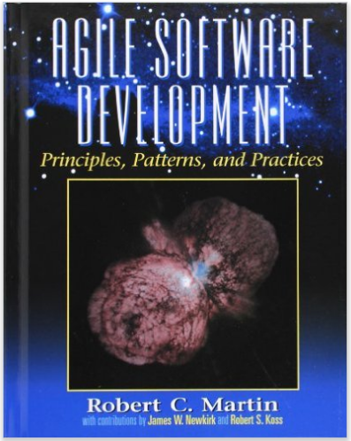
Object-Oriented Design Principles
Martin identifies the following Design Principles:
Open Close Principle
Dependency Inversion Principle
Interface Segregation Principle
Single Responsibility Principle
Liskov's Substitution Principle

Slide 40
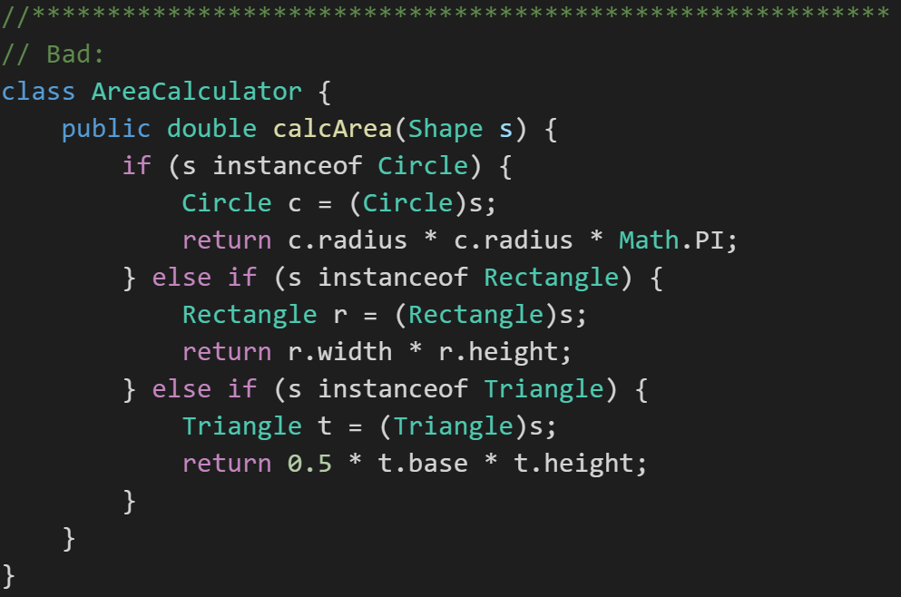
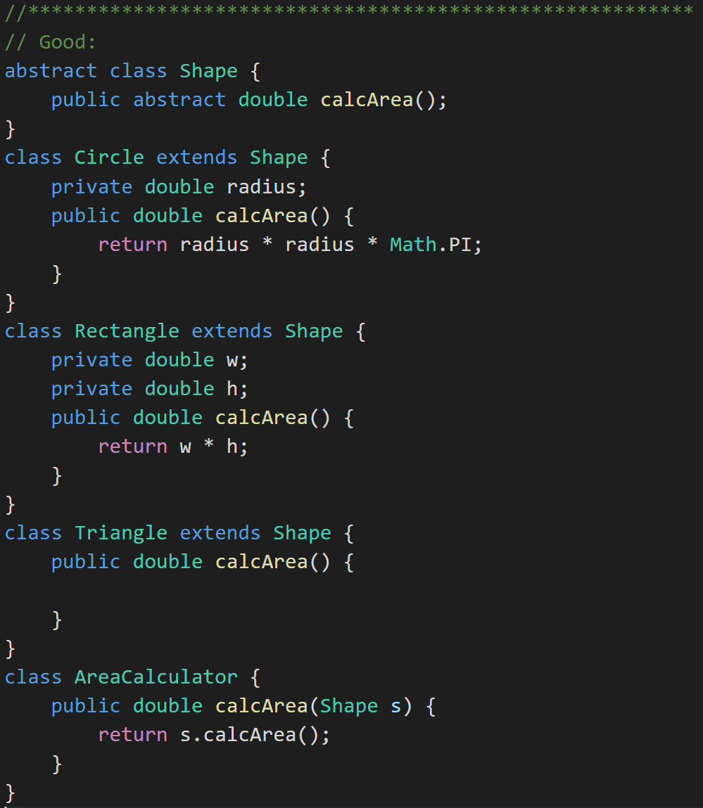
Open Close Principle
Software entities like classes should be open for extension but closed for modifications.
Notes:
Our example of BMI is C was a great example of NOT implementing this principle. We had to modify the core functionality in order to extend it. It take a long time to know if a class exhibits this principle. You only know after a class has been used by multiple other classes (preferably “owned” by other developers), the class has need to be extended (preferably multiple times), and the dependent classes have not had to change (and the dependent developers have not complained).

Slide 41
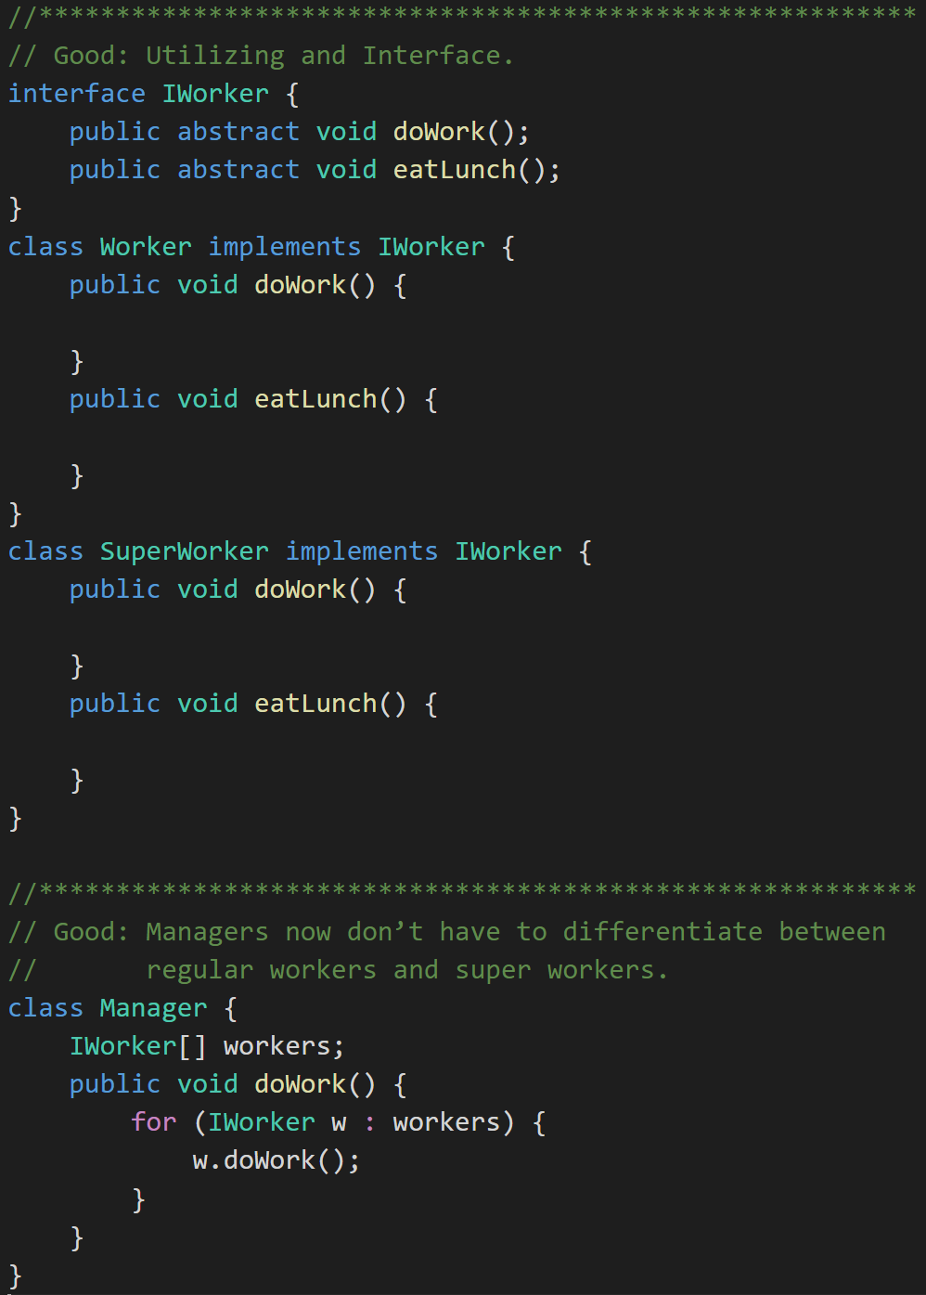
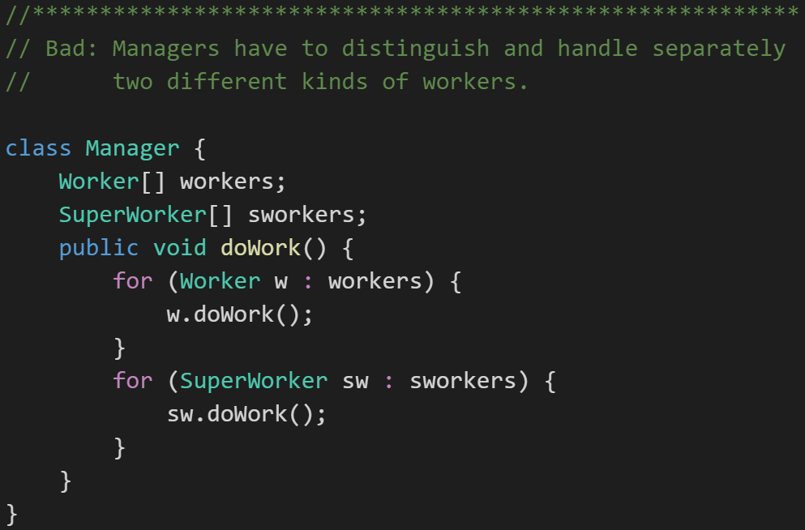
Dependency Inversion Principle
Don't let owners depend on the implementation of the things it owns.
Notes:
For example a Manager class should not have to behave differently depending on if a what type of workers.
One way to comply with Dependency Inversion Principle is to use an interface. An interface is a class-like data type that prescribes behaviors rather than data.

Slide 42
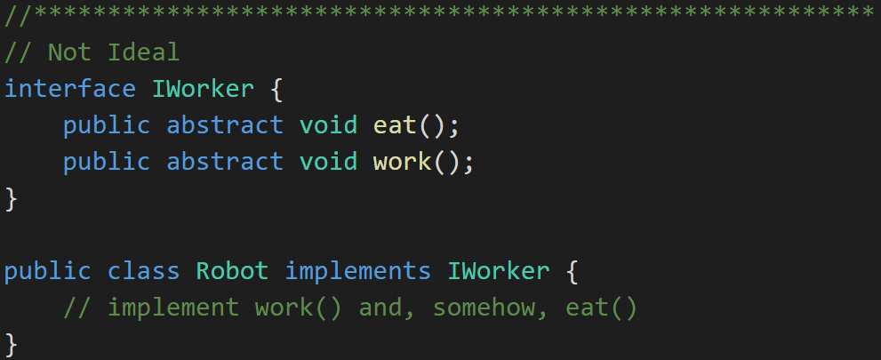
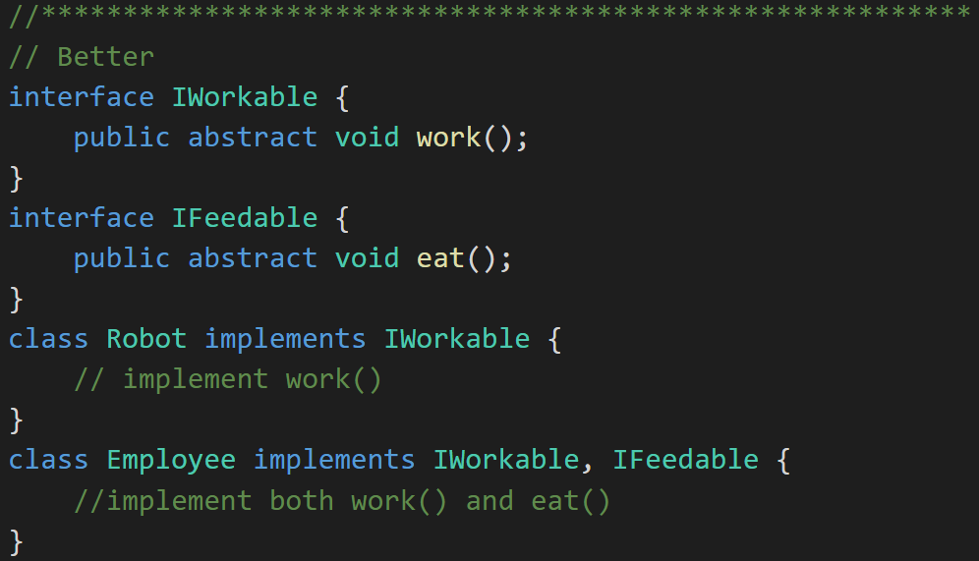
Interface Segregation Principle
Clients should not be forced to depend upon interfaces that they don't use.
Notes:
The previous example has a minor flaw. Consider the IWorker interface. It specifies that workers both eat lunch and do work. What if we end up building and using robotic workers? They don’t have to eat. So, our definition of Worker includes too much and therefore can only be clumsily applied to situations where our understanding of what a worker is might change.

Slide 43
Single Responsibility Principle
A class should have only one reason to change.
An example might be a video player. If you build into the video player class both the responsibility to render the content and control the networking and buffering, you now have two reasons to have to change that VideoPlayer class. Instead, separate out the rendering and the networking/buffering among classes that the VideoPlayer class owns.

Slide 44
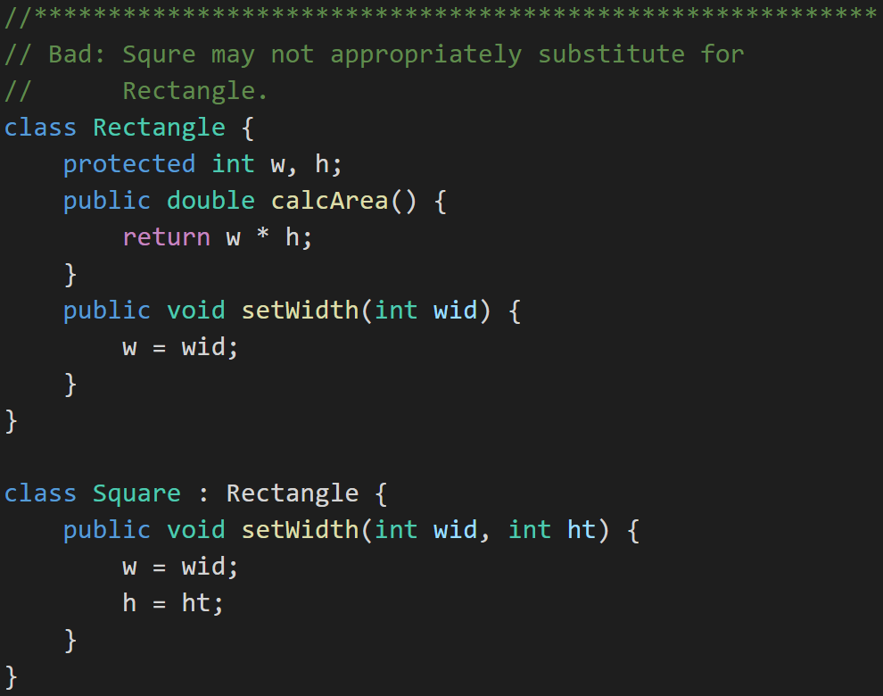
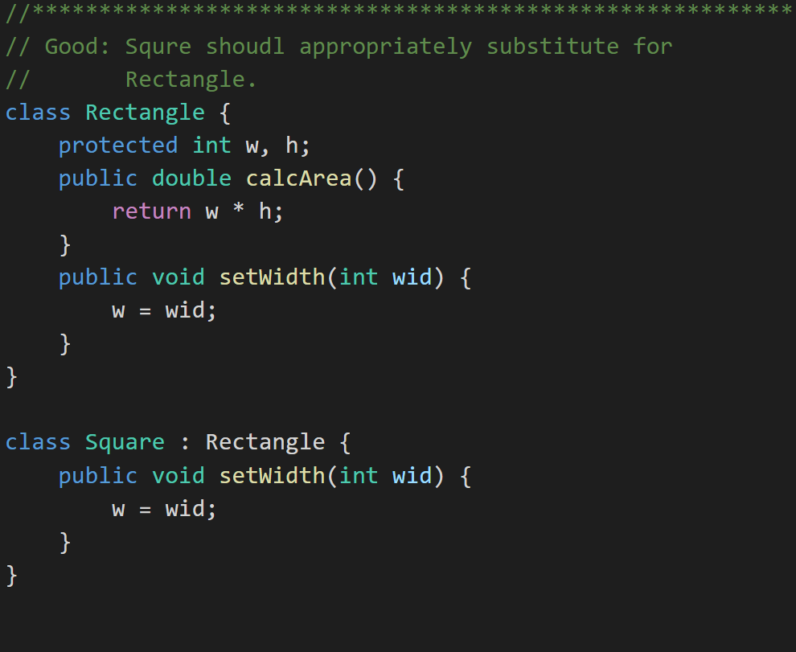
Liskov’s Substitution Principle
Derived classes must be completely substitutable for their base types. And similarly Subclasses should not break core functionality introduced by their parent.
Notes:
Bottom Line About These Principles
We’ll see these principles again as the course continues.
This course mixes theory and practice
We will learn and re-learn these concepts as we learn three object-oriented programming languages. The patterns and principles should remain (largely) consistent across languages and platforms.

Slide 45
Characteristics of Bad Design
Software design principles represent a set of guidelines that helps us to avoid having a bad design. The design principles are associated to Robert Martin who gathered them in "Agile Software Development: Principles, Patterns, and Practices".
According to Robert Martin there are 3 important characteristics of a bad design that should be avoided:
Rigidity – The design/code is hard to change.
Fragility – The design/code is easy to break.
Immobility – The design/code is hard to reuse.
Notes:
Our procedural (C) implementation of BMI would be a great example of Immobility… maybe a good example of all three of these.

Slide 46
Recap: Object-Oriented Programming
Rich is practice and theory with well accepted concepts, patterns, and principles
Consistent support for powerful concepts including features that support:
Encapsulation… and Information Hiding
Inheritance… and Abstraction
Polymorphism
Strong support for delivering extensible, maintainable, supportable, and scalable solutions
Long history of industry success in managing complexity and delivering solutions that minimize rigidity, fragility, and immobility.
Encompasses both design and programming activities
Provides benefit across various development methodologies

Slide 47
Recap: Why Choose an Object-Oriented Approach
#1 – This is the best way we know to consistently deliver high quality software products
#2 – It is the approach demanded by the industry where we hope to be employed
#3 – It’s an enjoyable way to build, enhance, and support software solutions
Notes:
You may have different reasons why you think it is important to learn object-oriented design and programming. That’s okay.

Slide 48
End of Session
Course Number: CPSC-24500
Week: 1
Instructor: Eric Pogue

Slide 49
Bonus Slides
Waterfall vs Iterative vs Agile

Slide 50
Waterfall vs Iterative vs Agile
 | Waterfall | Iterative | Agile
References | United States Department of Defense: DOD-STD-2167A (1985) | Rational Unified Process (RUP) Open Unified Process | Scrum Kanban Scaled Agile Framework (SAFe)
Priorities | Planning and predictability | Architecture, modeling, and efficiency through early detection & fixing of issues | Responsiveness to feedback, efficiency through engineering practices, early detection & fixing of issues
Principles | Execute phases sequentially: Requirements Analysis Design Coding Testing and Operations Define and commit to Scope, Cost, and Timeline “early” Implement strict Change Control | Develop and test iteratively Manage requirements Use components Model visually Verify quality Control changes | Develop, test, deploy, and release iteratively Capture lightweight near term requirements Empower teams Allow requirements to evolve but maintain fixed timelines Apply engineering practices and systems thinking (e.g. TDD) Integrate early user feedback into remaining plan Maintain a collaborative approach between all stakeholders

Slide 51
Waterfall vs Iterative vs Agile (continued)
 | Waterfall | Iterative | Agile
Engineering Standards | None specified | Components and Modeling (UML) XP referenced periodically | XP DevOps
Optimization | Specialization & standardization based on skills, location, and/or technology | Architecture, modeling, and iterations | Fast customer feedback, small cross-functional teams, and working software
Planning Horizon Focus | Years – High Months – High Days – Low | Years – Medium Months – Medium Days – Medium | Years – Low Months – Medium Days – High
Scope and Requirements Management | Scope locked-in after Requirements Phase (approximately one-third through the project) | Requirements are stabilized during Elaboration Phase with smaller changes in later phases | Changes in requirements embraced utilizing lowest priority items as Scope buffer
Prevalent Issues | Timeline and cost overruns | Timeline and cost overruns | Reduced functionality release
Industry Success Rates | Low to Medium | Medium | Medium to High

