Slide 1
Learning Objectives – GUI Java Development
Java
C#
.Net
Python
Eclipse and Visual Studio
Professional Positioning
Notes:
Graphical User Interfaces

Slide 2
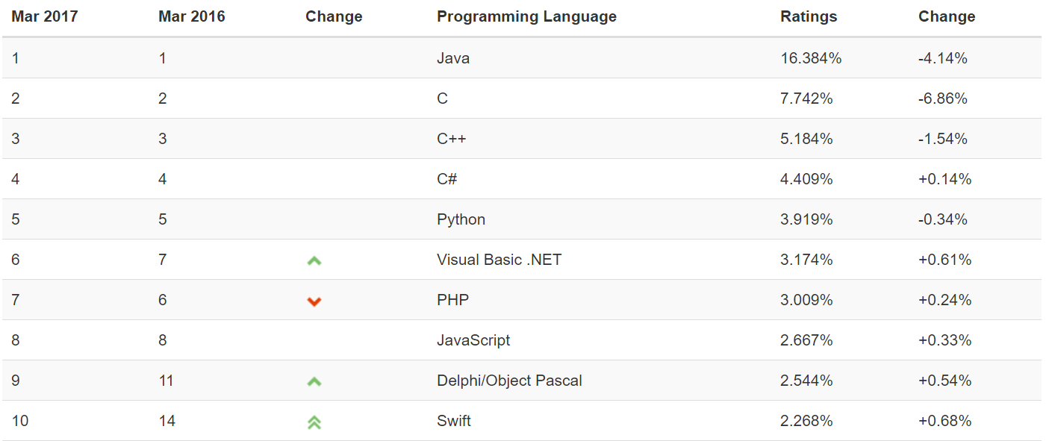
Object-Oriented Languages and Tools
The TIOBE index can be used to check whether your programming skills are still up to date or to make a strategic decision about what programming language should be adopted when starting to build a new software system. The full TIOBE is available online [link].
TIOBE Index for March 2017:
Notes:
We will utilize mostly Java and C# for our object-oriented programming examples. We may (or may not) do any Python work. Since it is often ‘unnatural’ to show procedural programming examples in Java, C#, or Python, we will implement programs in C to demonstrate procedure programming examples. Let me know if you have a desire to do some Python work… or work in another OOP language. If so, we can likely work something out.
Note that our reluctance to utilize C++ as a OOP learning tool is does not diminish the value of the C++ toolset. However, C++ is generally considered a very powerful set of tools with a steep learning curve. It’s a very sharp knife… use it carefully.

Slide 3
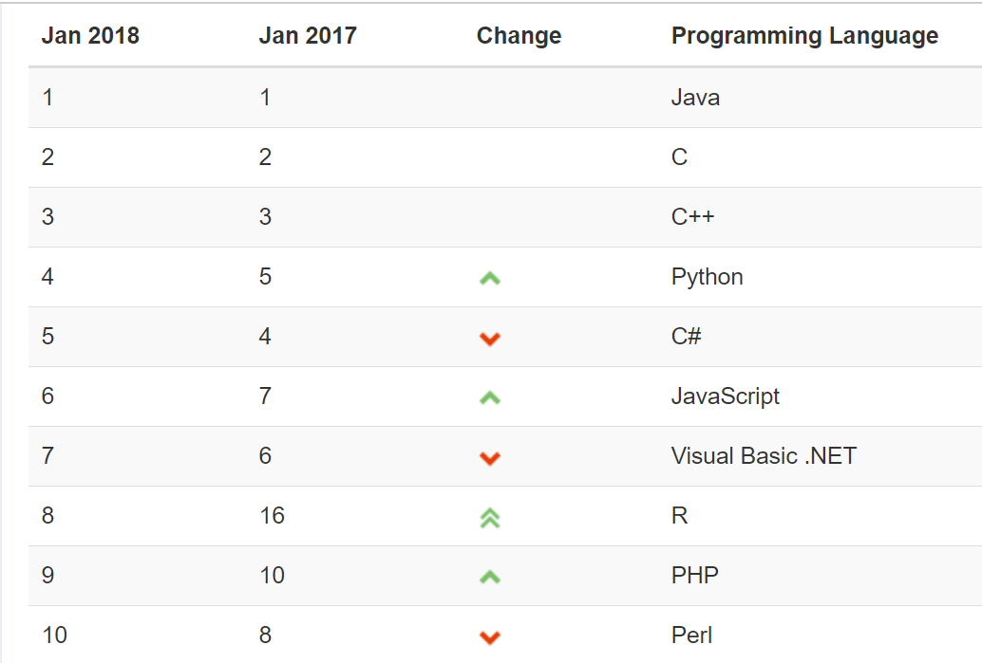
Object-Oriented Languages and Tools
The TIOBE index identifies which programming languages are most prevalent.
TIOBE Index for January 2018:
Notes:
We will utilize mostly Java and C# for our object-oriented programming examples. We may (or may not) do any Python work. Since it is often ‘unnatural’ to show procedural programming examples in Java, C#, or Python, we will implement programs in C to demonstrate procedure programming examples. Let me know if you have a desire to do some Python work… or work in another OOP language. If so, we can likely work something out.
Note that our reluctance to utilize C++ as a OOP learning tool is does not diminish the value of the C++ toolset. However, C++ is generally considered a very powerful set of tools with a steep learning curve. It’s a very sharp knife… use it carefully.

Slide 4
Java
Java is a general-purpose computer programming language that is concurrent, class-based, object-oriented, and specifically designed to have as few implementation dependencies as possible. [link]
Compiles to Java byte codes that run in the Java Virtual Machine (VM)
Achieved portability by running in VMs that exist on many platforms
Achieved dominance in the enterprise and for server side development
Plays a center role in Android development*
Served as a platform for multiple additional languages have been developed to compile to Java bytecode and run in the Java VM including Groovy and Scala
Achieved only minimal success in the development of commercial applications or applets
Syntax Notes: strongly typed, object-oriented, single inheritance, interface focused
Notes:
*The history of Google’s Android and Java is nothing short of a soap opera:
http://www.zdnet.com/article/the-real-history-of-java-and-android-as-told-by-google/
Android uses mostly the Java API but does not have the right to use the Java name. Be aware that Software and Legal Protections can be VERY complicated.

Slide 5
C#... And .NET
C# (pronounced “see sharp”) is a general purpose programming language that implements strong typing, object-oriented (class-based), and component-oriented programming disciplines. It was developed by Microsoft within its .NET initiative. [link]
Compiles to .NET Common Language Runtime (CLR)
Portable between CLR implementations… but MS Windows focused
Portable between Windows desktop, cloud, XBOX, tablets, embedded, and phone
Focused on industrial strength client applications with a solid server-side presence
Syntax Notes: strongly typed, object-oriented, single inheritance

Slide 6
C#... And .NET (continued)
.NET Framework (pronounced dot net) is a software framework developed by Microsoft that runs primarily on Microsoft Windows. It includes a large class library and provides language interoperability (each language can use code written in other languages). Programs written for .NET execute in a software “managed code” environment named Common Language Runtime (CLR). [link]
Implementations for many languages are available for .NET and CLI including Python… but not “real” Java [link]
Provides and object-oriented platform that is language agnostic
ASP.NET is the “standard” .NET Web development environment
Achieving dominance on Windows desktop, competitive place in cloud (Azure), and XBOX

Slide 7
Python
An interpreted language, Python has a design philosophy which emphasizes code readability (notably using whitespace indentation to delimit code blocks rather than curly braces or keywords), and a syntax which allows programmers to express concepts in fewer lines of code than possible in languages such as C++ or Java. [link]
Achieves portability through interpreter running on various platforms
Achieved great success as a “quick-and-dirt” scripting tool
… and in the data sciences realm
Runs slower because it is interpreted
Shares a similar space to other scripting languages like Perl and PowerShell
Syntax Notes: loosely typed, indent sensitive (no brackets or semi-colons), object-oriented

Slide 8
Professional Positioning
Become a professional software developer with depth in on or two areas (i.e. an expert in web application development in Java) and an understanding of several more (i.e. know a little system admin / devops and something about the healthcare industry).
Do NOT become the Java expert (only)
Languages and environments are tools, you will need to know several and be able to learn more
Branch out and play other related roles like business analyst, project manager, team leader, database analyst, product manager, architect, etc.
Know something about the domain
Get out and see your customers and business partners

Slide 9

Eclipse IDE
Eclipse is an integrated development environment (IDE), and is the most widely used Java IDE. It contains a base workspace and an extensible plug-in system for customizing the environment.
Eclipse is written mostly in Java and its primary use is for developing Java applications, but it may also be used to develop applications in other programming languages via plug-ins, including C, C++, C#, COBOL, D, Fortran, JavaScript, PHP, Python, R, Ruby, Rust, and Scala.
The Eclipse software development kit (SDK), which includes the Java development tools, is meant for Java developers.

Slide 10
Microsoft Visual Studio
Microsoft Visual Studio is an integrated development environment (IDE) from Microsoft. It is used to develop computer programs for Microsoft Windows, as well as web sites, web apps, web services and mobile apps. It can produce both native code and managed code. [link]

Slide 11
Eclipse & Java
Let’s make sure that we understand:
… embrace your IDE
New Application Wizard*… mixed blessings
Text Editor
Debugger!
Debug vs. Release builds
Project and source code files

Slide 12
Visual Studio & C#
Let’s make sure that we understand:
Visual Studio 2017… embrace your IDE
Visual Studio New Application Wizard*… mixed blessings
Visual Studio Text Editor
Debugger!
Debug vs. Release builds
Project and source code files

Slide 13
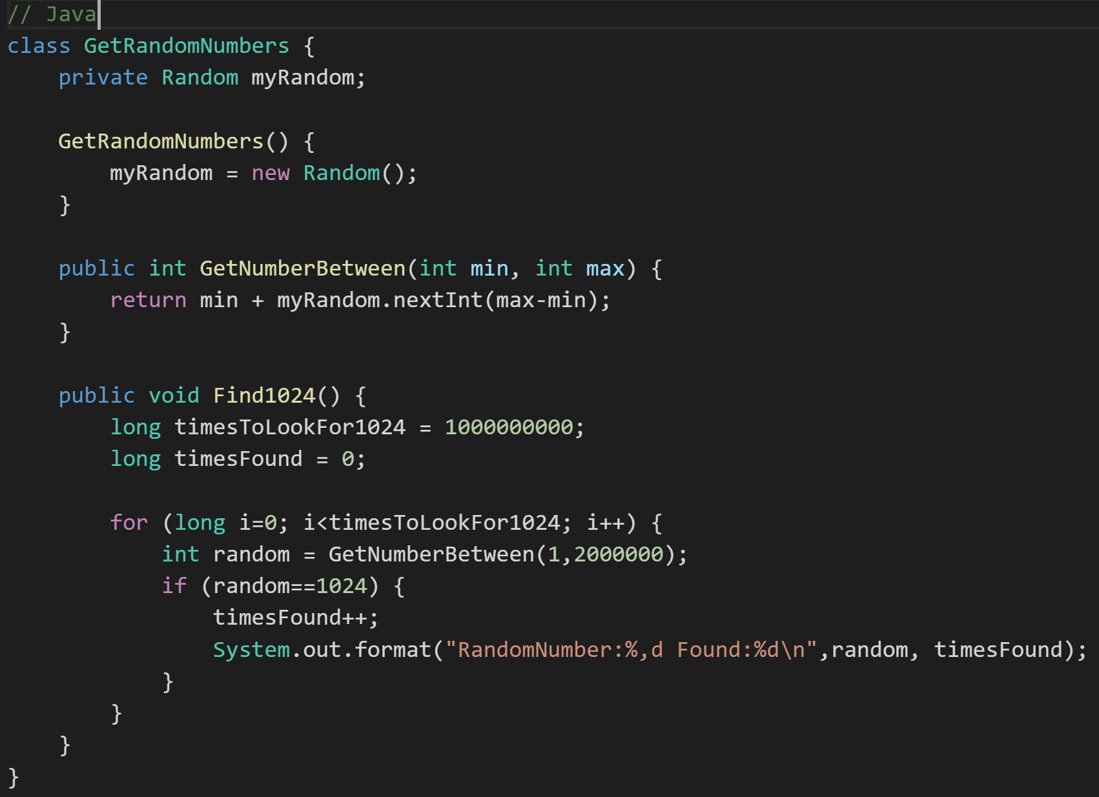
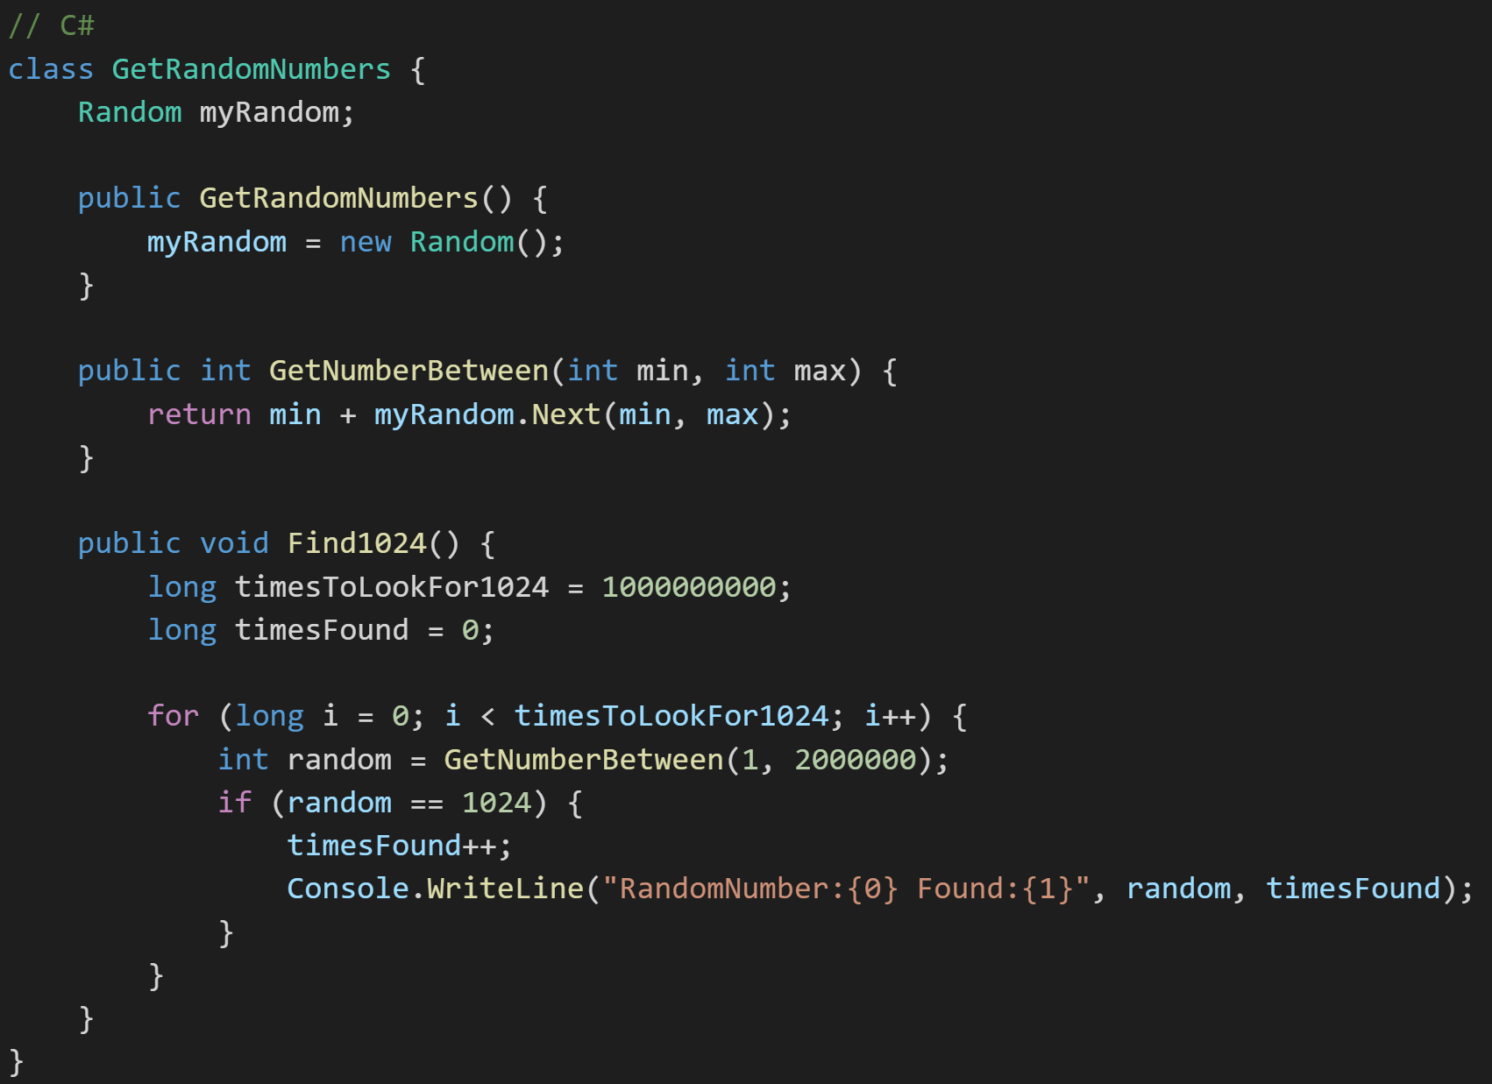
Java vs. C# Java GetRandomNumbers Class
Notes:
Shockingly similar code.

Slide 14
.NET (C#) Lists
The .NET framework offers multiple implementations of Collections and Collections.Concurrent including:
List [link]: Represents a strongly typed list of objects that can be accessed by index. Provides methods to search, sort, and manipulate lists.
ArrayList [link]: Implements the IList interface using an array whose size is dynamically increased as required.
ConcurrentQueue [link]: Represents a thread-safe first in-first out (FIFO) collection.
Notes:
Become comfortable in looking at the online documentation and examples… be aware of “reputable” sources and conflicting documentation.
.NET ArrayList Thread Safety: Any public static (Shared in Visual Basic) members of this type are thread safe. Any instance members are not guaranteed to be thread safe.
If you run into threading issues with ArrayaList in your assignment, you will need to switch over to a “Concerrent” collection list “ConcurrentQueue”.

Slide 15
End of Session

