Slide 1
Learning Objectives – Week 5
Understand performance optimization, threads, and how to develop and optimize multi-treaded Java applications
Single threaded vs. Multithreaded Development
Multithreaded development challenges
Suggested Multithreading Exercise
Notes:
Themes for the week:
Writing/Reading files and Serialization
XML & JSON
Performance, performance, performance…
Optimization through threads
Note that given the industry prioritization on developing high performance multithreaded applications, I have made multithreading a higher priority than in past terms of this class… this has resulted in JUnit and automated unit testing becoming a bit less of a focus.
Effectively packaging Java class files for sharing
Delivering quality products through design, development, and testing

Slide 2
Performance Optimization and Threading
Performance is critical in application development… the focus of performance optimization continues to evolve, but the criticality remains very high! Multithreading is one very important way that we can optimize CPU performance; however, there are many other performance bottlenecks and optimization techniques:
CPU… threading
Memory… optimize disk usage, buy more memory
Disk IO… buffering, file size, or faster (more expensive) disks
Network bandwidth… “file” or package size
Network latency… pray for a miracle!
User Interaction and Capabilities
Notes:
I believe that performance optimization is one of the most important and challenging aspects of developing high quality software.
Consider mobile phone networks and satellite networks… and latency.
User experience.
Know the difference between latency and bandwidth and how it impacts network and application performance:
https://en.wikipedia.org/wiki/Network_performance
The following measures are often considered important:
Bandwidth commonly measured in bits/second is the maximum rate that information can be transferred
Latency the delay between the sender and the receiver decoding it, this is mainly a function of the signals travel time, and processing time at any nodes the information traverses
Throughput is the actual rate that information is transferred
Jitter variation in packet delay at the receiver of the information
Error rate the number of corrupted bits expressed as a percentage or fraction of the total sent
You can usually buy more bandwidth. Fixing a latency issue might require you to change the speed of light.

Slide 3
Threads & Multithreaded Applications
Multithreading: A technique by which a single set of code can be used by several processors or cores at different stages of execution.
Threads and application performance are becoming nearly synonymous
Moore’s law only remains achievable if we can effectively utilize multi-processor, multi-core, and multi-threaded applications
Our performance principles that we discuss will be applicable across platforms and environments
Our practical focus will be on Java multi-threading
Parallel processing has become the focus of the computing and software development industry
The rise of big data, artificial intelligence, virtual/augmented reality, and dedicated graphical processing units (GPUs) have made that a nearly guaranteed trend for years to come
Notes:
The difference between user perceived (real or perceived) is as important as actual performance. Optimizing application performance to reflect user capabilities is challenging and necessary. It doesn’t matter if you optimize an application to be 10 times faster if the bottleneck is how fast the user.
Multithreading is the primary method of optimizing CPU performance. It is unlikely to be of benefit if the bottleneck is elsewhere. For example, if you are disk bound, splitting your process into multiple threads is unlike to be of benefit.

Slide 4
Processors, Cores, and Threads
Computers have one or more Processors (CPUs)
Processors each have one or more Cores
Cores can create one or more Threads
An application running only on one thread of a dual cpu, quad-core, single thread can utilize only a portion of 1/8th of the processing power of that machine
Notes:
For this discussion we will using multithreading and multiprocessing terms synonymously for our purposes.
Modern central processing units (CPUs) are made up of cores. A core is like a mini-processor that works with its fellow cores to perform the work that applications request of the CPU. In the old days, a CPU had just one core, a single channel through which all requests would pass. This was how we optimized applications… CPU, memory, fast disk, slow disk. Today, though, with multiple CPUs and multiple cores, a CPU can pay attention to and do many things at once.
This architecture, in turn, allows today’s applications to perform multiple tasks at once. This ability is called multitasking. Multitasking enables an

Slide 5
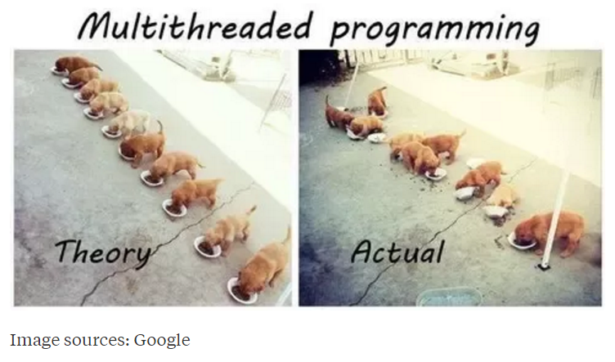
Multi-Threaded Development
Now for the bad news. Multi-Threaded Development is really hard!
Notes:
Rigidity - It is hard to change because every change affects too many other parts of the system
Fragility - When you make a change, unexpected parts of the system break
Immobility - It is hard to reuse in another application because it cannot be disentangled from the current application
Stadia add-in net change example.
Deadlock describes a situation where two or more threads are blocked forever, waiting for each other. Deadlock occurs when multiple threads need the same locks but obtain them in different order.

Slide 6
Multithreaded Development
Now for the bad news. Multi-Threaded Development is really hard!
Developing commercial quality multi-threaded applications makes Rigidity, Fragility, and Immobility much harder to avoid
Many of the 3rd party professional libraries that the industry had come to rely on came into question as multi-threading application became required
Testing becomes harder when a sequence of events becomes variable
What if your automated unit test results might be different depending on which thread finishes first?
What about deadlock?
Performance is so important that we will need to understand be able to effectively utilize, test, and deploy effective multi-threaded applications
Notes:
Rigidity - It is hard to change because every change affects too many other parts of the system
Fragility - When you make a change, unexpected parts of the system break
Immobility - It is hard to reuse in another application because it cannot be disentangled from the current application
Increased complexity is the primary disadvantage for developing multithreaded applications.
Some languages have come into existence in order to try to reduce the complexity of writing, enhancing, and supporting multithreaded applications. For example, Scala has implemented specific parallelization features in the core language that make it a first class threading language. Note that Scala also targets the Java runtime environment.
C++ would be an example of a language that has implemented a plethora of threading mechanisms for various platforms and implementations. Recent versions have introduced more common approaches.
Stadia add-in example.
Deadlock describes a situation where two or more threads are blocked forever, waiting for each other. Deadlock occurs when multiple threads need the same locks but obtain them in different order.
Interesting threading article:
http://blog.smartbear.com/programming/why-johnny-cant-write-multithreaded-programs/
When reviewing libraries look for something like “This class is immutable and thread-safe.” before you use it in multithreaded development.

Slide 7
Suggested Multithreaded Exercise
ThreadedRandomNumbers: Calculate 1,000,000,000 random numbers between 1 and 2,000,000. Print “We found number 1024!” to the console each time 1024 is generated. We would expect it to come up approximately 500 times.
Write a single threaded application
Divide the application into multiple threads and repeat
Consider the diminishing returns of adding additional threads
Implement by extending Thread
… and by implementing Runnable
Notes:
It’s good to have a trivial subject matter when starting with threaded applications. It’s challenging enough to learn a complex new topic when working with a random number or a prime number.
Bonus 10 points for anyone who can implement this application using “implements Runnable” and have it execute at the same speed as the “extending Thread” version… or explain why it performs consistently slower than the extends Thread implementation.

