Slide 1
Learning Objectives – Week 5
Explain software testing terms including unit, integration, user acceptance, performance testing, manual, automated, verification, validation, etc.
Understand the importance of testing and the criticality of finding/fixing defects early
Explain the purpose, syntax, and annotations of the various assert statements JUnit supports
Install JUnit onto your machine and execute a JUnit test on your application

Slide 2
Software Testing Overview
Software Testing [link] is important because, if done right, it can help us find and fix problems earlier and make our system delivery process less immobile, rigid, and fragile.
As future developers in an object-oriented programming class, we are going to:
Understand testing within the various Software Development Lifecycles
Understand testing terminology
Know how to develop applications that are easier to test
Master Unit Testing and Automated Testing
Notes:
Never underestimate the value of good design and implementation (for testability, encapsulation, etc.) on the economics of testing. You can’t afford to test in quality!
Developers are responsible for product quality. Tester should be able to minimize that chance that a defect makes it to production.
We test to find defects and/or to validate that we have not introduced new defects.
Defects are exponentially more expensive to fix the longer the exist.
Performance issues are often the most difficult and expensive defects to fix. They are often not found until the application if running under production load… which is often only when it is in production.
Unit - $200
Integration - $600
User Acceptance - $6,000
Production - $100,000+
The permutations of modern software features, data, tools, environments, etc. quickly becomes unmanageable. Testability needs to be goal of nearly all non-trivial applications.
Dave Cutler of Windows NT fame had a quote. I wish I could remember the exact words, but it went something like, “I hate having testers because they give developers the false hope that someone else can save them from their sins.”

Slide 3
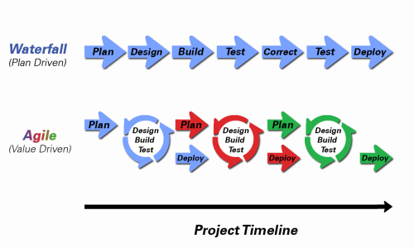
Object-Oriented Programming within Various Development Methodologies
Notes:
Development Methodology and Software Development Lifecycle (SDLC) are often used interchangeably.
The Iterative development methodology is not depicted here as even the mainstays and inventors of the Iterative development methodology seem to be moving toward agile. Plus as Waterfall “holdouts” move, they seem to be moving directly toward Agile. Can you start to see my biases?
Development Methodologies (SDLCs) are a future Bonus Topic. There are several optional slides t the end of this deck. Let me know if you would like to have a more formal overview of the topic as part of this class. I have a passion in this area.
Object oriented-programming concepts/practices evolve and reprioritize depending on the development methodology.
For example, in Waterfall (as well as in Iterative) object-oriented design often play a critical role in the (big upfront) design activities. UML diagrams and project artifacts are often important to the overall project success. (opinion) Practical reality has been that these design artifacts often do not reflect the actual implementation and are rarely maintained or updated.
The Agile practitioners do not reject these design artifacts. However, the focus on shorter time horizons, evolving architecture, and working code changes the value proposition for object-oriented practices to more focus on the build, test, enhance activities.

Slide 4
Waterfall vs Iterative vs Agile
 | Waterfall | Iterative | Agile
References | United States Department of Defense: DOD-STD-2167A (1985) | Rational Unified Process (RUP) Open Unified Process | Scrum Kanban Scaled Agile Framework (SAFe)
Priorities | Planning and predictability | Architecture, modeling, and efficiency through early detection & fixing of issues | Responsiveness to feedback, efficiency through engineering practices, early detection & fixing of issues
Principles | Execute phases sequentially: Requirements Analysis Design Coding Testing and Operations Define and commit to Scope, Cost, and Timeline “early” Implement strict Change Control | Develop and test iteratively Manage requirements Use components Model visually Verify quality Control changes | Develop, test, deploy, and release iteratively Capture lightweight near term requirements Empower teams Allow requirements to evolve but maintain fixed timelines Apply engineering practices and systems thinking (e.g. TDD) Integrate early user feedback into remaining plan Maintain a collaborative approach between all stakeholders
Notes:
The views on testing and change management have changed dramatically as organizations have moved from Waterfall to Iterative to Agile development lifecycles.
Successful Agile (and Iterative) Development REQUIRES better application design, development techniques, and testing practices.
Testing and lack of defects are not the end goal. A higher quality more usable more cost effective product is the goal.

Slide 5
Testing Terms
Important testing terms include:
Unit Testing: developer testing their own code
Integration Testing: development team testing their full code
System Testing: multiple development teams testing a full system or systems
Performance Testing: testing performance at the Unit, Integration, and/or System level
Manual Testing: a person using the application often running test scenarios
Automated Testing: a group of automated tests that run on the application in the Unit, Integration, System, or Performance testing areas
UI Automated Testing attempts to exercise the application be reproducing user events (key & mouse events)
API Automated Testing occurs at the function/method API level (JUnit for example)

Slide 6
Testing Terms
Important testing terms (continued):
Verification: does the application perform as expected
Validation: does the application provide the business benefit that was expected
Behavioral Testing: verifying that the correct functions were called with the correct parameters
State Testing: focuses on the results of those calls

Slide 7
Automated Testing
Unit testing can be done in two ways − manual testing and automated testing.
Automated testing has become a more important part of effective software testing. The pros of Automated Testing include:
Repeatable tests that are quick to run and can support Iterative and Agile development
Very effective in validating environments and doing “smoke tests” to make sure a new build meets a minimal set of requirements
Supports Performance Testing very effectively
Finds range defects
Very inexpensive and quick to repeat testing and validate fixes
Various implications include UI, API, and Unit automation tests
Notes:
False positives versus valid defects found.
Manual Testing and Automated Testing can be supportive of each other.

Slide 8
Automated Testing
Unit testing can be done in two ways − manual testing and automated testing.
Some of the benefits of Automated Testing have been oversold. Some of the challenges include:
Developers only rarely can come up with scenarios in scripts that they would not already have tested in their unit testing… they often don’t know what they don’t know
UI focused Automated Testing (key & mouse events) are often challenging and create a great number of false-positives
API Level Automated Testing (REST) are often more useful and easier to maintain
Environmental verification, API, and finally UI Automated testing is generally the best order to show value quickly with Automated Testing
Automated Testing investment is often not prioritized or tracked so it is difficult to know its effectiveness
Scripts can be expensive to develop and maintain
Notes:
False positives versus valid defects found.
Manual Testing and Automated Testing can be supportive of each other.

Slide 9
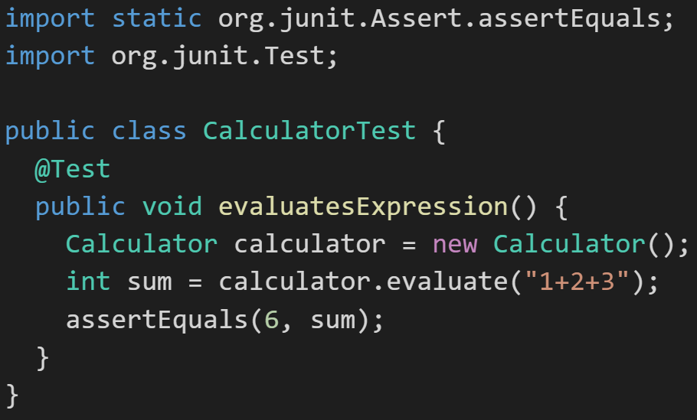
JUnit
Unit testing can be done in two ways − manual testing and automated testing.
JUnit [link] is a Automated Testing framework focused on developing and running Unit test for Java applications. JUnit:
Is a Java opensource extension
Provides annotations to identify test methods.
Provides assertions for testing expected results.
Provides test runners for running tests.
JUnit tests allow you to write codes faster, which increases quality.
JUnit is elegantly simple. It is less complex and takes less time.
JUnit tests can be run automatically and they check their own results and provide immediate feedback. There's no need to manually comb through a report of test results
Notes:
@Test
identifies the method as a test method (remember, method and function are synonyms)
@Test(expected = Exception.class)
fails if the method does not throw the named exception
@Test(timeout=100)
fails if the method takes longer than 100 milliseconds
@Before
public void method()
This method is executed before each test. It is used to prepare the test environment.
@After
public void method()
This method is executed after each test. It is used to clean up the test environment, including cleaning up expensive memory structures.
@BeforeClass
public static void method()
This method is executed once, before any test is done. It is used to do time-intensive tasks before any test is done.

