Slide 1
The Architecture of SaaS Applications
Engineering Software as a Service

Slide 2
Ruby on Rails vs. NodeJS (JavaScript)
© 2013 Armando Fox & David Patterson, all rights reserved

Slide 3
The Web as a Client-Server System
Engineering Software as a Service §2.1–2.2
© 2013 Armando Fox & David Patterson, all rights reserved

Slide 4
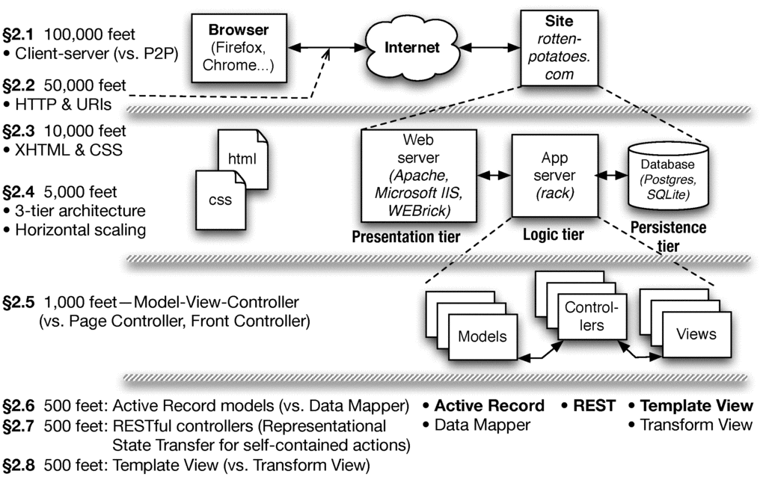

Slide 5

Web at 100,000 feet
The web is a client/server architecture
It is fundamentally request/reply oriented
Web browser
Web site
Internet

Slide 6


Client-Server vs. Peer-to-Peer
High-level architecture of the overall system
Soon we’ll talk about architecture inside boxes
Client and server each specialized for their tasks
Client: ask questions on behalf of users
Server: wait for & respond to questions, serve many clients
Design Patterns capture common structural solutions to recurring problems
Client-Server is an architectural pattern
C
C
P
P
S
P
C
P
P
C
P

Slide 7
Nuts and bolts: TCP/IP protocols
IP (Internet Protocol) address identifies a physical network interface with four octets, e.g. 128.32.244.172
Special address 127.0.0.1 is "this computer", named localhost, even if not connected to the Internet!
TCP/IP (Transmission Control Protocol/Internet Protocol)
IP: no-guarantee, best-effort service that delivers packets from one IP address to another
TCP: make IP reliable by detecting “dropped” packets, data arriving out of order, transmission errors, slow networks, etc., and respond appropriately
TCP ports allow multiple TCP apps on same computer

Slide 8
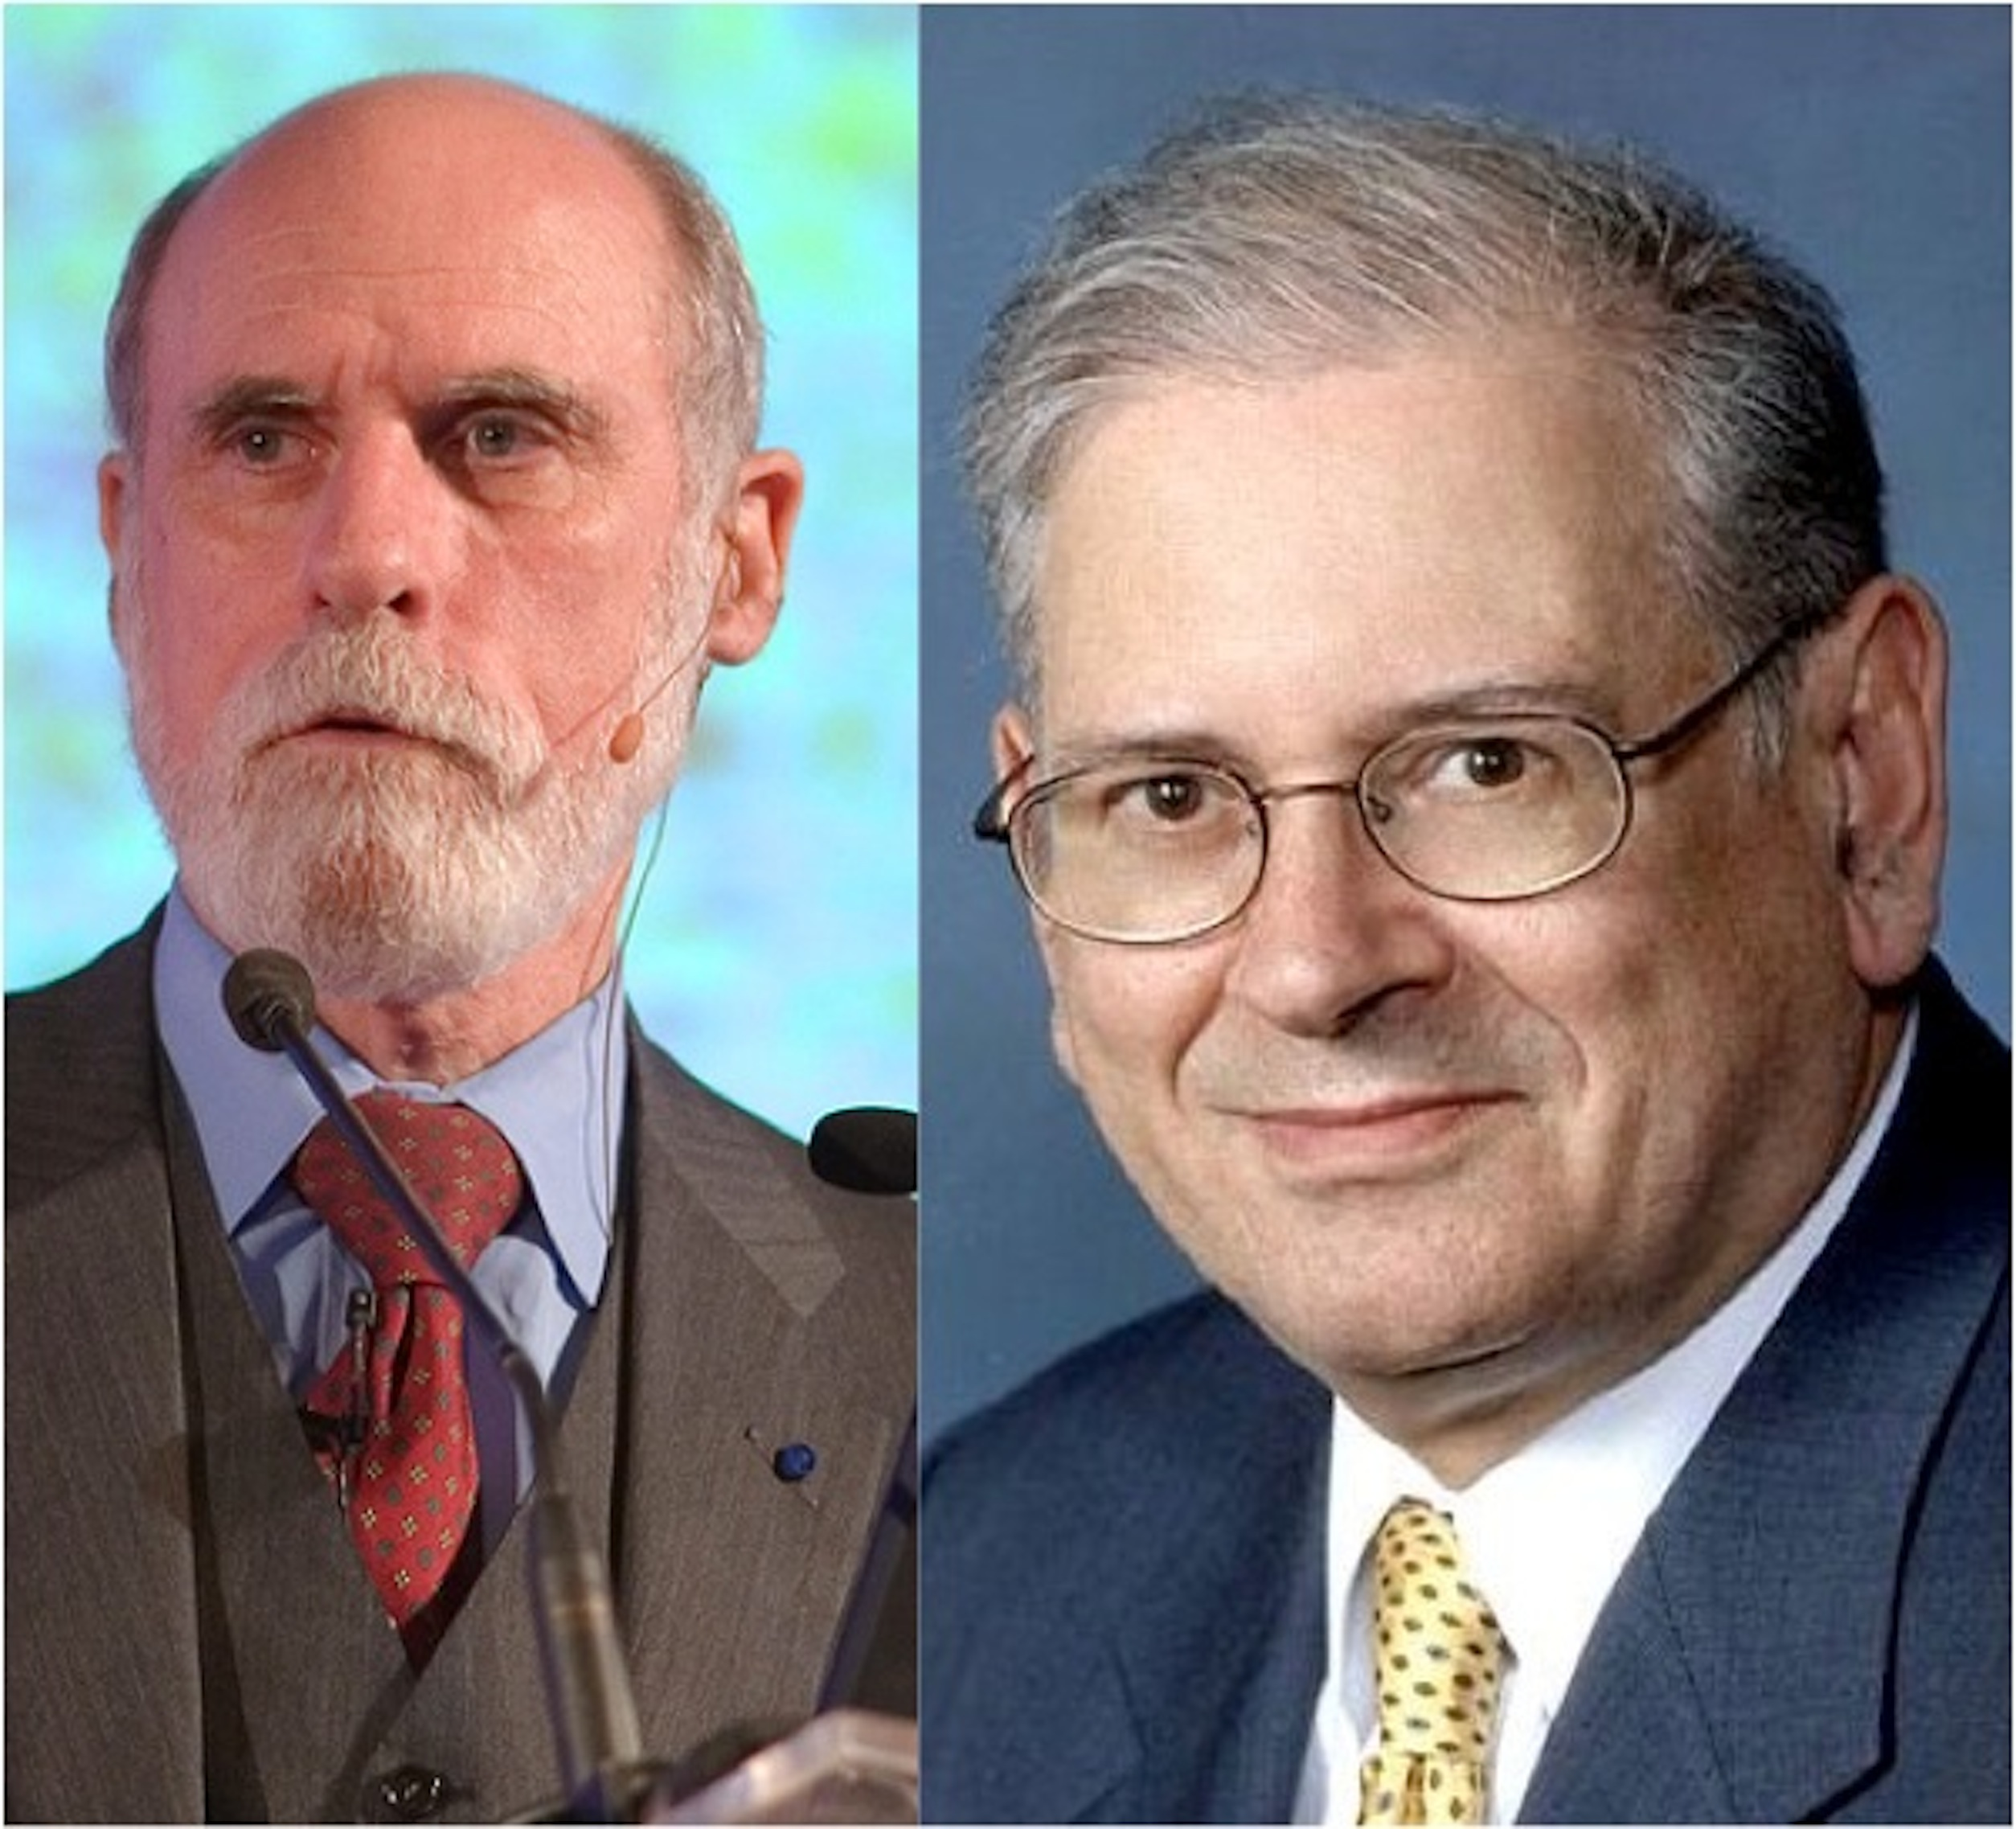
TCP/IP protocols (cont.)
Vint Cerf & Bob Kahn: 2004 Turing Award for Internet architecture and protocols, including TCP/IP
GET /bears/
GET /bears/
HTTP/0.9 200 OK
HTTP/0.9 200 OK

Slide 9
Web at 100,000 feet
The web is a client/server architecture
It is fundamentally request/reply oriented
Domain Name System (DNS) is another kind of server that maps names to IP addresses
Web browser
Web site
DNS server

Slide 10
Hypertext Transfer Protocol
an ASCII-based request/reply protocol for transferring information on the Web
HTTP request includes:
request method (GET, POST, etc.)
Uniform Resource Identifier (URI)
HTTP protocol version understood by the client
headers—extra info regarding transfer request
HTTP response from server
Protocol version and Status code
Response headers
Response body
HTTP status codes:
2xx — all is well
3xx — resource moved
4xx — access problem
5xx — server error

Slide 11
Assuming “>” means “relies on”, which statement is NOT correct?
DNS > IP
HTTP > TCP > IP
TCP > DNS
All the above are correct

Slide 12
HTTP is Stateless
Each HTTP call in completely independent
Pros:
Efficient
Scalable
Simple
Cons:
Multi-step processes
The “Back” button!
Notes:
Demo: see cookie arriving from Google.com
curl -D - http://www.google.com -o /dev/null

Slide 13
Cookies
Observation: HTTP is stateless
Early Web 1.0 problem: how to guide a user “through” a flow of pages?
use IP address to identify returning user? ✖ public computers, users sharing single IP
embed per-user junk into URI query string? ✖ breaks caching
Quickly superseded by cookies
Watch: screencast.saasbook.info
Rails manages tamper-evident cookies for you
Notes:
Demo: see cookie arriving from Google.com
curl -D - http://www.google.com -o /dev/null

Slide 14
Uses of cookies
Most sites quickly realized that the per-user state could be used for lots of things:
customization (“My Yahoo”)
click tracking/flow tracking
authentication (logged in or not)
Which of these could be implemented on the client side? Which ones shouldn't be and why?
A golden rule: don’t trust the client—cookies must be tamper-evident

Slide 15
A ____ can create and modify cookies; the ____ is responsible for including the correct cookie with each request
Browser; SaaS app
SaaS app; browser
HTTP request; browser
SaaS app; HTTP response

Slide 16
3-tier shared-nothing architecture and Scaling
Engineering Software as a Service §2.4
Armando Fox

Slide 17
Notes:
Physical view…

Slide 18
Dynamic content generation
In the Elder Days, most web pages were (collections of) plain old files
But most interesting Web 1.0/e-commerce sites run a program to generate each "page"
Originally: templates with embedded code “snippets”
Eventually, code became “tail that wagged the dog” and moved out of the Web server

Slide 19
Sites that are really programs (SaaS)
How do you:
"map" URI to correct program and function?
pass arguments?
invoke program on server?
handle persistent storage?
handle cookies?
handle errors?
package output back to user?
Frameworks support these common tasks
Filesystem
or database
persistence
logic (app)
your app
Common Gateway Interface (CGI)
presentation (Web server)
client (browser)
Notes:
HTTP stateless: IP addr? cookies? sessions in DB? other?
(why would you consider a specialized store?)

Slide 20
Developer environment vs. medium-scale deployment
file.sqlite3
MySQL
SQLite adapter
MySQL adapter
MySQL adapter
MySQL adapter
Rails library
Rails library
Rails library
Rails library
rack
rack
rack
rack
Webrick
thin
thin
thin
Page cache
Apache w/mod_rails + caching mode
Developer
Medium-scale deployment
Notes:
Why small machine for DB?
How many processes & how many machines in each example?

Slide 21
Large-scale deployment
PostgreSQL
Database
cache
“Dynos” running
apps
HTTP servers & static asset caches
Large-scale curated deployment, e.g. Heroku
Notes:
Why small machine for DB?
How many processes & how many machines in each example?

Slide 22
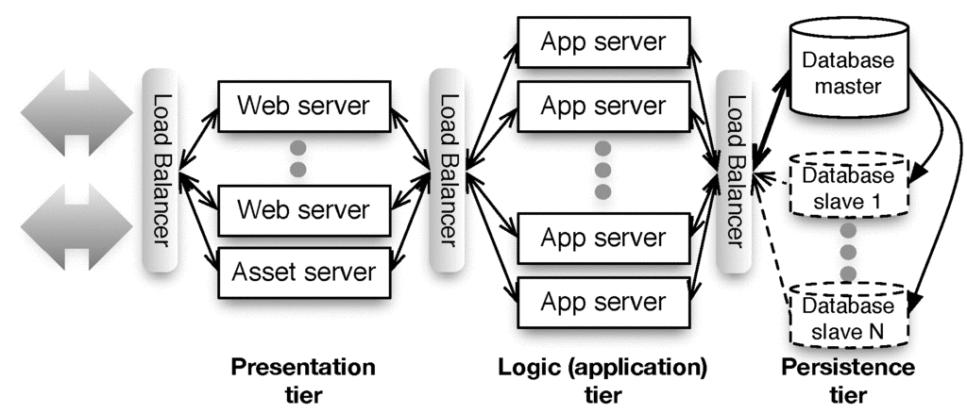
“Shared nothing”

Slide 23
Sharding vs. Replication
Partition data across independent “shards”?
+ Scales great
Bad when operations touch >1 table
Example use: user profile
Replicate all data everywhere?
+ Multi-table queries fast
Hard to scale: writes must propagate to all copies => temporary inconsistency in data values
Example: Facebook wall posts/“likes”
App server
users A-J
App server
users K-R
App server
users S-Z
App server
All users
App server
All users
App server
All users

Slide 24
Summary: Web 1.0 SaaS
Browser requests web resource (URI) using HTTP
HTTP is a simple request-reply protocol that relies on TCP/IP
In SaaS, most URI's cause a program to be run, rather than a static file to be fetched
HTML is used to encode content, CSS to style it visually
Cookies allow server to track client
Browser automatically passes cookie to server on each request
Server may change cookie on each response
Typical usage: cookie includes a handle to server-side information
That's why some sites don't work if cookies are completely disabled
Frameworks make all these abstractions convenient for programmers to use, without sweating the details
...and help map SaaS to 3-tier, shared-nothing architecture

Slide 25
Match the terms: (a) presentation tier (b) logic tier (c) persistence tier
(a) Apache web server (b) Rack+Rails (c) Relational database
(a) Firefox (b) Apache web server (c) PostgreSQL
(a) Microsoft Internet Information Server (b) Rack+Rails (c) Apache web server
(a) Firefox (b) Microsoft Internet Information Server (c) MySQL

Slide 26
HTML and CSS
Engineering Software as a Service §2.3

Slide 28
Introduction
This article is a review of the book
Dietary Preferences of Penguins,
by Alice Jones and Bill Smith. Jones
and Smith's controversial work makes
three hard-to-swallow claims about
penguins:
First, that penguins actually prefer
tropical foods such as bananas and
pineapple to their traditional diet
of fish
Second, that tropical foods give
penguins an odor that makes them
unattractive to their traditional
predators

Slide 29
<h1>Introduction</h1>
<p>
This article is a review of the book
<i>Dietary Preferences of Penguins</i>,
by Alice Jones and Bill Smith. Jones and Smith's controversial work makes three hard-to-swallow claims about penguins:
</p>
<ul>
<li>
First, that penguins actually prefer tropical foods such as bananas and pineapple to their traditional diet of fish
</li>
<li>
Second, that tropical foods give penguins an odor that makes them unattractive to their traditional predators
</li>
</ul>
...

Slide 30
Introduction
This article is a review of the book Dietary Preferences of Penguins, by Alice Jones and Bill Smith. Jones and Smith's controversial work makes two hard-to-swallow claims about penguins:
First, that penguins actually prefer tropical foods such as bananas and pineapple to their traditional diet of fish
Second, that tropical foods give penguins an odor that makes them unattractive to their traditional predators
...
<h1>Introduction</h1>
<p>
This article is a review of the book
<i>Dietary Preferences of Penguins</i>,
by Alice Jones and Bill Smith. Jones
and Smith's controversial work makes
three hard-to-swallow claims about
penguins:
<ul>
<li>
First, ...

Slide 31
Hypertext Markup Language
Document = Hierarchy of elements
inline (headings, tables, lists, paragraphs)
embedded (images, JavaScript)
forms—allow user to submit simple input (text, radio/check buttons, dropdown menus...)
Elements delimited by <tag>....</tag>
Some have content: <p>Hello world</p>
Some have attributes: <img src="http://...">
id and class attributes useful for styling

Slide 32
Cascading Style Sheets (CSS) separate content from presentation
<link rel="stylesheet" href="http://..."/>
inside <head> element
what stylesheet(s) go with this HTML page
HTML id and class attributes important in CSS
id must be unique within this page
same class can be attached to many elements
<div id="right" class="content">
<p>
I'm Armando. I teach CS169 and do
research in the AMP Lab and Par Lab.
</p>
</div>

Slide 33
CSS Selectors identify specific elements for styling
<div class="pageFrame" id="pageHead"> <h1> Welcome, <span id="custName">Armando</span> </h1> <img src="welcome.jpg" id="welcome"/> </div>
tag name: h1
class name: .pageFrame
element ID: #pageHead
tag name & class: div.pageFrame
tag name & id: img#welcome (usually redundant)
descendant relationship: div .custName
Attributes inherit browser defaults unless overridden
Goal: HTML markup contains no visual styling information
both of these match the outer div above. Don’t do this!

Slide 34
Which CSS selector will select only the word “bar” for styling:
<p class="myClass">foo, <span class="myClass">bar</span></p>
span.myClass
p .myClass
.myClass span
All of these

Slide 36
Model-View-Controller
Engineering Software as a Service §2.5

Slide 37
Whither frameworks?
Is there common application structure…
in interactive user-facing apps…
…that could simplify app development if we captured them in a framework?

Slide 39
The MVC Design Pattern
Goal: separate organization of data (model) from UI presentation (view) by introducing controller
mediates user actions requesting access to data
presents data for rendering by the view
Web apps may seem “obviously” MVC by design, but other alternatives are possible...
Controller
• Read data
• Update data
• User actions
• Directives for rendering data
View
Model
• Data provided to views through controller

Slide 40
Each entity has a model, controller, and set of views
Movies
Controller
Movie
Moviegoers
Controller
Reviews
Controller
Moviegoer
Review

Slide 41
Alternatives to MVC
Page Controller
(Ruby Sinatra)
Front Controller
(J2EE servlet)
Template View (PHP)
models
models
models
page A
A
app
views
page B
B
views
page C
C
Rails supports SaaS apps structured as MVC, but other architectures may be better fit for some apps.

Slide 42
Which statement is NOT true about the Model-View-Controller (MVC) architectural pattern
In SaaS apps on the Web, controller actions and view contents are transmitted using HTTP.
All MVC apps have both a “client” part (e.g. Web browser) and a “cloud” part (e.g. Rails app on cloud).
Model-View-Controller is just one of several possible ways to structure a SaaS app.
Peer-to-peer apps (vs. client-server apps) can be structured as Model-View-Controller.

Slide 43
Models, Databases, and Active Record
Engineering Software as a Service §2.6
Notes:
Start here

Slide 44
How should we store and retrieve record-oriented structured data?
What is the relationship between data as stored and data as manipulated in a programming language?

Slide 46
In-Memory vs. In-Storage objects
How to represent persisted object in storage
Example: Movie with name and rating attributes
Basic operations on object: CRUD (Create, Read, Update, Delete)
ActiveRecord: every model knows how to CRUD itself, using common mechanisms
#<Movie:0x1295580>
m.name, m.rating, ...
marshal/serialize
?
#<Movie:0x32ffe416>
m.name, m.rating, ...
unmarshal/deserialize

Slide 47
Rails Models Store Data in Relational Databases (RDBMS)
Each type of model gets its own database table
All rows in table have identical structure
one row in table == one instance of model's class
Each column stores value of an attribute of the model
Each row has unique value for primary key (by convention, in Rails this is an integer and is called id)
Schema: Collection of all tables and their structure
id | rating | title | release_date
2 | G | Gone With the Wind | 1939-12-15
11 | PG | Casablanca | 1942-11-26
... | ... | ... | ...
35 | PG | Star Wars | 1977-05-25

Slide 48
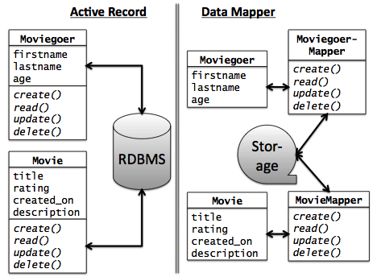
Alternative: DataMapper
Data Mapper associates separate mapper with each model
Idea: keep mapping independent of particular data store used => works with more types of databases
Used by Google AppEngine
Con: can't exploit RDBMS features to simplify complex queries and relationships
We'll revisit when talking about associations

Slide 49
Which statement is not true about the Model in Model-View-Controller?
The CRUD actions only apply to models backed by a database that supports ActiveRecord.
Part of the Model's job is to convert between in-memory and stored representations of objects.
Although Model data is displayed by the View, a Models' direct interaction is with Controllers.
Although DataMapper doesn't use relational databases, it's a valid way to implement a Model.

Slide 50
Controllers, Routes, and RESTfulness
Engineering Software as a Service §2.7

Slide 51
What design decisions would allow our app to support Service-Oriented Architecture?

Slide 53
REST (Representational State Transfer)—R. Fielding, 2000
Idea: URI names resource, not page or action
Self-contained: which resource, and what to do to it
Responses include hyperlinks to discover additional RESTful resources
“a post hoc [after the fact] description of the features that made the Web successful”
A service (in the SOA sense) whose operations are like this is a RESTful service
Ideally, RESTful URIs name the operations
Notes:
… vs SOAP
XML vs JSON

Slide 54
Routes
In MVC, each interaction the user can do is handled by a controller action
Ruby method that handles that interaction
A route maps <HTTP method, URI> to controller action
Route | Action
GET /movies/3 | Show info about movie whose ID=3
POST /movies | Create new movie from attached form data
PUT /movies/5 | Update movie ID 5 from attached form data
DELETE /movies/5 | Delete movie whose ID=5

Slide 55
Brief Intro to Rails' Routing Subsystem
dispatch <method,URI> to correct controller action
provides helper methods that generate a <method,URI> pair given a controller action
parses query parameters from both URI and form submission into a convenient hash
Built-in shortcuts to generate all CRUD routes (though most apps will also have other routes)
rake routes
I GET /movies {:action=>"index", :controller=>"movies"}
C POST /movies {:action=>"create", :controller=>"movies"}
GET /movies/new {:action=>"new", :controller=>"movies"}
GET /movies/:id/edit {:action=>"edit", :controller=>"movies"}
R GET /movies/:id {:action=>"show", :controller=>"movies"}
U PUT /movies/:id {:action=>"update", :controller=>"movies"}
D DELETE /movies/:id {:action=>"destroy", :controller=>"movies"}
Notes:
Most apps will have routes

Slide 56
GET /movies/3/edit HTTP/1.0
Matches route:
GET /movies/:id/edit {:action=>"edit", :controller=>"movies"}
Parse wildcard parameters: params[:id] = "3"
Dispatch to edit method in movies_controller.rb
To include a URI in generated view that will submit the form to the update controller action with params[:id]==3, call helper: update_movie_path(3) # => PUT /movies/3
rake routes
I GET /movies {:action=>"index", :controller=>"movies"}
C POST /movies {:action=>"create", :controller=>"movies"}
GET /movies/new {:action=>"new", :controller=>"movies"}
GET /movies/:id/edit {:action=>"edit", :controller=>"movies"}
R GET /movies/:id {:action=>"show", :controller=>"movies"}
U PUT /movies/:id {:action=>"update", :controller=>"movies"}
D DELETE /movies/:id {:action=>"destroy", :controller=>"movies"}

Slide 57
CRUD on a RESTful resource: resources :movies
get '/movies' => 'movies#index', :as => 'movies'
get '/movies/:id/new'=>'movies#new', :as=>'new_movie'
post '/movies' => 'movies#create', :as => 'movie'
get '/movies/:id' => 'movies#show', :as => 'movie'
get '/movies/:id/edit' => 'movies#edit', :as => 'edit_movie'
put '/movies/:id'=>'movies#update', :as=>'movie'
delete '/movies/:id' => 'movies#destroy', :as=>'movie'
Route | Action
GET /movies/3 | Show info about movie whose ID=3
POST /movies | Create new movie from attached form data
PUT /movies/5 | Update movie ID 5 from attached form data
DELETE /movies/5 | Delete movie whose ID=5

Slide 58
Which statement is NOT true regarding Rails RESTful routes and the resources to which they refer?
A resource may be existing content or a request to modify something.
In an MVC app, every route must eventually trigger a controller action.
One common set of RESTful actions is the CRUD actions on models.
The route always contains one or more "wildcard" parameters, such as :id, to identify the particular resource instance in the operation

Slide 59
Template Views and Haml
Engineering Software as a Service §2.8
Armando Fox
Notes:
earliest ever lecture prep! aug 4
follow along download slides

Slide 60
HTML is how we must present content to browsers…
…but what's the process by which our app's output becomes HTML?

Slide 62
Template View pattern
View consists of markup with selected interpolation to happen at runtime
Usually, values of variables or result of evaluating short bits of code
In Elder Days, this was the app (e.g. PHP)
Alternative: Transform View
XML
Closure
Haml
Closure
Renderer (Action-View)
Renderer (Action-View)
HTML
JSON
erb
Movie
Movie
Movie

Slide 63
Haml is HTML on a diet
%h1.pagename All Movies
%table#movies
%thead
%tr
%th Movie Title
%th Release Date
%th More Info
%tbody
- @movies.each do |movie|
%tr
%td= movie.title
%td= movie.release_date
%td= link_to "More on #{movie.title}", | movie_path(movie) |
= link_to 'Add new movie', new_movie_path

Slide 64
Don't put code in your views
Syntactically, you can put any code in view
But MVC advocates thin views and controllers
Haml makes deliberately awkward to put in lots of code
Helpers (methods that "prettify" objects for including in views) have their own place in Rails app
Alternative to Haml: html.erb (Embedded Ruby) templates, look more like PHP

Slide 65
Summary and Reflections: SaaS Architecture
Engineering Software as a Service §2.9-2.10

Slide 66
The big picture (technologies)
• URI’s, HTTP, TCP/IP stack
• REST & RESTful routes
Controller
View
Model
• Databases & migrations
• CRUD
• HTML & CSS
• XML & XPath
Notes:
NOTE: Rails doesn't appear anywhere on this slide!!

Slide 67
c. 2008: "Rails doesn't scale"
Scalability is an architectural concern—not confined to language or framework
The stateless tiers of 3-tier arch do scale
With cloud computing, just worry about constants
Traditional relational databases do not scale
Various solutions combining relational and non-relational storage (“NoSQL”) scale much better
DataMapper works well with some of them
Intelligent use of caching (later in course) can greatly improve the constant factors

Slide 68
Frameworks, Apps, Design patterns
Many design patterns so far, more to come
In 1995, it was the wild west: biggest Web sites were minicomputers, not 3-tier/cloud
Best practices (patterns) “extracted” from experience and captured in frameworks
But API's transcended it: 1969 protocols + 1960s markup language + 1990 browser + 1992 Web server works in 2011

Slide 69
Architecture is about Alternatives
Pattern we're using | Alternatives
Client-Server | Peer-to-Peer
Shared-nothing (cloud computing) | Symmetric multiprocessor, shared global address space
Model-View-Controller | Page controller, Front controller, Template view
Active Record | Data Mapper
RESTful URIs (all state affecting request is explicit) | Same URI does different things depending on internal state
As you work on other SaaS apps beyond this course, you should find yourself considering different architectural choices and questioning the choices being made.

Slide 70
Summary: Architecture and Rails
Model-view-controller is a well known architectural pattern for structuring apps
Rails codifies SaaS app structure as MVC
Views are Haml w/embedded Ruby code, transformed to HTML when sent to browser
Models are stored in tables of a relational database, accessed using ActiveRecord
Controllers tie views and models together via routes and code in controller methods

