Slide 1
Today’s “Friendly Conversation” topic… ~3-5min
Agile Manifesto
“We are uncovering better ways of developing software by doing it and helping others do it. Through this work we have come to value:
Individuals and interactions over processes and tools
Working software over comprehensive documentation
Customer collaboration over contract negotiation
Responding to change over following a plan
That is, while there is value in the items on the right, we value the items on the left more.”
Notes:
This was kind of “hippy-ish” and egalitarian in its day… quite controversial in its day (2001)
“Everyone is a team member and is responsible for the work getting done”… we don’t need no titles or positions… self-organizing… we will make our own commitments… transparency (let’s share the information)… flexible/organic teams, organic architecture (minimal documentation/standards)… no contracts (let’s talk it over)
The flip side:
We will actively and voluntarily play important roles on our team
The rules (rituals) that we do have… we WILL follow
We will create, demo, and release working software/products
We will utilize practical processes, tools, documentation, and planning
When we make commitments, we will live up to those commitments… as a team (“No winners on a losing team, and no losers on a winning team”)
We will be responsive and continuously improve (Retrospectives)
We will be transparent with how WE work and share our information

Slide 2

Software Engineering Session: Week 1 Session 1 Instructor: Eric Pogue
Agenda:
Friendly Conversation & Good Natured Banter… let’s make sure that everyone gets a good seat where they can hear and speak comfortably
Welcome & Introductions*
Syllabus Overview
Your Turn for Introductions
People, Process, and Technology… and the Virtuous Triangle
Agile Definition
Assignment and Lab… and a first attempt at self-organizing lab (“Scrum”) teams
Lab Time… and Report-Out
Assignments, Wrap-up, and Final Comments
Discussion & Questions welcome at any time… please be present with no phones or email during our discussion time
Notes:
*Your opportunity to give introductions will come after the syllabus overview.
Lab time needs to start no later than 11:40 today… please help me keep us on track

Slide 3
Welcome & Introductions
This is:
Software Engineering
TTh 11:00 to 12:15pm CST
AS 106A
And I am:
Eric Pogue
Introduction Topics:
Full and Preferred Name
Family, Home, College background
Programming experience
Likely programming environment
Top two or three things that you would like to get out of this class
Hobby or two
Unique fun fact about yourself

Slide 4
Welcome & Introductions
Full and Preferred Name:
Eric Pogue
Eric, Mr. Pogue, or Professor
Family, Home, College background:
Married with five children, recently relocated from Davenport, IA to Chicago area
Undergraduate in CS and Masters in Business… teaching online/evening for many years
Programming experience:
Decades in the industry as a developer, architect, project manager, manager, vice president
of various software development organizations.
Part of many teams that have delivered products to ten’s of millions of customers globally
Parsons Technology, Intuit, The Learning Company, Jasc Software, and John Deere
… and currently working on a startup with my oldest son
Notes:
Remind me to tell you a story about Bob Parsons who I worked for at Parsons Technology when we get to the section on DNS… Domain Name Services

Slide 5


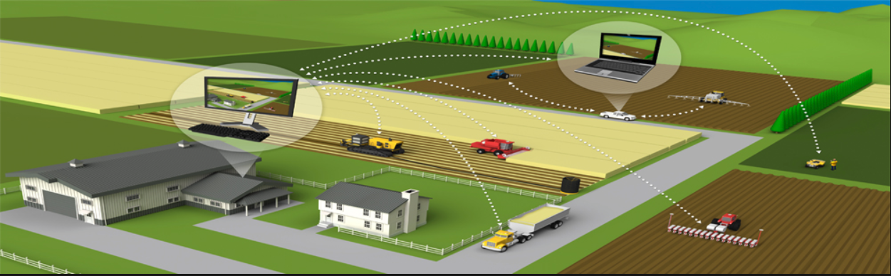




Slide 6
Welcome & Introductions
Likely programming environment
Personal Laptop, Windows 10, Chrome browser, PowerShell, and Visual Studio Code text editor
Hobbies:
Wilderness Canoeing & Camping (Quetico) and Triathlons
Top two or three things that you would like to get out of this class
help each of you be successful in this class
explore software development processes and techniques together and motivate you to look deeper
and for us to find a little enjoyment and fun along the way*
… oh yes, and it would be wonderful if I could help you build something that made you proud during the semester
Fun Fact:
At one point I had the very dubious “honor” or being the most traveled John Deere employee to India with 40+ trips over a 5-6 year period while setting up the 400+ person John Deere Technology Center – India application development organization.

Slide 7
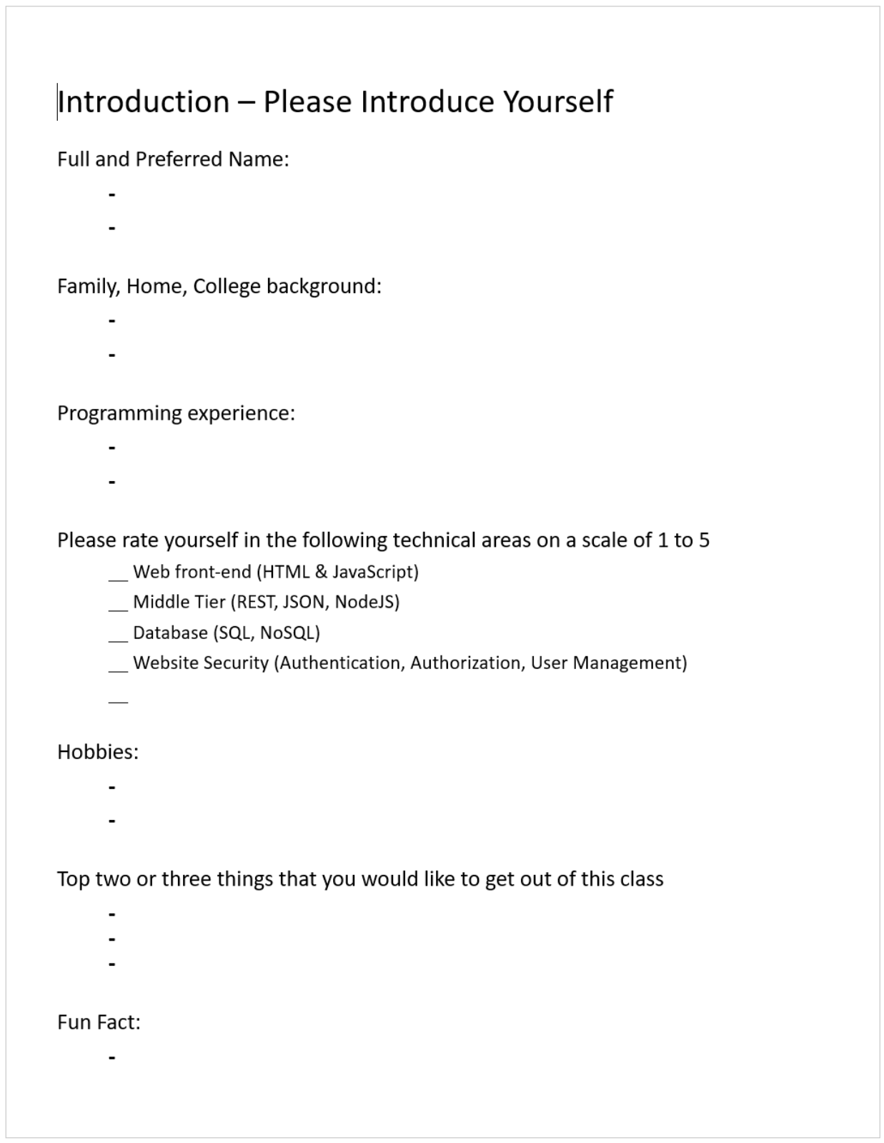
Your Turn for Introductions
Notes:
Hand out name tags and introduction forms before Syllabus Overview

Slide 8
Syllabus Review
Notes:
Optimism, good natured humor, and effectively working together is immensely important to delivering good software… and likely equally important to delivering just about any quality product
Even if you don’t intend to be a professional software developer, many of the things that we learn will be valuable in related areas.
Soooo… We have 16 weeks to learn something valuable and interesting. Let’s enjoy our time together and make the most out of it.

Slide 9
Your Turn for Introductions

Slide 10
Software Engineering Session: Week 1 Session 1 Instructor: Eric Pogue
Agenda:
Friendly Conversation & Good Natured Banter… let’s make sure that everyone gets a good seat where they can hear and speak comfortably
Welcome & Introductions*
Review Course Syllabus
Your Time for Introductions
People, Process, and Technology… and the Virtuous Triangle
Agile Definition
Review Current Learning Objectives
Assignment and Lab… and a first attempt at self-organizing lab (“Scrum”) teams
Lab Time… and Report-Out
Assignments, Wrap-up, and Final Comments
Discussion & Questions welcome at any time… please be present with no phones or email during our discussion time
Notes:
*Your opportunity to give introductions will come after the syllabus overview.

Slide 11
People, Process, and Technology
Software Engineering:
People: Teams, Optimism, Engagement, Ambition, Dedication, Leadership, Skills, Experience, Domain Knowledge…
Process: Waterfall/Iterative/Agile, Portfolio Management, Project Management, Funding, Prioritization, Metrics…
Technology: Configuration Management, Cloud Hosting, Scriptable Infrastructure, Source Code Management, Automated Testing…
Notes:
Eric’s View

Slide 12
…And the Virtuous Triangle
Software Engineering:
People: Teams, Optimism, Engagement, Ambition, Dedication, Leadership, Skills, Experience, Domain Knowledge…
Process: Waterfall/Iterative/Agile, Portfolio Management, Project Management, Funding, Prioritization Metrics…
Technology: Configuration Management, Cloud Hosting, Scriptable Infrastructure, Source Code Management, Automated Testing…

Slide 13
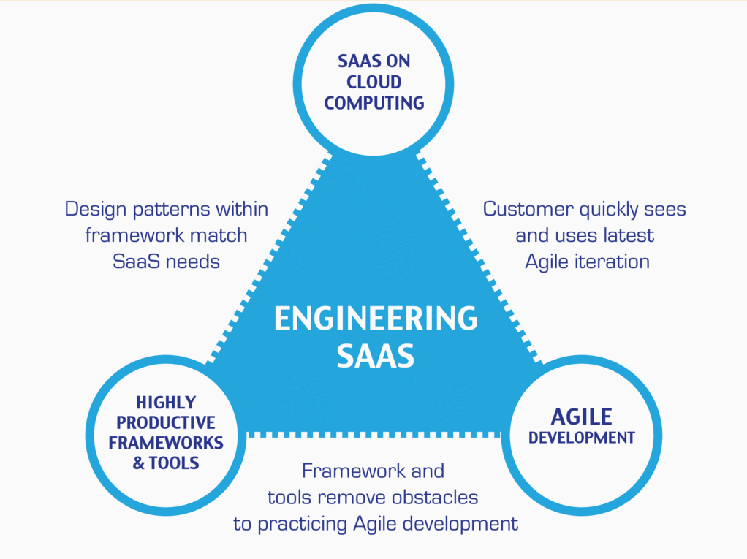
…And the Virtuous Triangle
Hosting Technology: Cloud, Scriptable Infrastructure, Software as a Service (SaaS)…
People: Teams, Optimism, Engagement, Ambition, Dedication, Leadership, Skills, Experience, Domain Knowledge…
Process: Agile, Portfolio Management, Project Management, Funding, Prioritization, Metrics…
Productivity Technology: Configuration Management, Source Code Management, Automated Testing…

Slide 14
Agile Manifesto (February 2001)
“We are uncovering better ways of developing software by doing it and helping others do it. Through this work we have come to value:
Individuals and interactions over processes and tools
Working software over comprehensive documentation
Customer collaboration over contract negotiation
Responding to change over following a plan
That is, while there is value in the items on the right, we value the items on the left more.”

Slide 15
Assignment
Prior to class on Thursday:
Be fully prepared “Scrum-ify” Ourselves… our first chance to demonstrate our capabilities as self-organizing Scrum team members
View and reflect on “Introduction to Scrum in 7 Minutes” video [link]
Be prepared to discuss Ch.1.1 to 1.3
Be prepared to discuss Ch.10.1 to 10.5… focusing on Scrum and Git
Install/implement MS PowerShell [link]
Install Git Client [link]… and test it on multiple shells
Be prepared to: Utilize (local) Git Client to create, update, branch, and merge a local project utilizing a beginners level tutorial… one option would be “An Intro to Git and GitHub for Beginners” [link]
Estimate: 3 hours… “Fist of Five” Agile polling

Slide 16
Lab Time ~30min Lab (“Stand Up”) report out at 12:10
Lab Assignment:
Split into “Two-Pizza” sized Lab (“Scrum”) teams (3-8 people per team) ~3min
Elect a team leader (“Scrum Master”) ~2min
Give your team a name… a specific type of wild animal ~1min
Spend our lab time helping each other accomplish items 5, 6, 7 from today’s assignment
Perform a team “Fist of Five” polling on the assignment and alternatives at 3:08 ~2min
Be ready for a ~1 minute Lab (“Stand Up”) report-out where the team leader (“Scrum Master”) will report your progress, capacity, and commitment on the assignment items
Optionally, continue to assist each other with today’s assignment outside of class
Notes:
We would like to start our lab time no later than 11:40 to give us at least 30 minutes.

Slide 17
Lab (“Stand Up”) Report-Out

Slide 18
Wrap-up and Final Questions/Comments?
Notes:
Who will volunteer to bring us a “Friendly Conversation” topic Thursday?

Slide 19
End of Session
Instructor: Eric Pogue

