Slide 1

Software Engineering Session: Week 1 Session 2 Instructor: Eric Pogue
Agenda:
Assignment Review through Scrum of Scrums Stand-up
Your Turn for Introductions… and to Create Name Cards
People, Process, and Technology
The Virtuous Triangle
Agile Manifesto (February 2001)
Chapter 1 Discussion: Introduction to Saas and Agile Development
Assignment
Lab
Wrap-up
Discussion & Questions welcome at any time… please be present with no phones or email during our discussion time
Notes:
*Your opportunity to give introductions will come after the syllabus overview.
Lab time needs to start no later than 11:50 today… please help me keep us on track
Conversation Topics: Sprints? Scrum Roles?… or Salmonella Probably Killed the Aztecs… who will volunteer to bring us a topic next class?

Slide 2
Assignment Review through Scrum of Scrums
Prior to class on Thursday:
Be fully prepared “Scrum-ify” Ourselves… our first chance to demonstrate our capabilities as self-organizing Scrum team members
View and reflect on “Introduction to Scrum in 7 Minutes” video [link]
Be prepared to discuss Ch.1.1 to 1.3
Be prepared to discuss Ch.10.1 to 10.5… focusing on Scrum and Git
Install/implement MS PowerShell [link]
Install Git Client [link]… and test it on multiple shells
Be prepared to: Utilize (local) Git Client to create, update, branch, and merge a local project utilizing a beginners level tutorial… one option would be “An Intro to Git and GitHub for Beginners” [link]
Estimate: 3 hours
… Approximately how long did it take? What was our Velocity? Velocity per Person?

Slide 3
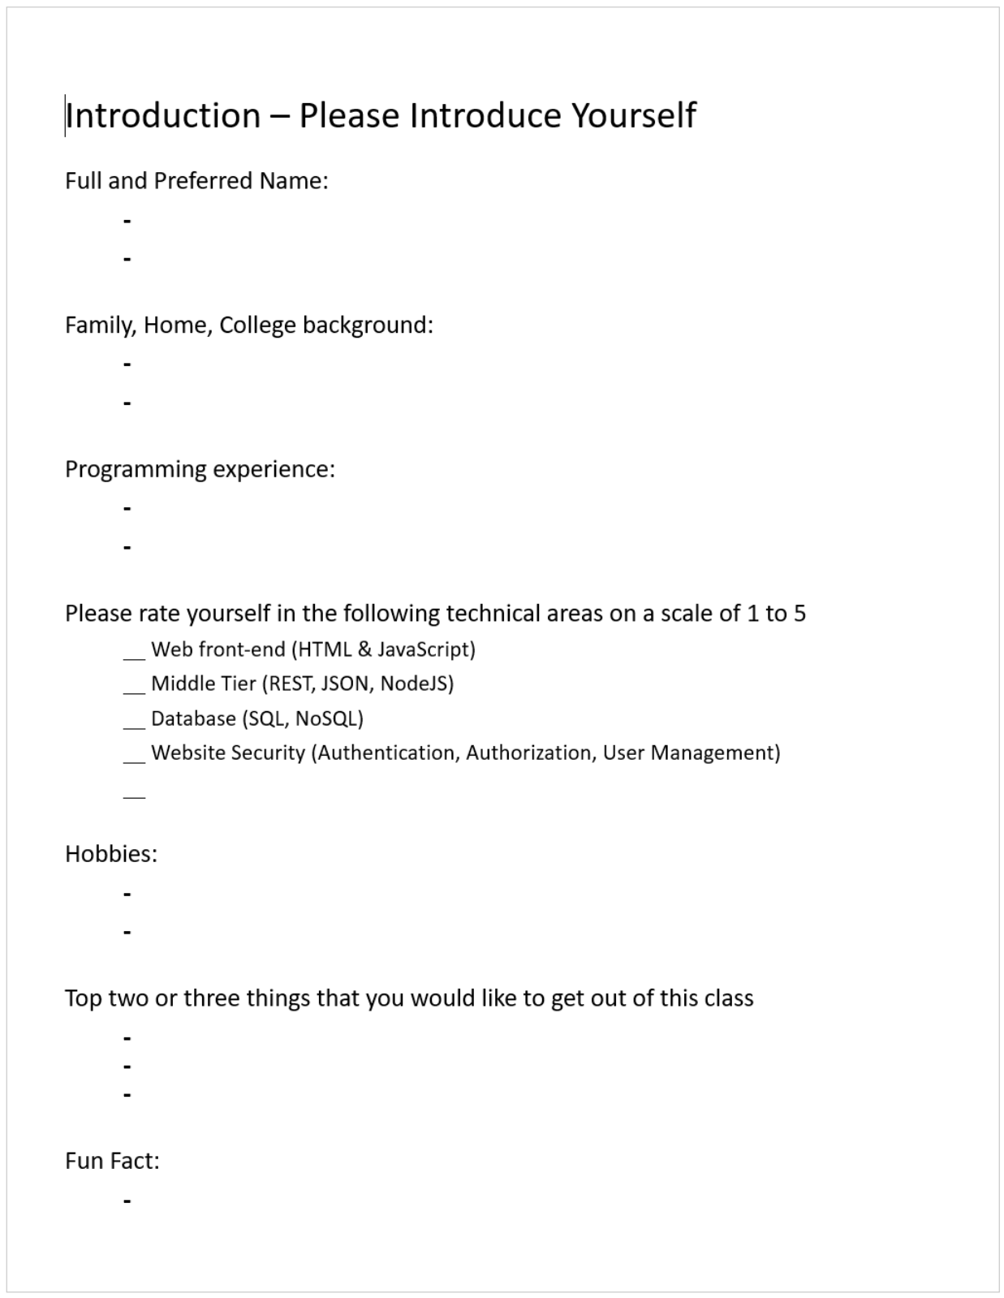
Your Turn for Introductions… and Name Cards
Notes:
Hand out name tags and introduction forms before Syllabus Overview

Slide 4
Software Engineering Session: Week 1 Session 2 Instructor: Eric Pogue
Agenda:
Assignment Review through Scrum of Scrums Stand-up
Your Turn for Introductions… and Create Name Cards
People, Process, and Technology
The Virtuous Triangle
Agile Manifesto (February 2001)
Assignment
Lab
Wrap-up
Discussion & Questions welcome at any time… please be present with no phones or email during our discussion time
Notes:
*Your opportunity to give introductions will come after the syllabus overview.
Lab time needs to start no later than 11:50 today… please help me keep us on track
Conversation Topics: Sprints? Scrum Roles?… or Salmonella Probably Killed the Aztecs… who will volunteer to bring us a topic next class?

Slide 5
People, Process, and Technology
Software Engineering:
People: Teams, Skills, Experience, Domain Knowledge, Optimism, Engagement, Dedication, Leadership
Process: Waterfall/Iterative/Agile, Portfolio Management, Project Management, Funding, Prioritization, Metrics
Technology: Configuration Management, Cloud Hosting, Scriptable Infrastructure, Source Code Management, Automated Testing
Notes:
Eric’s View

Slide 6
…And the Virtuous Triangle
Software Engineering:
People: Teams, Skills, Experience, Domain Knowledge, Optimism, Engagement, Dedication, Leadership
Process: Waterfall/Iterative/Agile, Portfolio Management, Project Management, Funding, Prioritization Metrics
Technology: Configuration Management, Cloud Hosting, Scriptable Infrastructure, Source Code Management, Automated Testing

Slide 7
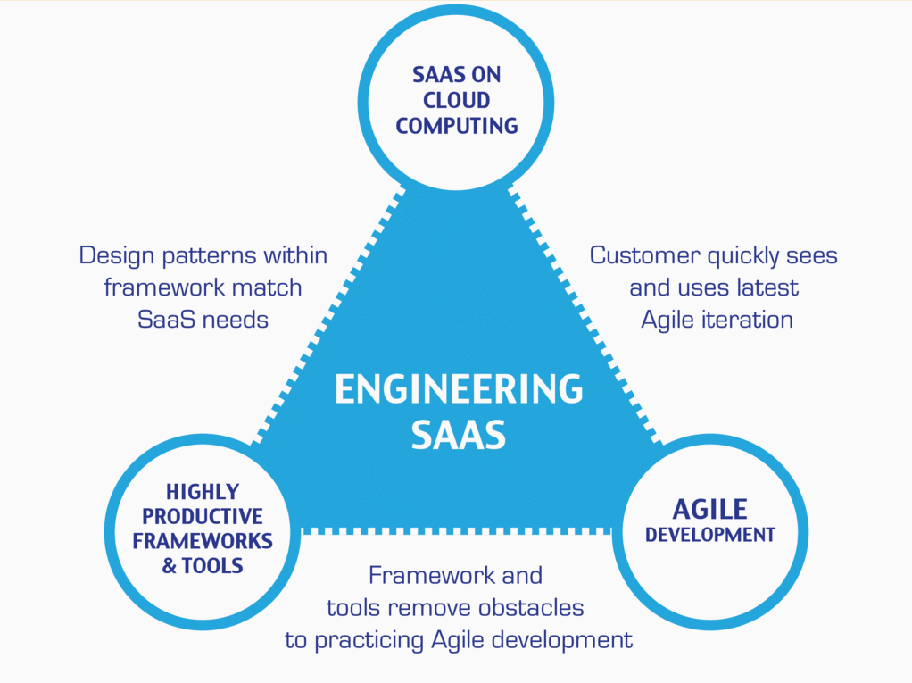
…And the Virtuous Triangle
Hosting Technology: Cloud, Scriptable Infrastructure, Software as a Service (SaaS)
People: Teams, Optimism, Engagement, Ambition, Dedication, Leadership, Skills, Experience, Domain Knowledge
Process: Agile, Portfolio Management, Project Management, Funding, Prioritization, Metrics
Productivity Technology: Configuration Management, Source Code Management, Automated Testing

Slide 8
Agile Manifesto (February 2001)
“We are uncovering better ways of developing software by doing it and helping others do it. Through this work we have come to value:
Individuals and interactions over processes and tools
Working software over comprehensive documentation
Customer collaboration over contract negotiation
Responding to change over following a plan
That is, while there is value in the items on the right, we value the items on the left more.”

Slide 9
Chapter 1 Discussion: Introduction to Saas and Agile Development
Notes:
Optimism, good natured humor, and effectively working together is immensely important to delivering good software… and likely equally important to delivering just about any quality product
Even if you don’t intend to be a professional software developer, many of the things that we learn will be valuable in related areas.
Soooo… We have 16 weeks to learn something valuable and interesting. Let’s enjoy our time together and make the most out of it.

Slide 10
Assignment
Prior to class on Tuesday:
“Scrum-ify” Ourselves… our second chance to demonstrate our capabilities as self-organizing Scrum team members
Complete Discussion Board “Introduction” before you leave class today
Read and be prepared to discuss Preface & Chapter 1
Install MS PowerPoint & MS Word Viewers (if you do not have access to the full products)
Setup a GitHub account with a Student Developer Pack/Plan [link]
Utilize Git & GitHub to create, update, branch, and merge local and remote projects utilizing several beginner level tutorials:
One option would be “An Intro to Git and GitHub for Beginners” tutorial [link]
Another option would be the GitHub “Hello World” tutorial [link]
Create a public GitHub repository and share it with another Team Member
Be the recipient of a shared public GitHub repository from a Team Member
Estimate: 3 hours… “Fist of Five” Agile polling
Notes:
Do we want to “Scrum-ify” ourselves again… possibly with more a focused effort on technical specialization? Or should we keep the teams and team nams?
Possible Team Name categories:
Space Shuttles… nobody wanted to be Challenger
World War I battles in Europe… did not go very well
Thoughts?
Discussion Board items are ALWAYS due by Thursday at 11:59… You should include them in your own or your teams backlog (to-do list)
Excellent link for additional GitHub tutorials:
https://www.youtube.com/GitHubGuides

Slide 11
Lab Time Report-out at 12:18
Lab Assignment:
Was Tuesday a practice run? Or should we stick with our teams and team names?
Possibly re-split or re-balance Scrum teams ~3min
Elect or retain a Scrum Master who will be in the roll for the first 2 two-week sprints ~1min
Elect a Product Owner* who will also be in the roll for the first 2 two-week sprints ~2min
Finalize your team name
Work on assignment items
Review remaining assignment items, perform a team “Fist of Five” polling, and determine commitment
Assist each other with today’s assignment outside of class… Product Owner to be the central point of contact

Slide 12
Wrap-up
Notes:
Who will volunteer to bring us a “Friendly Conversation” topic Thursday?

Slide 13
End of Session

