Slide 1

Software Engineering Session: Week 2 Session 1 Instructor: Eric Pogue
Agenda:
Assignment Review through Scrum of Scrums Stand-up
Git/GitHub Demo… Thank you, Alex!
Chapter 1 Discussion: Introduction to Saas and Agile Development
Agile Manifesto (February 2001)
The Virtuous Triangle
People, Process, and Technology
Assignment
Lab
Wrap-up
Discussion & Questions welcome at any time… please be present with no phones or email during our discussion time
Notes:
*Your opportunity to give introductions will come after the syllabus overview.
Lab time needs to start no later than 11:50 today… please help me keep us on track
Conversation Topics: Sprints? Scrum Roles?… or Salmonella Probably Killed the Aztecs… who will volunteer to bring us a topic next class?

Slide 2
Assignment
Prior to class on Tuesday:
“Scrum-ify” Ourselves… our second chance to demonstrate our capabilities as self-organizing Scrum team members
Complete Discussion Board “Introduction” before you leave class today
Read and be prepared to discuss Preface & Chapter 1
Install MS PowerPoint & MS Word Viewers (if you do not have access to the full products)
Setup a GitHub account with a Student Developer Pack/Plan [link]
Utilize Git & GitHub to create, update, branch, and merge local and remote projects utilizing several beginner level tutorials:
One option would be “An Intro to Git and GitHub for Beginners” tutorial [link]
Another option would be the GitHub “Hello World” tutorial [link]
Create a public GitHub repository and share it with another Team Member
Be the recipient of a shared public GitHub repository from a Team Member
Estimate: 3 hours… “Fist of Five” Agile polling
Notes:
Do we want to “Scrum-ify” ourselves again… possibly with more a focused effort on technical specialization? Or should we keep the teams and team nams?
Possible Team Name categories:
Space Shuttles… nobody wanted to be Challenger
World War I battles in Europe… did not go very well
Thoughts?
Discussion Board items are ALWAYS due by Thursday at 11:59… You should include them in your own or your teams backlog (to-do list)
Excellent link for additional GitHub tutorials:
https://www.youtube.com/GitHubGuides

Slide 3
Git/GitHub Demo …Thank you, Alex!
Notes:
Who will volunteer to bring us a “Friendly Conversation” topic Thursday?

Slide 4
Chapter 1 Discussion: Introduction to Saas and Agile Development
Notes:
Optimism, good natured humor, and effectively working together is immensely important to delivering good software… and likely equally important to delivering just about any quality product
Even if you don’t intend to be a professional software developer, many of the things that we learn will be valuable in related areas.
Soooo… We have 16 weeks to learn something valuable and interesting. Let’s enjoy our time together and make the most out of it.

Slide 5
Agile Manifesto (February 2001)
“We are uncovering better ways of developing software by doing it and helping others do it. Through this work we have come to value:
Individuals and interactions over processes and tools
Working software over comprehensive documentation
Customer collaboration over contract negotiation
Responding to change over following a plan
That is, while there is value in the items on the right, we value the items on the left more.”

Slide 6
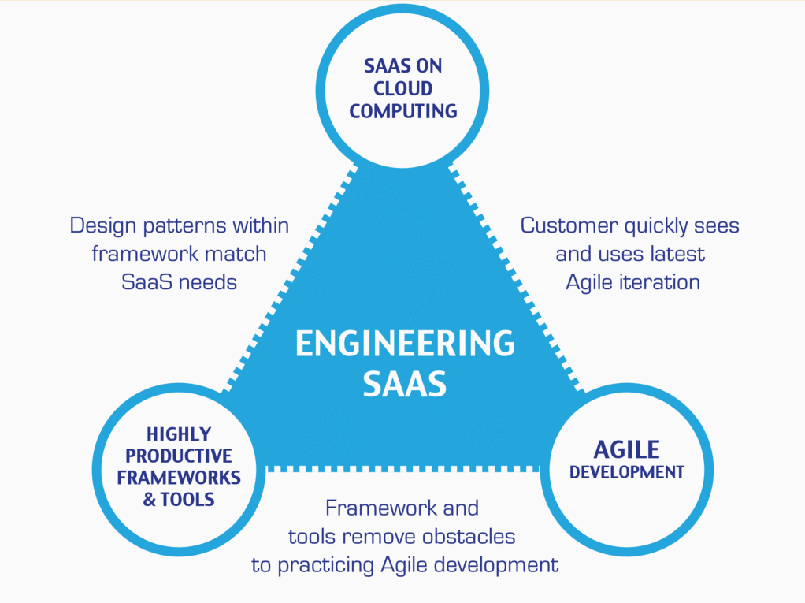
…And the Virtuous Triangle
Hosting Technology: Cloud, Scriptable Infrastructure, Software as a Service (SaaS)
People: Teams, Optimism, Engagement, Ambition, Dedication, Leadership, Skills, Experience, Domain Knowledge
Process: Agile, Portfolio Management, Project Management, Funding, Prioritization, Metrics
Productivity Technology: Configuration Management, Source Code Management, Automated Testing

Slide 7
People, Process, and Technology
Software Engineering:
People: Teams, Skills, Experience, Domain Knowledge, Optimism, Engagement, Dedication, Leadership
Process: Waterfall/Iterative/Agile, Portfolio Management, Project Management, Funding, Prioritization, Metrics
Technology: Configuration Management, Cloud Hosting, Scriptable Infrastructure, Source Code Management, Automated Testing
Notes:
Eric’s View

Slide 8
Assignment (for a full week instead if one class period)
Sprint 1b Product Backlog:
Create a public GitHub repository and share it with another Team Member… carry over from last assignment
Be the recipient of a shared public GitHub repository from a Team Member… carry over from last assignment
Individually setup a Microsoft Imagine Azure account [link]
Individually review, but do no complete, Eric’s Azure Static website tutorial video [link]
Individually complete the Azure static website tutorial... leave the site in place [link]
Individually complete a “permanent” personal static website where you will initially host your “My Information” JSON file for this class utilizing the previous tutorial to create the new website
Individually complete the dynamic NodeJS website… leave the site in place [link]
Read Chapter 2
Individually complete Quiz 1
As a Class agree on a standard and extensible “My Information” JSON format and data requirements that include FirstName, LastName, PreferredName, TeamName, SeatLocation, and Roles* in a standard file name (e.g. “my-information.json”) at a minimum… Product Owners to discuss/lead and elect someone to play the Product Architect role
As a Class commit each Team to research, discuss, and present on one of the following topics… Scrum Masters to discuss/lead and to elect someone to play the Project Manager role:
SaaS Client Frameworks including “HTML/JavaScript vs AngularJS vs Angular2 vs React vs others”
SaaS Frameworks including “MEAN vs LAMP vs Ruby on Rails”
File Formats including “HTML vs XML vs JSON vs Key/Value Pair Text Files”
Service Oriented Architectures including “Web Services and SOAP/WSAD vs REST vs Sockets”
Databases on Azure including “Azure tables vs Azure MongoDB vs Azure other DBs”
Sprint 2 Planning Session
Notes:
A Backlog is a prioritized list of request deliverables. It exists at the Team and Product (and possibly Portfolio) levels… Stories, Features, Epics
Sprint 1b will end next Monday at 11:59pm… approximately 1 week
Notes:
All agile Backlogs must be a list of Features or Stories prioritized on business value
Dependencies should be identified
The optimal order and method of completing them is up to the individual teams
Eventually we will need to provide a definition of “Done”

Slide 9
Prioritize List and Consider Dependencies
Notes:
Who will volunteer to bring us a “Friendly Conversation” topic Thursday?

Slide 10
Assignment (for a full week instead if one class period)
Sprint 1b Product Backlog:
Create a public GitHub repository and share it with another Team Member… carry over from last assignment
Be the recipient of a shared public GitHub repository from a Team Member… carry over from last assignment
Individually setup a Microsoft Imagine Azure account [link]
Individually complete the Azure static website tutorial... leave the site in place [link]
As a Class agree on a standard and extensible “My Information” JSON format and data requirements that include FirstName, LastName, PreferredName, TeamName, SeatLocation, and Roles* in a standard file name (e.g. “my-information.json”) at a minimum… Product Owners to discuss/lead and elect someone to play the Product Architect role
Individually complete a “permanent” personal static website where you will initially host your “My Information” JSON file for this class utilizing the previous tutorial to create the new website
Complete Sprint 2 Planning Session
Individually complete Quiz 1
Read Chapter 2
As a Class commit each Team to research, discuss, and present on one of the following topics… Scrum Masters to discuss/lead and to elect someone to play the Project Manager role:
SaaS Client Frameworks including “HTML/JavaScript vs AngularJS vs Angular2 vs React vs others”
SaaS Frameworks including “MEAN vs LAMP vs Ruby on Rails”
File Formats including “HTML vs XML vs JSON vs Key/Value Pair Text Files”
Service Oriented Architectures including “Web Services and SOAP/WSAD vs REST vs Sockets”
Databases on Azure including “Azure tables vs Azure MongoDB vs Azure other DBs”
Individually review, but do no complete, Eric’s Azure Static website tutorial video [link]
Individually complete the dynamic NodeJS website… leave the site in place [link]
Notes:
A Backlog is a prioritized list of request deliverables. It exists at the Team and Product (and possibly Portfolio) levels… Stories, Features, Epics
Sprint 1b will end next Monday at 11:59pm… approximately 1 week
Notes:
All agile Backlogs must be a list of Features or Stores based prioritized on business value
Dependencies should be identified
The optimal order and method of completing them is up to the individual teams
Eventually we will need to provide a definition of “Done”

Slide 11
Lab (report-out at 12:08)
Lab Activities:
Elect or confirm a Product Owner who will be in the roll through at least Sprint 2
Discuss assignment item #10 and which area(s) your Team would like to… be ready send your Scrum Master to discuss options with the other Scrum Masters
Complete Sprint 1b Planning and Planning Sheet... note that your Team’s capacity should be ~14 Story Points (SP) per person because we have decided that 1 SP = ~30min and we* anticipate approximately 1 hour in class and 6 hours outside of class per team member for next week… discuss and make your own Capacity estimate
Consider Individual and Team estimates for each Product Backlog Item
Report-out on assumptions, estimates, commitments, and proposed “Cut-line”
After completing planning activities, work on committed Backlog items
Assist each other with assignment outside of class
* Your Product Owner or another Team Member may need to step in to lead this activity initially as the Scrum Master will be participating on Activity #2
Notes:
Sprints: 2 Week periods where deliverables are due and demos should be complete
Story Points (SP): Estimate of work that should be based on example deliverables. Generally not normalized between groups or teams. We will utilize ~30min to equal 1 SP
Hand out sprint planning sheet… 1 sheet per team

Slide 12
Wrap-up
Notes:
Who will volunteer to bring us a “Friendly Conversation” topic Thursday?

Slide 13
End of Session

