Slide 1

Software Engineering Session: Week 2 Session 2 Instructor: Eric Pogue
Agenda:
Assignment Review through Scrum of Scrums Stand-up
Demo of Sharing Repositories in GitHub… Thank you, John!
Complete Chapter 1 Discussion: Introduction to Saas and Agile Development
Agile Manifesto
The Virtuous Triangle
People, Process, and Technology
Sprint Planning for Sprint 2
Lab
Lab Report-out & Wrap-up
Discussion & Questions welcome at any time… please be present with no phones or email during our discussion time

Slide 2
Assignment (for a full week instead if one class period)
Sprint 1b Product Backlog… due Monday night (11:59pm):
Create a public GitHub repository and share it with another Team Member… carry over from last assignment
Be the recipient of a shared public GitHub repository from a Team Member… carry over from last assignment
Individually setup a Microsoft Imagine Azure account [link]
Individually complete the Azure static website tutorial... leave the site in place [link]
As a Team agree on a standard and extensible “My Information” JSON format and data requirements that include FirstName, LastName, PreferredName, TeamName, SeatLocation, and Roles* in a standard file name (e.g. “my-information.json”) at a minimum… Product Owners to discuss/lead and elect someone to play the Product Architect role
Individually complete a “permanent” personal static website where you will initially host your “My Information” JSON file for this class utilizing the previous tutorial to create the new website
Complete Sprint 2 Planning Session
Individually complete Quiz 1
Read Chapter 2
As a Class commit each Team to research, discuss, and present on one of the following topics… Scrum Masters to discuss/lead and to elect someone to play the Project Manager role:
SaaS Client Frameworks including “HTML/JavaScript vs AngularJS vs Angular2 vs React vs others”
SaaS Frameworks including “MEAN vs LAMP vs Ruby on Rails”
File Formats including “HTML vs XML vs JSON vs Key/Value Pair Text Files”
Service Oriented Architectures including “Web Services and SOAP/WSAD vs REST vs Sockets”
Databases on Azure including “Azure tables vs Azure MongoDB vs Azure other DBs”
Individually review, but do no complete, Eric’s Azure Static website tutorial video [link]
Individually complete the dynamic NodeJS website… leave the site in place [link]
Notes:
A Backlog is a prioritized list of request deliverables. It exists at the Team and Product (and possibly Portfolio) levels… Stories, Features, Epics
Sprint 1b will end next Monday at 11:59pm… approximately 1 week
Notes:
All agile Backlogs must be a list of Features or Stores based prioritized on business value
Dependencies should be identified
The optimal order and method of completing them is up to the individual teams
Eventually we will need to provide a definition of “Done”

Slide 3
Demo of Sharing Repositories in GitHub …Thank you, John!
Notes:
Who will volunteer to bring us a “Friendly Conversation” topic Thursday?

Slide 4
Chapter 1 Discussion: Introduction to Saas and Agile Development
Notes:
Optimism, good natured humor, and effectively working together is immensely important to delivering good software… and likely equally important to delivering just about any quality product
Even if you don’t intend to be a professional software developer, many of the things that we learn will be valuable in related areas.
Soooo… We have 16 weeks to learn something valuable and interesting. Let’s enjoy our time together and make the most out of it.

Slide 5
Agile Manifesto (February 2001)
“We are uncovering better ways of developing software by doing it and helping others do it. Through this work we have come to value:
Individuals and interactions over processes and tools
Working software over comprehensive documentation
Customer collaboration over contract negotiation
Responding to change over following a plan
That is, while there is value in the items on the right, we value the items on the left more.”

Slide 6
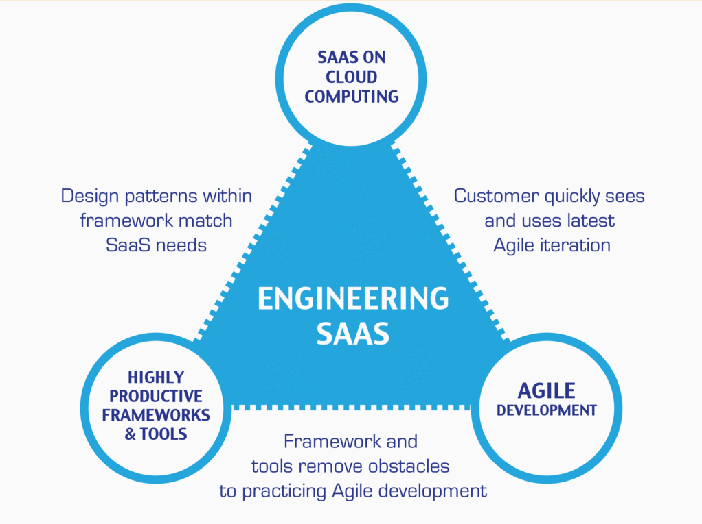
…And the Virtuous Triangle
Hosting Technology: Cloud, Scriptable Infrastructure, Software as a Service (SaaS)
People: Teams, Optimism, Engagement, Ambition, Dedication, Leadership, Skills, Experience, Domain Knowledge
Process: Agile, Portfolio Management, Project Management, Funding, Prioritization, Metrics
Productivity Technology: Configuration Management, Source Code Management, Automated Testing

Slide 7
People, Process, and Technology
Software Engineering:
People: Teams, Skills, Experience, Domain Knowledge, Optimism, Engagement, Dedication, Leadership
Process: Waterfall/Iterative/Agile, Portfolio Management, Project Management, Funding, Prioritization, Metrics
Technology: Configuration Management, Cloud Hosting, Scriptable Infrastructure, Source Code Management, Automated Testing
Notes:
Eric’s View

Slide 8
Sprint Planning for Sprint 2
Notes:
Who will volunteer to bring us a “Friendly Conversation” topic Thursday?

Slide 9
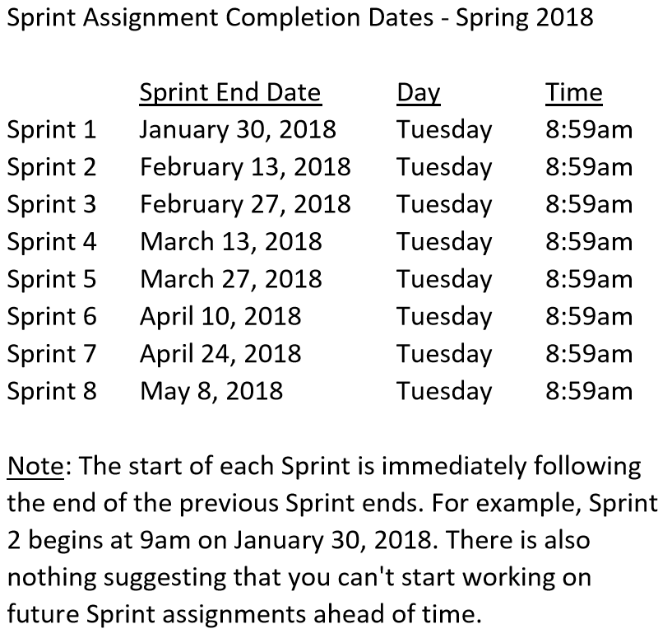

Slide 10
Sprint 2 Product Backlog… page 1 of 2
As a Class document a standard “My Information” JSON format that at a minimum include one or more “records” that each include FirstName, LastName, PreferredName, TeamName, SeatLocation, and Roles in a standard file name (e.g. “my-information.json”)… Product Owners and the Product Architect will lead this effort
As a Class commit each Team to research, discuss, and present at least one of the following topics:
Databases on Azure including “Azure tables vs Azure MongoDB vs Azure other DBs”**
Cloud/Azure based Authentication/Authorization services and who they could be integrated into a NodeJS based application*
JavaScript and NodeJS with a focus on Azure and including the best Internet based tutorials and/or books on the topic
SaaS Frameworks including “MEAN vs LAMP vs Ruby on Rails”
Service Oriented Architectures including “Web Services and SOAP/WSAD vs REST vs Sockets”
As a Team select one or two team members who will lead the team’s effort to research and discuss the above topic and then delivery a (~10min) presentation on the topic to the class on Tuesday, February 13.
Read and be prepared to discuss Chapter 6
Complete the dynamic Azure NodeJS website tutorial… leave the site in place [link]
As a Team Test each other’s Personal Static Website, verify JSON formats, and report sites tested and defects found as a MS Word or JSON file to your Product Owner and to the owner of the site(s) where the defect was found
Find and complete an additional HTML/NodeJS tutorial on Azure… leave it in place
Complete Sprint 2 Quiz
Complete and document Sprint 2 Retrospective and summarization/prioritization of Team level Continuous Improvement (CI) items... be prepared to include one CI item on in your Sprint 3 backlog
Notes:
As a Class commit each Team to research, discuss, and present at least one of the following topics:
Databases on Azure including “Azure tables vs Azure MongoDB vs Azure other DBs”**
Cloud/Azure based Authentication/Authorization services and who they could be integrated into a NodeJS based application*
JavaScript and NodeJS with a focus on Azure and including the best Internet based tutorials and/or books on the topic
SaaS Frameworks including “MEAN vs LAMP vs Ruby on Rails”
Service Oriented Architectures including “Web Services and SOAP/WSAD vs REST vs Sockets”
SaaS Client Frameworks including “HTML/JavaScript vs AngularJS vs Angular2 vs React vs others”
File Formats including “HTML vs XML vs JSON vs Key/Value Pair Text Files”

Slide 11
Sprint 2 Product Backlog… page 2 of 2
Complete Sprint 3 Planning
Download class materials utilizing Git client and cloning “https://github.com/EricJPogue/sp18-cpsc-44000-001.git”
As a Team define the “Team Information Service” project by writing the necessary Team level User Stories for the project
As a Team create a shared private “Team Information Service” GitHub repository that is shared with everyone on the team and with the Instructor… name the repository “Team Information Service for [Team Name]”
Review, but do no complete, Eric’s Azure Static website tutorial video [link]
As a Team create a “Team Information Service” Production site on Azure
As a Team develop, test, and deploy “Team Information Service” Release 1 to Test
As a Team develop, test, and deploy “Team Information Service” Release 2 to Test and Production
Our “Team Information Service” product should include:
Reading each team member’s “My Information” JSON files from each of their Person Static Websites
Validating the JSON formats
Consolidating the data into the Class standard JSON format
Publishing the consolidated data to a simple HTML/JavaScript web page
Publishing the consolidated data to a Web Service
Notes:
As a Class commit each Team to research, discuss, and present at least one of the following topics:
Databases on Azure including “Azure tables vs Azure MongoDB vs Azure other DBs”**
Cloud/Azure based Authentication/Authorization services and who they could be integrated into a NodeJS based application*
JavaScript and NodeJS with a focus on Azure and including the best Internet based tutorials and/or books on the topic
SaaS Frameworks including “MEAN vs LAMP vs Ruby on Rails”
Service Oriented Architectures including “Web Services and SOAP/WSAD vs REST vs Sockets”
SaaS Client Frameworks including “HTML/JavaScript vs AngularJS vs Angular2 vs React vs others”
File Formats including “HTML vs XML vs JSON vs Key/Value Pair Text Files”

Slide 12
Lab (report-out at 12:08)
Lab Activities:
All Product Owners should immediately meet to discuss Item #1. They will need to identify which Product Owner will also play the Product Architect role for the Class through Sprint 3
Scrum Master will lead Sprint 2 Planning activities and completion of the Sprint 2 Planning Sheet. Note that your Team’s capacity should be 20 to 28 Story Points (SP) per person because we:
Are planning for two full weeks
Have decided that 1 SP = the effort it takes to read a chapter = ~30min.
Assume approximately 1 hour in class and 6 hours outside of class per team member per week
Do not have any holidays or vacations planned
Be prepared to report-out on assumptions, estimates, commitments, and a proposed Backlog “cut-line”… I will be collecting the completed Sprint 2 Planning sheets at that time
Each team member should retain a copy of the completed planning sheet (Excel, Pdf, or JPEG/PNG) to be submitted as part of their Sprint 2 Quiz
After completing planning activities, work on Individual or Team committed Backlog items
Scrum Masters to meet on Item #2. They will need to identify which Scrum Master will also play the role of Project Manager for the Class through Sprint 3
Notes:
Sprints: 2 Week periods where deliverables are due and demos should be complete
Story Points (SP): Estimate of work that should be based on example deliverables. Generally not normalized between groups or teams. We will utilize ~30min to equal 1 SP
Hand out sprint planning sheet… 1 sheet per team

Slide 13
Lab Report-out & Wrap-up
Notes:
Who will volunteer to bring us a “Friendly Conversation” topic Thursday?

Slide 14
End of Session

Slide 15
Assignment (Sprint 1)
Prior to class on Tuesday:
“Scrum-ify” Ourselves… our second chance to demonstrate our capabilities as self-organizing Scrum team members
Complete Discussion Board “Introduction” before you leave class today
Read and be prepared to discuss Preface & Chapter 1
Install MS PowerPoint & MS Word Viewers (if you do not have access to the full products)
Setup a GitHub account with a Student Developer Pack/Plan [link]
Utilize Git & GitHub to create, update, branch, and merge local and remote projects utilizing several beginner level tutorials:
One option would be “An Intro to Git and GitHub for Beginners” tutorial [link]
Another option would be the GitHub “Hello World” tutorial [link]
Create a public GitHub repository and share it with another Team Member
Be the recipient of a shared public GitHub repository from a Team Member
Estimate: 3 hours… “Fist of Five” Agile polling
Notes:
Do we want to “Scrum-ify” ourselves again… possibly with more a focused effort on technical specialization? Or should we keep the teams and team nams?
Possible Team Name categories:
Space Shuttles… nobody wanted to be Challenger
World War I battles in Europe… did not go very well
Thoughts?
Discussion Board items are ALWAYS due by Thursday at 11:59… You should include them in your own or your teams backlog (to-do list)
Excellent link for additional GitHub tutorials:
https://www.youtube.com/GitHubGuides

Slide 16
Assignment (Sprint 1b)
Sprint 1b Product Backlog… due Monday night (11:59pm):
Create a public GitHub repository and share it with another Team Member… carry over from last assignment
Be the recipient of a shared public GitHub repository from a Team Member… carry over from last assignment
Individually setup a Microsoft Imagine Azure account [link]
Individually complete the Azure static website tutorial... leave the site in place [link]
As a Team agree on a standard and extensible “My Information” JSON format and data requirements that include FirstName, LastName, PreferredName, TeamName, SeatLocation, and Roles* in a standard file name (e.g. “my-information.json”) at a minimum… Product Owners to discuss/lead and elect someone to play the Product Architect role
Individually complete a “permanent” personal static website where you will initially host your “My Information” JSON file for this class utilizing the previous tutorial to create the new website
Complete Sprint 2 Planning Session
Individually complete Quiz 1
Read Chapter 2
As a Class commit each Team to research, discuss, and present on one of the following topics… Scrum Masters to discuss/lead and to elect someone to play the Project Manager role:
SaaS Client Frameworks including “HTML/JavaScript vs AngularJS vs Angular2 vs React vs others”
SaaS Frameworks including “MEAN vs LAMP vs Ruby on Rails”
File Formats including “HTML vs XML vs JSON vs Key/Value Pair Text Files”
Service Oriented Architectures including “Web Services and SOAP/WSAD vs REST vs Sockets”
Databases on Azure including “Azure tables vs Azure MongoDB vs Azure other DBs”
Individually review, but do no complete, Eric’s Azure Static website tutorial video [link]
Individually complete the dynamic NodeJS website… leave the site in place [link]
Notes:
A Backlog is a prioritized list of request deliverables. It exists at the Team and Product (and possibly Portfolio) levels… Stories, Features, Epics
Sprint 1b will end next Monday at 11:59pm… approximately 1 week
Notes:
All agile Backlogs must be a list of Features or Stores based prioritized on business value
Dependencies should be identified
The optimal order and method of completing them is up to the individual teams
Eventually we will need to provide a definition of “Done”

