Slide 1

Software Engineering Session: Week 4 Session 2 Instructor: Eric Pogue
Agenda:
Scrum of Scrums Standup led by Shane… Thank you, Shane!
Demos of Adding “My Information” JSON to static website… Thank you, Chas & Ali!
Review Class JSON format and how to determine your seat
Review Presentation Schedule
Sprint 3 Planning
Report-out & Wrap-up
Discussion & Questions welcome at any time… please be present with no phones or email during our discussion time

Slide 2
Scrum Team Standup
The “daily” scrum meeting is not used as a problem-solving or issue resolution meeting. Issues that are raised are taken offline and usually dealt with by the relevant subgroup immediately after the meeting. During the daily scrum, each team member answers the following three questions:
What did you do since our last standup?
What will you do before our next standup?
Are there any impediments in your way?

Slide 3
Scrum-of-Scrums Report-out
Repeat: The “daily” scrum meeting is not used as a problem-solving or issue resolution meeting. Issues that are raised are taken offline and usually dealt with by the relevant subgroup immediately after the meeting. During the daily scrum, each team member answers the following three questions:
What did you do since our last standup?
What will you do before our next standup?
Are there any impediments in your way that you need help from outside the Team to resolve?

Slide 4
Presentation Schedule for Tuesday, February 13:
Databases on Azure including “Azure tables vs Azure MongoDB vs Azure other DBs”
– by the Ocelots presented by Jake & Thad
JavaScript and NodeJS with a focus on Azure and including the best Internet based tutorials and/or books
– by the Great White Buffalos presented by Cris & Nick
Cloud/Azure based Authentication/Authorization services and how they could be integrated into a NodeJS based application
– by the Lewis Honeybadgers presented by Kevin and Louie
Databases on Azure including “Azure tables vs Azure MongoDB vs Azure other DBs”
– by the Back Row Bandicoots presented by Tyler and Joe
JavaScript and NodeJS with a focus on Azure and including the best Internet based tutorials and/or books
– by the Flamingos presented by Lenny
Note that presentations may carry over to Thursday as needed.

Slide 5
Class JSON format… and how to determine your seat
Notes:
Who will volunteer to bring us a “Friendly Conversation” topic Thursday?

Slide 6
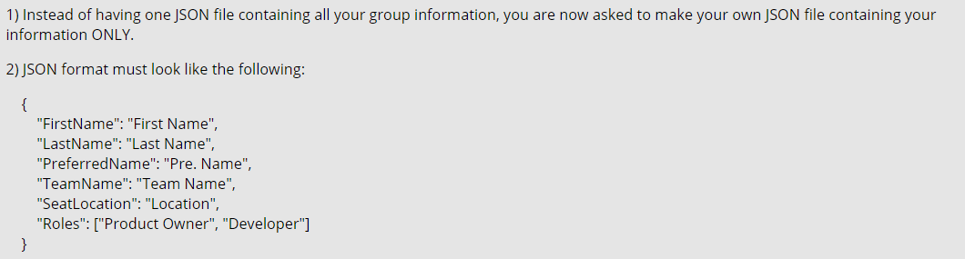
Class JSON Format
Specifications (per Ahmad and Product Owners):
Notes:
Do we want to “Scrum-ify” ourselves again… possibly with more a focused effort on technical specialization? Or should we keep the teams and team nams?
Possible Team Name categories:
Space Shuttles… nobody wanted to be Challenger
World War I battles in Europe… did not go very well
Thoughts?
Discussion Board items are ALWAYS due by Thursday at 11:59… You should include them in your own or your teams backlog (to-do list)
Excellent link for additional GitHub tutorials:
https://www.youtube.com/GitHubGuides

Slide 7
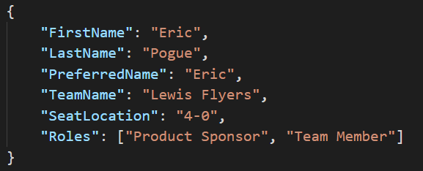
My “my-information.json” File
JSON URL: “http://sp18-cpsc-44000-001.azurewebsites.net/my-information.json”
Notes:
Do we want to “Scrum-ify” ourselves again… possibly with more a focused effort on technical specialization? Or should we keep the teams and team nams?
Possible Team Name categories:
Space Shuttles… nobody wanted to be Challenger
World War I battles in Europe… did not go very well
Thoughts?
Discussion Board items are ALWAYS due by Thursday at 11:59… You should include them in your own or your teams backlog (to-do list)
Excellent link for additional GitHub tutorials:
https://www.youtube.com/GitHubGuides

Slide 8
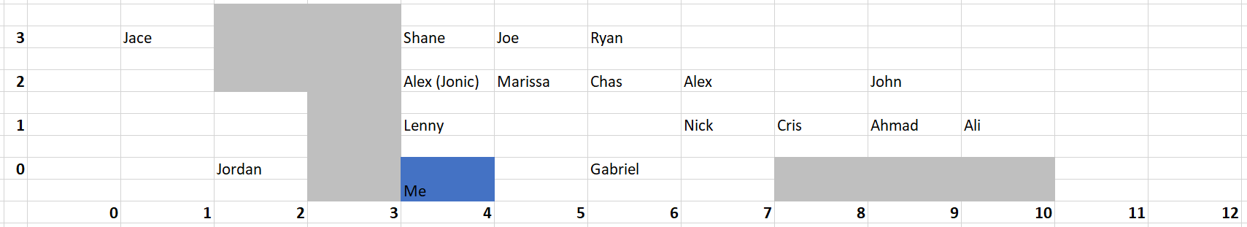
Finding SeatLocation
Notes:
Do we want to “Scrum-ify” ourselves again… possibly with more a focused effort on technical specialization? Or should we keep the teams and team nams?
Possible Team Name categories:
Space Shuttles… nobody wanted to be Challenger
World War I battles in Europe… did not go very well
Thoughts?
Discussion Board items are ALWAYS due by Thursday at 11:59… You should include them in your own or your teams backlog (to-do list)
Excellent link for additional GitHub tutorials:
https://www.youtube.com/GitHubGuides

Slide 9
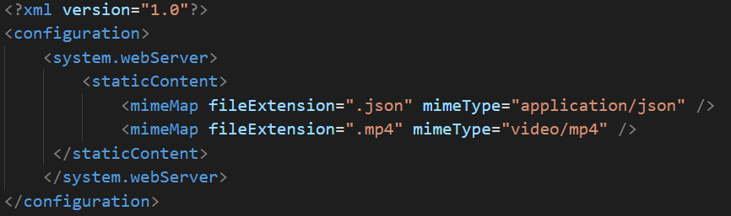
My “web.config” File
Notes:
Do we want to “Scrum-ify” ourselves again… possibly with more a focused effort on technical specialization? Or should we keep the teams and team nams?
Possible Team Name categories:
Space Shuttles… nobody wanted to be Challenger
World War I battles in Europe… did not go very well
Thoughts?
Discussion Board items are ALWAYS due by Thursday at 11:59… You should include them in your own or your teams backlog (to-do list)
Excellent link for additional GitHub tutorials:
https://www.youtube.com/GitHubGuides

Slide 10
Lab (report-out at 12:00)
Lab Activities:
Congratulate Alex on his new assignment as Project Manager for Sprint 4!
Congratulate Brandon on his new assignment as UI Designer for Sprints 3&4!
Ahmed and Product Owners identify/confirm who will be Product Architect for Sprint 4
Briefly review Team roles assignments for Sprints 3 through 8
Sprint 3 Planning:
Review Sprint 3 backlog, estimate Capacity, review priorities/dependencies, make commitments, report-out, etc… just like we did for Sprint 2
Identify and estimate your carryover items from Sprint 2
Identify Team’s Continuous Improvement item(s) that your team would like to implement in Sprint 3… limit 12% of Team Sprint 3 Capacity
Mini-retrospective on Sprint 3 Planning… feedback for Alex for his Sprint 4 Planning in two weeks
Work on Backlog items
Note that the Sprint Dates and Backlogs for Sprint 2 and Sprint 3 are provided for reference on the following slides.
Notes:
Sprints: 2 Week periods where deliverables are due and demos should be complete
Story Points (SP): Estimate of work that should be based on example deliverables. Generally not normalized between groups or teams. We will utilize ~30min to equal 1 SP
Hand out sprint planning sheet… 1 sheet per team

Slide 11
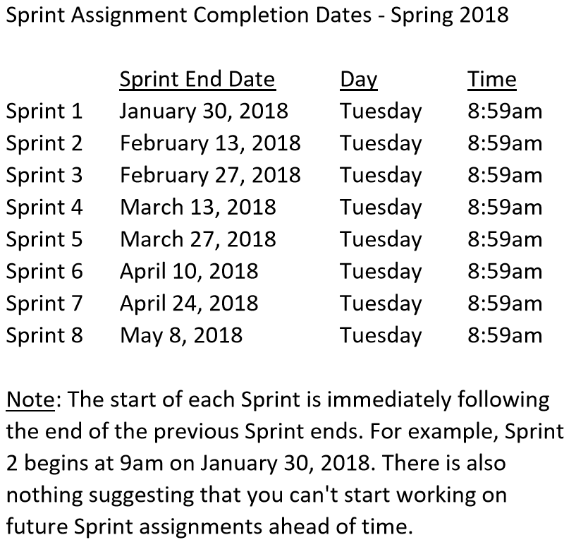

Slide 12
Sprint 2 Product Backlog… page 1 of 2
As a Class document a standard “My Information” JSON format that at a minimum include one or more “records” that each include FirstName, LastName, PreferredName, TeamName, SeatLocation, and Roles in a standard file name (e.g. “my-information.json”)… Product Owners and the Product Architect will lead this effort
As a Class commit each Team to research, discuss, and present at least one of the following topics:
Databases on Azure including “Azure tables vs Azure MongoDB vs Azure other DBs”**
Cloud/Azure based Authentication/Authorization services and who they could be integrated into a NodeJS based application*
JavaScript and NodeJS with a focus on Azure and including the best Internet based tutorials and/or books on the topic
SaaS Frameworks including “MEAN vs LAMP vs Ruby on Rails”
Service Oriented Architectures including “Web Services and SOAP/WSAD vs REST vs Sockets”
As a Team select one or two team members who will lead the team’s effort to research and discuss the above topic and then delivery a (~10min) presentation on the topic to the class on Tuesday, February 13.
Read and be prepared to discuss Chapter 6
Complete the dynamic Azure NodeJS website tutorial… leave the site in place [link]
As a Team Test each other’s Personal Static Website, verify JSON formats, and report sites tested and defects found as a MS Word or JSON file to your Product Owner and to the owner of the site(s) where the defect was found
Find and complete an additional HTML/NodeJS tutorial on Azure… leave it in place
Complete Sprint 2 Assignment/Quiz
Complete and document Sprint 2 Retrospective and summarization/prioritization of Team level Continuous Improvement (CI) items... be prepared to include one CI item on in your Sprint 3 backlog
Notes:
As a Class commit each Team to research, discuss, and present at least one of the following topics:
Databases on Azure including “Azure tables vs Azure MongoDB vs Azure other DBs”**
Cloud/Azure based Authentication/Authorization services and who they could be integrated into a NodeJS based application*
JavaScript and NodeJS with a focus on Azure and including the best Internet based tutorials and/or books on the topic
SaaS Frameworks including “MEAN vs LAMP vs Ruby on Rails”
Service Oriented Architectures including “Web Services and SOAP/WSAD vs REST vs Sockets”
SaaS Client Frameworks including “HTML/JavaScript vs AngularJS vs Angular2 vs React vs others”
File Formats including “HTML vs XML vs JSON vs Key/Value Pair Text Files”

Slide 13
Sprint 2 Product Backlog… page 2 of 2
Complete Sprint 3 Planning
Download class materials utilizing Git client and cloning “https://github.com/EricJPogue/sp18-cpsc-44000-001.git”
As a Team define the “Team Information Service” project by writing the necessary Team level User Stories for the project
As a Team create a shared private “Team Information Service” GitHub repository that is shared with everyone on the team and with the Instructor… name the repository “Team Information Service for [Team Name]”
Review, but do no complete, Eric’s Azure Static website tutorial video [link]
As a Team create a “Team Information Service” Production site on Azure
As a Team develop, test, and deploy “Team Information Service” Release 1 to Test
As a Team develop, test, and deploy “Team Information Service” Release 2 to Test and Production
Our “Team Information Service” product should include:
Reading each team member’s “My Information” JSON files from each of their Person Static Websites
Validating the JSON formats
Consolidating the data into the Class standard JSON format
Publishing the consolidated data to a simple HTML/JavaScript web page
Publishing the consolidated data to a Web Service
Notes:
As a Class commit each Team to research, discuss, and present at least one of the following topics:
Databases on Azure including “Azure tables vs Azure MongoDB vs Azure other DBs”**
Cloud/Azure based Authentication/Authorization services and who they could be integrated into a NodeJS based application*
JavaScript and NodeJS with a focus on Azure and including the best Internet based tutorials and/or books on the topic
SaaS Frameworks including “MEAN vs LAMP vs Ruby on Rails”
Service Oriented Architectures including “Web Services and SOAP/WSAD vs REST vs Sockets”
SaaS Client Frameworks including “HTML/JavaScript vs AngularJS vs Angular2 vs React vs others”
File Formats including “HTML vs XML vs JSON vs Key/Value Pair Text Files”

Slide 15
Sprint 3 Product Backlog… page 1 of 3
Verify and Demo that all items from Sprint 2 are Done* or add them as Carryover items to Sprint 3
Complete Sprint 3 Assignment/Quiz
Complete and document Sprint 3 Retrospective and summarization/prioritization of Team level Continuous Improvement (CI) items... be prepared to include one CI item on in your Sprint 3 backlog
Complete Sprint 4 Planning
Read and be prepared to discuss Chapter 7
Complete and document Sprint 3 Metrics which will consist of a published Say-Do ratio
Download and/or update class materials utilizing Git client and cloning https://github.com/EricJPogue/sp18-cpsc-44000-001.git
Review, but do no complete, Eric’s Azure Static website tutorial video [link]
As a Team define the “Team Information Service” project by writing the necessary Team level User Stories for the project
As a Team create a shared private “Team Information Service” GitHub repository that is shared with everyone on the team and with the Instructor… name the repository “Team Information Service for [Team Name]”
As a Team create a “Team Information Service” Production site on Azure
As a Team develop, test, and deploy “Team Information Service” Release 1 to Test
Notes:
As a Class commit each Team to research, discuss, and present at least one of the following topics:
Databases on Azure including “Azure tables vs Azure MongoDB vs Azure other DBs”**
Cloud/Azure based Authentication/Authorization services and who they could be integrated into a NodeJS based application*
JavaScript and NodeJS with a focus on Azure and including the best Internet based tutorials and/or books on the topic
SaaS Frameworks including “MEAN vs LAMP vs Ruby on Rails”
Service Oriented Architectures including “Web Services and SOAP/WSAD vs REST vs Sockets”
SaaS Client Frameworks including “HTML/JavaScript vs AngularJS vs Angular2 vs React vs others”
File Formats including “HTML vs XML vs JSON vs Key/Value Pair Text Files”

Slide 16
Sprint 3 Product Backlog… page 2 of 3
As a Team develop, test, and deploy “Team Information Service” Release 2 to Test and Production
As a Class commit each Team to research, discuss, and present at least one of the following topics:
SaaS Frameworks including “MEAN vs LAMP vs Ruby on Rails”
Service Oriented Architectures including “Web Services and SOAP/WSAD vs REST vs Sockets”
Web Client Application Architectures including “HTML/JavaScript, Angular.js, Angular2/TypeScript, and ReactJS”
As a Team select one or two team members who will lead the team’s effort to research and discuss the above topic and then delivery a (~10min) presentation on the topic to the class on Tuesday, February 27.
Define Product Teams for “Dynamic Class Seating Chart” application delivery project including, Project Manager, Product Architect, UI Designer, and Product Manager
As a Product Team define the “Dynamic Class Seating Chart” application as Epics, Features, and Stories
Notes:
As a Class commit each Team to research, discuss, and present at least one of the following topics:
Databases on Azure including “Azure tables vs Azure MongoDB vs Azure other DBs”**
Cloud/Azure based Authentication/Authorization services and who they could be integrated into a NodeJS based application*
JavaScript and NodeJS with a focus on Azure and including the best Internet based tutorials and/or books on the topic
SaaS Frameworks including “MEAN vs LAMP vs Ruby on Rails”
Service Oriented Architectures including “Web Services and SOAP/WSAD vs REST vs Sockets”
SaaS Client Frameworks including “HTML/JavaScript vs AngularJS vs Angular2 vs React vs others”
File Formats including “HTML vs XML vs JSON vs Key/Value Pair Text Files”

Slide 17
Sprint 3 Product Backlog… page 3 of 3
Our “Team Information Service” product should include:
Reading each team member’s “My Information” JSON files from each of their Personal Static Websites
Validating the JSON formats
Consolidating the data into a multi-person Class standard JSON format
Publishing the consolidated data to a simple HTML/JavaScript web page
Publishing the consolidated data to a Web Service
Include current time and last time each individuals information was last updated
Implement 30 minute caching and forced refresh… this could be a release 2 feature
Notes:
As a Class commit each Team to research, discuss, and present at least one of the following topics:
Databases on Azure including “Azure tables vs Azure MongoDB vs Azure other DBs”**
Cloud/Azure based Authentication/Authorization services and who they could be integrated into a NodeJS based application*
JavaScript and NodeJS with a focus on Azure and including the best Internet based tutorials and/or books on the topic
SaaS Frameworks including “MEAN vs LAMP vs Ruby on Rails”
Service Oriented Architectures including “Web Services and SOAP/WSAD vs REST vs Sockets”
SaaS Client Frameworks including “HTML/JavaScript vs AngularJS vs Angular2 vs React vs others”
File Formats including “HTML vs XML vs JSON vs Key/Value Pair Text Files”

Slide 18
Report-out & Wrap-up
Notes:
Who will volunteer to bring us a “Friendly Conversation” topic Thursday?

Slide 19
End of Session

Slide 20
Previous Assignments

Slide 21
Assignment (Sprint 1)
Prior to class on Tuesday:
“Scrum-ify” Ourselves… our second chance to demonstrate our capabilities as self-organizing Scrum team members
Complete Discussion Board “Introduction” before you leave class today
Read and be prepared to discuss Preface & Chapter 1
Install MS PowerPoint & MS Word Viewers (if you do not have access to the full products)
Setup a GitHub account with a Student Developer Pack/Plan [link]
Utilize Git & GitHub to create, update, branch, and merge local and remote projects utilizing several beginner level tutorials:
One option would be “An Intro to Git and GitHub for Beginners” tutorial [link]
Another option would be the GitHub “Hello World” tutorial [link]
Create a public GitHub repository and share it with another Team Member
Be the recipient of a shared public GitHub repository from a Team Member
Estimate: 3 hours… “Fist of Five” Agile polling
Notes:
Do we want to “Scrum-ify” ourselves again… possibly with more a focused effort on technical specialization? Or should we keep the teams and team nams?
Possible Team Name categories:
Space Shuttles… nobody wanted to be Challenger
World War I battles in Europe… did not go very well
Thoughts?
Discussion Board items are ALWAYS due by Thursday at 11:59… You should include them in your own or your teams backlog (to-do list)
Excellent link for additional GitHub tutorials:
https://www.youtube.com/GitHubGuides

Slide 22
Assignment (Sprint 1b)
Sprint 1b Product Backlog… due Monday night (11:59pm):
Create a public GitHub repository and share it with another Team Member… carry over from last assignment
Be the recipient of a shared public GitHub repository from a Team Member… carry over from last assignment
Individually setup a Microsoft Imagine Azure account [link]
Individually complete the Azure static website tutorial... leave the site in place [link]
As a Team agree on a standard and extensible “My Information” JSON format and data requirements that include FirstName, LastName, PreferredName, TeamName, SeatLocation, and Roles* in a standard file name (e.g. “my-information.json”) at a minimum… Product Owners to discuss/lead and elect someone to play the Product Architect role
Individually complete a “permanent” personal static website where you will initially host your “My Information” JSON file for this class utilizing the previous tutorial to create the new website
Complete Sprint 2 Planning Session
Individually complete Quiz 1
Read Chapter 2
As a Class commit each Team to research, discuss, and present on one of the following topics… Scrum Masters to discuss/lead and to elect someone to play the Project Manager role:
SaaS Client Frameworks including “HTML/JavaScript vs AngularJS vs Angular2 vs React vs others”
SaaS Frameworks including “MEAN vs LAMP vs Ruby on Rails”
File Formats including “HTML vs XML vs JSON vs Key/Value Pair Text Files”
Service Oriented Architectures including “Web Services and SOAP/WSAD vs REST vs Sockets”
Databases on Azure including “Azure tables vs Azure MongoDB vs Azure other DBs”
Individually review, but do no complete, Eric’s Azure Static website tutorial video [link]
Individually complete the dynamic NodeJS website… leave the site in place [link]
Notes:
A Backlog is a prioritized list of request deliverables. It exists at the Team and Product (and possibly Portfolio) levels… Stories, Features, Epics
Sprint 1b will end next Monday at 11:59pm… approximately 1 week
Notes:
All agile Backlogs must be a list of Features or Stores based prioritized on business value
Dependencies should be identified
The optimal order and method of completing them is up to the individual teams
Eventually we will need to provide a definition of “Done”

Slide 23
Assignment (for a full week instead if one class period)
Sprint 1b Product Backlog… due Monday night (11:59pm):
Create a public GitHub repository and share it with another Team Member… carry over from last assignment
Be the recipient of a shared public GitHub repository from a Team Member… carry over from last assignment
Individually setup a Microsoft Imagine Azure account [link]
Individually complete the Azure static website tutorial... leave the site in place [link]
As a Team agree on a standard and extensible “My Information” JSON format and data requirements that include FirstName, LastName, PreferredName, TeamName, SeatLocation, and Roles* in a standard file name (e.g. “my-information.json”) at a minimum… Product Owners to discuss/lead and elect someone to play the Product Architect role
Individually complete a “permanent” personal static website where you will initially host your “My Information” JSON file for this class utilizing the previous tutorial to create the new website
Complete Sprint 2 Planning Session
Individually complete Quiz 1
Read Chapter 2
As a Class commit each Team to research, discuss, and present on one of the following topics… Scrum Masters to discuss/lead and to elect someone to play the Project Manager role:
SaaS Client Frameworks including “HTML/JavaScript vs AngularJS vs Angular2 vs React vs others”
SaaS Frameworks including “MEAN vs LAMP vs Ruby on Rails”
File Formats including “HTML vs XML vs JSON vs Key/Value Pair Text Files”
Service Oriented Architectures including “Web Services and SOAP/WSAD vs REST vs Sockets”
Databases on Azure including “Azure tables vs Azure MongoDB vs Azure other DBs”
Individually review, but do no complete, Eric’s Azure Static website tutorial video [link]
Individually complete the dynamic NodeJS website… leave the site in place [link]
Notes:
A Backlog is a prioritized list of request deliverables. It exists at the Team and Product (and possibly Portfolio) levels… Stories, Features, Epics
Sprint 1b will end next Monday at 11:59pm… approximately 1 week
Notes:
All agile Backlogs must be a list of Features or Stores based prioritized on business value
Dependencies should be identified
The optimal order and method of completing them is up to the individual teams
Eventually we will need to provide a definition of “Done”

