Slide 1

Software Engineering Session: Week 5 Session 2 Instructor: Eric Pogue
Agenda:
Scrum of Scrums Standup led by Alex… Thank you, Alex!
Presentation & Discussion
Submitting Class Presentations… and the difference between Presentations and Demos
Sprint 2 Assignment/Quiz Q&A Discussion
JavaScript Basics (Chp. 6)
Lab
Lab Report-out & Wrap-up

Slide 2
Scrum-of-Scrums Report-out
The “daily” scrum meeting is not used as a problem-solving or issue resolution meeting. Issues that are raised are taken offline and usually dealt with by the relevant subgroup immediately after the meeting. During the daily scrum, each team member answers the following three questions:
What did you do since our last standup?
What will you do before our next standup?
Are there any impediments in your way that you need help from outside the team to resolve?

Slide 3
Presentation Schedule:
Databases on Azure including “Azure tables vs Azure MongoDB vs Azure other DBs”
– by the Ocelots presented by Jake & Thad
JavaScript and NodeJS with a focus on Azure and including the best Internet based tutorials and/or books
– by the Great White Buffalos presented by Cris & Nick
Cloud/Azure based Authentication/Authorization services and how they could be integrated into a NodeJS based application
– by the Lewis Honeybadgers presented by Kevin and Louie
Databases on Azure including “Azure tables vs Azure MongoDB vs Azure other DBs”
– by the Back Row Bandicoots presented by Tyler and Joe
JavaScript and NodeJS with a focus on Azure and including the best Internet based tutorials and/or books
– by the Flamingos presented by Lenny
Notes:
Did I get the names correct, etc?

Slide 4
Submitting Class Presentations… and the difference between Presentations and Demos

Slide 5
Sprint 2 Assignment/Quiz Q&A
Notes:
Notes:
One question was “removed”
Overall very good

Slide 6
JavaScript Basics (Chp. 6)

Slide 7
Lab (report-out at 12:00)
Lab Activities:
Support Alex as Project Manager for Sprint 4!
Determine who will be Project Manager for Sprint 5… Alex to email Eric
Brandon Demo of Seating Chart UI? on his new assignment as UI Designer for Sprints 3&4!
Determine who will be UI Designer for Sprint 5... Brandon to email Eric
Review cut lines
Ahmed and Product Owners identify/confirm who will be Product Architect for Sprint 4… Ahmed to email Eric
Work on Backlog items
Note that the Sprint Dates and Backlogs for Sprint 2 and Sprint 3 are provided for reference on the following slides.
Notes:
Sprints: 2 Week periods where deliverables are due and demos should be complete
Story Points (SP): Estimate of work that should be based on example deliverables. Generally not normalized between groups or teams. We will utilize ~30min to equal 1 SP
Hand out sprint planning sheet… 1 sheet per team

Slide 8
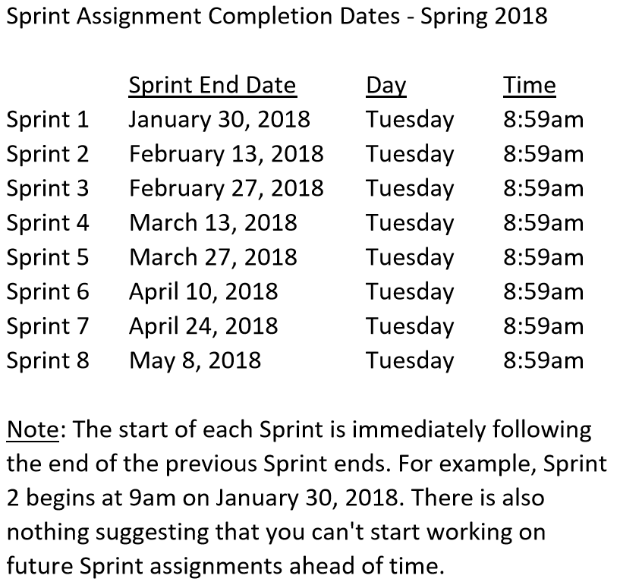

Slide 9
Sprint 3 Product Backlog… page 1 of 3
Verify and Demo that all items from Sprint 2 are Done* or add them as Carryover items to Sprint 3
Complete Sprint 3 Assignment/Quiz
Complete and document Sprint 3 Retrospective and summarization/prioritization of Team level Continuous Improvement (CI) items... be prepared to include one CI item on in your Sprint 3 backlog
Complete Sprint 4 Planning
Read and be prepared to discuss Chapter 7
Complete and document Sprint 3 Metrics which will consist of a published Say-Do ratio
Download and/or update class materials utilizing Git client and cloning https://github.com/EricJPogue/sp18-cpsc-44000-001.git
Review, but do no complete, Eric’s Azure Static website tutorial video [link]
As a Team define the “Team Information Service” project by writing the necessary Team level User Stories for the project
As a Team create a shared private “Team Information Service” GitHub repository that is shared with everyone on the team and with the Instructor… name the repository “Team Information Service for [Team Name]”
As a Team create a “Team Information Service” Production site on Azure
As a Team develop, test, and deploy “Team Information Service” Release 1 to Test
Notes:
As a Class commit each Team to research, discuss, and present at least one of the following topics:
Databases on Azure including “Azure tables vs Azure MongoDB vs Azure other DBs”**
Cloud/Azure based Authentication/Authorization services and who they could be integrated into a NodeJS based application*
JavaScript and NodeJS with a focus on Azure and including the best Internet based tutorials and/or books on the topic
SaaS Frameworks including “MEAN vs LAMP vs Ruby on Rails”
Service Oriented Architectures including “Web Services and SOAP/WSAD vs REST vs Sockets”
SaaS Client Frameworks including “HTML/JavaScript vs AngularJS vs Angular2 vs React vs others”
File Formats including “HTML vs XML vs JSON vs Key/Value Pair Text Files”

Slide 10
Sprint 3 Product Backlog… page 2 of 3
As a Team develop, test, and deploy “Team Information Service” Release 2 to Test and Production
As a Class commit each Team to research, discuss, and present at least one of the following topics:
A valuable follow-up topic from previous Class Presentations
SaaS Frameworks including “MEAN vs LAMP vs Ruby on Rails”
Service Oriented Architectures including “Web Services and SOAP/WSAD vs REST vs Sockets”
Web Client Application Architectures including “HTML/JavaScript, Angular.js, Angular2/TypeScript, and ReactJS”
As a Team select one or two team members who will lead the team’s effort to research and discuss the above topic and then delivery a (~10min) presentation on the topic to the class on Tuesday, February 27.
Define Product Teams for “Dynamic Class Seating Chart” application delivery project including, Project Manager, Product Architect, UI Designer, and Product Manager
As a Product Team define the “Dynamic Class Seating Chart” application as Epics, Features, and Stories
Notes:
As a Class commit each Team to research, discuss, and present at least one of the following topics:
Databases on Azure including “Azure tables vs Azure MongoDB vs Azure other DBs”**
Cloud/Azure based Authentication/Authorization services and who they could be integrated into a NodeJS based application*
JavaScript and NodeJS with a focus on Azure and including the best Internet based tutorials and/or books on the topic
SaaS Frameworks including “MEAN vs LAMP vs Ruby on Rails”
Service Oriented Architectures including “Web Services and SOAP/WSAD vs REST vs Sockets”
SaaS Client Frameworks including “HTML/JavaScript vs AngularJS vs Angular2 vs React vs others”
File Formats including “HTML vs XML vs JSON vs Key/Value Pair Text Files”

Slide 11
Sprint 3 Product Backlog… page 3 of 3
Our “Team Information Service” product should include:
Reading each team member’s “My Information” JSON files from each of their Personal Static Websites
Validating the JSON formats
Consolidating the data into a multi-person Class standard JSON format
Publishing the consolidated data to a simple HTML/JavaScript web page
Publishing the consolidated data to a Web Service
Include current time and last time each individuals information was last updated
Implement 30 minute caching and forced refresh… this could be a release 2 feature
Notes:
As a Class commit each Team to research, discuss, and present at least one of the following topics:
Databases on Azure including “Azure tables vs Azure MongoDB vs Azure other DBs”**
Cloud/Azure based Authentication/Authorization services and who they could be integrated into a NodeJS based application*
JavaScript and NodeJS with a focus on Azure and including the best Internet based tutorials and/or books on the topic
SaaS Frameworks including “MEAN vs LAMP vs Ruby on Rails”
Service Oriented Architectures including “Web Services and SOAP/WSAD vs REST vs Sockets”
SaaS Client Frameworks including “HTML/JavaScript vs AngularJS vs Angular2 vs React vs others”
File Formats including “HTML vs XML vs JSON vs Key/Value Pair Text Files”

Slide 12
Lab Report-out & Wrap-up
Notes:
Who will volunteer to bring us a “Friendly Conversation” topic Thursday?

Slide 13
End of Session

