Slide 1

Software Engineering Session: Week 7 Session 2 Instructor: Eric Pogue
Agenda:
Scrum of Scrums Standup led by Alex
TypeScript Presentation! Thank you, Quinn!!
Sprint 3 Assignment/Quiz review
Lecture: More SAFe and how SDLCs impact testing
Lab
Wrap-up

Slide 2
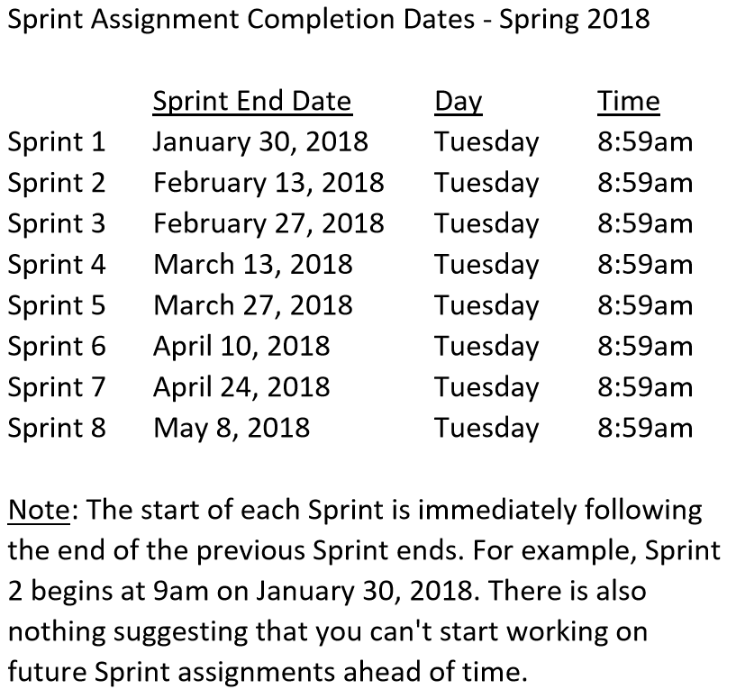

Slide 3
Sprint 4 Product Backlog… page 1 of 2
Complete and document Sprint 4 Metrics, Retrospective, Review Sprint 5 Backlog, and be prepared for Sprint 5 Planning on Tuesday, March 13
Complete Sprint 4 Assignment/Quiz
Deliver Sprint 4 User Stories… it the “real” world, 80%+ of a teams capacity should be devote to this! In addition to Product functions, user Stories should include”
As a Team create a “Klump” Production site on Azure
As a Team create a “Klump” Test site on Azure
As a Team develop, test, and deploy “Klump” Release 1 to Test
As a Team test and deploy Klump Release 1 to Production
Individually deploy and test Klump to your local development environment
Read and be prepared to discuss Chapter 8
Sprint 5 User Story Backlog “grooming”
As a Class commit each Team to research, discuss, and present at least one of the following topics:
A valuable follow-up topic from previous Class Presentations… i.e. securing a site with Microsoft Live / Lewis University credentials
SaaS Frameworks including “MEAN vs LAMP vs Ruby on Rails”
Service Oriented Architectures including “Web Services and SOAP/WSAD vs REST vs Sockets”
Web Client Application Architectures including “HTML/JavaScript, Angular.js, Angular2/TypeScript, and ReactJS”
As a Team select one or two team members who will lead the team’s effort to research and discuss the above topic and then delivery a (~10min) presentation on the topic to the class on Tuesday, February 27.
Notes:
As a Class commit each Team to research, discuss, and present at least one of the following topics:
Databases on Azure including “Azure tables vs Azure MongoDB vs Azure other DBs”**
Cloud/Azure based Authentication/Authorization services and who they could be integrated into a NodeJS based application*
JavaScript and NodeJS with a focus on Azure and including the best Internet based tutorials and/or books on the topic
SaaS Frameworks including “MEAN vs LAMP vs Ruby on Rails”
Service Oriented Architectures including “Web Services and SOAP/WSAD vs REST vs Sockets”
SaaS Client Frameworks including “HTML/JavaScript vs AngularJS vs Angular2 vs React vs others”
File Formats including “HTML vs XML vs JSON vs Key/Value Pair Text Files”

Slide 4
Scrum-of-Scrums Report-out
The “daily” scrum meeting is not used as a problem-solving or issue resolution meeting. Issues that are raised are taken offline and usually dealt with by the relevant subgroup immediately after the meeting. During the daily scrum, each team member answers the following three questions:
What did you do since our last standup?
What will you do before our next standup?
Are there any impediments in your way that you need help from outside the team to resolve?

Slide 5
More SAFe and how SDLCs impact testing
Notes:
Who will volunteer to bring us a “Friendly Conversation” topic Thursday?

Slide 6
Software Testing Overview
Software Testing [link] is important because, if done right, it can help us find and fix problems earlier and make our system delivery process less immobile, rigid, and fragile.
As future Software Engineers , we are going to:
Understand testing within the various Software Development Lifecycles
Understand testing terminology
Know how to develop applications that are easier to test
Understand Unit Testing and Automated Testing
Notes:
Never underestimate the value of good design and implementation (for testability, encapsulation, etc.) on the economics of testing. You can’t afford to test in quality!
Developers are responsible for product quality. Tester should be able to minimize that chance that a defect makes it to production.
We test to find defects and/or to validate that we have not introduced new defects.
Defects are exponentially more expensive to fix the longer the exist.
Performance issues are often the most difficult and expensive defects to fix. They are often not found until the application if running under production load… which is often only when it is in production.
Unit - $200
Integration - $600
User Acceptance - $6,000
Production - $100,000+
The permutations of modern software features, data, tools, environments, etc. quickly becomes unmanageable. Testability needs to be goal of nearly all non-trivial applications.
Dave Cutler of Windows NT fame had a quote. I wish I could remember the exact words, but it went something like, “I hate having testers because they give developers the false hope that someone else can save them from their sins.”

Slide 7
Software Testing “Truths”
Never underestimate the value of good design and implementation (for testability, encapsulation, etc.) on the economics of testing… You can’t afford to test in quality!
Defects are exponentially more expensive to fix the longer the exist.
Unit - $200
Integration - $600
User Acceptance - $6,000
Production - $100,000+
Performance issues are often the most difficult and expensive defects to fix. They are often not found until the application if running under production load… which is often only when it is in production.
The permutations of modern software features, data, tools, environments, etc. quickly becomes unmanageable. Testability needs to be goal of nearly all non-trivial applications.
Developers need to be responsible for product quality. Tester should be able to minimize that chance that a defect makes it to production.
Dave Cutler of Windows NT fame had a quote. I wish I could remember the exact words, but it went something like, “I hate having testers because they give developers the false hope that someone else can save them from their sins.”

Slide 8
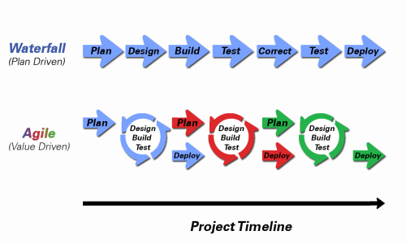
Object-Oriented Programming within Various Development Methodologies
Notes:
Development Methodology and Software Development Lifecycle (SDLC) are often used interchangeably.
The Iterative development methodology is not depicted here as even the mainstays and inventors of the Iterative development methodology seem to be moving toward agile. Plus as Waterfall “holdouts” move, they seem to be moving directly toward Agile. Can you start to see my biases?
Development Methodologies (SDLCs) are a future Bonus Topic. There are several optional slides t the end of this deck. Let me know if you would like to have a more formal overview of the topic as part of this class. I have a passion in this area.
Object oriented-programming concepts/practices evolve and reprioritize depending on the development methodology.
For example, in Waterfall (as well as in Iterative) object-oriented design often play a critical role in the (big upfront) design activities. UML diagrams and project artifacts are often important to the overall project success. (opinion) Practical reality has been that these design artifacts often do not reflect the actual implementation and are rarely maintained or updated.
The Agile practitioners do not reject these design artifacts. However, the focus on shorter time horizons, evolving architecture, and working code changes the value proposition for object-oriented practices to more focus on the build, test, enhance activities.

Slide 9
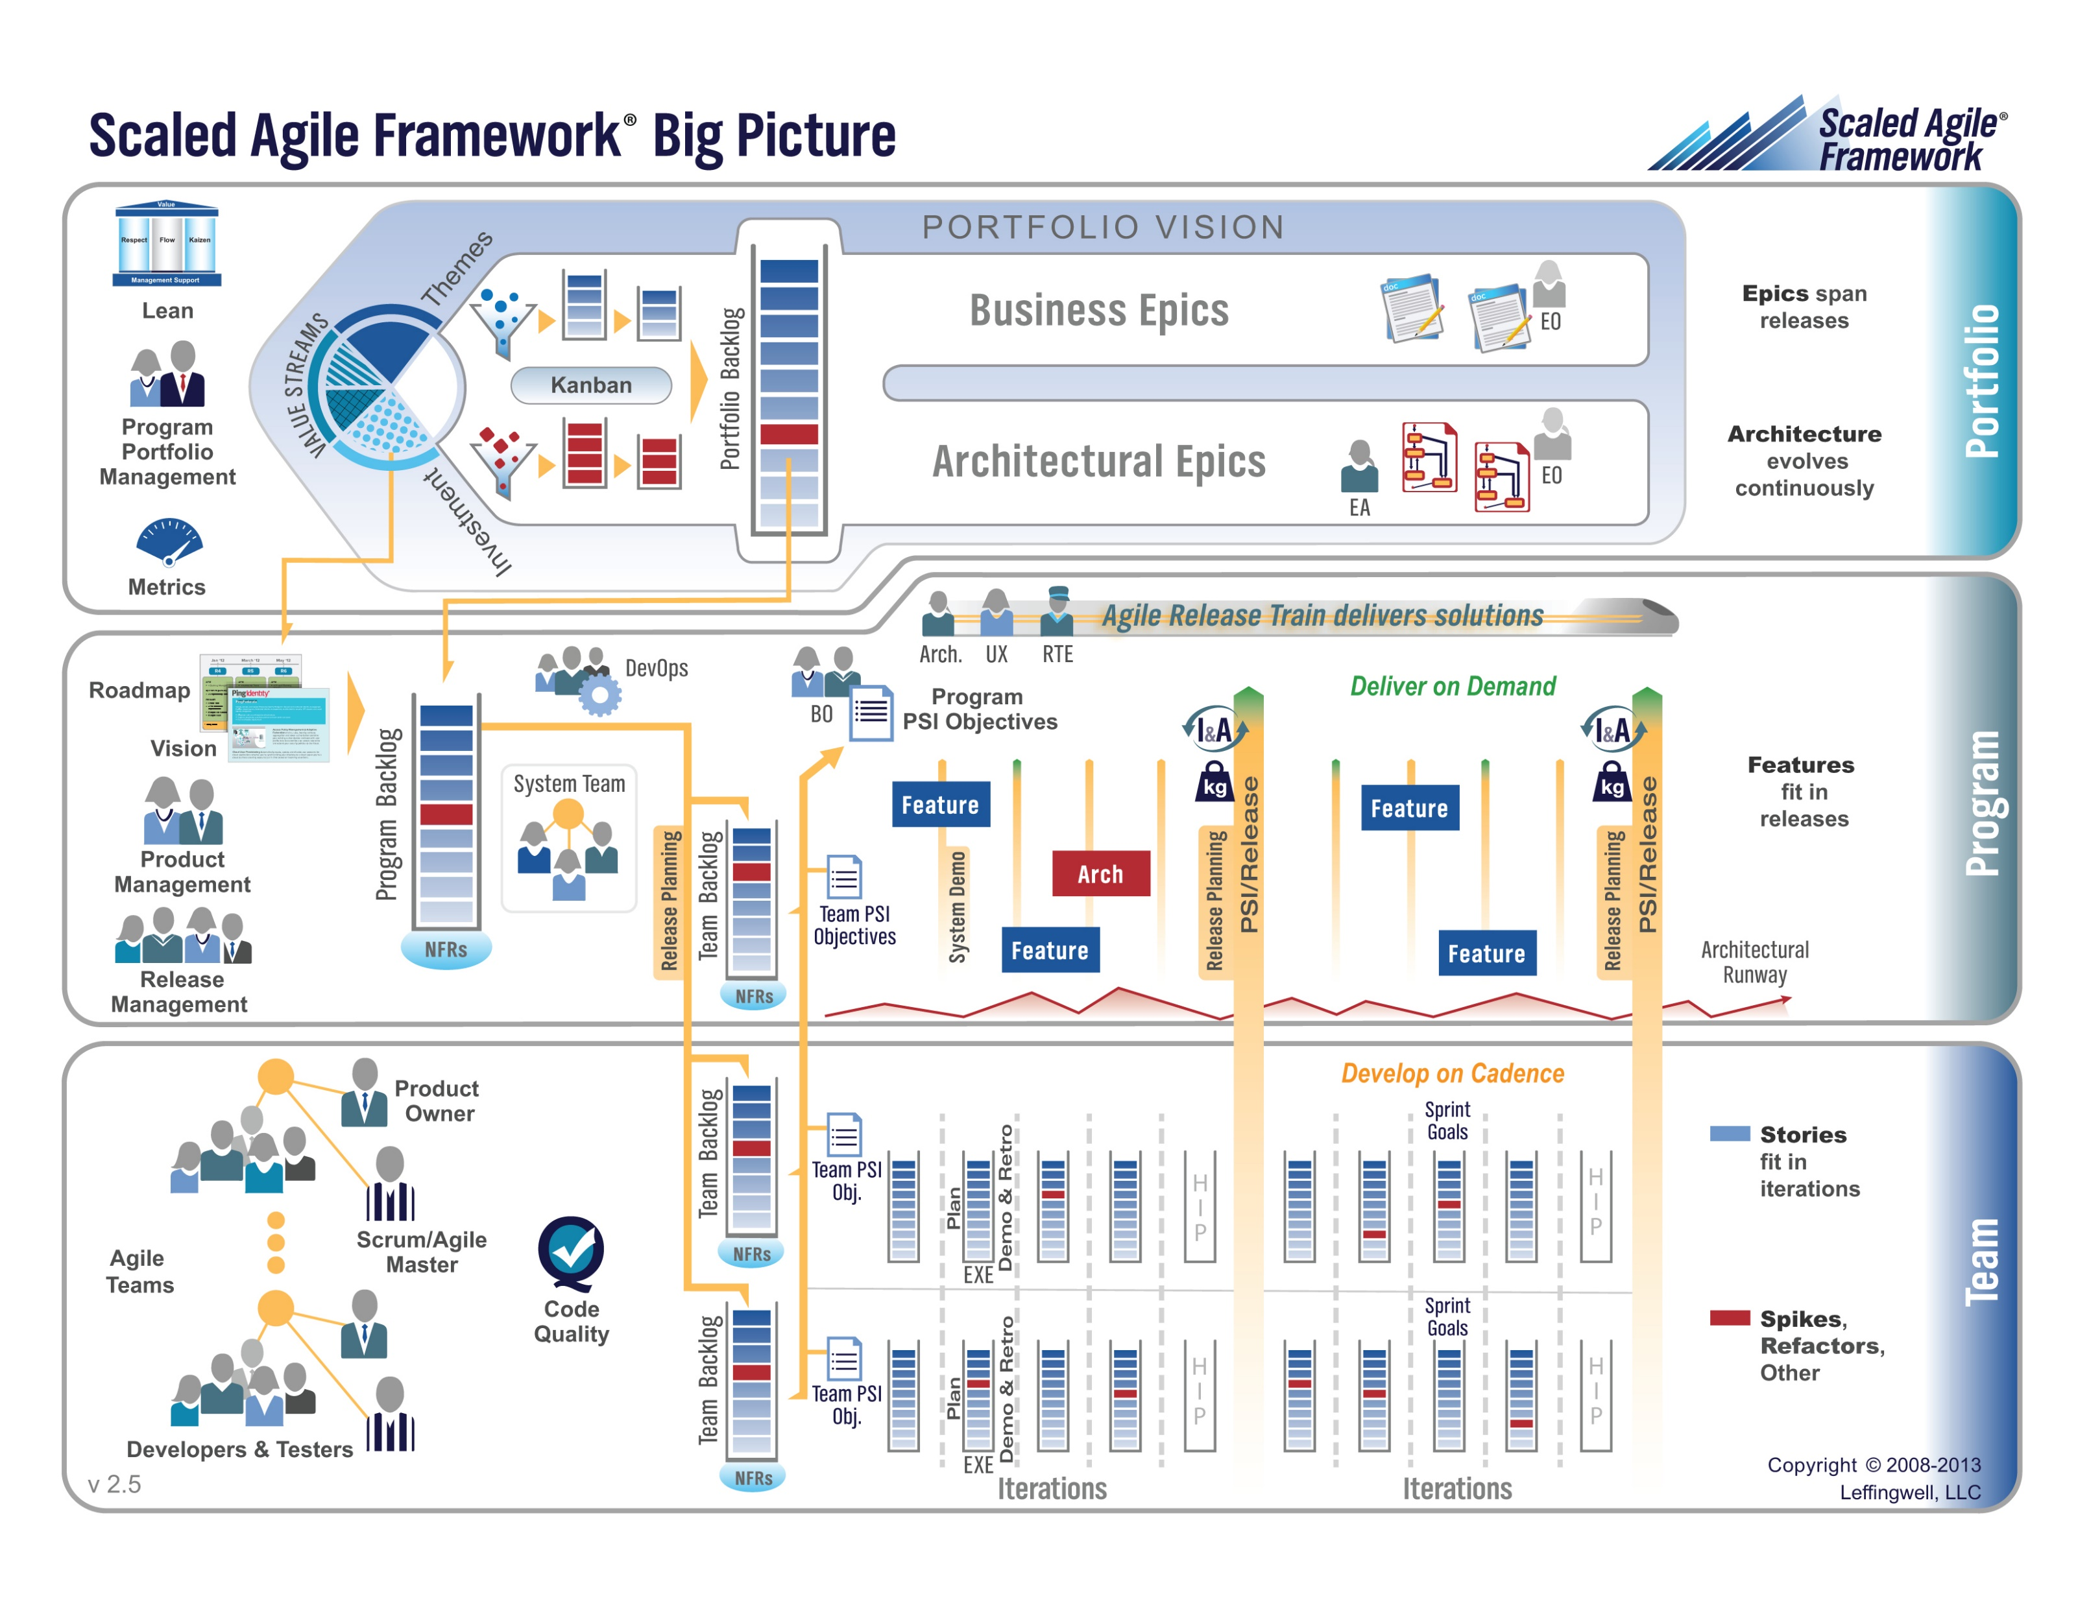

Slide 10
Waterfall vs Iterative vs Agile
 | Waterfall | Iterative | Agile
References | United States Department of Defense: DOD-STD-2167A (1985) | Rational Unified Process (RUP) Open Unified Process | Scrum Kanban Scaled Agile Framework (SAFe)
Priorities | Planning and predictability | Architecture, modeling, and efficiency through early detection & fixing of issues | Responsiveness to feedback, efficiency through engineering practices, early detection & fixing of issues
Principles | Execute phases sequentially: Requirements Analysis Design Coding Testing and Operations Define and commit to Scope, Cost, and Timeline “early” Implement strict Change Control | Develop and test iteratively Manage requirements Use components Model visually Verify quality Control changes | Develop, test, deploy, and release iteratively Capture lightweight near term requirements Empower teams Allow requirements to evolve but maintain fixed timelines Apply engineering practices and systems thinking (e.g. TDD) Integrate early user feedback into remaining plan Maintain a collaborative approach between all stakeholders
Notes:
The views on testing and change management have changed dramatically as organizations have moved from Waterfall to Iterative to Agile development lifecycles.
Successful Agile (and Iterative) Development REQUIRES better application design, development techniques, and testing practices.
Testing and lack of defects are not the end goal. A higher quality more usable more cost effective product is the goal.

Slide 11
Testing Terms
Important testing terms include:
Unit Testing: developer testing their own code
Integration Testing: development team testing their full code
System Testing: multiple development teams testing a full system or systems
Performance Testing: testing performance at the Unit, Integration, and/or System level
Manual Testing: a person using the application often running test scenarios
Automated Testing: a group of automated tests that run on the application in the Unit, Integration, System, or Performance testing areas
UI Automated Testing attempts to exercise the application be reproducing user events (key & mouse events)
API Automated Testing occurs at the function/method API level (JUnit for example)

Slide 12
Testing Terms
Important testing terms (continued):
Verification: does the application perform as expected
Validation: does the application provide the business benefit that was expected
Behavioral Testing: verifying that the correct functions were called with the correct parameters
State Testing: focuses on the results of those calls

Slide 13
Automated Testing
Unit testing can be done in two ways − manual testing and automated testing.
Automated testing has become a more important part of effective software testing. The pros of Automated Testing include:
Repeatable tests that are quick to run and can support Iterative and Agile development
Very effective in validating environments and doing “smoke tests” to make sure a new build meets a minimal set of requirements
Supports Performance Testing very effectively
Very inexpensive and quick to repeat testing and validate fixes
Various implications include UI, API, and Unit automation tests… each has a very different set of pros and cons
Notes:
False positives versus valid defects found.
Manual Testing and Automated Testing can be supportive of each other.

Slide 14
Automated Testing
Unit testing can be done in two ways − manual testing and automated testing.
Some of the benefits of Automated Testing have been oversold. Some of the challenges include:
Developers rarely can come up with scenarios in scripts that they would not already have tested in their normal unit testing… they often don’t know what they don’t know
UI focused Automated Testing (key & mouse events) are often challenging and create/maintain a great number of false-positives
API Level Automated Testing (i.e. REST) scripts are often more useful and easier to maintain
Environmental verification, API, and finally UI Automated testing is generally the best order to show value quickly with Automated Testing
Automated Testing investment is often not prioritized or tracked so it is difficult to know its effectiveness
Scripts can be expensive to develop and maintain
Notes:
False positives versus valid defects found.
Manual Testing and Automated Testing can be supportive of each other.

Slide 15
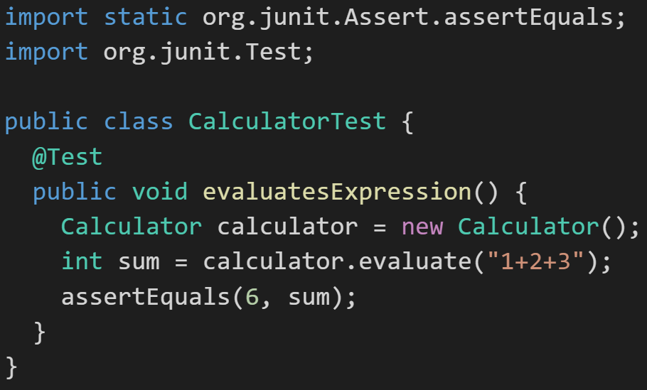
Automated Unit Testing Example: JUnit
Unit testing can be done in two ways − manual testing and automated testing.
JUnit [link] is a Automated Testing framework focused on developing and running Unit test for Java applications. JUnit:
Is a Java opensource extension
Provides annotations to identify test methods.
Provides assertions for testing expected results.
Provides test runners for running tests.
JUnit tests allow you to write codes faster, which increases quality.
JUnit is elegantly simple. It is less complex and takes less time.
JUnit tests can be run automatically and they check their own results and provide immediate feedback. There's no need to manually comb through a report of test results
Notes:
@Test
identifies the method as a test method (remember, method and function are synonyms)
@Test(expected = Exception.class)
fails if the method does not throw the named exception
@Test(timeout=100)
fails if the method takes longer than 100 milliseconds
@Before
public void method()
This method is executed before each test. It is used to prepare the test environment.
@After
public void method()
This method is executed after each test. It is used to clean up the test environment, including cleaning up expensive memory structures.
@BeforeClass
public static void method()
This method is executed once, before any test is done. It is used to do time-intensive tasks before any test is done.

Slide 16
Lab (report-out at 12:08)
Lab Activities:
I need two volunteers to demo setting up a local NodeJS application… you can record it and submit the recording if you prefer
I need two volunteers to demo setting up a Azure NodeJS application… you can record it and submit the recording if you prefer
Complete initial Sprint 4 Discussion Board (DB) post… during class
Review and respond back (test/verify) to at least one DB post from a classmate… during class
Submit ALL completed Presentations, Demos, and Roles played by the end of the day
Work on Team Backlog items
Notes:
Sprints: 2 Week periods where deliverables are due and demos should be complete
Story Points (SP): Estimate of work that should be based on example deliverables. Generally not normalized between groups or teams. We will utilize ~30min to equal 1 SP
Hand out sprint planning sheet… 1 sheet per team

Slide 17
Lab Report-out
Notes:
Who will volunteer to bring us a “Friendly Conversation” topic Thursday?

Slide 18
Wrap-up
Notes:
Who will volunteer to bring us a “Friendly Conversation” topic Thursday?

Slide 19
End of Session

Slide 20
Backup Slides

Slide 21
Team Information Service Requirements
Our “Team Information Service” product should include:
Reading each team member’s “My Information” JSON files from each of their Personal Static Websites
Validating the JSON formats
Publishing the consolidated data to a simple HTML/JavaScript web page
Consolidating the data into a multi-person Class standard JSON format… note that to make the format simpler, we can limit roles to 3 roles (role1, role2, and role3)
Publishing the consolidated data to a Web Service that returns the standard multi-person JSON format
Include current time and last time each individuals information was last updated
Implement 30 minute caching and forced refresh… this could be a release 2 feature
Question: What is a better name for this Product???
Notes:
As a Class commit each Team to research, discuss, and present at least one of the following topics:
Databases on Azure including “Azure tables vs Azure MongoDB vs Azure other DBs”**
Cloud/Azure based Authentication/Authorization services and who they could be integrated into a NodeJS based application*
JavaScript and NodeJS with a focus on Azure and including the best Internet based tutorials and/or books on the topic
SaaS Frameworks including “MEAN vs LAMP vs Ruby on Rails”
Service Oriented Architectures including “Web Services and SOAP/WSAD vs REST vs Sockets”
SaaS Client Frameworks including “HTML/JavaScript vs AngularJS vs Angular2 vs React vs others”
File Formats including “HTML vs XML vs JSON vs Key/Value Pair Text Files”

Slide 22
Standup for Sprint 3 Product Backlog
Verify and Demo that all items from Sprint 2 are Done* or add them as Carryover items to Sprint 3
Complete Sprint 3 Assignment/Quiz
Complete and document Sprint 3 Retrospective and summarization/prioritization of Team level Continuous Improvement (CI) items... be prepared to include one CI item on in your Sprint 3 backlog
Complete Sprint 4 Planning
Read and be prepared to discuss Chapter 7
Complete and document Sprint 3 Metrics which will consist of a published Say-Do ratio
Download and/or update class materials utilizing Git client and cloning https://github.com/EricJPogue/sp18-cpsc-44000-001.git
Review, but do no complete, Eric’s Azure Static website tutorial video [link]
As a Team define the “Team Information Service” project by writing the necessary Team level User Stories for the project
As a Team create a shared private “Team Information Service” GitHub repository that is shared with everyone on the team and with the Instructor… name the repository “Team Information Service for [Team Name]”
As a Team create a “Team Information Service” Production site on Azure
As a Team develop, test, and deploy “Team Information Service” Release 1 to Test
Notes:
As a Class commit each Team to research, discuss, and present at least one of the following topics:
Databases on Azure including “Azure tables vs Azure MongoDB vs Azure other DBs”**
Cloud/Azure based Authentication/Authorization services and who they could be integrated into a NodeJS based application*
JavaScript and NodeJS with a focus on Azure and including the best Internet based tutorials and/or books on the topic
SaaS Frameworks including “MEAN vs LAMP vs Ruby on Rails”
Service Oriented Architectures including “Web Services and SOAP/WSAD vs REST vs Sockets”
SaaS Client Frameworks including “HTML/JavaScript vs AngularJS vs Angular2 vs React vs others”
File Formats including “HTML vs XML vs JSON vs Key/Value Pair Text Files”

Slide 23
Sprint 4 Product Backlog… page 1 of 2
Complete and document Sprint 4 Metrics, Retrospective, Review Sprint 5 Backlog, and be prepared for Sprint 5 Planning on Tuesday, March 13
Complete Sprint 4 Assignment/Quiz
Deliver Sprint 4 User Stories… it the “real” world, 80%+ of a teams capacity should be devote to this! In addition to Product functions, user Stories should include”
As a Team create a “Klump” Production site on Azure
As a Team create a “Klump” Test site on Azure
As a Team develop, test, and deploy “Klump” Release 1 to Test
As a Team test and deploy Klump Release 1 to Production
Individually deploy and test Klump to your local development environment
Read and be prepared to discuss Chapter 8
Sprint 5 User Story Backlog “grooming”
As a Class commit each Team to research, discuss, and present at least one of the following topics:
A valuable follow-up topic from previous Class Presentations… i.e. securing a site with Microsoft Live / Lewis University credentials
SaaS Frameworks including “MEAN vs LAMP vs Ruby on Rails”
Service Oriented Architectures including “Web Services and SOAP/WSAD vs REST vs Sockets”
Web Client Application Architectures including “HTML/JavaScript, Angular.js, Angular2/TypeScript, and ReactJS”
As a Team select one or two team members who will lead the team’s effort to research and discuss the above topic and then delivery a (~10min) presentation on the topic to the class on Tuesday, February 27.
Notes:
As a Class commit each Team to research, discuss, and present at least one of the following topics:
Databases on Azure including “Azure tables vs Azure MongoDB vs Azure other DBs”**
Cloud/Azure based Authentication/Authorization services and who they could be integrated into a NodeJS based application*
JavaScript and NodeJS with a focus on Azure and including the best Internet based tutorials and/or books on the topic
SaaS Frameworks including “MEAN vs LAMP vs Ruby on Rails”
Service Oriented Architectures including “Web Services and SOAP/WSAD vs REST vs Sockets”
SaaS Client Frameworks including “HTML/JavaScript vs AngularJS vs Angular2 vs React vs others”
File Formats including “HTML vs XML vs JSON vs Key/Value Pair Text Files”

Slide 24
Sprint 4 Product Backlog… page 2 of 2
As a Team develop, test, and deploy “Team Information Service” Release 2 to Test and Production
Define Product Teams for “Dynamic Class Seating Chart” application delivery project including, Project Manager, Product Architect, UI Designer, and Product Manager
As a Product Team define the “Dynamic Class Seating Chart” application as Epics, Features, and Stories
Individually deploy and test Team Information Service to your personal Azure site
Notes:
As a Class commit each Team to research, discuss, and present at least one of the following topics:
Databases on Azure including “Azure tables vs Azure MongoDB vs Azure other DBs”**
Cloud/Azure based Authentication/Authorization services and who they could be integrated into a NodeJS based application*
JavaScript and NodeJS with a focus on Azure and including the best Internet based tutorials and/or books on the topic
SaaS Frameworks including “MEAN vs LAMP vs Ruby on Rails”
Service Oriented Architectures including “Web Services and SOAP/WSAD vs REST vs Sockets”
SaaS Client Frameworks including “HTML/JavaScript vs AngularJS vs Angular2 vs React vs others”
File Formats including “HTML vs XML vs JSON vs Key/Value Pair Text Files”

