Slide 1

Software Engineering Session: Sprint 5 Session 1 Instructor: Eric Pogue
Agenda:
Review Product Roles
Scrum of Scrums Standup led by Jordon (Elmer) with product assistance from out new Product Manager Joe (Van Luyk)
NodeJS Setup Demos by Marissa (Koronkiewicz) and Joe (Van Luyk)
Release Planning
Sprint 5 Backlog Grooming and Planning Session
Report-out
 | Product Manager | Project Manager | Product Architect | UI Designer
Sprint 4 | Eric (Pogue) | Alex (Jonic) | John (Laschober) | Chas (Logue)
Sprint 5 | Joe (Van Luyk) | Jordon (Elmer) | Quinn (Stratton) | Jace (Horner)
Sprint 6 | Louie (Lorenzo) | Tyler (Kummer) | Thad (Albert) | Michael (Pedzimaz)

Slide 2
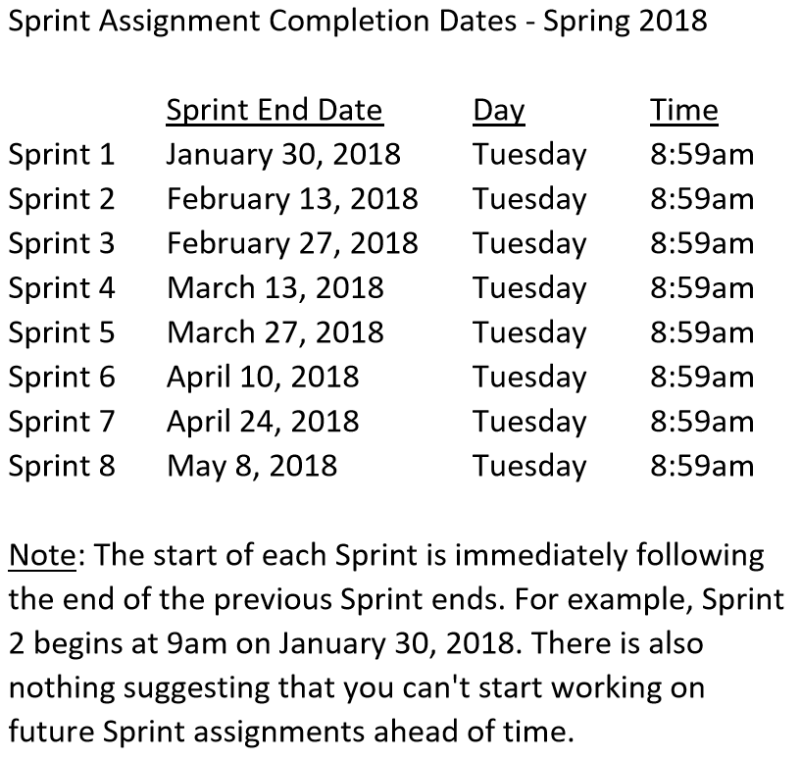

Slide 3
Scrum-of-Scrums Report-out
The “daily” scrum meeting is not used as a problem-solving or issue resolution meeting. Issues that are raised are taken offline and usually dealt with by the relevant subgroup immediately after the meeting. During the daily scrum, each team member answers the following three questions:
What did you do since our last standup?
What will you do before our next standup?
Are there any impediments in your way that you need help from outside the team to resolve?

Slide 4
Scrum-of-Scrums Report-out
Complete and document Sprint 4 Metrics, Retrospective, Review Sprint 5 Backlog, and be prepared for Sprint 5 Planning on Tuesday, March 13
Complete Sprint 4 Assignment/Quiz
Deliver Sprint 4 User Stories… it the “real” world, 80%+ of a teams capacity should be devote to this! In addition to Product functions, user Stories should include”
As a Team create a “Klump” Production site on Azure
As a Team create a “Klump” Test site on Azure
As a Team develop, test, and deploy “Klump” Release 1 to Test
As a Team test and deploy Klump Release 1 to Production
Individually deploy and test Klump to your local development environment
Read and be prepared to discuss Chapter 8
Sprint 5 User Story Backlog “grooming”
As a Class commit each Team to research, discuss, and present at least one of the following topics:
A valuable follow-up topic from previous Class Presentations… i.e. securing a site with Microsoft Live / Lewis University credentials
SaaS Frameworks including “MEAN vs LAMP vs Ruby on Rails”
Service Oriented Architectures including “Web Services and SOAP/WSAD vs REST vs Sockets”
Web Client Application Architectures including “HTML/JavaScript, Angular.js, Angular2/TypeScript, and ReactJS”
As a Team select one or two team members who will lead the team’s effort to research and discuss the above topic and then delivery a (~10min) presentation on the topic to the class on Tuesday, February 27.
Notes:
As a Class commit each Team to research, discuss, and present at least one of the following topics:
Databases on Azure including “Azure tables vs Azure MongoDB vs Azure other DBs”**
Cloud/Azure based Authentication/Authorization services and who they could be integrated into a NodeJS based application*
JavaScript and NodeJS with a focus on Azure and including the best Internet based tutorials and/or books on the topic
SaaS Frameworks including “MEAN vs LAMP vs Ruby on Rails”
Service Oriented Architectures including “Web Services and SOAP/WSAD vs REST vs Sockets”
SaaS Client Frameworks including “HTML/JavaScript vs AngularJS vs Angular2 vs React vs others”
File Formats including “HTML vs XML vs JSON vs Key/Value Pair Text Files”

Slide 5
Release/PSI Planning
 | Product Manager | Project Manager | Product Architect | UI Designer
Sprint 4 | Eric (Pogue) | Alex (Jonic) | John (Laschober) | Chas (Logue)
Sprint 5 | Joe (Van Luyk) | Jordon (Elmer) | Quinn (Stratton) | Jace (Horner)
Sprint 6 | Louie (Lorenzo) | Tyler (Kummer) | Thad (Albert) | Michael (Pedzimaz)
Notes:
Who will volunteer to bring us a “Friendly Conversation” topic Thursday?

Slide 6
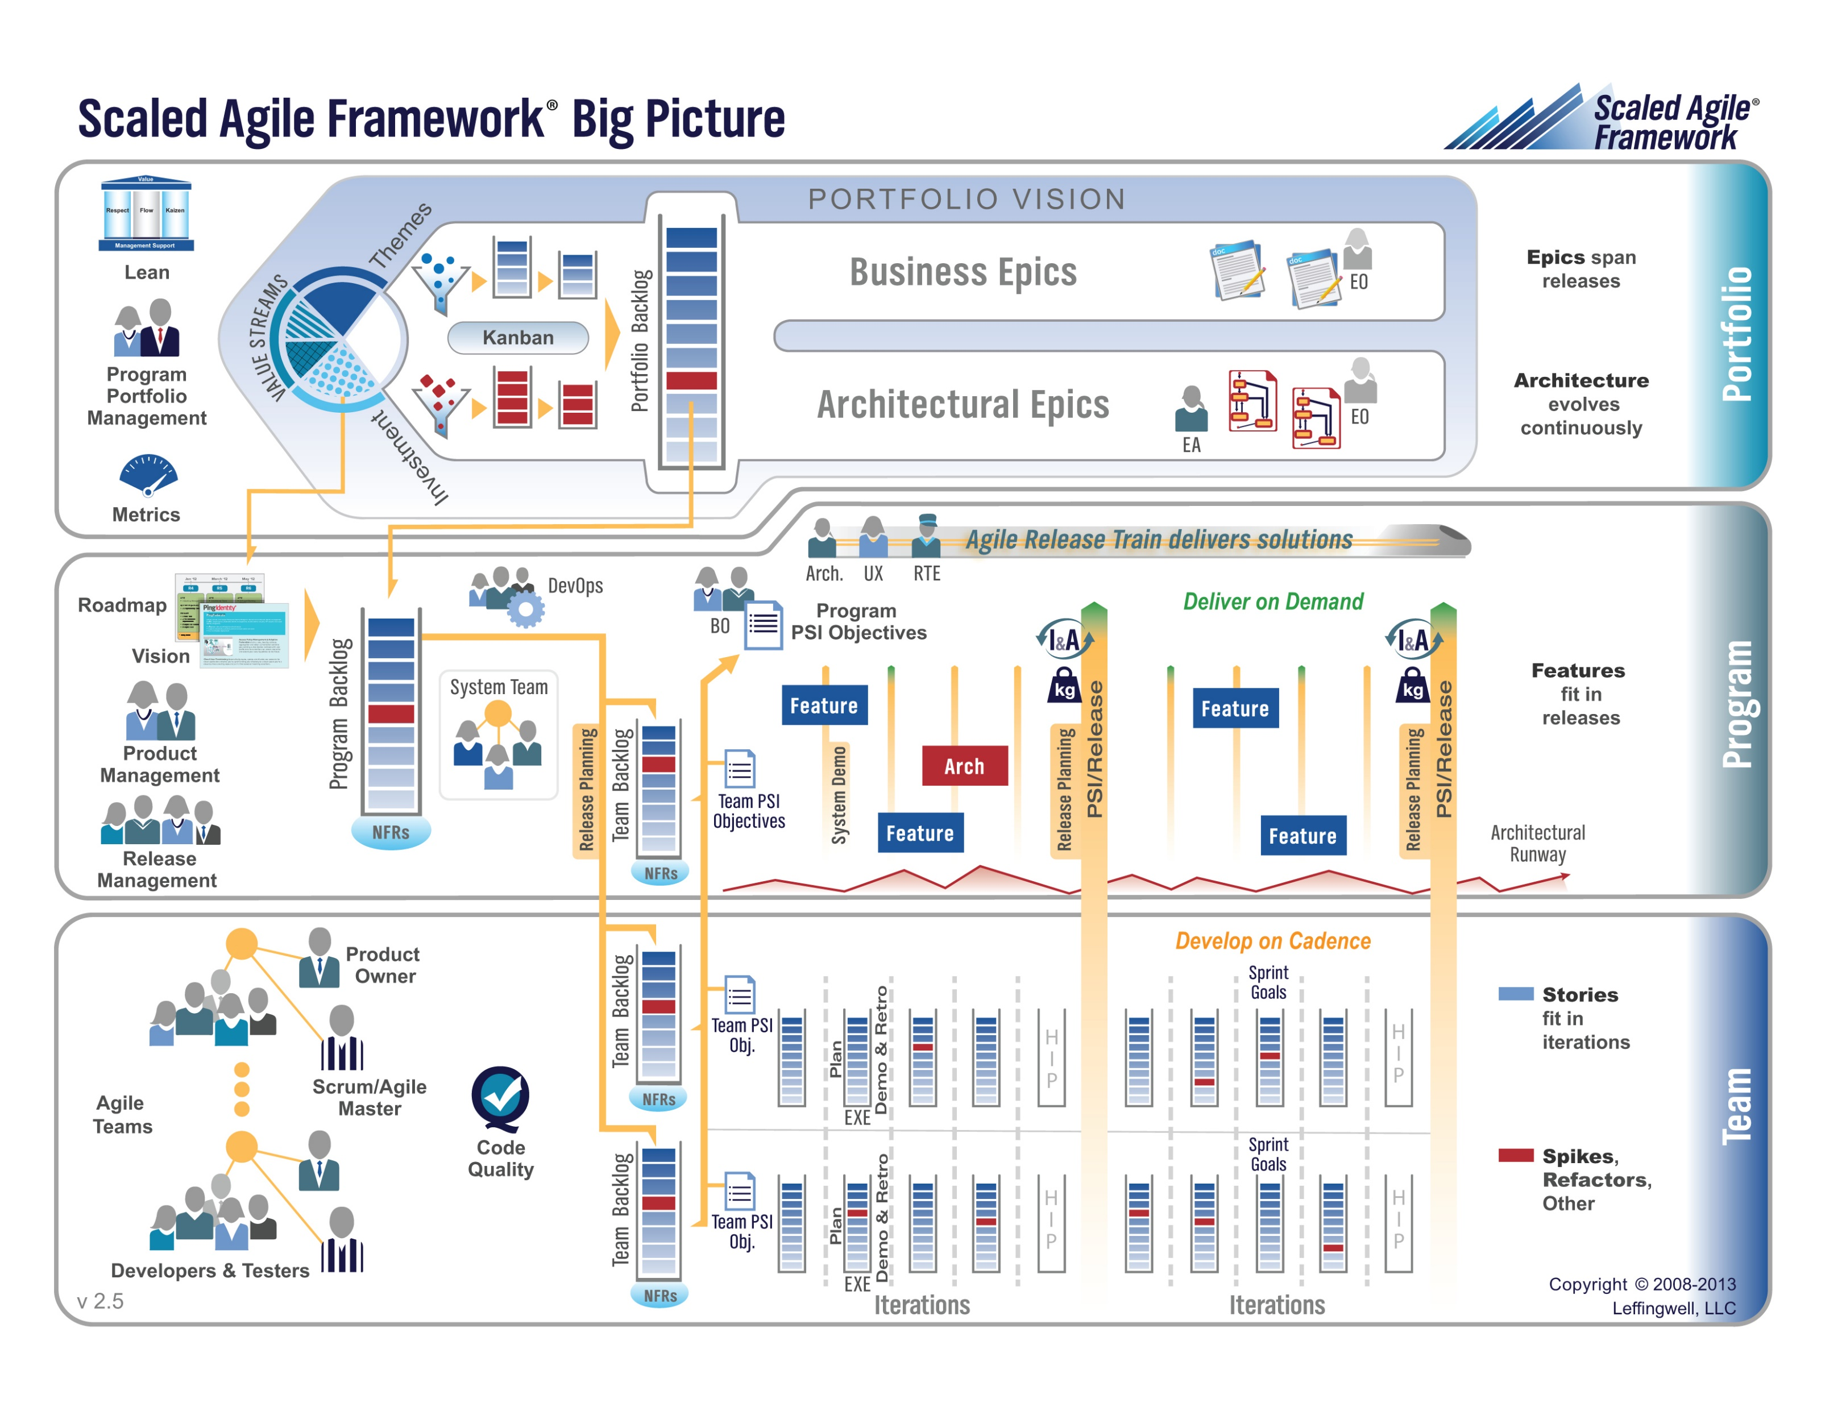

Slide 7
Release – Seating Chart
Release – Final Project(s)

Slide 8
Sprint 5 Backlog Grooming & Sprint 5 Planning
Notes:
Who will volunteer to bring us a “Friendly Conversation” topic Thursday?

Slide 10
Team the “Klump” Product
Our “Klump” product should include:
Reading each team member’s “My Information” JSON files from each of their Personal Static Websites
Validating of JSON formats
Publishing the consolidated data to a simple HTML/JavaScript web page
Consolidating the data into a multi-person Class standard JSON format… note that to make the format simpler, we can limit roles to 3 roles (role1, role2, and role3)… Product Architect to lead
Publishing the consolidated data to a Web Service that returns the standard multi-person JSON format
Include current time and last time each individuals information was last updated in the multi-person JSON response
Testing mode to validate and report JSON formatting errors
Implement 30 minute caching and forced refresh
Solid Development (each team member), Test (team), and Production sites (team)
Notes:
As a Class commit each Team to research, discuss, and present at least one of the following topics:
Databases on Azure including “Azure tables vs Azure MongoDB vs Azure other DBs”**
Cloud/Azure based Authentication/Authorization services and who they could be integrated into a NodeJS based application*
JavaScript and NodeJS with a focus on Azure and including the best Internet based tutorials and/or books on the topic
SaaS Frameworks including “MEAN vs LAMP vs Ruby on Rails”
Service Oriented Architectures including “Web Services and SOAP/WSAD vs REST vs Sockets”
SaaS Client Frameworks including “HTML/JavaScript vs AngularJS vs Angular2 vs React vs others”
File Formats including “HTML vs XML vs JSON vs Key/Value Pair Text Files”

Slide 11
Sprint 5 Product Backlog… page 1 of 2
Complete midterm exam which is scheduled for Thursday, March 22 during the last 50 minutes of class
Complete and document Sprint 5 Metrics, Retrospective, Prepare and Review Sprint 6 Stories, and be prepared for Sprint 6 Planning on Tuesday, March 27
Complete Sprint 5 Assignment/Quiz
Deliver Sprint 5 User Stories that will allow your team to exceed “Klump” product specifications by the end of Sprint 6
Read and be prepared to discuss Chapter 9
Prepare and Groom Sprint 6 User Stories
As a Class commit each Team to research, discuss, and present at least one of the following topics:
A valuable follow-up topic from previous Class Presentations… i.e. securing a site with Microsoft Live / Lewis University credentials
SaaS Frameworks including “MEAN vs LAMP vs Ruby on Rails”
Service Oriented Architectures including “Web Services and SOAP/WSAD vs REST vs Sockets”
Web Client Application Architectures including “HTML/JavaScript, Angular.js, Angular2/TypeScript, and ReactJS”
As a Team select one or two team members who will lead the team’s effort to research and discuss the above topic and then delivery a (~10min) presentation on the topic to the class on Tuesday, February 27.
Notes:
… the test questions will be similar to the questions from the Quizzes. The test will be limited to 50 minutes and you will not have access to notes or other resources.
As a Class commit each Team to research, discuss, and present at least one of the following topics:
Databases on Azure including “Azure tables vs Azure MongoDB vs Azure other DBs”**
Cloud/Azure based Authentication/Authorization services and who they could be integrated into a NodeJS based application*
JavaScript and NodeJS with a focus on Azure and including the best Internet based tutorials and/or books on the topic
SaaS Frameworks including “MEAN vs LAMP vs Ruby on Rails”
Service Oriented Architectures including “Web Services and SOAP/WSAD vs REST vs Sockets”
SaaS Client Frameworks including “HTML/JavaScript vs AngularJS vs Angular2 vs React vs others”
File Formats including “HTML vs XML vs JSON vs Key/Value Pair Text Files”

Slide 12
Sprint 4 Product Backlog… page 2 of 2
As a Team develop, test, and deploy “Team Information Service” Release 2 to Test and Production
Define Product Teams for “Dynamic Class Seating Chart” application delivery project including, Project Manager, Product Architect, UI Designer, and Product Manager
As a Product Team define the “Dynamic Class Seating Chart” application as Epics, Features, and Stories
Individually deploy and test Team Information Service to your personal Azure site
Notes:
As a Class commit each Team to research, discuss, and present at least one of the following topics:
Databases on Azure including “Azure tables vs Azure MongoDB vs Azure other DBs”**
Cloud/Azure based Authentication/Authorization services and who they could be integrated into a NodeJS based application*
JavaScript and NodeJS with a focus on Azure and including the best Internet based tutorials and/or books on the topic
SaaS Frameworks including “MEAN vs LAMP vs Ruby on Rails”
Service Oriented Architectures including “Web Services and SOAP/WSAD vs REST vs Sockets”
SaaS Client Frameworks including “HTML/JavaScript vs AngularJS vs Angular2 vs React vs others”
File Formats including “HTML vs XML vs JSON vs Key/Value Pair Text Files”

Slide 13
Wrap-up
Notes:
Who will volunteer to bring us a “Friendly Conversation” topic Thursday?

Slide 14
End of Session

Slide 15
Backup Slides

Slide 16
Team Information Service Requirements
Our “Team Information Service” product should include:
Reading each team member’s “My Information” JSON files from each of their Personal Static Websites
Validating the JSON formats
Publishing the consolidated data to a simple HTML/JavaScript web page
Consolidating the data into a multi-person Class standard JSON format… note that to make the format simpler, we can limit roles to 3 roles (role1, role2, and role3)
Publishing the consolidated data to a Web Service that returns the standard multi-person JSON format
Include current time and last time each individuals information was last updated
Implement 30 minute caching and forced refresh… this could be a release 2 feature
Question: What is a better name for this Product???
Notes:
As a Class commit each Team to research, discuss, and present at least one of the following topics:
Databases on Azure including “Azure tables vs Azure MongoDB vs Azure other DBs”**
Cloud/Azure based Authentication/Authorization services and who they could be integrated into a NodeJS based application*
JavaScript and NodeJS with a focus on Azure and including the best Internet based tutorials and/or books on the topic
SaaS Frameworks including “MEAN vs LAMP vs Ruby on Rails”
Service Oriented Architectures including “Web Services and SOAP/WSAD vs REST vs Sockets”
SaaS Client Frameworks including “HTML/JavaScript vs AngularJS vs Angular2 vs React vs others”
File Formats including “HTML vs XML vs JSON vs Key/Value Pair Text Files”

Slide 17
Standup for Sprint 3 Product Backlog
Verify and Demo that all items from Sprint 2 are Done* or add them as Carryover items to Sprint 3
Complete Sprint 3 Assignment/Quiz
Complete and document Sprint 3 Retrospective and summarization/prioritization of Team level Continuous Improvement (CI) items... be prepared to include one CI item on in your Sprint 3 backlog
Complete Sprint 4 Planning
Read and be prepared to discuss Chapter 7
Complete and document Sprint 3 Metrics which will consist of a published Say-Do ratio
Download and/or update class materials utilizing Git client and cloning https://github.com/EricJPogue/sp18-cpsc-44000-001.git
Review, but do no complete, Eric’s Azure Static website tutorial video [link]
As a Team define the “Team Information Service” project by writing the necessary Team level User Stories for the project
As a Team create a shared private “Team Information Service” GitHub repository that is shared with everyone on the team and with the Instructor… name the repository “Team Information Service for [Team Name]”
As a Team create a “Team Information Service” Production site on Azure
As a Team develop, test, and deploy “Team Information Service” Release 1 to Test
Notes:
As a Class commit each Team to research, discuss, and present at least one of the following topics:
Databases on Azure including “Azure tables vs Azure MongoDB vs Azure other DBs”**
Cloud/Azure based Authentication/Authorization services and who they could be integrated into a NodeJS based application*
JavaScript and NodeJS with a focus on Azure and including the best Internet based tutorials and/or books on the topic
SaaS Frameworks including “MEAN vs LAMP vs Ruby on Rails”
Service Oriented Architectures including “Web Services and SOAP/WSAD vs REST vs Sockets”
SaaS Client Frameworks including “HTML/JavaScript vs AngularJS vs Angular2 vs React vs others”
File Formats including “HTML vs XML vs JSON vs Key/Value Pair Text Files”

Slide 18
Sprint 4 Product Backlog… page 1 of 2
Complete and document Sprint 4 Metrics, Retrospective, Review Sprint 5 Backlog, and be prepared for Sprint 5 Planning on Tuesday, March 13
Complete Sprint 4 Assignment/Quiz
Deliver Sprint 4 User Stories… it the “real” world, 80%+ of a teams capacity should be devote to this! In addition to Product functions, user Stories should include”
As a Team create a “Klump” Production site on Azure
As a Team create a “Klump” Test site on Azure
As a Team develop, test, and deploy “Klump” Release 1 to Test
As a Team test and deploy Klump Release 1 to Production
Individually deploy and test Klump to your local development environment
Read and be prepared to discuss Chapter 8
Sprint 5 User Story Backlog “grooming”
As a Class commit each Team to research, discuss, and present at least one of the following topics:
A valuable follow-up topic from previous Class Presentations… i.e. securing a site with Microsoft Live / Lewis University credentials
SaaS Frameworks including “MEAN vs LAMP vs Ruby on Rails”
Service Oriented Architectures including “Web Services and SOAP/WSAD vs REST vs Sockets”
Web Client Application Architectures including “HTML/JavaScript, Angular.js, Angular2/TypeScript, and ReactJS”
As a Team select one or two team members who will lead the team’s effort to research and discuss the above topic and then delivery a (~10min) presentation on the topic to the class on Tuesday, February 27.
Notes:
As a Class commit each Team to research, discuss, and present at least one of the following topics:
Databases on Azure including “Azure tables vs Azure MongoDB vs Azure other DBs”**
Cloud/Azure based Authentication/Authorization services and who they could be integrated into a NodeJS based application*
JavaScript and NodeJS with a focus on Azure and including the best Internet based tutorials and/or books on the topic
SaaS Frameworks including “MEAN vs LAMP vs Ruby on Rails”
Service Oriented Architectures including “Web Services and SOAP/WSAD vs REST vs Sockets”
SaaS Client Frameworks including “HTML/JavaScript vs AngularJS vs Angular2 vs React vs others”
File Formats including “HTML vs XML vs JSON vs Key/Value Pair Text Files”

Slide 19
Sprint 4 Product Backlog… page 2 of 2
As a Team develop, test, and deploy “Team Information Service” Release 2 to Test and Production
Define Product Teams for “Dynamic Class Seating Chart” application delivery project including, Project Manager, Product Architect, UI Designer, and Product Manager
As a Product Team define the “Dynamic Class Seating Chart” application as Epics, Features, and Stories
Individually deploy and test Team Information Service to your personal Azure site
Notes:
As a Class commit each Team to research, discuss, and present at least one of the following topics:
Databases on Azure including “Azure tables vs Azure MongoDB vs Azure other DBs”**
Cloud/Azure based Authentication/Authorization services and who they could be integrated into a NodeJS based application*
JavaScript and NodeJS with a focus on Azure and including the best Internet based tutorials and/or books on the topic
SaaS Frameworks including “MEAN vs LAMP vs Ruby on Rails”
Service Oriented Architectures including “Web Services and SOAP/WSAD vs REST vs Sockets”
SaaS Client Frameworks including “HTML/JavaScript vs AngularJS vs Angular2 vs React vs others”
File Formats including “HTML vs XML vs JSON vs Key/Value Pair Text Files”

