Slide 1

Software Engineering Session: Sprint 5 Session 2 Instructor: Eric Pogue
Agenda:
Scaled Agile Product Roles
Scrum of Scrums Standup led by Jordon (Elmer) with product assistance from out new Product Manager Joe (Van Luyk)
Demo of Viewing Quiz Answer… Thanks Shane! ‎
Release Planning Review
Mid-Term Test Study Guide
Lab
Report-out
 | Product Manager | Project Manager | Product Architect | UI Designer
Sprint 4 | Eric (Pogue) | Alex (Jonic) | John (Laschober) | Chas (Logue)
Sprint 5 | Joe (Van Luyk) | Jordon (Elmer) | Quinn (Stratton) | Jace (Horner)
Sprint 6 | Louie (Lorenzo) | Tyler (Kummer) | Thad (Albert) | Michael (Pedzimaz)

Slide 2
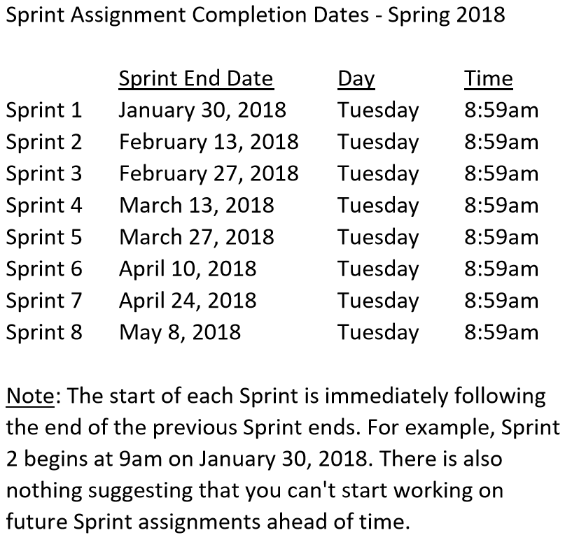

Slide 3
Sprint 5 Product Backlog
Complete midterm exam which is scheduled for Thursday, March 22 during the last 50 minutes of class
Complete and document Sprint 5 Metrics, Retrospective, Prepare and Review Sprint 6 Stories, and be prepared for Sprint 6 Planning on Tuesday, March 27
Complete Sprint 5 Assignment/Quiz
Deliver Sprint 5 User Stories that will allow your team to exceed “Klump” product specifications by the end of Sprint 6
Read and be prepared to discuss Chapter 9
Prepare and Groom Sprint 6 User Stories
Notes:
… the test questions will be similar to the questions from the Quizzes. The test will be limited to 50 minutes and you will not have access to notes or other resources.
As a Class commit each Team to research, discuss, and present at least one of the following topics:
Databases on Azure including “Azure tables vs Azure MongoDB vs Azure other DBs”**
Cloud/Azure based Authentication/Authorization services and who they could be integrated into a NodeJS based application*
JavaScript and NodeJS with a focus on Azure and including the best Internet based tutorials and/or books on the topic
SaaS Frameworks including “MEAN vs LAMP vs Ruby on Rails”
Service Oriented Architectures including “Web Services and SOAP/WSAD vs REST vs Sockets”
SaaS Client Frameworks including “HTML/JavaScript vs AngularJS vs Angular2 vs React vs others”
File Formats including “HTML vs XML vs JSON vs Key/Value Pair Text Files”

Slide 4
Team the “Klump” Product
Our “Klump” product should include:
Reading each team member’s “My Information” JSON files from each of their Personal Static Websites
Validating of JSON formats
Publishing the consolidated data to a simple HTML/JavaScript web page
Consolidating the data into a multi-person Class standard JSON format… note that to make the format simpler, we can limit roles to 3 roles (role1, role2, and role3)… Product Architect to lead
Publishing the consolidated data to a Web Service that returns the standard multi-person JSON format
Include current time and last time each individuals information was last updated in the multi-person JSON response
Testing mode to validate and report JSON formatting errors
Implement 30 minute caching and forced refresh
Solid Development (each team member), Test (team), and Production sites (team)
Notes:
As a Class commit each Team to research, discuss, and present at least one of the following topics:
Databases on Azure including “Azure tables vs Azure MongoDB vs Azure other DBs”**
Cloud/Azure based Authentication/Authorization services and who they could be integrated into a NodeJS based application*
JavaScript and NodeJS with a focus on Azure and including the best Internet based tutorials and/or books on the topic
SaaS Frameworks including “MEAN vs LAMP vs Ruby on Rails”
Service Oriented Architectures including “Web Services and SOAP/WSAD vs REST vs Sockets”
SaaS Client Frameworks including “HTML/JavaScript vs AngularJS vs Angular2 vs React vs others”
File Formats including “HTML vs XML vs JSON vs Key/Value Pair Text Files”

Slide 5
Scrum-of-Scrums Report-out
The “daily” scrum meeting is not used as a problem-solving or issue resolution meeting. Issues that are raised are taken offline and usually dealt with by the relevant subgroup immediately after the meeting. During the daily scrum, each team member answers the following three questions:
What did you do since our last standup?
What will you do before our next standup?
Are there any impediments in your way that you need help from outside the team to resolve?

Slide 6
Review Release/PSI Planning
 | Product Manager | Project Manager | Product Architect | UI Designer
Sprint 4 | Eric (Pogue) | Alex (Jonic) | John (Laschober) | Chas (Logue)
Sprint 5 | Joe (Van Luyk) | Jordon (Elmer) | Quinn (Stratton) | Jace (Horner)
Sprint 6 | Louie (Lorenzo) | Tyler (Kummer) | Thad (Albert) | Michael (Pedzimaz)
Notes:
Who will volunteer to bring us a “Friendly Conversation” topic Thursday?

Slide 7
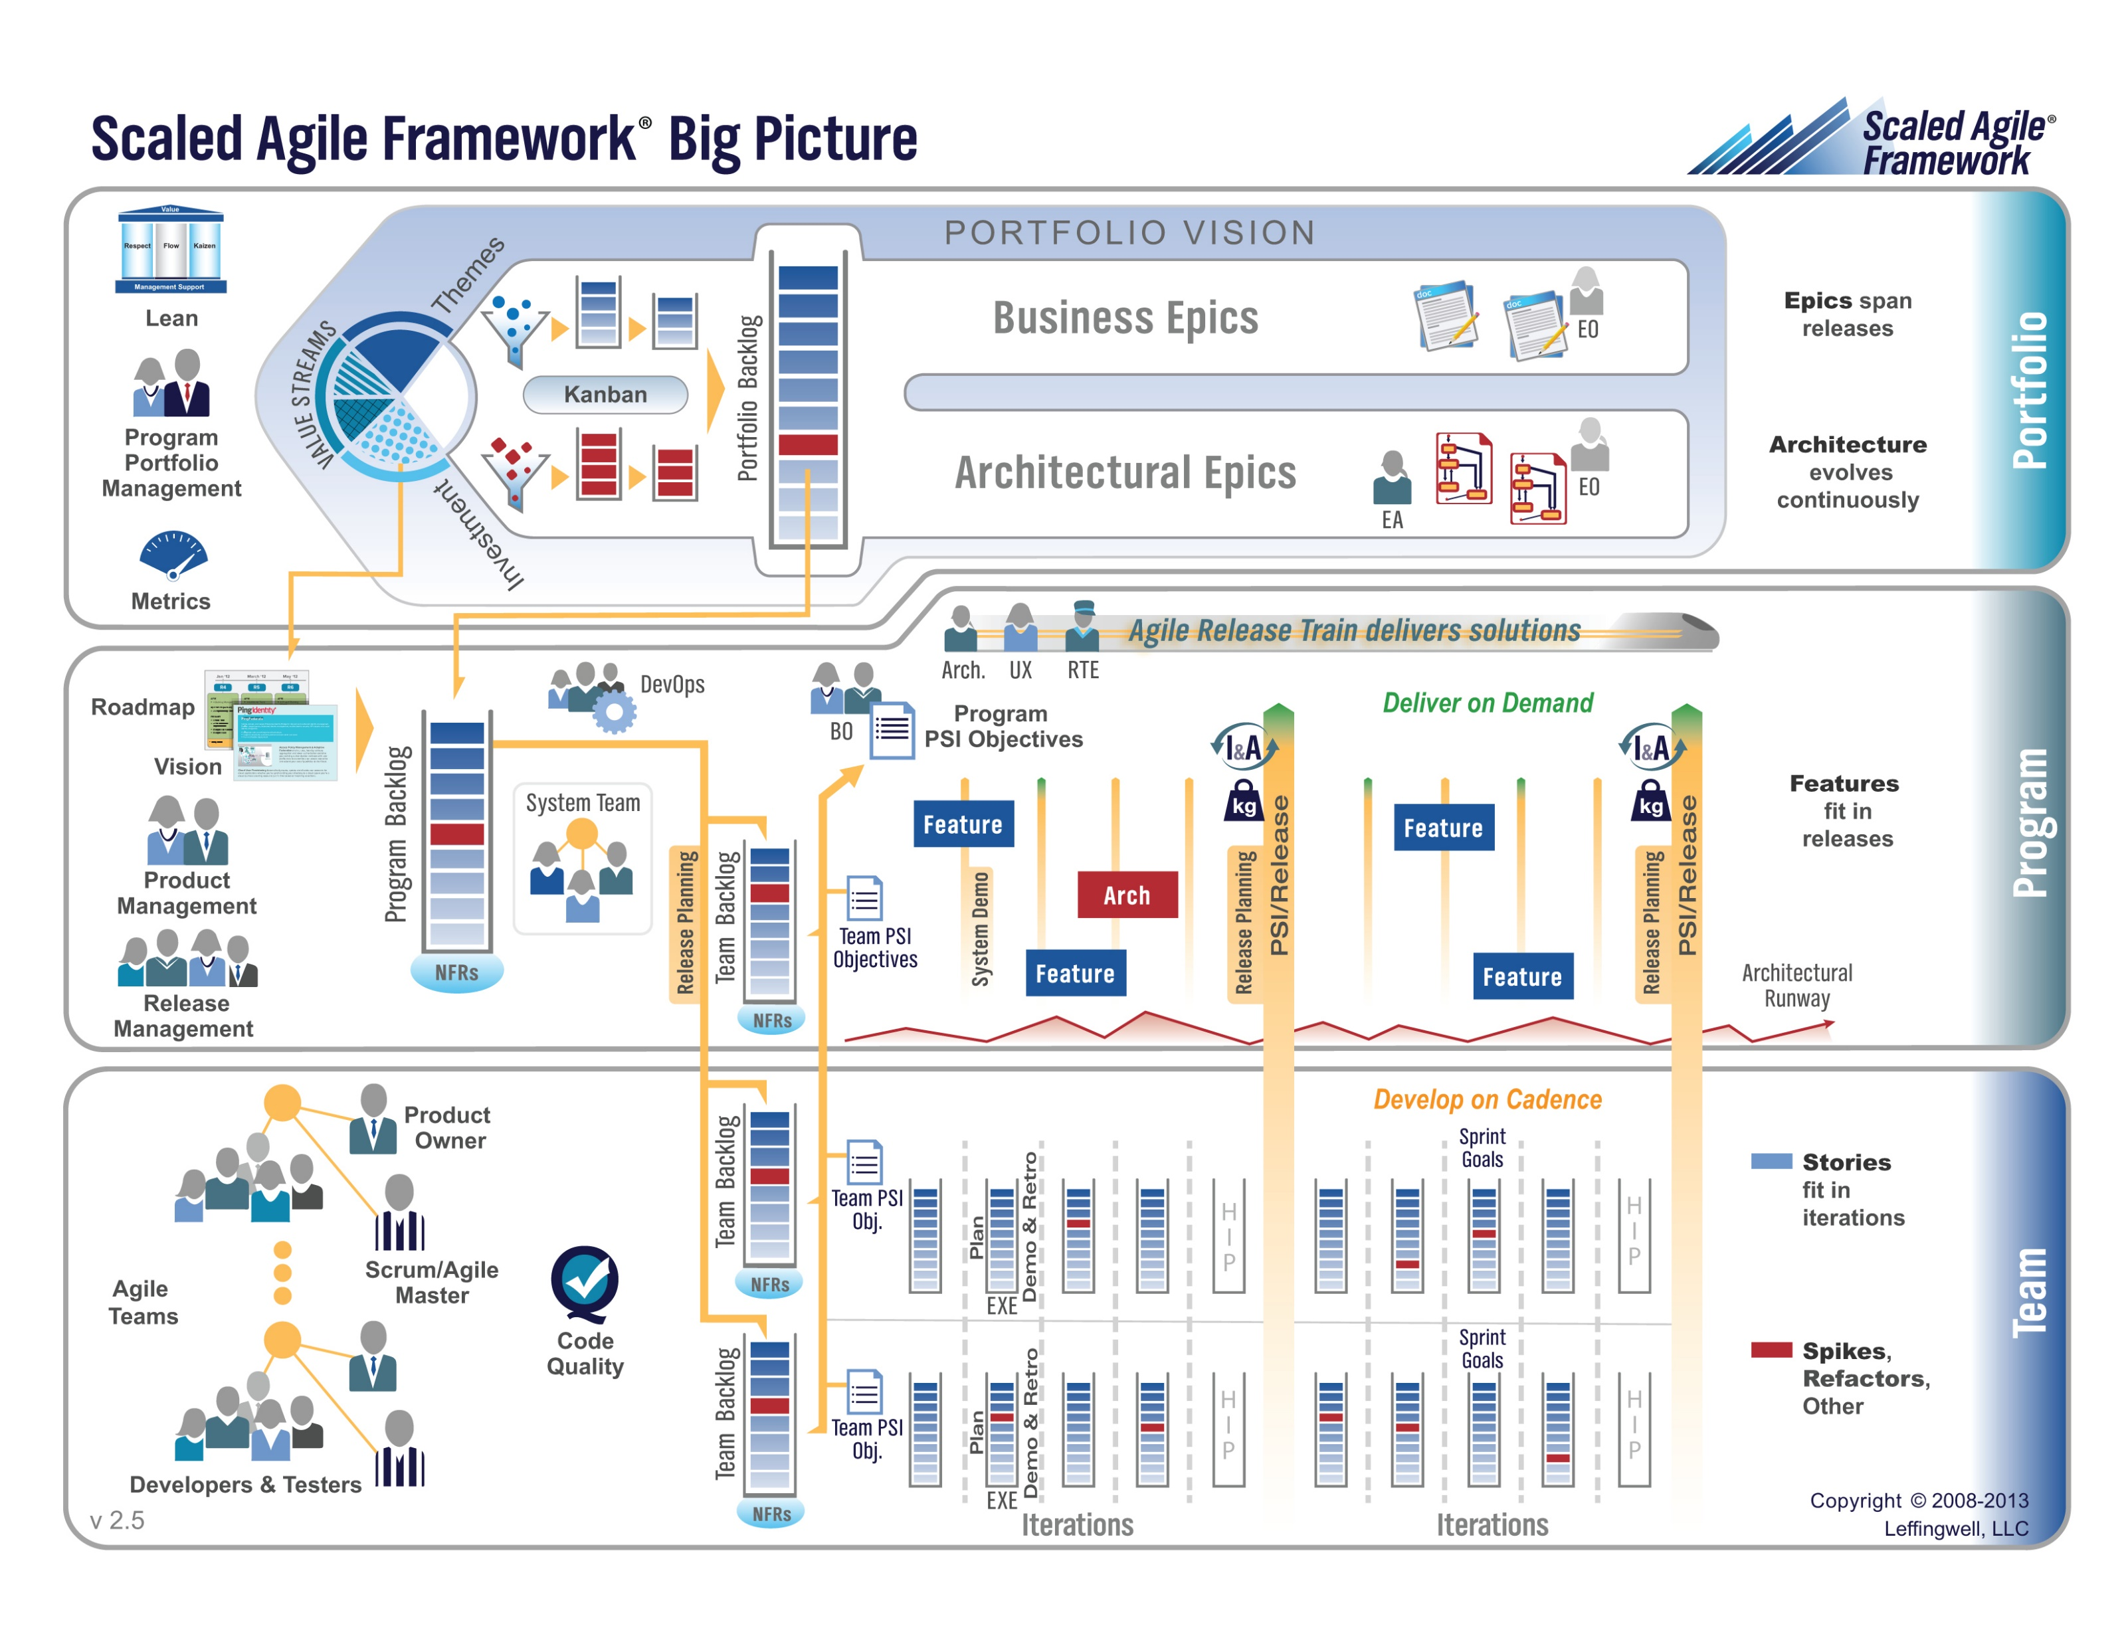

Slide 8
Release – Seating Chart
Release – Final Project(s)

Slide 9
Study Guide and Course Review
Assignment/Quiz 1 through 4
Chapters 1, 2, 6, 7, and 10
Scaled Agile Framework (SAFe)
Class Discussion Topics
HTML, JavaScript, Node.js
Class Presentations
Databases on Azure including “Azure tables vs Azure MongoDB vs Azure other DBs”
Cloud/Azure based Authentication/Authorization services and who they could be integrated into a NodeJS based application
JavaScript and NodeJS with a focus on Azure and including the best Internet based tutorials and/or books on the topic
Notes:
… the test questions will be similar to the questions from the Quizzes. The test will be limited to 50 minutes and you will not have access to notes or other resources.
As a Class commit each Team to research, discuss, and present at least one of the following topics:
Databases on Azure including “Azure tables vs Azure MongoDB vs Azure other DBs”**
Cloud/Azure based Authentication/Authorization services and who they could be integrated into a NodeJS based application*
JavaScript and NodeJS with a focus on Azure and including the best Internet based tutorials and/or books on the topic
SaaS Frameworks including “MEAN vs LAMP vs Ruby on Rails”
Service Oriented Architectures including “Web Services and SOAP/WSAD vs REST vs Sockets”
SaaS Client Frameworks including “HTML/JavaScript vs AngularJS vs Angular2 vs React vs others”
File Formats including “HTML vs XML vs JSON vs Key/Value Pair Text Files”

Slide 10
Week 1
Notes:
Who will volunteer to bring us a “Friendly Conversation” topic Thursday?

Slide 11
People, Process, and Technology
Software Engineering:
People: Teams, Optimism, Engagement, Ambition, Dedication, Leadership, Skills, Experience, Domain Knowledge…
Process: Waterfall/Iterative/Agile, Portfolio Management, Project Management, Funding, Prioritization, Metrics…
Technology: Configuration Management, Cloud Hosting, Scriptable Infrastructure, Source Code Management, Automated Testing…
Notes:
Eric’s View

Slide 12
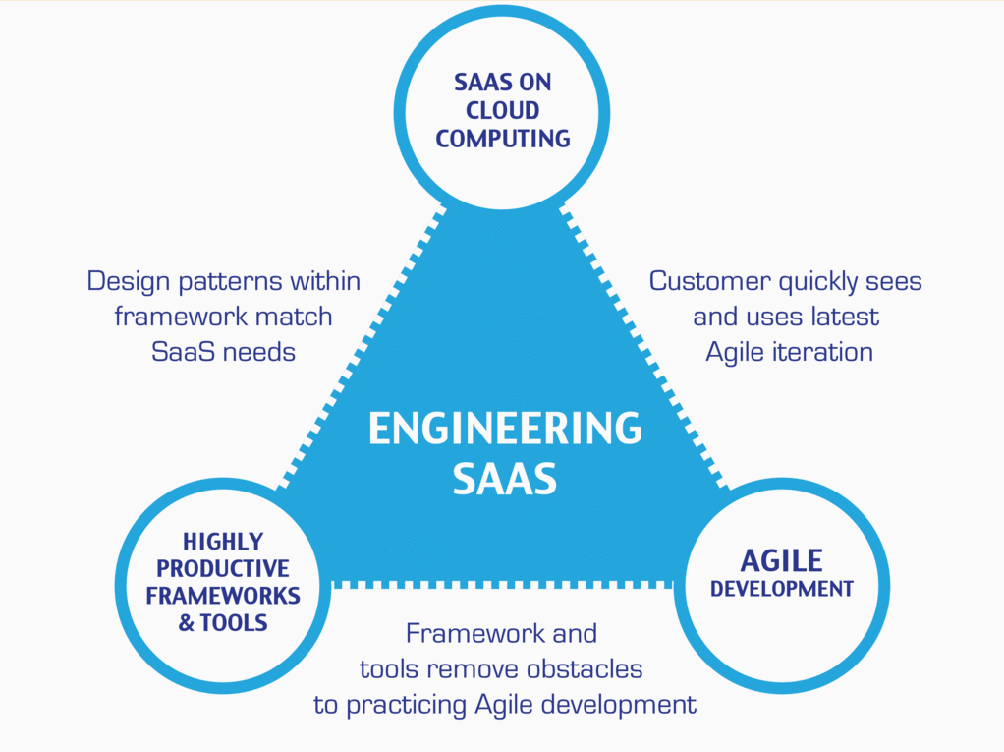
…And the Virtuous Triangle
Hosting Technology: Cloud, Scriptable Infrastructure, Software as a Service (SaaS)…
People: Teams, Optimism, Engagement, Ambition, Dedication, Leadership, Skills, Experience, Domain Knowledge…
Process: Agile, Portfolio Management, Project Management, Funding, Prioritization, Metrics…
Productivity Technology: Configuration Management, Source Code Management, Automated Testing…

Slide 13
Agile Manifesto (February 2001)
“We are uncovering better ways of developing software by doing it and helping others do it. Through this work we have come to value:
Individuals and interactions over processes and tools
Working software over comprehensive documentation
Customer collaboration over contract negotiation
Responding to change over following a plan
That is, while there is value in the items on the right, we value the items on the left more.”

Slide 14
Assignment
Prior to class on Thursday:
Be fully prepared “Scrum-ify” Ourselves… our first chance to demonstrate our capabilities as self-organizing Scrum team members
View and reflect on “Introduction to Scrum in 7 Minutes” video [link]
Be prepared to discuss Ch.1.1 to 1.3
Be prepared to discuss Ch.10.1 to 10.5… focusing on Scrum and Git
Install/implement MS PowerShell [link]
Install Git Client [link]… and test it on multiple shells
Be prepared to: Utilize (local) Git Client to create, update, branch, and merge a local project utilizing a beginners level tutorial… one option would be “An Intro to Git and GitHub for Beginners” [link]

Slide 15
Assignment
Prior to class on Tuesday:
“Scrum-ify” Ourselves… our second chance to demonstrate our capabilities as self-organizing Scrum team members
Complete Discussion Board “Introduction” before you leave class today
Read and be prepared to discuss Preface & Chapter 1
Install MS PowerPoint & MS Word Viewers (if you do not have access to the full products)
Setup a GitHub account with a Student Developer Pack/Plan [link]
Utilize Git & GitHub to create, update, branch, and merge local and remote projects utilizing several beginner level tutorials:
One option would be “An Intro to Git and GitHub for Beginners” tutorial [link]
Another option would be the GitHub “Hello World” tutorial [link]
Create a public GitHub repository and share it with another Team Member
Be the recipient of a shared public GitHub repository from a Team Member

Slide 16
Week 2
Notes:
Who will volunteer to bring us a “Friendly Conversation” topic Thursday?

Slide 17
Assignment (for a full week instead if one class period)
Sprint 1b Product Backlog… due Monday night (11:59pm):
Create a public GitHub repository and share it with another Team Member… carry over from last assignment
Be the recipient of a shared public GitHub repository from a Team Member… carry over from last assignment
Individually setup a Microsoft Imagine Azure account [link]
Individually complete the Azure static website tutorial... leave the site in place [link]
As a Team agree on a standard and extensible “My Information” JSON format and data requirements that include FirstName, LastName, PreferredName, TeamName, SeatLocation, and Roles* in a standard file name (e.g. “my-information.json”) at a minimum… Product Owners to discuss/lead and elect someone to play the Product Architect role
Individually complete a “permanent” personal static website where you will initially host your “My Information” JSON file for this class utilizing the previous tutorial to create the new website
Complete Sprint 2 Planning Session
Individually complete Quiz 1
Read Chapter 2
Notes:
A Backlog is a prioritized list of request deliverables. It exists at the Team and Product (and possibly Portfolio) levels… Stories, Features, Epics
Sprint 1b will end next Monday at 11:59pm… approximately 1 week
Notes:
All agile Backlogs must be a list of Features or Stores based prioritized on business value
Dependencies should be identified
The optimal order and method of completing them is up to the individual teams
Eventually we will need to provide a definition of “Done”

Slide 18
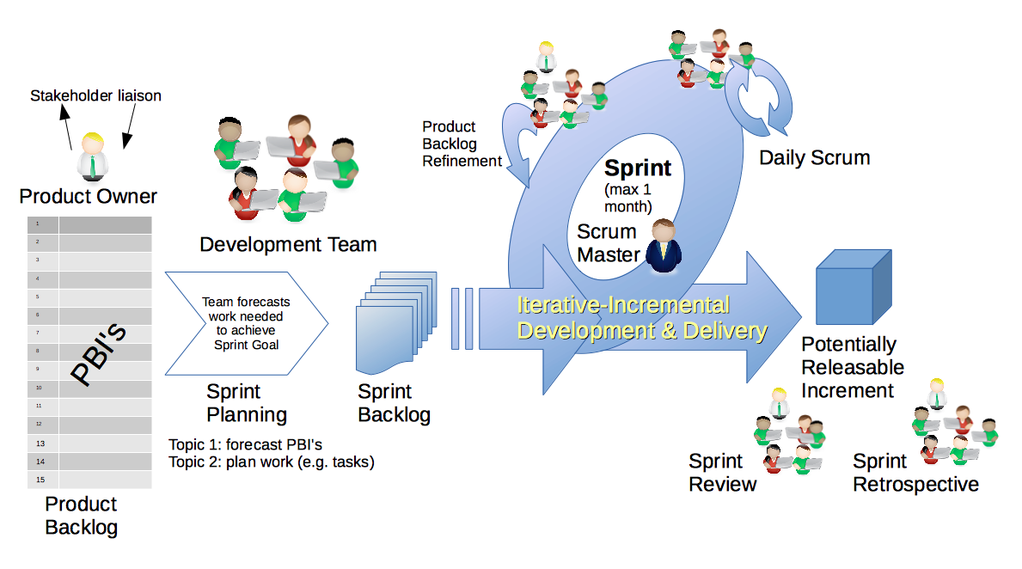
Scrum & Scrum Roles
By Dr ian mitchell - Own work, CC BY-SA 4.0, Link

Slide 19
Sprint 2
Notes:
Who will volunteer to bring us a “Friendly Conversation” topic Thursday?

Slide 20
Sprint 2 Product Backlog… page 1 of 2
As a Class document a standard “My Information” JSON format that at a minimum include one or more “records” that each include FirstName, LastName, PreferredName, TeamName, SeatLocation, and Roles in a standard file name (e.g. “my-information.json”)… Product Owners and the Product Architect will lead this effort
As a Class commit each Team to research, discuss, and present at least one of the following topics:
Databases on Azure including “Azure tables vs Azure MongoDB vs Azure other DBs”**
Cloud/Azure based Authentication/Authorization services and who they could be integrated into a NodeJS based application*
JavaScript and NodeJS with a focus on Azure and including the best Internet based tutorials and/or books on the topic
SaaS Frameworks including “MEAN vs LAMP vs Ruby on Rails”
Service Oriented Architectures including “Web Services and SOAP/WSAD vs REST vs Sockets”
As a Team select one or two team members who will lead the team’s effort to research and discuss the above topic and then delivery a (~10min) presentation on the topic to the class on Tuesday, February 13.
Read and be prepared to discuss Chapter 6
Complete the dynamic Azure NodeJS website tutorial… leave the site in place [link]
As a Team Test each other’s Personal Static Website, verify JSON formats, and report sites tested and defects found as a MS Word or JSON file to your Product Owner and to the owner of the site(s) where the defect was found
Find and complete an additional HTML/NodeJS tutorial on Azure… leave it in place
Complete Sprint 2 Quiz
Complete and document Sprint 2 Retrospective and summarization/prioritization of Team level Continuous Improvement (CI) items... be prepared to include one CI item on in your Sprint 3 backlog
Notes:
As a Class commit each Team to research, discuss, and present at least one of the following topics:
Databases on Azure including “Azure tables vs Azure MongoDB vs Azure other DBs”**
Cloud/Azure based Authentication/Authorization services and who they could be integrated into a NodeJS based application*
JavaScript and NodeJS with a focus on Azure and including the best Internet based tutorials and/or books on the topic
SaaS Frameworks including “MEAN vs LAMP vs Ruby on Rails”
Service Oriented Architectures including “Web Services and SOAP/WSAD vs REST vs Sockets”
SaaS Client Frameworks including “HTML/JavaScript vs AngularJS vs Angular2 vs React vs others”
File Formats including “HTML vs XML vs JSON vs Key/Value Pair Text Files”

Slide 21
Sprint 2 Product Backlog… page 2 of 2
Complete Sprint 3 Planning
Download class materials utilizing Git client and cloning “https://github.com/EricJPogue/sp18-cpsc-44000-001.git”
Notes:
As a Class commit each Team to research, discuss, and present at least one of the following topics:
Databases on Azure including “Azure tables vs Azure MongoDB vs Azure other DBs”**
Cloud/Azure based Authentication/Authorization services and who they could be integrated into a NodeJS based application*
JavaScript and NodeJS with a focus on Azure and including the best Internet based tutorials and/or books on the topic
SaaS Frameworks including “MEAN vs LAMP vs Ruby on Rails”
Service Oriented Architectures including “Web Services and SOAP/WSAD vs REST vs Sockets”
SaaS Client Frameworks including “HTML/JavaScript vs AngularJS vs Angular2 vs React vs others”
File Formats including “HTML vs XML vs JSON vs Key/Value Pair Text Files”

Slide 22
Sprint 3
Notes:
Who will volunteer to bring us a “Friendly Conversation” topic Thursday?

Slide 23
Presentation Schedule for Tuesday, February 13:
Databases on Azure including “Azure tables vs Azure MongoDB vs Azure other DBs”
– by the Ocelots presented by Jake & Thad
JavaScript and NodeJS with a focus on Azure and including the best Internet based tutorials and/or books
– by the Great White Buffalos presented by Cris & Nick
Cloud/Azure based Authentication/Authorization services and how they could be integrated into a NodeJS based application
– by the Lewis Honeybadgers presented by Kevin and Louie
Databases on Azure including “Azure tables vs Azure MongoDB vs Azure other DBs”
– by the Back Row Bandicoots presented by Tyler and Joe
JavaScript and NodeJS with a focus on Azure and including the best Internet based tutorials and/or books
– by the Flamingos presented by Lenny
Note that presentations may carry over to Thursday as needed.

Slide 24
Standup for Sprint 3 Product Backlog
Verify and Demo that all items from Sprint 2 are Done* or add them as Carryover items to Sprint 3
Complete Sprint 3 Assignment/Quiz
Complete and document Sprint 3 Retrospective and summarization/prioritization of Team level Continuous Improvement (CI) items... be prepared to include one CI item on in your Sprint 3 backlog
Complete Sprint 4 Planning
Read and be prepared to discuss Chapter 7
Complete and document Sprint 3 Metrics which will consist of a published Say-Do ratio
Download and/or update class materials utilizing Git client and cloning https://github.com/EricJPogue/sp18-cpsc-44000-001.git
Review, but do no complete, Eric’s Azure Static website tutorial video [link]
As a Team define the “Team Information Service” project by writing the necessary Team level User Stories for the project
As a Team create a shared private “Team Information Service” GitHub repository that is shared with everyone on the team and with the Instructor… name the repository “Team Information Service for [Team Name]”
As a Team create a “Team Information Service” Production site on Azure
As a Team develop, test, and deploy “Team Information Service” Release 1 to Test
Notes:
As a Class commit each Team to research, discuss, and present at least one of the following topics:
Databases on Azure including “Azure tables vs Azure MongoDB vs Azure other DBs”**
Cloud/Azure based Authentication/Authorization services and who they could be integrated into a NodeJS based application*
JavaScript and NodeJS with a focus on Azure and including the best Internet based tutorials and/or books on the topic
SaaS Frameworks including “MEAN vs LAMP vs Ruby on Rails”
Service Oriented Architectures including “Web Services and SOAP/WSAD vs REST vs Sockets”
SaaS Client Frameworks including “HTML/JavaScript vs AngularJS vs Angular2 vs React vs others”
File Formats including “HTML vs XML vs JSON vs Key/Value Pair Text Files”

Slide 25
JavaScript Basics (Chp. 6)

Slide 26
JavaScript Basics (Plus)
Let’s review some practical code:
Let’s start with our own sprint3.html file [link]
Now let’s look at Yahtzee Dice Roller
And finally Yahtzee Dice Roller with external JavaScript

Slide 28
Sprint 4
Notes:
Who will volunteer to bring us a “Friendly Conversation” topic Thursday?

Slide 29
Sprint 4 Product Backlog
Complete and document Sprint 4 Metrics, Retrospective, Review Sprint 5 Backlog, and be prepared for Sprint 5 Planning on Tuesday, March 13
Complete Sprint 4 Assignment/Quiz
Deliver Sprint 4 User Stories… it the “real” world, 80%+ of a teams capacity should be devote to this! In addition to Product functions, user Stories should include”
As a Team create a “Klump” Production site on Azure
As a Team create a “Klump” Test site on Azure
As a Team develop, test, and deploy “Klump” Release 1 to Test
As a Team test and deploy Klump Release 1 to Production
Individually deploy and test Klump to your local development environment
Read and be prepared to discuss Chapter 8
Notes:
As a Class commit each Team to research, discuss, and present at least one of the following topics:
Databases on Azure including “Azure tables vs Azure MongoDB vs Azure other DBs”**
Cloud/Azure based Authentication/Authorization services and who they could be integrated into a NodeJS based application*
JavaScript and NodeJS with a focus on Azure and including the best Internet based tutorials and/or books on the topic
SaaS Frameworks including “MEAN vs LAMP vs Ruby on Rails”
Service Oriented Architectures including “Web Services and SOAP/WSAD vs REST vs Sockets”
SaaS Client Frameworks including “HTML/JavaScript vs AngularJS vs Angular2 vs React vs others”
File Formats including “HTML vs XML vs JSON vs Key/Value Pair Text Files”

Slide 30
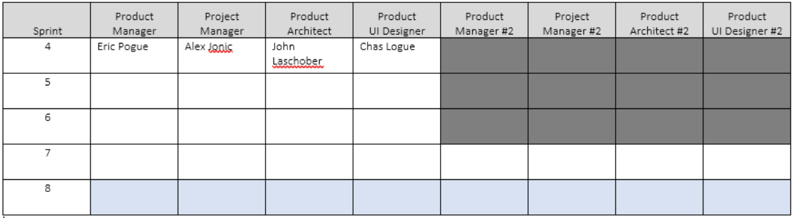
Scaled Agile Roles

Slide 31
Software Testing Overview
Software Testing [link] is important because, if done right, it can help us find and fix problems earlier and make our system delivery process less immobile, rigid, and fragile.
As future Software Engineers , we are going to:
Understand testing within the various Software Development Lifecycles
Understand testing terminology
Know how to develop applications that are easier to test
Understand Unit Testing and Automated Testing
Notes:
Never underestimate the value of good design and implementation (for testability, encapsulation, etc.) on the economics of testing. You can’t afford to test in quality!
Developers are responsible for product quality. Tester should be able to minimize that chance that a defect makes it to production.
We test to find defects and/or to validate that we have not introduced new defects.
Defects are exponentially more expensive to fix the longer the exist.
Performance issues are often the most difficult and expensive defects to fix. They are often not found until the application if running under production load… which is often only when it is in production.
Unit - $200
Integration - $600
User Acceptance - $6,000
Production - $100,000+
The permutations of modern software features, data, tools, environments, etc. quickly becomes unmanageable. Testability needs to be goal of nearly all non-trivial applications.
Dave Cutler of Windows NT fame had a quote. I wish I could remember the exact words, but it went something like, “I hate having testers because they give developers the false hope that someone else can save them from their sins.”

Slide 32
Software Testing “Truths”
Never underestimate the value of good design and implementation (for testability, encapsulation, etc.) on the economics of testing… You can’t afford to test in quality!
Defects are exponentially more expensive to fix the longer the exist.
Unit - $200
Integration - $600
User Acceptance - $6,000
Production - $100,000+
Performance issues are often the most difficult and expensive defects to fix. They are often not found until the application if running under production load… which is often only when it is in production.
The permutations of modern software features, data, tools, environments, etc. quickly becomes unmanageable. Testability needs to be goal of nearly all non-trivial applications.
Developers need to be responsible for product quality. Tester should be able to minimize that chance that a defect makes it to production.
Dave Cutler of Windows NT fame had a quote. I wish I could remember the exact words, but it went something like, “I hate having testers because they give developers the false hope that someone else can save them from their sins.”

Slide 33
Team the “Klump” Product
Our “Klump” product should include:
Reading each team member’s “My Information” JSON files from each of their Personal Static Websites
Validating of JSON formats
Publishing the consolidated data to a simple HTML/JavaScript web page
Consolidating the data into a multi-person Class standard JSON format… note that to make the format simpler, we can limit roles to 3 roles (role1, role2, and role3)… Product Architect to lead
Publishing the consolidated data to a Web Service that returns the standard multi-person JSON format
Include current time and last time each individuals information was last updated in the multi-person JSON response
Testing mode to validate and report JSON formatting errors
Implement 30 minute caching and forced refresh
Solid Development (each team member), Test (team), and Production sites (team)
Notes:
As a Class commit each Team to research, discuss, and present at least one of the following topics:
Databases on Azure including “Azure tables vs Azure MongoDB vs Azure other DBs”**
Cloud/Azure based Authentication/Authorization services and who they could be integrated into a NodeJS based application*
JavaScript and NodeJS with a focus on Azure and including the best Internet based tutorials and/or books on the topic
SaaS Frameworks including “MEAN vs LAMP vs Ruby on Rails”
Service Oriented Architectures including “Web Services and SOAP/WSAD vs REST vs Sockets”
SaaS Client Frameworks including “HTML/JavaScript vs AngularJS vs Angular2 vs React vs others”
File Formats including “HTML vs XML vs JSON vs Key/Value Pair Text Files”

Slide 34
TypeScript Presentation
Notes:
Who will volunteer to bring us a “Friendly Conversation” topic Thursday?

Slide 35
Questions about Test?
Notes:
Who will volunteer to bring us a “Friendly Conversation” topic Thursday?

Slide 36
Lab (report-out at 12:08)
Lab Activities:
The Klump
Notes:
Sprints: 2 Week periods where deliverables are due and demos should be complete
Story Points (SP): Estimate of work that should be based on example deliverables. Generally not normalized between groups or teams. We will utilize ~30min to equal 1 SP
Hand out sprint planning sheet… 1 sheet per team

Slide 37
Lab Report-out & Wrap-up
Notes:
Who will volunteer to bring us a “Friendly Conversation” topic Thursday?

Slide 38
End of Session

Slide 39
Backup Slides

Slide 40
Team Information Service Requirements
Our “Team Information Service” product should include:
Reading each team member’s “My Information” JSON files from each of their Personal Static Websites
Validating the JSON formats
Publishing the consolidated data to a simple HTML/JavaScript web page
Consolidating the data into a multi-person Class standard JSON format… note that to make the format simpler, we can limit roles to 3 roles (role1, role2, and role3)
Publishing the consolidated data to a Web Service that returns the standard multi-person JSON format
Include current time and last time each individuals information was last updated
Implement 30 minute caching and forced refresh… this could be a release 2 feature
Question: What is a better name for this Product???
Notes:
As a Class commit each Team to research, discuss, and present at least one of the following topics:
Databases on Azure including “Azure tables vs Azure MongoDB vs Azure other DBs”**
Cloud/Azure based Authentication/Authorization services and who they could be integrated into a NodeJS based application*
JavaScript and NodeJS with a focus on Azure and including the best Internet based tutorials and/or books on the topic
SaaS Frameworks including “MEAN vs LAMP vs Ruby on Rails”
Service Oriented Architectures including “Web Services and SOAP/WSAD vs REST vs Sockets”
SaaS Client Frameworks including “HTML/JavaScript vs AngularJS vs Angular2 vs React vs others”
File Formats including “HTML vs XML vs JSON vs Key/Value Pair Text Files”

Slide 41
Standup for Sprint 3 Product Backlog
Verify and Demo that all items from Sprint 2 are Done* or add them as Carryover items to Sprint 3
Complete Sprint 3 Assignment/Quiz
Complete and document Sprint 3 Retrospective and summarization/prioritization of Team level Continuous Improvement (CI) items... be prepared to include one CI item on in your Sprint 3 backlog
Complete Sprint 4 Planning
Read and be prepared to discuss Chapter 7
Complete and document Sprint 3 Metrics which will consist of a published Say-Do ratio
Download and/or update class materials utilizing Git client and cloning https://github.com/EricJPogue/sp18-cpsc-44000-001.git
Review, but do no complete, Eric’s Azure Static website tutorial video [link]
As a Team define the “Team Information Service” project by writing the necessary Team level User Stories for the project
As a Team create a shared private “Team Information Service” GitHub repository that is shared with everyone on the team and with the Instructor… name the repository “Team Information Service for [Team Name]”
As a Team create a “Team Information Service” Production site on Azure
As a Team develop, test, and deploy “Team Information Service” Release 1 to Test
Notes:
As a Class commit each Team to research, discuss, and present at least one of the following topics:
Databases on Azure including “Azure tables vs Azure MongoDB vs Azure other DBs”**
Cloud/Azure based Authentication/Authorization services and who they could be integrated into a NodeJS based application*
JavaScript and NodeJS with a focus on Azure and including the best Internet based tutorials and/or books on the topic
SaaS Frameworks including “MEAN vs LAMP vs Ruby on Rails”
Service Oriented Architectures including “Web Services and SOAP/WSAD vs REST vs Sockets”
SaaS Client Frameworks including “HTML/JavaScript vs AngularJS vs Angular2 vs React vs others”
File Formats including “HTML vs XML vs JSON vs Key/Value Pair Text Files”

Slide 42
Sprint 4 Product Backlog… page 1 of 2
Complete and document Sprint 4 Metrics, Retrospective, Review Sprint 5 Backlog, and be prepared for Sprint 5 Planning on Tuesday, March 13
Complete Sprint 4 Assignment/Quiz
Deliver Sprint 4 User Stories… it the “real” world, 80%+ of a teams capacity should be devote to this! In addition to Product functions, user Stories should include”
As a Team create a “Klump” Production site on Azure
As a Team create a “Klump” Test site on Azure
As a Team develop, test, and deploy “Klump” Release 1 to Test
As a Team test and deploy Klump Release 1 to Production
Individually deploy and test Klump to your local development environment
Read and be prepared to discuss Chapter 8
Sprint 5 User Story Backlog “grooming”
As a Class commit each Team to research, discuss, and present at least one of the following topics:
A valuable follow-up topic from previous Class Presentations… i.e. securing a site with Microsoft Live / Lewis University credentials
SaaS Frameworks including “MEAN vs LAMP vs Ruby on Rails”
Service Oriented Architectures including “Web Services and SOAP/WSAD vs REST vs Sockets”
Web Client Application Architectures including “HTML/JavaScript, Angular.js, Angular2/TypeScript, and ReactJS”
As a Team select one or two team members who will lead the team’s effort to research and discuss the above topic and then delivery a (~10min) presentation on the topic to the class on Tuesday, February 27.
Notes:
As a Class commit each Team to research, discuss, and present at least one of the following topics:
Databases on Azure including “Azure tables vs Azure MongoDB vs Azure other DBs”**
Cloud/Azure based Authentication/Authorization services and who they could be integrated into a NodeJS based application*
JavaScript and NodeJS with a focus on Azure and including the best Internet based tutorials and/or books on the topic
SaaS Frameworks including “MEAN vs LAMP vs Ruby on Rails”
Service Oriented Architectures including “Web Services and SOAP/WSAD vs REST vs Sockets”
SaaS Client Frameworks including “HTML/JavaScript vs AngularJS vs Angular2 vs React vs others”
File Formats including “HTML vs XML vs JSON vs Key/Value Pair Text Files”

Slide 43
Sprint 4 Product Backlog… page 2 of 2
As a Team develop, test, and deploy “Team Information Service” Release 2 to Test and Production
Define Product Teams for “Dynamic Class Seating Chart” application delivery project including, Project Manager, Product Architect, UI Designer, and Product Manager
As a Product Team define the “Dynamic Class Seating Chart” application as Epics, Features, and Stories
Individually deploy and test Team Information Service to your personal Azure site
Notes:
As a Class commit each Team to research, discuss, and present at least one of the following topics:
Databases on Azure including “Azure tables vs Azure MongoDB vs Azure other DBs”**
Cloud/Azure based Authentication/Authorization services and who they could be integrated into a NodeJS based application*
JavaScript and NodeJS with a focus on Azure and including the best Internet based tutorials and/or books on the topic
SaaS Frameworks including “MEAN vs LAMP vs Ruby on Rails”
Service Oriented Architectures including “Web Services and SOAP/WSAD vs REST vs Sockets”
SaaS Client Frameworks including “HTML/JavaScript vs AngularJS vs Angular2 vs React vs others”
File Formats including “HTML vs XML vs JSON vs Key/Value Pair Text Files”

