Slide 1

Software Engineering Session: Sprint 5 Session 4 Instructor: Eric Pogue
Agenda:
Scaled Agile Product Roles
Scrum of Scrums Standup led by Jordon (Elmer) with product assistance from out new Product Manager Joe (Van Luyk)
Exam 1
Verify that your test has been successfully submitted BEFORE you leave… give me the wave or thumbs up
Be prepared for Sprint 6 Planning next class
 | Product Manager | Project Manager | Product Architect | UI Designer
Sprint 4 | Eric (Pogue) | Alex (Jonic) | John (Laschober) | Chas (Logue)
Sprint 5 | Joe (Van Luyk) | Jordon (Elmer) | Quinn (Stratton) | Jace (Horner)
Sprint 6 | Louie (Lorenzo) | Tyler (Kummer) | Thad (Albert) | Michael (Pedzimaz)

Slide 2
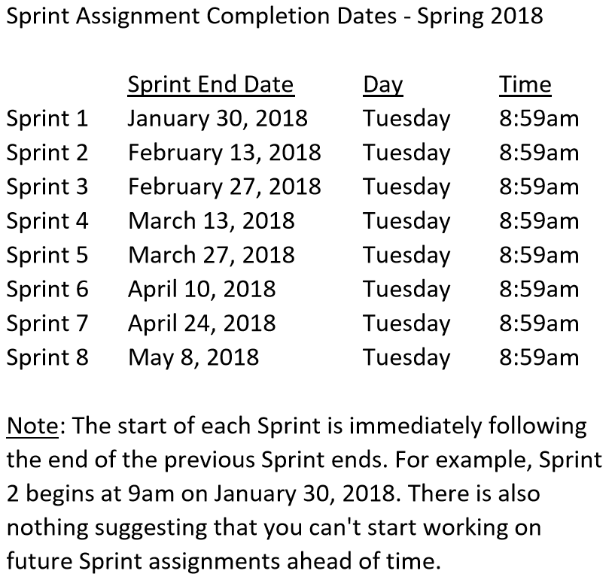

Slide 3
Sprint 5 Product Backlog
Complete midterm exam which is scheduled for Thursday, March 22 during the last 50 minutes of class
Complete and document Sprint 5 Metrics, Retrospective, Prepare and Review Sprint 6 Stories, and be prepared for Sprint 6 Planning on Tuesday, March 27
Complete Sprint 5 Assignment/Quiz
Deliver Sprint 5 User Stories that will allow your team to exceed “Klump” product specifications by the end of Sprint 6
Read and be prepared to discuss Chapter 9
Prepare and Groom Sprint 6 User Stories
Notes:
… the test questions will be similar to the questions from the Quizzes. The test will be limited to 50 minutes and you will not have access to notes or other resources.
As a Class commit each Team to research, discuss, and present at least one of the following topics:
Databases on Azure including “Azure tables vs Azure MongoDB vs Azure other DBs”**
Cloud/Azure based Authentication/Authorization services and who they could be integrated into a NodeJS based application*
JavaScript and NodeJS with a focus on Azure and including the best Internet based tutorials and/or books on the topic
SaaS Frameworks including “MEAN vs LAMP vs Ruby on Rails”
Service Oriented Architectures including “Web Services and SOAP/WSAD vs REST vs Sockets”
SaaS Client Frameworks including “HTML/JavaScript vs AngularJS vs Angular2 vs React vs others”
File Formats including “HTML vs XML vs JSON vs Key/Value Pair Text Files”

Slide 4
Team the “Klump” Product
Our “Klump” product should include:
Reading each team member’s “My Information” JSON files from each of their Personal Static Websites
Validating of JSON formats
Publishing the consolidated data to a simple HTML/JavaScript web page
Consolidating the data into a multi-person Class standard JSON format… note that to make the format simpler, we can limit roles to 3 roles (role1, role2, and role3)… Product Architect to lead
Publishing the consolidated data to a Web Service that returns the standard multi-person JSON format
Include current time and last time each individuals information was last updated in the multi-person JSON response
Testing mode to validate and report JSON formatting errors
Implement 30 minute caching and forced refresh
Solid Development (each team member), Test (team), and Production sites (team)
Notes:
As a Class commit each Team to research, discuss, and present at least one of the following topics:
Databases on Azure including “Azure tables vs Azure MongoDB vs Azure other DBs”**
Cloud/Azure based Authentication/Authorization services and who they could be integrated into a NodeJS based application*
JavaScript and NodeJS with a focus on Azure and including the best Internet based tutorials and/or books on the topic
SaaS Frameworks including “MEAN vs LAMP vs Ruby on Rails”
Service Oriented Architectures including “Web Services and SOAP/WSAD vs REST vs Sockets”
SaaS Client Frameworks including “HTML/JavaScript vs AngularJS vs Angular2 vs React vs others”
File Formats including “HTML vs XML vs JSON vs Key/Value Pair Text Files”

Slide 5
Scrum-of-Scrums Report-out
The “daily” scrum meeting is not used as a problem-solving or issue resolution meeting. Issues that are raised are taken offline and usually dealt with by the relevant subgroup immediately after the meeting. During the daily scrum, each team member answers the following three questions:
What did you do since our last standup?
What will you do before our next standup?
Are there any impediments in your way that you need help from outside the team to resolve?

Slide 6
Software Engineering Session: Sprint 5 Session 4 Instructor: Eric Pogue
Agenda:
Scaled Agile Product Roles
Scrum of Scrums Standup led by Jordon (Elmer) with product assistance from out new Product Manager Joe (Van Luyk)
Exam 1
Verify that your test has been successfully submitted BEFORE you leave… give me the wave or thumbs up
Be prepared for Sprint 6 Planning next class
 | Product Manager | Project Manager | Product Architect | UI Designer
Sprint 4 | Eric (Pogue) | Alex (Jonic) | John (Laschober) | Chas (Logue)
Sprint 5 | Joe (Van Luyk) | Jordon (Elmer) | Quinn (Stratton) | Jace (Horner)
Sprint 6 | Louie (Lorenzo) | Tyler (Kummer) | Thad (Albert) | Michael (Pedzimaz)

Slide 7
End of Session

