Slide 1

Software Engineering Session: Sprint 7 Session 1 Instructor: Eric Pogue
Agenda:
Roles, Schedule, and Backlog
Scrum of Scrums Standup with limited Report-out (blocking items only)
Preview of Thursday Klump Release 1 Presentations
Review Demo & Presentation Planning
Product Team Q&A Session: Klump Requirements
Demos & Presentations: LAMP... coming next Tuesday
How did we get here?
Where do we go now?
Lab: Sprint 7 Planning
Sprint 7 Planning Report-out
Notes:
Demos & Presentations: UI Team, Quinn, Juan, Alex

Slide 2
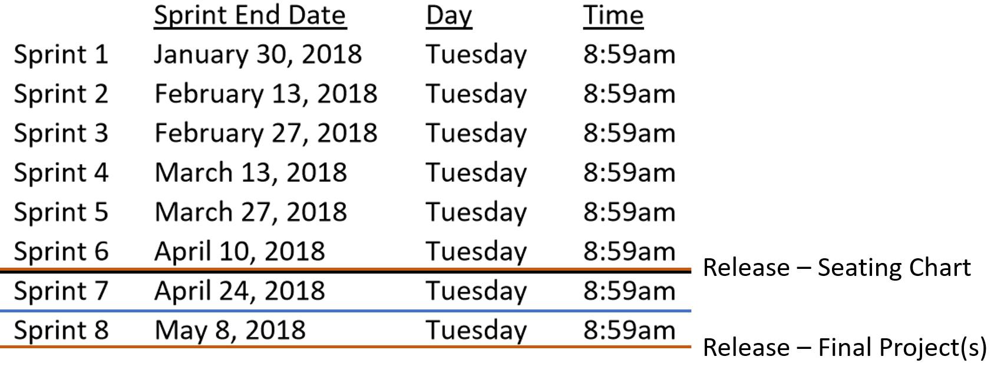
Roles and Schedule
 | Product Manager | Project Manager | Product Architect | UI Designer
Sprint 6 | Louie (Lorenzo) | Tyler (Kummer) | Thad (Albert) | Michael (Pedzimaz)
Sprint 7 | Alex (Espinal) | Juan (Dasco) | Ryan (Clark) | Karol (Orszulak)
Sprint 8 | Marissa (Koronkiewicz) | Lenny (Florez)* | Ali (Kaxmi) | Cris (Serrano)
Notes:
… the test questions will be similar to the questions from the Quizzes. The test will be limited to 50 minutes and you will not have access to notes or other resources.
As a Class commit each Team to research, discuss, and present at least one of the following topics:
Databases on Azure including “Azure tables vs Azure MongoDB vs Azure other DBs”**
Cloud/Azure based Authentication/Authorization services and who they could be integrated into a NodeJS based application*
JavaScript and NodeJS with a focus on Azure and including the best Internet based tutorials and/or books on the topic
SaaS Frameworks including “MEAN vs LAMP vs Ruby on Rails”
Service Oriented Architectures including “Web Services and SOAP/WSAD vs REST vs Sockets”
SaaS Client Frameworks including “HTML/JavaScript vs AngularJS vs Angular2 vs React vs others”
File Formats including “HTML vs XML vs JSON vs Key/Value Pair Text Files”

Slide 3
Sprint 6 Product Backlog
Verifiably complete all Agile Rituals (including Demos) and Metrics (including at least one team level metric)
Deliver User Stories that will complete the Klump product by exceeding specifications by the end of this Sprint… this will need to include testing and deployment to your test and production sites
Prepare a Presentation of your Klump product implementation to be delivered by 1 or 2 team members on 12 April
Complete Sprint 6 Assignment
Prepare a Demo of your team’s Stories and Story management method to be delivered by 1 or 2 team members on 10 April
Prepare for Sprint 7 by preparing a proposal for a final project. The final project can be team level or up to three teams working together.
Read and be prepared to discuss Chapter 10
Important Note: You will need to scope that backlog items associated with #2 so that you will be able to complete at least through backlog item #5. I will be grading Klump based on (1) a functioning product, (2) feature complete, (3) quality of implementation.
Notes:
… the test questions will be similar to the questions from the Quizzes. The test will be limited to 50 minutes and you will not have access to notes or other resources.
As a Class commit each Team to research, discuss, and present at least one of the following topics:
Databases on Azure including “Azure tables vs Azure MongoDB vs Azure other DBs”**
Cloud/Azure based Authentication/Authorization services and who they could be integrated into a NodeJS based application*
JavaScript and NodeJS with a focus on Azure and including the best Internet based tutorials and/or books on the topic
SaaS Frameworks including “MEAN vs LAMP vs Ruby on Rails”
Service Oriented Architectures including “Web Services and SOAP/WSAD vs REST vs Sockets”
SaaS Client Frameworks including “HTML/JavaScript vs AngularJS vs Angular2 vs React vs others”
File Formats including “HTML vs XML vs JSON vs Key/Value Pair Text Files”

Slide 4
Team the “Klump” Product
Our “Klump” product should include:
Reading each team member’s “My Information” JSON files from each of their Personal Static Websites
Validating of JSON formats
Publishing the consolidated data to a simple HTML/JavaScript web page
Consolidating the data into a multi-person Class standard JSON format… note that to make the format simpler, we can limit roles to 3 roles (role1, role2, and role3)… Product Architect to lead
Publishing the consolidated data to a Web Service that returns the standard multi-person JSON format
Include current time and last time each individuals information was last updated in the multi-person JSON response
Testing mode to validate and report JSON formatting errors
Implement 30 minute caching and forced refresh
Solid Development (each team member), Test (team), and Production sites (team)
Notes:
As a Class commit each Team to research, discuss, and present at least one of the following topics:
Databases on Azure including “Azure tables vs Azure MongoDB vs Azure other DBs”**
Cloud/Azure based Authentication/Authorization services and who they could be integrated into a NodeJS based application*
JavaScript and NodeJS with a focus on Azure and including the best Internet based tutorials and/or books on the topic
SaaS Frameworks including “MEAN vs LAMP vs Ruby on Rails”
Service Oriented Architectures including “Web Services and SOAP/WSAD vs REST vs Sockets”
SaaS Client Frameworks including “HTML/JavaScript vs AngularJS vs Angular2 vs React vs others”
File Formats including “HTML vs XML vs JSON vs Key/Value Pair Text Files”

Slide 5
Scrum-of-Scrums Report-out
The “daily” scrum meeting is not used as a problem-solving or issue resolution meeting. Issues that are raised are taken offline and usually dealt with by the relevant subgroup immediately after the meeting. During the daily scrum, each team member answers the following three questions:
What did you do since our last standup?
What will you do before our next standup?
Are there any impediments in your way that you need help from outside the team to resolve?

Slide 6
Klump Presentations Schedule for Thursday, April 12
Back Row Bandicoots by Shane (Tucci)
Lewis Honey Badgers by Juan (Dasco)
Ocelots by Julian (Moses)
Great White Buffalos by Karol (Orszulak) and John (Laschober)
Flamingos by Jordan Elmer
Presentations may carry over to Tuesday as needed.
Notes:
… the test questions will be similar to the questions from the Quizzes. The test will be limited to 50 minutes and you will not have access to notes or other resources.
As a Class commit each Team to research, discuss, and present at least one of the following topics:
Databases on Azure including “Azure tables vs Azure MongoDB vs Azure other DBs”**
Cloud/Azure based Authentication/Authorization services and who they could be integrated into a NodeJS based application*
JavaScript and NodeJS with a focus on Azure and including the best Internet based tutorials and/or books on the topic
SaaS Frameworks including “MEAN vs LAMP vs Ruby on Rails”
Service Oriented Architectures including “Web Services and SOAP/WSAD vs REST vs Sockets”
SaaS Client Frameworks including “HTML/JavaScript vs AngularJS vs Angular2 vs React vs others”
File Formats including “HTML vs XML vs JSON vs Key/Value Pair Text Files”

Slide 7
Review Demo & Presentation Planning
Notes:
Who will volunteer to bring us a “Friendly Conversation” topic Thursday?

Slide 8
How did we get here?
Notes:
Who will volunteer to bring us a “Friendly Conversation” topic Thursday?

Slide 9
Agile Manifesto
“We are uncovering better ways of developing software by doing it and helping others do it. Through this work we have come to value:
Individuals and interactions over processes and tools
Working software over comprehensive documentation
Customer collaboration over contract negotiation
Responding to change over following a plan
That is, while there is value in the items on the right, we value the items on the left more.”
Notes:
This was kind of “hippy-ish” and egalitarian in its day… quite controversial in its day (2001)
“Everyone is a team member and is responsible for the work getting done”… we don’t need no titles or positions… self-organizing… we will make our own commitments… transparency (let’s share the information)… flexible/organic teams, organic architecture (minimal documentation/standards)… no contracts (let’s talk it over)
The flip side:
We will actively and voluntarily play important roles on our team
The rules (rituals) that we do have… we WILL follow
We will create, demo, and release working software/products
We will utilize practical processes, tools, documentation, and planning
When we make commitments, we will live up to those commitments… as a team (“No winners on a losing team, and no losers on a winning team”)
We will be responsive and continuously improve (Retrospectives)
We will be transparent with how WE work and share our information

Slide 10
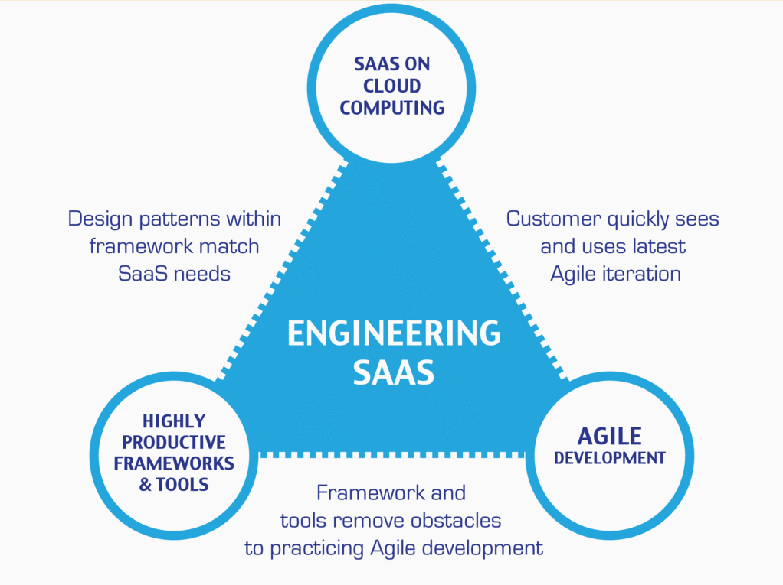
…And the Virtuous Triangle
Hosting Technology: Cloud, Scriptable Infrastructure, Software as a Service (SaaS)…
People: Teams, Optimism, Engagement, Ambition, Dedication, Leadership, Skills, Experience, Domain Knowledge…
Process: Agile, Portfolio Management, Project Management, Prioritization, Metrics, Funding…
Productivity Technology: Configuration Management, Source Code Management, Automated Testing…

Slide 11
Product Team Q&A Session: Klump Requirements
Reading each team member’s “My Information” JSON files from each of their Personal Static Websites
Validating of JSON formats
Publishing the consolidated data to a simple HTML/JavaScript web page
Consolidating the data into a multi-person Class standard JSON format… note that to make the format simpler, we can limit roles to 3 roles (role1, role2, and role3)… Product Architect to lead
Publishing the consolidated data to a Web Service that returns the standard multi-person JSON format
Include current time and last time each individuals information was last updated in the multi-person JSON response
Testing mode to validate and report JSON formatting errors
Implement 30 minute caching and forced refresh
Solid Development (each team member), Test (team), and Production sites (team)
Notes:
… the test questions will be similar to the questions from the Quizzes. The test will be limited to 50 minutes and you will not have access to notes or other resources.
As a Class commit each Team to research, discuss, and present at least one of the following topics:
Databases on Azure including “Azure tables vs Azure MongoDB vs Azure other DBs”**
Cloud/Azure based Authentication/Authorization services and who they could be integrated into a NodeJS based application*
JavaScript and NodeJS with a focus on Azure and including the best Internet based tutorials and/or books on the topic
SaaS Frameworks including “MEAN vs LAMP vs Ruby on Rails”
Service Oriented Architectures including “Web Services and SOAP/WSAD vs REST vs Sockets”
SaaS Client Frameworks including “HTML/JavaScript vs AngularJS vs Angular2 vs React vs others”
File Formats including “HTML vs XML vs JSON vs Key/Value Pair Text Files”

Slide 12
Where are we going?

Slide 13
Sprint 6 Product Backlog
Verifiably complete all Agile Rituals (including Demos) and Metrics (including at least one team level metric)
Deliver User Stories that will complete the Klump product by exceeding specifications by the end of this Sprint… this will need to include testing and deployment to your test and production sites
Prepare a Presentation of your Klump product implementation to be delivered by 1 or 2 team members on 12 April
Complete Sprint 6 Assignment
Prepare a Demo of your team’s Stories and Story management method to be delivered by 1 or 2 team members on 10 April
Prepare for Sprint 7 by preparing a proposal for a final project. The final project can be team level or up to three teams working together.
Read and be prepared to discuss Chapter 10
Important Note: You will need to scope that backlog items associated with #2 so that you will be able to complete at least through backlog item #5. I will be grading Klump based on (1) a functioning product, (2) feature complete, (3) quality of implementation.
Notes:
… the test questions will be similar to the questions from the Quizzes. The test will be limited to 50 minutes and you will not have access to notes or other resources.
As a Class commit each Team to research, discuss, and present at least one of the following topics:
Databases on Azure including “Azure tables vs Azure MongoDB vs Azure other DBs”**
Cloud/Azure based Authentication/Authorization services and who they could be integrated into a NodeJS based application*
JavaScript and NodeJS with a focus on Azure and including the best Internet based tutorials and/or books on the topic
SaaS Frameworks including “MEAN vs LAMP vs Ruby on Rails”
Service Oriented Architectures including “Web Services and SOAP/WSAD vs REST vs Sockets”
SaaS Client Frameworks including “HTML/JavaScript vs AngularJS vs Angular2 vs React vs others”
File Formats including “HTML vs XML vs JSON vs Key/Value Pair Text Files”

Slide 14
Klump Product Vision
Create a useful product that:
Teaches how to develop Web Applications (client and server), utilize Web Services, and implement JSON
Replaces name cards for class sessions
Can obtain real-time class feedback
Can be enhanced on by other teams in the future
Notes:
… the test questions will be similar to the questions from the Quizzes. The test will be limited to 50 minutes and you will not have access to notes or other resources.
As a Class commit each Team to research, discuss, and present at least one of the following topics:
Databases on Azure including “Azure tables vs Azure MongoDB vs Azure other DBs”**
Cloud/Azure based Authentication/Authorization services and who they could be integrated into a NodeJS based application*
JavaScript and NodeJS with a focus on Azure and including the best Internet based tutorials and/or books on the topic
SaaS Frameworks including “MEAN vs LAMP vs Ruby on Rails”
Service Oriented Architectures including “Web Services and SOAP/WSAD vs REST vs Sockets”
SaaS Client Frameworks including “HTML/JavaScript vs AngularJS vs Angular2 vs React vs others”
File Formats including “HTML vs XML vs JSON vs Key/Value Pair Text Files”

Slide 15
Sprint 7 Product Backlog
Verifiably complete all Agile Rituals (including Demos) and Metrics (including at least one team level metric)
Complete Sprint 7 Assignment
Read and be prepared to discuss Chapter 10
Create User Stories that will deliver a Klump tutorial based on your team’s Klump implementation. Requirements include:
Allow a future team should be able to effectively install the product on Azure and make a minor enhancement to your product in less than one hour by following the tutorial
Include a single zip file named klump-sp18-[your-team-name].zip with all product assets submitted on a USB drive that will be provided to your team
Include an appropriate license file
Include a Readme.txt or Readme.md file in the root folder of the zip file that represents the starting point for the tutorial
Assume or require only prerequisites that the tutorial participant should have an MS Azure account and knowledge equivalent to taking this software development class
Deliver the above tutorial by completing the user stories
Prepare a video recording that demonstrates completing your tutorial within 30 minutes… the video can substitute for a presentation for the individual(s) who record it
Prepare for Sprint 8 by creating a proposal for a final project… the final should include at least two teams working together
Read and be prepared to discuss Chapter 11
Read and be prepared to discuss Chapter 12
Notes:
… the test questions will be similar to the questions from the Quizzes. The test will be limited to 50 minutes and you will not have access to notes or other resources.
As a Class commit each Team to research, discuss, and present at least one of the following topics:
Databases on Azure including “Azure tables vs Azure MongoDB vs Azure other DBs”**
Cloud/Azure based Authentication/Authorization services and who they could be integrated into a NodeJS based application*
JavaScript and NodeJS with a focus on Azure and including the best Internet based tutorials and/or books on the topic
SaaS Frameworks including “MEAN vs LAMP vs Ruby on Rails”
Service Oriented Architectures including “Web Services and SOAP/WSAD vs REST vs Sockets”
SaaS Client Frameworks including “HTML/JavaScript vs AngularJS vs Angular2 vs React vs others”
File Formats including “HTML vs XML vs JSON vs Key/Value Pair Text Files”

Slide 16
Lab: Sprint 7 Planning
Notes:
UI Team meet and prepare to Present or Demo UI Design for Klump

Slide 17
Sprint 7 Planning Report-out
Notes:
UI Team meet and prepare to Present or Demo UI Design for Klump

Slide 18
End of Session

Slide 19
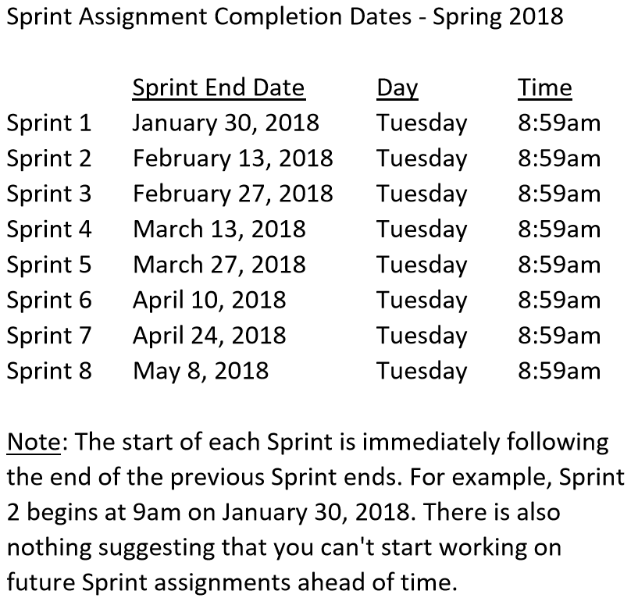
Release – Seating Chart
Release – Final Project(s)

