Slide 1

Software Engineering Session: Sprint 7 Session 3 Instructor: Eric Pogue
Agenda:
Roles, Schedule, and Backlog
Scrum of Scrums Standup with limited Report-out (blocking items only)
Review Demos, Presentations, and Roles Assignments
Klump Tutorial Product Team Q&A Session… and USB stick to be provided to each team Product Owner
Presentations on Klump, Software Licenses, and Web Real-Time Communication (RTC)
Preparing for Sprint 8 and Final Project Proposals Schedule for Thursday, April 19
Lab: Klump Tutorial… as time allows
Wrap-up
Notes:
Demos & Presentations: UI Team, Quinn, Juan, Alex

Slide 2
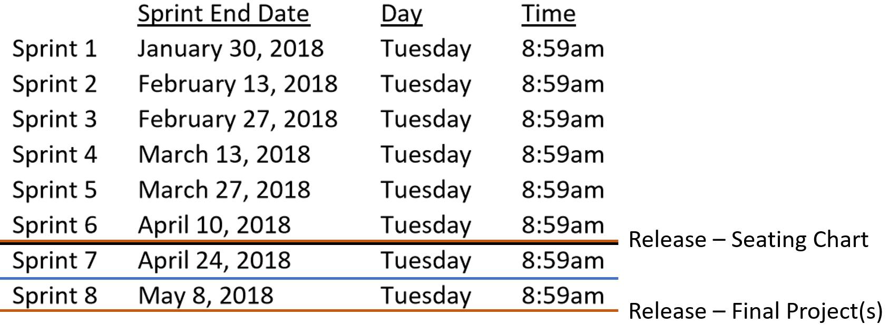
Roles and Schedule
 | Product Manager | Project Manager | Product Architect | UI Designer
Sprint 6 | Louie (Lorenzo) | Tyler (Kummer) | Thad (Albert) | Michael (Pedzimaz)
Sprint 7 | Alex (Espinal) | Juan (Dasco) | Ryan (Clark) | Karol (Orszulak)
Sprint 8 | Marissa (Koronkiewicz) | Lenny (Florez)* | Ali (Kazmi) | Cris (Serrano)
Notes:
… the test questions will be similar to the questions from the Quizzes. The test will be limited to 50 minutes and you will not have access to notes or other resources.
As a Class commit each Team to research, discuss, and present at least one of the following topics:
Databases on Azure including “Azure tables vs Azure MongoDB vs Azure other DBs”**
Cloud/Azure based Authentication/Authorization services and who they could be integrated into a NodeJS based application*
JavaScript and NodeJS with a focus on Azure and including the best Internet based tutorials and/or books on the topic
SaaS Frameworks including “MEAN vs LAMP vs Ruby on Rails”
Service Oriented Architectures including “Web Services and SOAP/WSAD vs REST vs Sockets”
SaaS Client Frameworks including “HTML/JavaScript vs AngularJS vs Angular2 vs React vs others”
File Formats including “HTML vs XML vs JSON vs Key/Value Pair Text Files”

Slide 3
Sprint 7 Product Backlog
Verifiably complete all Agile Rituals (including Demos) and Metrics (including at least one team level metric)
Complete Sprint 7 Assignment
Read and be prepared to discuss Chapter 10
Create User Stories that will deliver a Klump tutorial based on your team’s Klump implementation. Requirements include:
Allow a future team should be able to effectively install the product on Azure and make a minor enhancement to your product in less than one hour by following the tutorial
Include a single zip file named klump-sp18-[your-team-name].zip with all product assets submitted on a USB drive that will be provided to your team
Include an appropriate license file
Include a Readme.txt or Readme.md file in the root folder of the zip file that represents the starting point for the tutorial
Assume or require only prerequisites that the tutorial participant should have an MS Azure account and knowledge equivalent to taking this software development class
Deliver the above tutorial by completing the user stories
Prepare a video recording that demonstrates completing your tutorial within 30 minutes… the video can substitute for a presentation for the individual(s) who record it
Prepare for Sprint 8 by creating a proposal for a final project… the final should include at least two teams working together
Read and be prepared to discuss Chapter 11
Read and be prepared to discuss Chapter 12
Notes:
… the test questions will be similar to the questions from the Quizzes. The test will be limited to 50 minutes and you will not have access to notes or other resources.
As a Class commit each Team to research, discuss, and present at least one of the following topics:
Databases on Azure including “Azure tables vs Azure MongoDB vs Azure other DBs”**
Cloud/Azure based Authentication/Authorization services and who they could be integrated into a NodeJS based application*
JavaScript and NodeJS with a focus on Azure and including the best Internet based tutorials and/or books on the topic
SaaS Frameworks including “MEAN vs LAMP vs Ruby on Rails”
Service Oriented Architectures including “Web Services and SOAP/WSAD vs REST vs Sockets”
SaaS Client Frameworks including “HTML/JavaScript vs AngularJS vs Angular2 vs React vs others”
File Formats including “HTML vs XML vs JSON vs Key/Value Pair Text Files”

Slide 4
Team the “Klump” Product
Our “Klump” product should include:
Reading each team member’s “My Information” JSON files from each of their Personal Static Websites
Validating of JSON formats
Publishing the consolidated data to a simple HTML/JavaScript web page
Consolidating the data into a multi-person Class standard JSON format… note that to make the format simpler, we can limit roles to 3 roles (role1, role2, and role3)… Product Architect to lead
Publishing the consolidated data to a Web Service that returns the standard multi-person JSON format
Include current time and last time each individuals information was last updated in the multi-person JSON response
Testing mode to validate and report JSON formatting errors
Implement 30 minute caching and forced refresh
Solid Development (each team member), Test (team), and Production sites (team)
Notes:
As a Class commit each Team to research, discuss, and present at least one of the following topics:
Databases on Azure including “Azure tables vs Azure MongoDB vs Azure other DBs”**
Cloud/Azure based Authentication/Authorization services and who they could be integrated into a NodeJS based application*
JavaScript and NodeJS with a focus on Azure and including the best Internet based tutorials and/or books on the topic
SaaS Frameworks including “MEAN vs LAMP vs Ruby on Rails”
Service Oriented Architectures including “Web Services and SOAP/WSAD vs REST vs Sockets”
SaaS Client Frameworks including “HTML/JavaScript vs AngularJS vs Angular2 vs React vs others”
File Formats including “HTML vs XML vs JSON vs Key/Value Pair Text Files”

Slide 5
The Klump Tutorial
Our “Klump” product should include:
Deliver a Klump tutorial based on your team’s Klump implementation. Requirements include:
Allow a future team should be able to effectively install the product on Azure and make a minor enhancement to your product in less than one hour by following the tutorial
Include a single zip file named klump-sp18-[your-team-name].zip with all product assets submitted on a USB drive that will be provided to your team
Include an appropriate license file… explain the license requirements in your video
Include a “README.txt” or “README.md” file in the root folder of the zip file that represents the starting point for the tutorial
Assume or require only prerequisites that the tutorial participant should have an MS Azure account and knowledge equivalent to starting this software development class
Prepare a video recording that demonstrates completing your tutorial within 30 minutes… the video can substitute for a presentation for the individual(s) who record it
The video should be include in the zip file as well
Notes:
As a Class commit each Team to research, discuss, and present at least one of the following topics:
Databases on Azure including “Azure tables vs Azure MongoDB vs Azure other DBs”**
Cloud/Azure based Authentication/Authorization services and who they could be integrated into a NodeJS based application*
JavaScript and NodeJS with a focus on Azure and including the best Internet based tutorials and/or books on the topic
SaaS Frameworks including “MEAN vs LAMP vs Ruby on Rails”
Service Oriented Architectures including “Web Services and SOAP/WSAD vs REST vs Sockets”
SaaS Client Frameworks including “HTML/JavaScript vs AngularJS vs Angular2 vs React vs others”
File Formats including “HTML vs XML vs JSON vs Key/Value Pair Text Files”

Slide 6
Scrum-of-Scrums Report-out
The “daily” scrum meeting is not used as a problem-solving or issue resolution meeting. Issues that are raised are taken offline and usually dealt with by the relevant subgroup immediately after the meeting. During the daily scrum, each team member answers the following three questions:
What did you do since our last standup?
What will you do before our next standup?
Are there any impediments in your way that you need help from outside the team to resolve?

Slide 7
Product Team Q&A Session: Klump Requirements
Alex (Espinal) to hand out USB stick to team Product Owners**
 | Product Manager | Project Manager | Product Architect | UI Designer
Sprint 6 | Louie (Lorenzo) | Tyler (Kummer) | Thad (Albert) | Michael (Pedzimaz)
Sprint 7 | Alex (Espinal) | Juan (Dasco) | Ryan (Clark) | Karol (Orszulak)
Sprint 8 | Marissa (Koronkiewicz) | Lenny (Florez)* | Ali (Kazmi) | Cris (Serrano)
 | Product Manager | Project Manager | Product Architect | UI Designer
Sprint 5 | Joe (Van Luyk) | Jordon (Elmer) | Quinn (Stratton) | Jace (Horner)
Sprint 6 | Louie (Lorenzo) | Tyler (Kummer) | Thad (Albert) | Michael (Pedzimaz)
Sprint 7 | Alex (Espinal) | Juan (Dasco) | Ryan (Clark) | Karol (Orszulak)
Deliver a Klump tutorial based on your team’s Klump implementation. Requirements include:
Allow a future team should be able to effectively install the product on Azure and make a minor enhancement to your product in less than one hour by following the tutorial
Include a single zip file named klump-sp18-[your-team-name].zip with all product assets submitted on a USB drive that will be provided to your team
Include an appropriate license file… explain the license requirements in your video
Include a “README.txt” or “README.md” file in the root folder of the zip file that represents the starting point for the tutorial
Assume or require only prerequisites that the tutorial participant should have an MS Azure account and knowledge equivalent to starting this software development class
Prepare a video recording that demonstrates completing your tutorial within 30 minutes… the video can substitute for a presentation for the individual(s) who record it
The video should be include in the zip file as well
Notes:
… the test questions will be similar to the questions from the Quizzes. The test will be limited to 50 minutes and you will not have access to notes or other resources.
As a Class commit each Team to research, discuss, and present at least one of the following topics:
Databases on Azure including “Azure tables vs Azure MongoDB vs Azure other DBs”**
Cloud/Azure based Authentication/Authorization services and who they could be integrated into a NodeJS based application*
JavaScript and NodeJS with a focus on Azure and including the best Internet based tutorials and/or books on the topic
SaaS Frameworks including “MEAN vs LAMP vs Ruby on Rails”
Service Oriented Architectures including “Web Services and SOAP/WSAD vs REST vs Sockets”
SaaS Client Frameworks including “HTML/JavaScript vs AngularJS vs Angular2 vs React vs others”
File Formats including “HTML vs XML vs JSON vs Key/Value Pair Text Files”

Slide 8
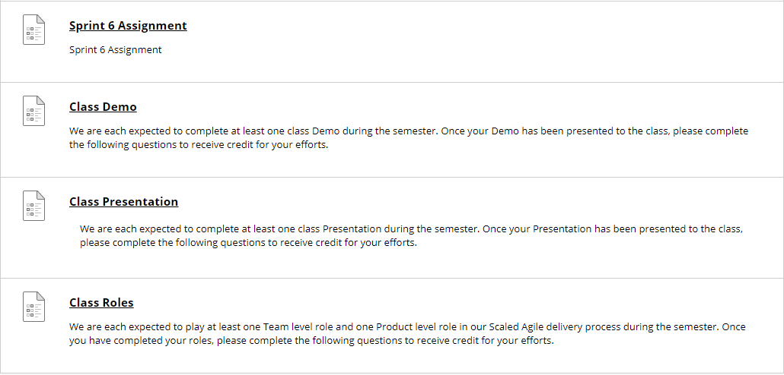
Demos, Presentations, and Roles Review
If you have completed your Demo, Presentation, or Roles previously or today, you have until tomorrow evening (Friday) to fill out your associated assignment
Going forward, complete your Demo or Presentation assignment before you deliver you Demo or Presentation… those demoing and presenting today have until tomorrow evening to complete
At the start of Sprint 8, I will be marking all incomplete Demo, Presentation, and Roles assignments zero (0) to help us make sure that we complete them all… I will grade them normally once the are submitted
Note that at the end of our last class session they will actually be zeros

Slide 9
Presentations
Klump – Jordan (Elmer)
Software Product Licensing – Marissa (Koronkiewicz)
Web RTC – Jace Horner
Software Product Licensing – Julian (Moses)… Thursday
Notes:
… the test questions will be similar to the questions from the Quizzes. The test will be limited to 50 minutes and you will not have access to notes or other resources.
As a Class commit each Team to research, discuss, and present at least one of the following topics:
Databases on Azure including “Azure tables vs Azure MongoDB vs Azure other DBs”**
Cloud/Azure based Authentication/Authorization services and who they could be integrated into a NodeJS based application*
JavaScript and NodeJS with a focus on Azure and including the best Internet based tutorials and/or books on the topic
SaaS Frameworks including “MEAN vs LAMP vs Ruby on Rails”
Service Oriented Architectures including “Web Services and SOAP/WSAD vs REST vs Sockets”
SaaS Client Frameworks including “HTML/JavaScript vs AngularJS vs Angular2 vs React vs others”
File Formats including “HTML vs XML vs JSON vs Key/Value Pair Text Files”

Slide 10
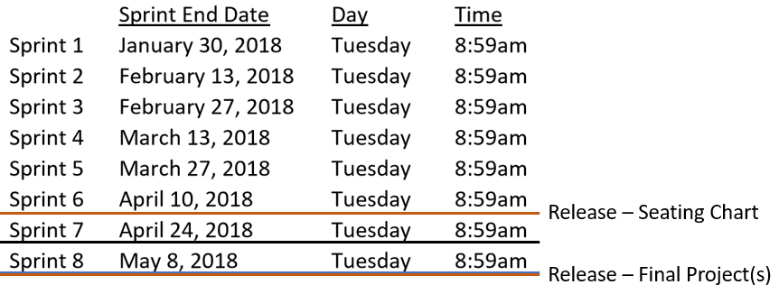
Sprint 8 Preparation
Notes:
UI Team meet and prepare to Present or Demo UI Design for Klump

Slide 11
Sprint 8
April 28 at 9am through May 8 at 9am
Last regular class will be May 3rd
Final will be May 8th from 10:30 to 12:30 in our regular room… very similar to mid-term
Final projects will be due May 3rd at 9am with presentations for final projects to be on May 3 during class
The final projects are expected to be quite small even though at least two teams will be working on them
Notes:
… the test questions will be similar to the questions from the Quizzes. The test will be limited to 50 minutes and you will not have access to notes or other resources.
As a Class commit each Team to research, discuss, and present at least one of the following topics:
Databases on Azure including “Azure tables vs Azure MongoDB vs Azure other DBs”**
Cloud/Azure based Authentication/Authorization services and who they could be integrated into a NodeJS based application*
JavaScript and NodeJS with a focus on Azure and including the best Internet based tutorials and/or books on the topic
SaaS Frameworks including “MEAN vs LAMP vs Ruby on Rails”
Service Oriented Architectures including “Web Services and SOAP/WSAD vs REST vs Sockets”
SaaS Client Frameworks including “HTML/JavaScript vs AngularJS vs Angular2 vs React vs others”
File Formats including “HTML vs XML vs JSON vs Key/Value Pair Text Files”

Slide 12
Final Project
Our final project will need to:
Include either two or three Scrum teams with each Product Team
Include all Scrum and Scaled Agile roles
Verifiably complete all Scrum and Scaled Agile rituals… Sprint planning, user stories, metrics, retrospectives, demos, etc.
Be deployed in a cloud environment in both test and production environments
Be deployed to each team members desktop
Include GitHub source code control that has each individual in each team contribute something to the product… you will need to give me access the repository as well
Implement branching to control test and production deployments
Ideas include an enhancement to an existing product, the starting point for a potential new substantial product, or a small new product
Notes:
As a Class commit each Team to research, discuss, and present at least one of the following topics:
Databases on Azure including “Azure tables vs Azure MongoDB vs Azure other DBs”**
Cloud/Azure based Authentication/Authorization services and who they could be integrated into a NodeJS based application*
JavaScript and NodeJS with a focus on Azure and including the best Internet based tutorials and/or books on the topic
SaaS Frameworks including “MEAN vs LAMP vs Ruby on Rails”
Service Oriented Architectures including “Web Services and SOAP/WSAD vs REST vs Sockets”
SaaS Client Frameworks including “HTML/JavaScript vs AngularJS vs Angular2 vs React vs others”
File Formats including “HTML vs XML vs JSON vs Key/Value Pair Text Files”

Slide 13
Final Project Proposals Schedule for Thursday, April 19
Back Row Bandicoots
Lewis Honey Badgers
Ocelots?
Great White Buffalos
Flamingos
Presentations may carry over to Tuesday as needed.
Notes:
… the test questions will be similar to the questions from the Quizzes. The test will be limited to 50 minutes and you will not have access to notes or other resources.
As a Class commit each Team to research, discuss, and present at least one of the following topics:
Databases on Azure including “Azure tables vs Azure MongoDB vs Azure other DBs”**
Cloud/Azure based Authentication/Authorization services and who they could be integrated into a NodeJS based application*
JavaScript and NodeJS with a focus on Azure and including the best Internet based tutorials and/or books on the topic
SaaS Frameworks including “MEAN vs LAMP vs Ruby on Rails”
Service Oriented Architectures including “Web Services and SOAP/WSAD vs REST vs Sockets”
SaaS Client Frameworks including “HTML/JavaScript vs AngularJS vs Angular2 vs React vs others”
File Formats including “HTML vs XML vs JSON vs Key/Value Pair Text Files”

Slide 14
Lab: Klump Tutorial… as time allows
Notes:
UI Team meet and prepare to Present or Demo UI Design for Klump

Slide 15
End of Session

