Slide 1

Software Engineering Session: Sprint 8 Session 1 Instructor: Eric Pogue
Agenda:
Roles, Schedule, and Backlog
Scrum of Scrums Standup with limited Report-out (blocking items only)… Turn in USB drives
Final Project Presentation Schedule
Portfolio Level Planning Report-out
Lab: Sprint 8 Program Team and Sprint Team Planning & Report-out
Portfolio Level Report-out by Sprint 8 Program Teams
Notes:
Demos & Presentations: UI Team, Quinn, Juan, Alex

Slide 2
Product Team Q&A Session: Klump Requirements
 | Product Manager | Project Manager | Product Architect | UI Designer
Sprint 6 | Louie (Lorenzo) | Tyler (Kummer) | Thad (Albert) | Michael (Pedzimaz)
Sprint 7 | Alex (Espinal) | Juan (Dasco) | Ryan (Clark) | Karol (Orszulak)
Sprint 8 | Marissa (Koronkiewicz) | Lenny (Florez) | Ali (Kazmi) | Cris (Serrano)
 | Product Manager | Project Manager | Product Architect | UI Designer
Sprint 5 | Joe (Van Luyk) | Jordon (Elmer) | Quinn (Stratton) | Jace (Horner)
Sprint 6 | Louie (Lorenzo) | Tyler (Kummer) | Thad (Albert) | Michael (Pedzimaz)
Sprint 7 | Alex (Espinal) | Juan (Dasco) | Ryan (Clark) | Karol (Orszulak)
Deliver a Klump tutorial based on your team’s Klump implementation. Requirements include:
Allow a future team should be able to effectively install the product on Azure and make a minor enhancement to your product in less than one hour by following the tutorial
Include a single zip file named klump-sp18-[your-team-name].zip with all product assets submitted on a USB drive that will be provided to your team
Include an appropriate license file… explain the license requirements in your video
Include a “README.txt” or “README.md” file in the root folder of the zip file that represents the starting point for the tutorial
Assume or require only prerequisites that the tutorial participant should have an MS Azure account and knowledge equivalent to starting this software development class
Prepare a video recording that demonstrates completing your tutorial within 30 minutes… the video can substitute for a presentation for the individual(s) who record it
The video should be include in the zip file as well
Notes:
… the test questions will be similar to the questions from the Quizzes. The test will be limited to 50 minutes and you will not have access to notes or other resources.
As a Class commit each Team to research, discuss, and present at least one of the following topics:
Databases on Azure including “Azure tables vs Azure MongoDB vs Azure other DBs”**
Cloud/Azure based Authentication/Authorization services and who they could be integrated into a NodeJS based application*
JavaScript and NodeJS with a focus on Azure and including the best Internet based tutorials and/or books on the topic
SaaS Frameworks including “MEAN vs LAMP vs Ruby on Rails”
Service Oriented Architectures including “Web Services and SOAP/WSAD vs REST vs Sockets”
SaaS Client Frameworks including “HTML/JavaScript vs AngularJS vs Angular2 vs React vs others”
File Formats including “HTML vs XML vs JSON vs Key/Value Pair Text Files”

Slide 3
Scrum-of-Scrums Report-out
The “daily” scrum meeting is not used as a problem-solving or issue resolution meeting. Issues that are raised are taken offline and usually dealt with by the relevant subgroup immediately after the meeting. During the daily scrum, each team member answers the following three questions:
What did you do since our last standup?
What will you do before our next standup?
Are there any impediments in your way that you need help from outside the team to resolve?

Slide 4
Sprint 7 is done!
Notes:
UI Team meet and prepare to Present or Demo UI Design for Klump

Slide 5
Sprint 8 Starts Now Change seating location for Sprint 8 and today’s Planning… yes, now.
Notes:
UI Team meet and prepare to Present or Demo UI Design for Klump

Slide 6
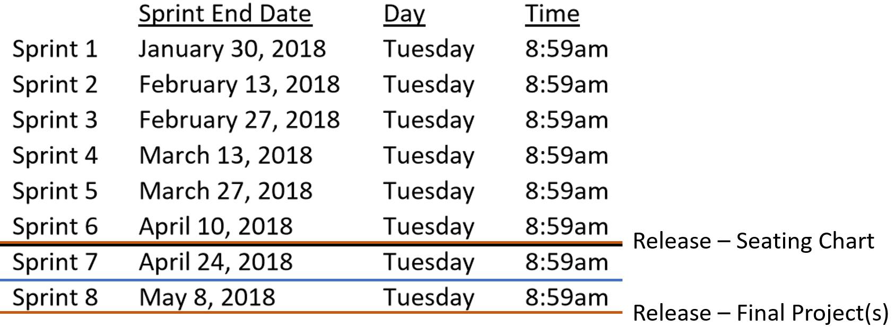
Sprint 8 Roles and Schedule
 | Team Klump Speak |  |  |  | Team IFP
 | Product Manager | Project Manager | Product Architect | UI Designer | Product Manager | Project Manager | Product Architect | UI Designer
Sprint 8 | Marissa | Juan | Lenny | Brandon | Jake | John | Karol | Cris
May 3, 2018

Slide 7
Final Project Presentations Schedule for Thursday, May 3
Trump Speak
Image Formatting Program (IFP)

Slide 8
Portfolio Level Planning
Notes:
UI Team meet and prepare to Present or Demo UI Design for Klump

Slide 9
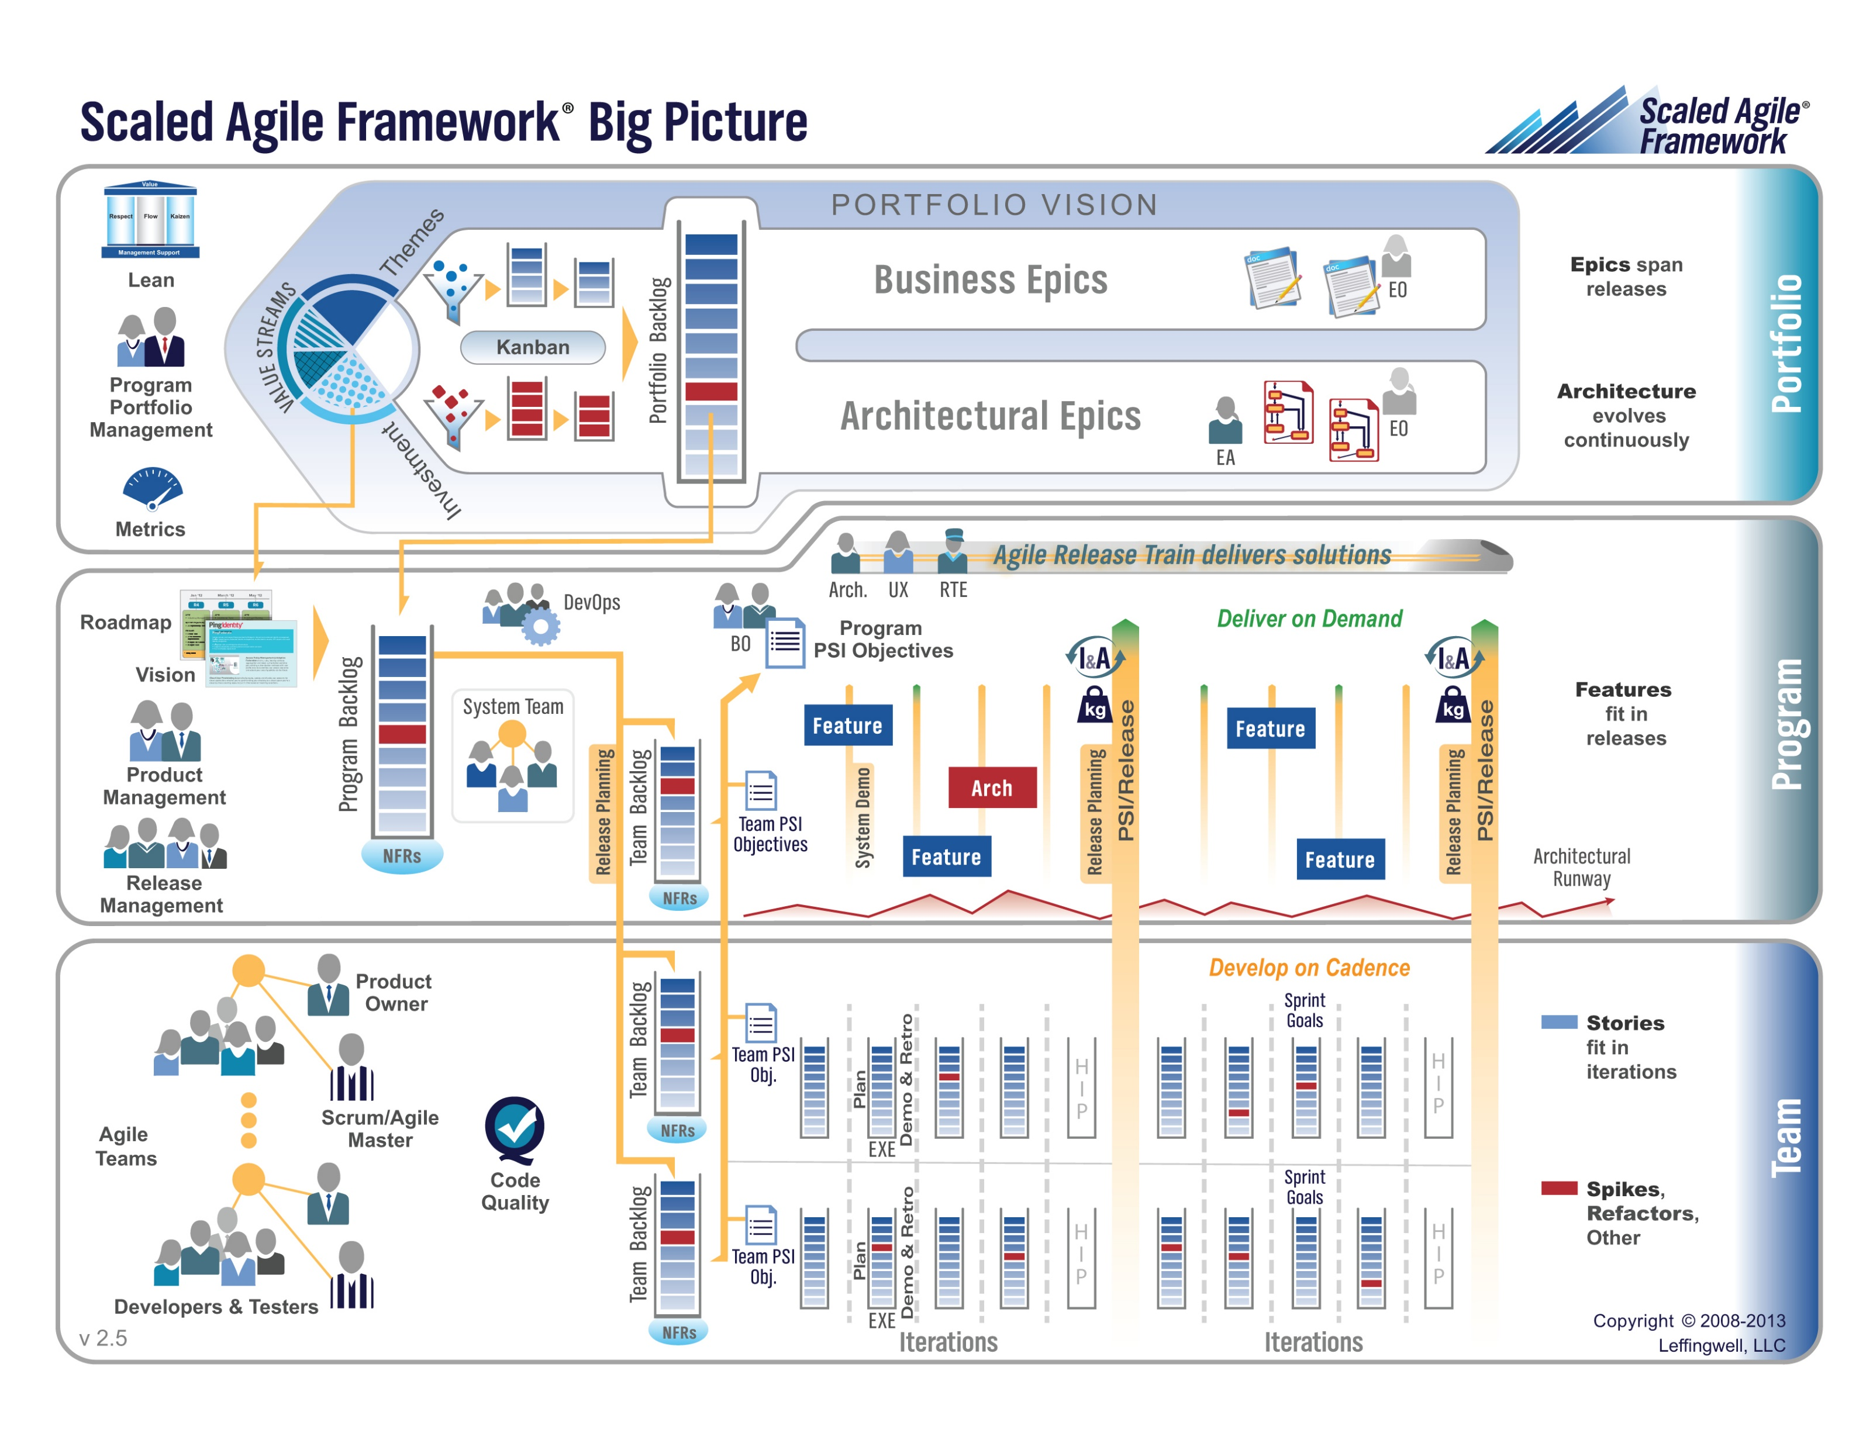
Sprint 8 Portfolio Level Scaled Agile Planning
Portfolio Responsibilities:
Release Schedule
Investment & Staffing
Program Team Dependencies
Epic Backlog
Notes:
UI Team meet and prepare to Present or Demo UI Design for Klump

Slide 10
Sprint 8 Portfolio Level Scaled Agile Planning
Portfolio Responsibilities:
Investment & Staffing
Program Team Dependencies
Epic Backlog
Investment & Staffing:
Klump Speak – Three Scrum Teams
Image Formatting Program (IFP) – Two Scrum Teams
Program Team Dependencies:
No cross-program dependencies required or allowed
Epic Backlog:
Deliver Klump Speak v1 & IFP v1 by May 3, 2018 at 9am
Prepare for final on May 8, 2018 at 10:30am
Notes:
UI Team meet and prepare to Present or Demo UI Design for Klump

Slide 11
Sprint 8 Program Backlog
Complete Sprint 8 Assignment
Deliver Final Project… “Klump Speak” or “IFP” that:
Include either two or three Scrum teams with each Product Team
Includes all Scaled Agile and Scrum roles
Verifiably completes all Team Level Agile Rituals and Metrics… Sprint planning, user stories, metrics, retrospectives, demos, etc.
Verifiably completes some Product Level Rituals including Product Team Stand-up, prioritized Feature Backlog and Say-Do ratio
Be deployed in a cloud environment in both test and production environments
Be deployed to each team members desktop
Include GitHub source code control that has each individual in each team contribute something to the product… you will need to give me access the repository as well
Implement branching to control test and production deployments
Read and be prepared to discuss selected sections of Chapter 11 plus two sections of Chapter 12 (12.3 and 12.9)… this can be done after May 3rd.
 | Team Klump Speak |  |  |  | Team IFP
 | Product Manager | Project Manager | Product Architect | UI Designer | Product Manager | Project Manager | Product Architect | UI Designer
Sprint 8 | Marissa | Juan | Lenny | Brandon | Jake | John | Karol | Cris

Slide 12
Sprint 8 Portfolio Level Report-out… 12:05am CST
Notes:
UI Team meet and prepare to Present or Demo UI Design for Klump

Slide 13
Lab: Sprint 8 Program Team and Sprint Team Planning & Report-out
Notes:
UI Team meet and prepare to Present or Demo UI Design for Klump

Slide 14
Roles and Schedule
 | Team Klump Speak |  |  |  | Team IFP
 | Product Manager | Project Manager | Product Architect | UI Designer | Product Manager | Project Manager | Product Architect | UI Designer
Sprint 8 | Marissa | Juan | Lenny | Brandon | Jake | John | Karol | Cris
May 3, 2018
Notes:
… the test questions will be similar to the questions from the Quizzes. The test will be limited to 50 minutes and you will not have access to notes or other resources.
As a Class commit each Team to research, discuss, and present at least one of the following topics:
Databases on Azure including “Azure tables vs Azure MongoDB vs Azure other DBs”**
Cloud/Azure based Authentication/Authorization services and who they could be integrated into a NodeJS based application*
JavaScript and NodeJS with a focus on Azure and including the best Internet based tutorials and/or books on the topic
SaaS Frameworks including “MEAN vs LAMP vs Ruby on Rails”
Service Oriented Architectures including “Web Services and SOAP/WSAD vs REST vs Sockets”
SaaS Client Frameworks including “HTML/JavaScript vs AngularJS vs Angular2 vs React vs others”
File Formats including “HTML vs XML vs JSON vs Key/Value Pair Text Files”

Slide 15
End of Session

