Slide 1

Software Engineering Session: Sprint 8 Session 2 Instructor: Eric Pogue
Agenda:
Roles, Schedule, and Backlog
Portfolio Standup Scrum of Scrums
Klump Speak Program: Scrum of Scrums Standup with limited Report-out (blocking items only)
Image Filter Program: Scrum of Scrums Standup with limited Report-out (blocking items only)
Final Project Presentation Schedule
Demos, Presentations, and Roles Assignments Reminder
Review Assignment 8 and Discussion Board 8
Lab: Working on Final Project
Notes:
Demos & Presentations: UI Team, Quinn, Juan, Alex

Slide 2
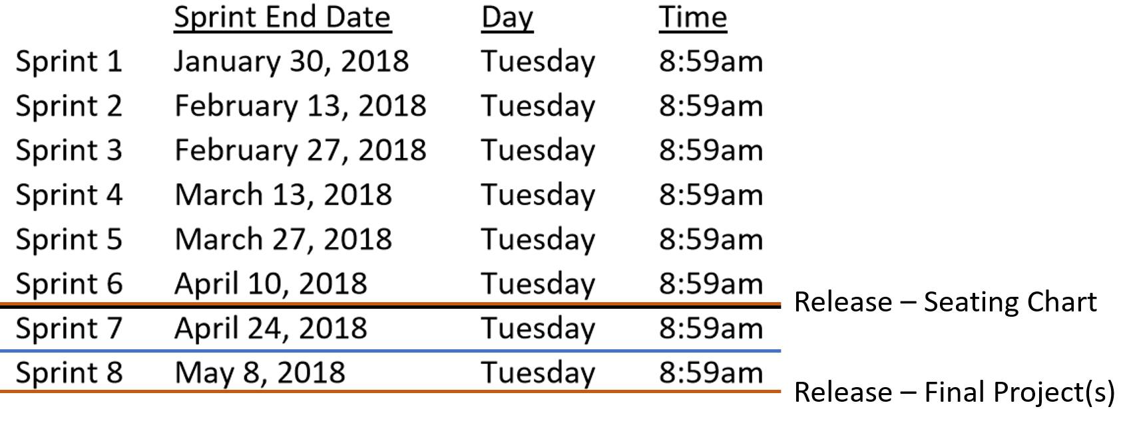
Sprint 8 Roles and Schedule
 | Team Klump Speak |  |  |  | Team Image Filter (IFP)
 | Product Manager | Project Manager | Product Architect | UI Designer | Product Manager | Project Manager | Product Architect | UI Designer
Sprint 8 | Marissa | Juan | Lenny | Brandon | Jake | John | Karol | Cris
May 3, 2018

Slide 3
Scrum-of-Scrums Report-out
The “daily” scrum meeting is not used as a problem-solving or issue resolution meeting. Issues that are raised are taken offline and usually dealt with by the relevant subgroup immediately after the meeting. During the daily scrum, each team member answers the following three questions:
What did you do since our last standup?
What will you do before our next standup?
Are there any impediments in your way that you need help from outside the team to resolve?

Slide 4
Final Project Presentations Schedule for Thursday, May 3
Klump Speak
Image Filter Program (IFP)
Who will be presenting?

Slide 5
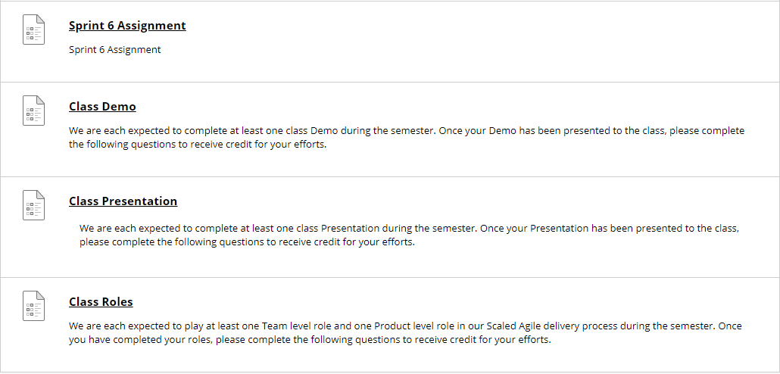
Demos, Presentations, and Roles Review
Going forward, complete your Demo or Presentation assignment before you deliver you Demo or Presentation… those demoing and presenting today have until tomorrow evening to complete
At the start of Sprint 8, I will be marking all incomplete Demo, Presentation, and Roles assignments zero (0) to help us make sure that we complete them all… I will grade them normally once the are submitted
Note that at the end of our last class session they will actually be zeros

Slide 6
Review Assignment 8 and Discussion Board (DB) 8
Notes:
UI Team meet and prepare to Present or Demo UI Design for Klump

Slide 7
Lab: Portfolio, Program, Scrum Teams … working on Final Projects
Notes:
UI Team meet and prepare to Present or Demo UI Design for Klump

Slide 8
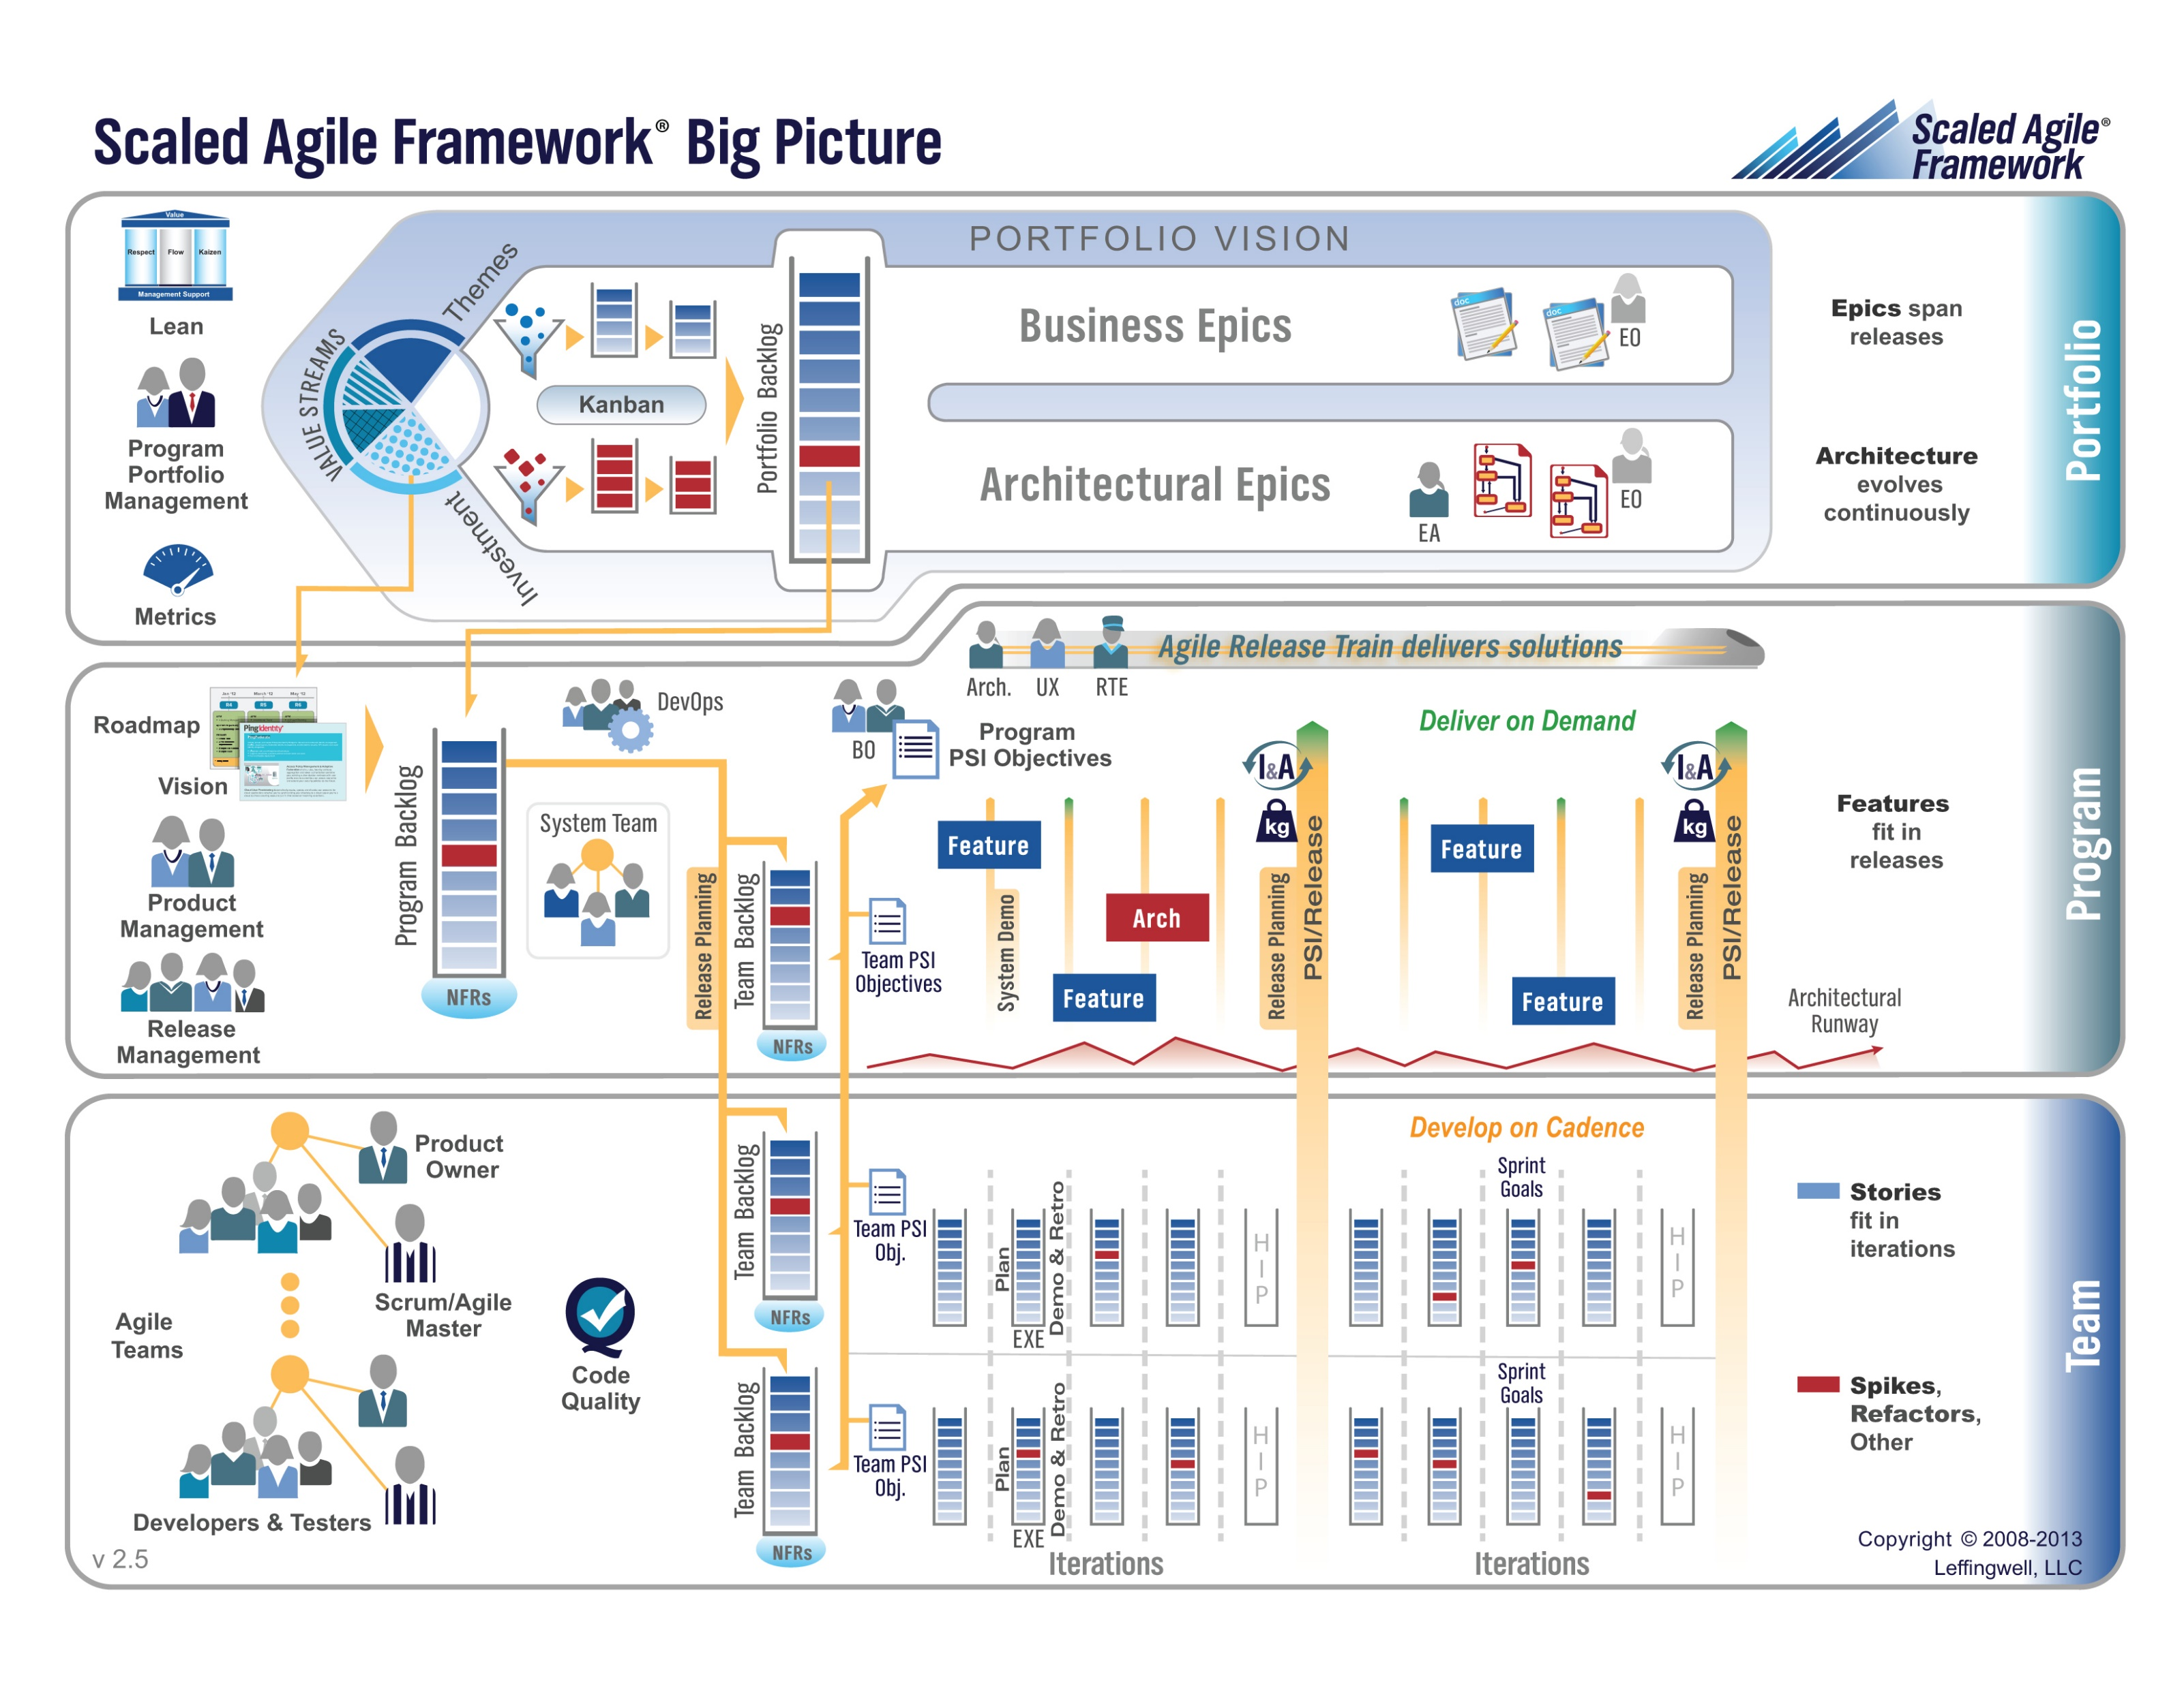
5%
10%
85%
Notes:
The physics of getting work done help the team(s) self organize/optimize

Slide 9
Portfolio Level Responsibilities
Portfolio Responsibilities:
Release Schedule
Investment & Staffing
Program Team Dependencies
Epic Backlog
Notes:
UI Team meet and prepare to Present or Demo UI Design for Klump

Slide 10
Portfolio Responsibilities
Investment & Staffing:
Klump Speak – Three Scrum Teams
Image Filter Program (IFP) – Two Scrum Teams
Program Team Dependencies:
No cross-program dependencies required or allowed
Epic Backlog:
Deliver Klump Speak v1 & IFP v1 by May 3, 2018 at 9am
Prepare for final by May 8, 2018 at 10:30am
Notes:
UI Team meet and prepare to Present or Demo UI Design for Klump

Slide 11
Program Level Responsibilities
Program Responsibilities:
Investment & Staffing
Feature Backlog
Scrum Team Dependencies
Notes:
UI Team meet and prepare to Present or Demo UI Design for Klump

Slide 12
Program Backlog
Complete Sprint 8 Assignment
Deliver Final Project… “Klump Speak” or “IFP” that:
Include either two or three Scrum teams with each Product Team
Includes all Scaled Agile and Scrum roles
Verifiably completes all Team Level Agile Rituals and Metrics… Sprint planning, user stories, metrics, retrospectives, demos, etc.
Verifiably completes some Product Level Rituals including Product Team Stand-up, prioritized Feature Backlog and Say-Do ratio
Be deployed in a cloud environment in both test and production environments
Be deployed to each team members desktop
Include GitHub source code control that has each individual in each team contribute something to the product… you will need to give me access the repository as well
Implement branching to control test and production deployments
Read and be prepared to discuss selected sections of Chapter 11 plus two sections of Chapter 12 (12.3 and 12.9)… this can be done after May 3rd.
 | Team Klump Speak |  |  |  | Team IFP
 | Product Manager | Project Manager | Product Architect | UI Designer | Product Manager | Project Manager | Product Architect | UI Designer
Sprint 8 | Marissa | Juan | Lenny | Brandon | Jake | John | Karol | Cris

Slide 13
End of Session

